Slide 1
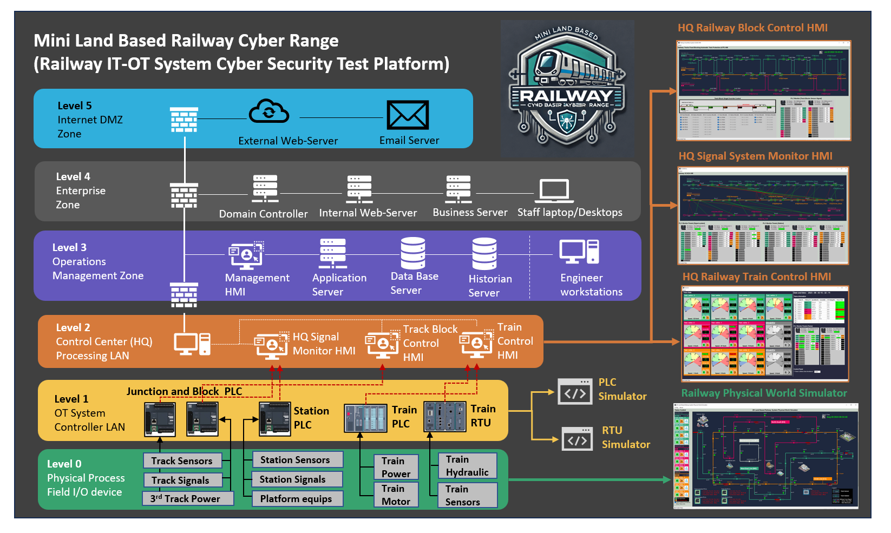
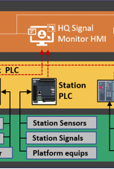
Railway Station OT Control Part in the whole system

Slide 2
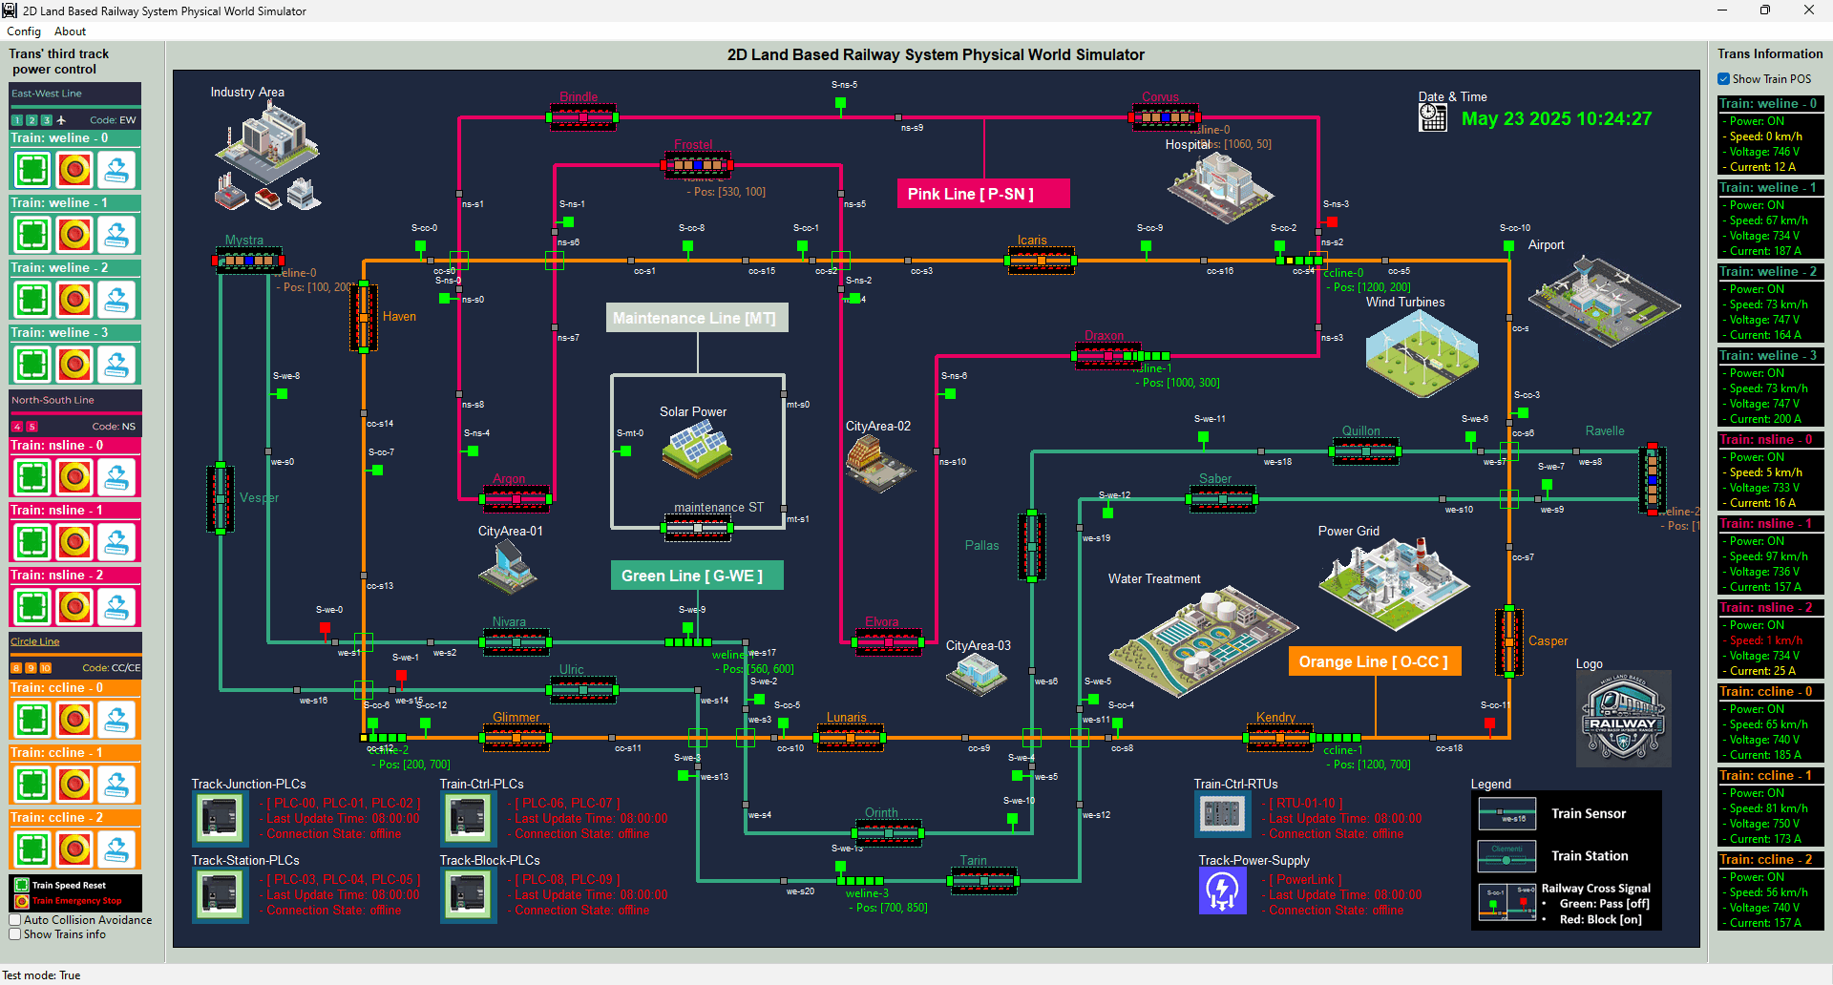
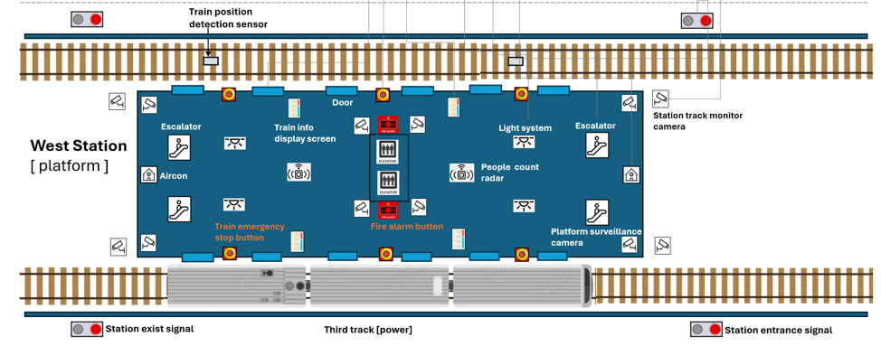
Railway Station Physical World Simulation

Slide 3
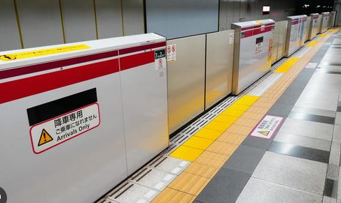
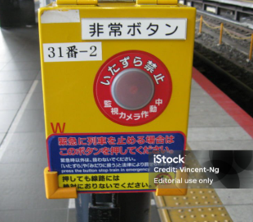
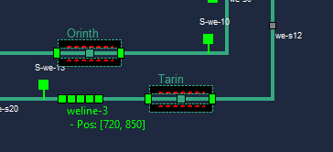
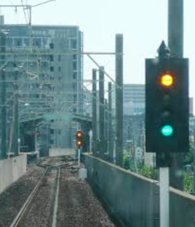
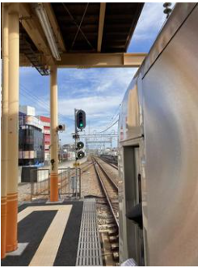
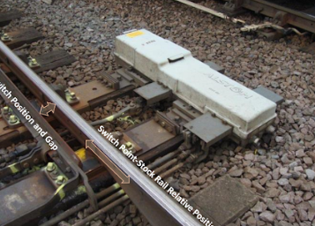
Station Platform Emergency Buttons
Railway Station Platform Safety Doors
Physical Simulation Program
Railway Station Train Entrance Dock Signal
Railway Station Train Position Sensors
Railway Station Exist Train departure signal

Slide 4
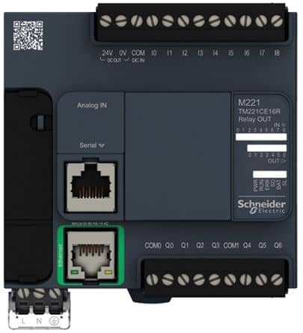
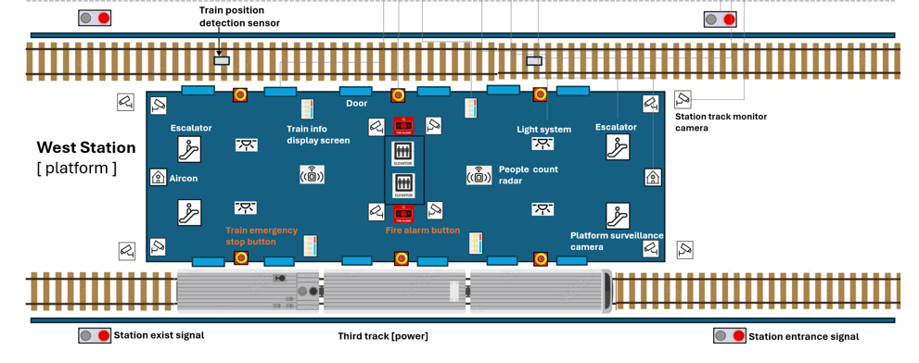
PLC2
PLC1
PLC0

Slide 5


%C [000011]
HMI Overload Switch
IN_STATE1
IF IN_STATE1 == STEP.HIGHER
OUT = TRUE
ELIF IN_STATA1 == STEP.LOWER
OUT = FALSE
ELSE
OUT = IN_STATE2
END IF
%M [000002]
Train sensor 1
%M [000005]
Entrance Dock Signals
IN_STATE2
OUT
%C [000012]
HMI Overload Switch
IN_STATE1
IF IN_STATE1 == STEP.HIGHER
OUT = TRUE
ELIF IN_STATA1 == STEP.LOWER
OUT = FALSE
ELSE
OUT = IN_STATE2
END IF
%M [000002]
Train sensor 1
%M [000006]
Train Exit Departure Signal
IN_STATE2
OUT

Slide 6

Condition Selector
Step.Lower => output = False
Step.Higher => output = True
Step.Invalid_0 => output = input
Train sensor 1
Entrance Dock Signal

