Slide 1
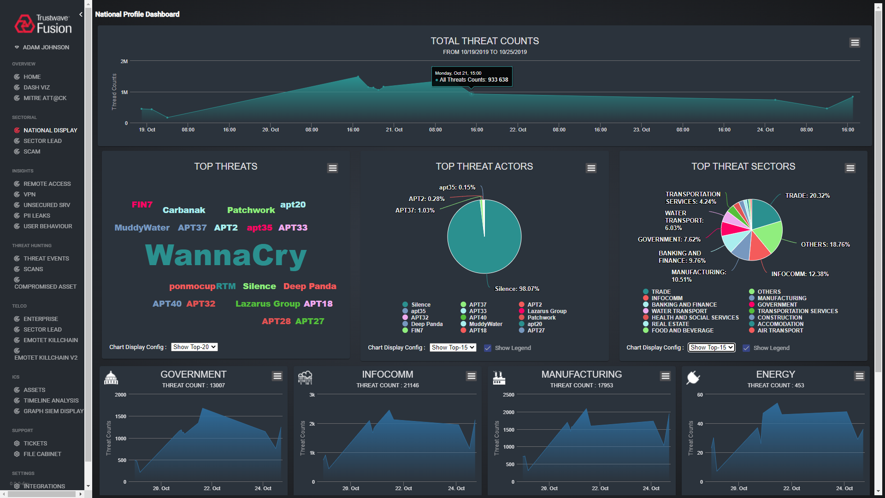



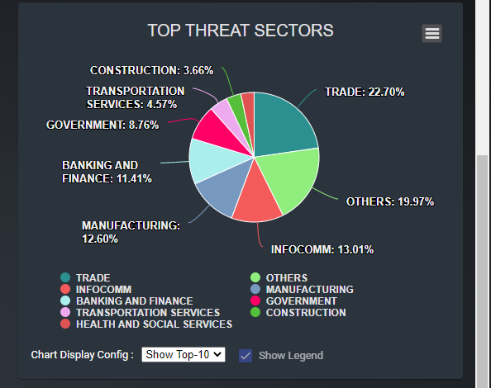
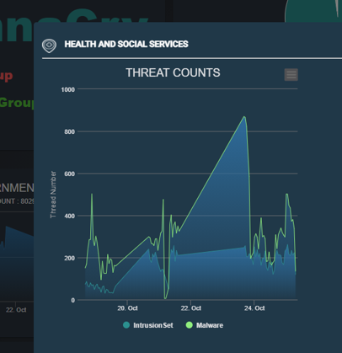


SIEM Big Data Visualization: Dashboard for Summarizing Singapore National Cyber Threats
User Authorization Server
Data access permission verification server
Web Host Program [FE]
User authoring and cookie generation
Threats data fetch request
DB data access permission filter
Graph-QL
Balancer[BE]
Druid [Final Data database cluster]
SG National Cyber Threats in Critical Infrastructure Dashboard Plugin
Authorization and Request parsing module
Network
Native Query
database
Combined Scam Event data
Data
Packaged data value
Data combination module
Data Package module
Data Source
Data scrape and filter
Users, Security Managers
(CSA) Annual Cybersecurity Report
SingCERT Advisories
Asia Pacific (APAC) Cyber Information Sharing
Security Information and Event Management System Dashboard

