Slide 1


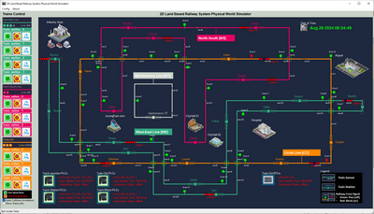
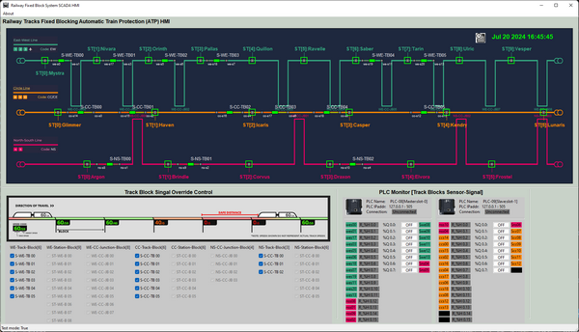
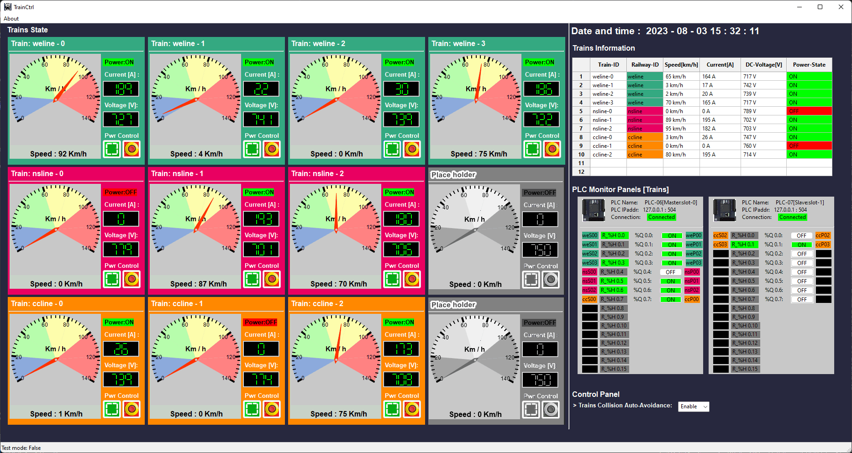
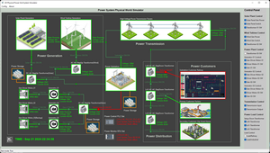
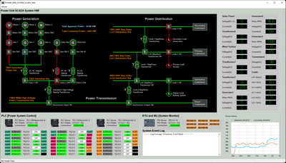
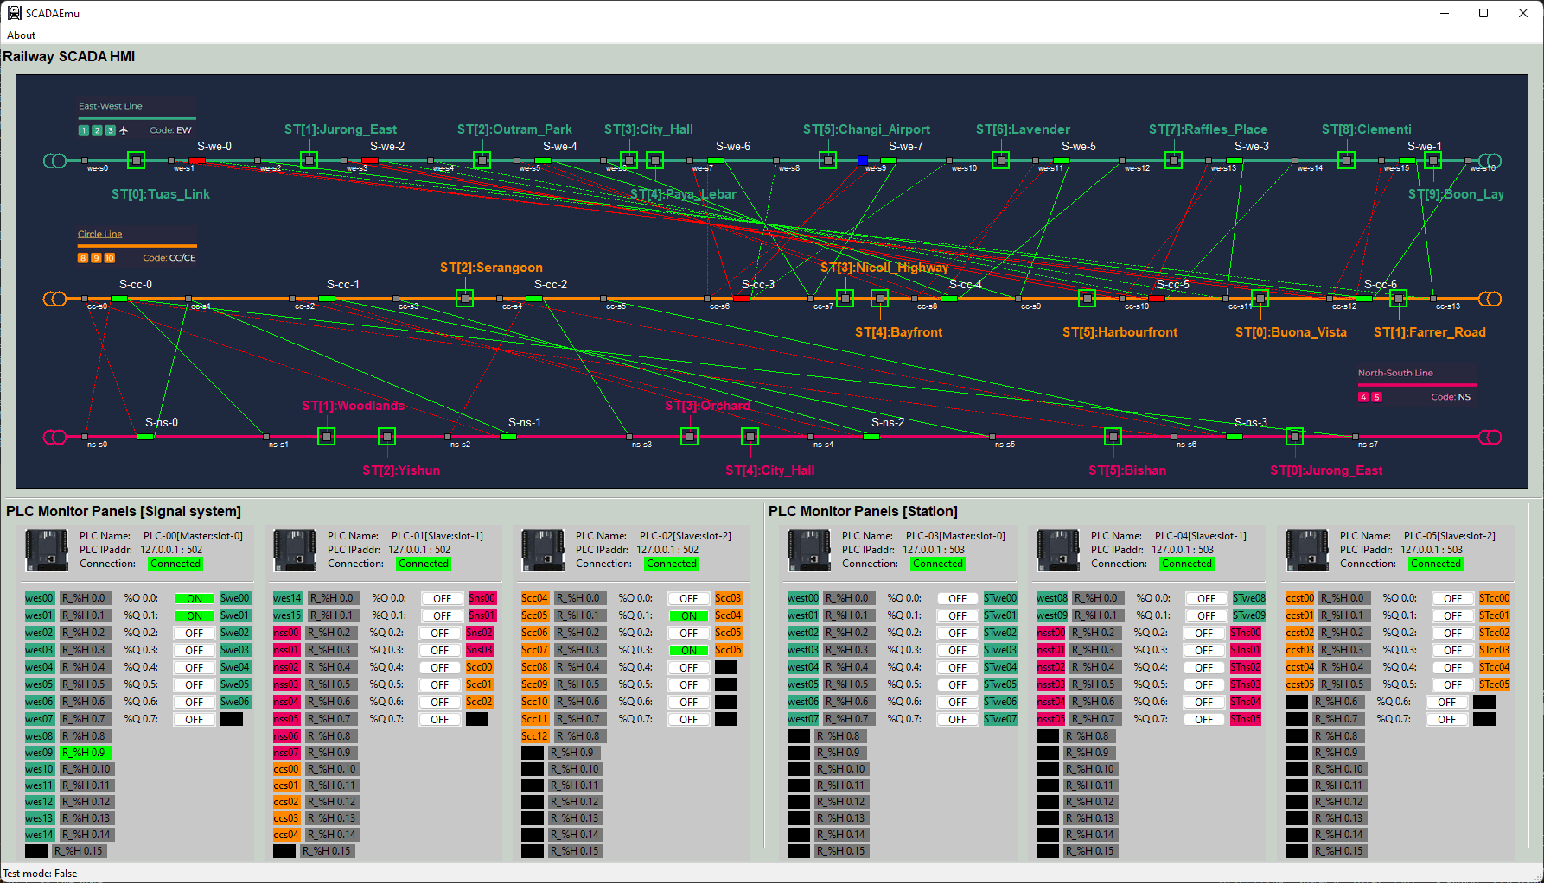



Power Grid and Railway Combine System
Lvl 0 Physical World Simulation Network
Lvl1 OT Controller network
Lvl2 SCADA HMI network
VM_ID: rail-md-pw-rail
Func: Railway Physical World
IP: 10.107.[ team_nr ]09.6
VM_ID: rail-ED-plc01-rail
Func: Junction PLC
IP: 10.107.[ team_nr ]08.5
VM_ID: rail-op-tb-rail
Func: Track block HMI
IP: 10.107.[ team_nr ]21.5
VM_ID: rail-op-tc-rail
Func: Train Control HMI
IP: 10.107.[ team_nr ]21.6
VM_ID: rail-ED-plc02-rail
Func: station PLC
IP: 10.107.[ team_nr ]08.6
VM_ID: rail-ED-plc03-rail
Func: Track Blk PLC
IP: 10.107.[ team_nr ]08.7
VM_ID: rail-md-pg-rail
Func: Power Grid System
IP: 10.107.[ team_nr ]09.7
VM_ID: rail-op-pg-rail
Func: Power Grid HMI
IP: 10.107.[ team_nr ]21.8
VM_ID: rail-ED-plc04-rail
Func: Train PLC
IP: 10.107.[ team_nr ]08.8
VM_ID: rail-op-sm-rail
Func: Signal Monitor HMI
IP: 10.107.[ team_nr ]21.7
VM_ID: rail-ED-rtu01-rail
Func: Train RTU01-10
IP: 10.107.[ team_nr ]08.9
VM_ID: rail-ED-plc05-rail
Func: Power Grid PLC
IP: 10.107.[ team_nr ]08.10
VM_ID: rail-md-pl-rail
Func: Power Link
IP: 10.107.[ team_nr ]09.8
VM_ID: rail-ED-rtu02-rail
Func: Power RTU01-08
IP: 10.107.[ team_nr ]08.11
Fw-rail 10.107.X09.1
Fw-rail 10.107.X08.1
Fw-rail 10.107.X21.1

Slide 2
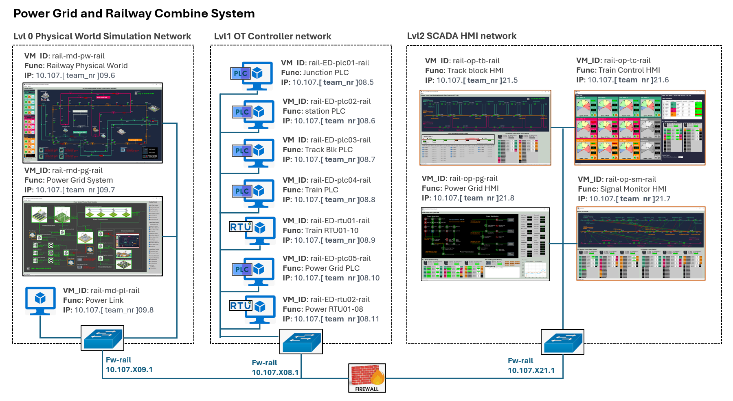



Attacker’s direct target VM
Attacker’s direct target VM
Attack Data Flow
VM effected during the attack progress

Slide 3


Case Study Flow
Matching to MITRE Common Weakness Enumeration
Defense strategies Implement
Vulnerability Introduction
System Introduction
Background knowledge
Attack Demo
Attack Path analysis
Attack Vector Introduction
Mapping to MITRE
Adversarial Tactics, Techniques,
&nd Common Knowledge

