Slide 1






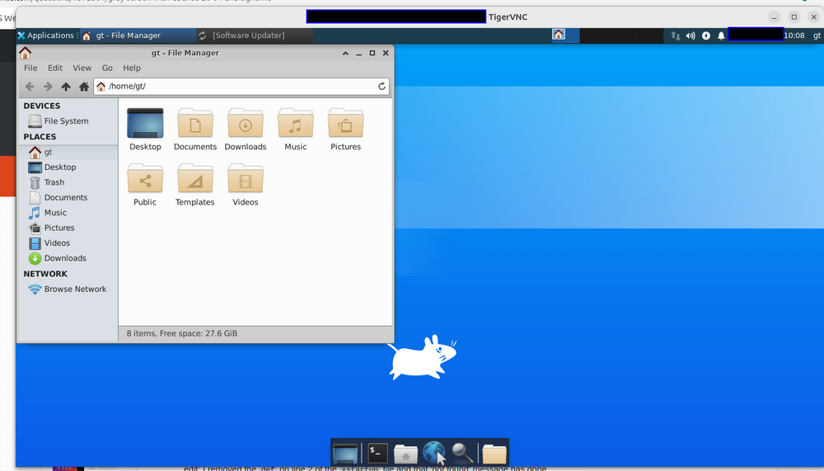
Steps to Solve the VNC "Gray Screen" Issue on Ubuntu Systems
VNC Connection

