Slide 1
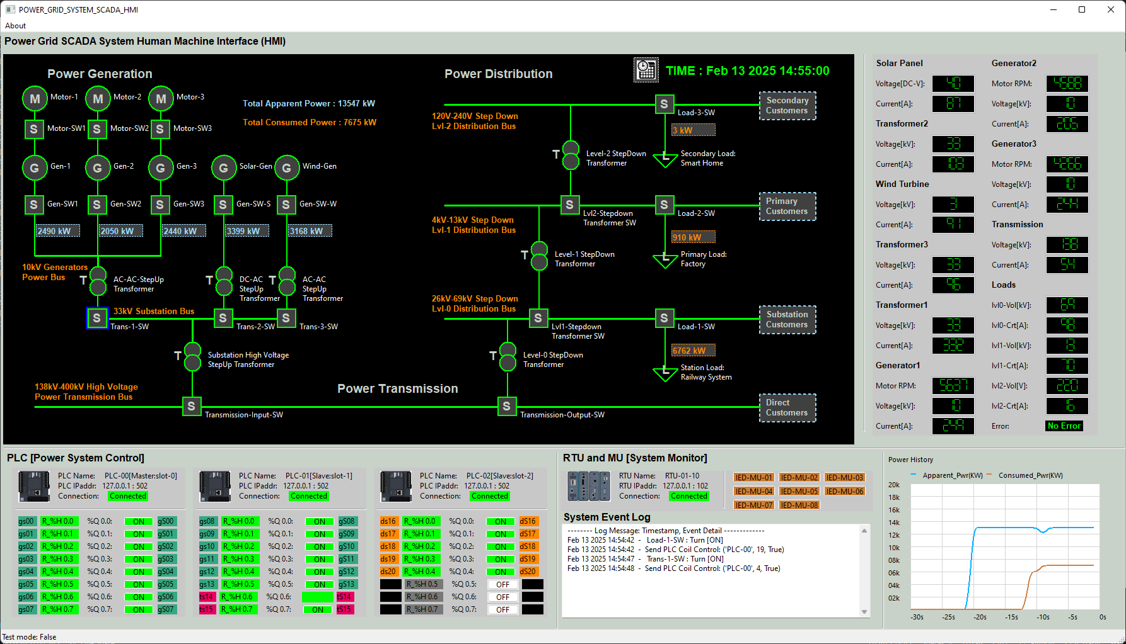
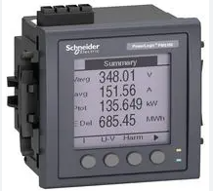
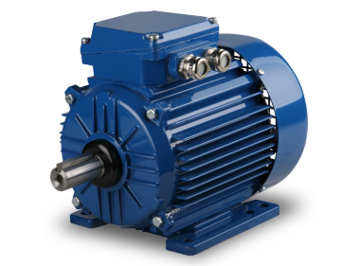

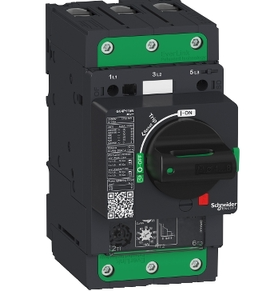
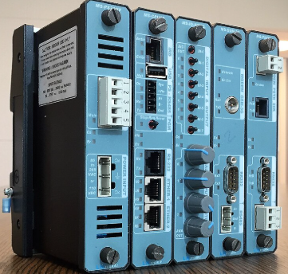
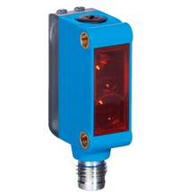
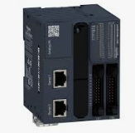
Human Machine Interface
OT Field Controller/Meter
OT Field Devices
System Operators
MU
Electrical Analog Signal
Motor
Modbus-TCP, OPC S7Comm,ICE104
RTU
Physical wires
OT ICS Network (Ethernet/Radio/5G)
Breaker Controller
PLC
Sensor
Operator control request
Equipment Operation State Data

Slide 2



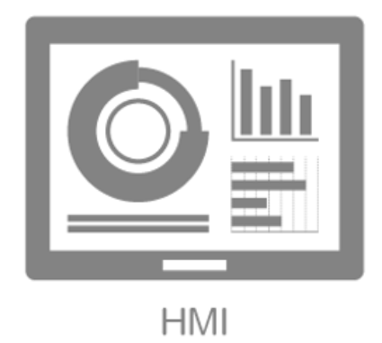
Master HMI
OT Controller
Master HMI
OT Controller
Serial-Com Connection
Ethernet Connection
Master HMI
OT Controller
Master HMI
OT Controller
NMEA Bus Connection
Radio or Bluetooth Connection
Slave HMI
Slave HMI
Master HMI
OT Controller
Ethernet Connection
Ethernet Connection

Slide 3
Management HMI
Master HMI
OT Controller
Ethernet Connection
Database
OT data process units

Slide 4
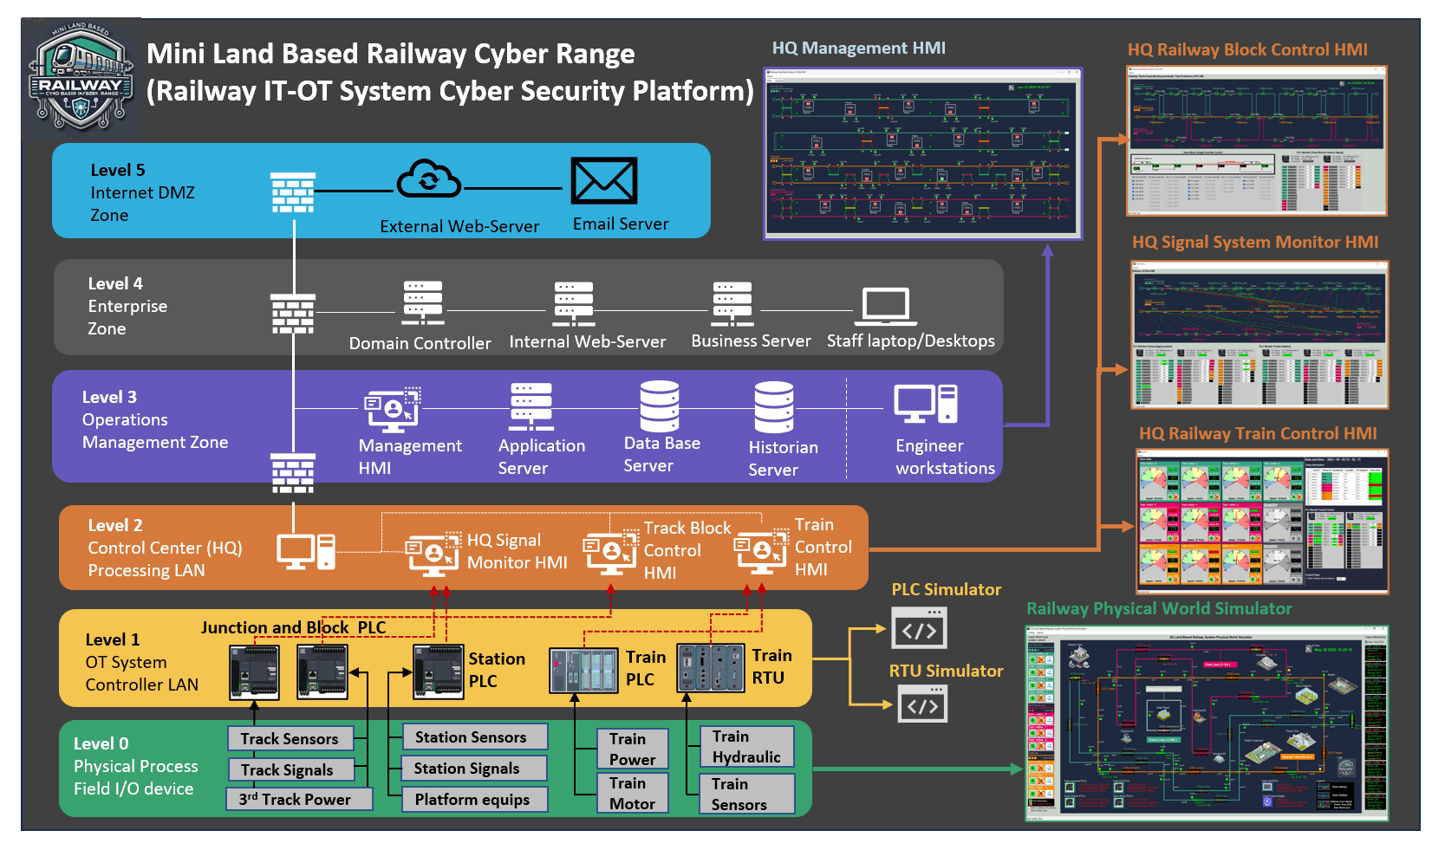

Slide 5
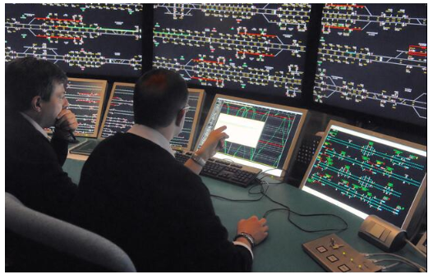
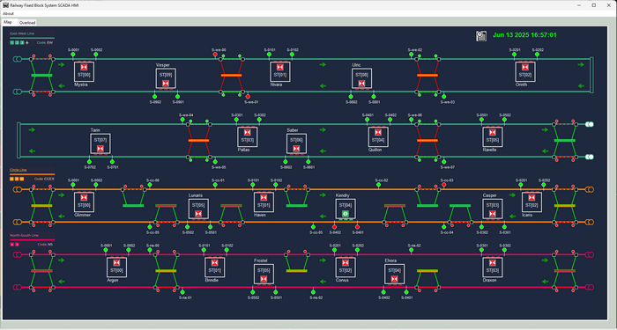

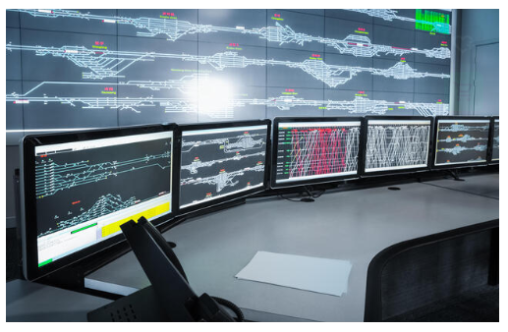
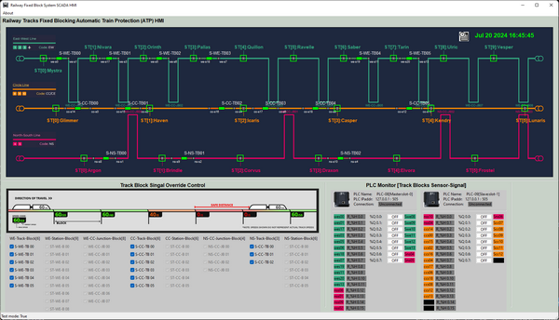
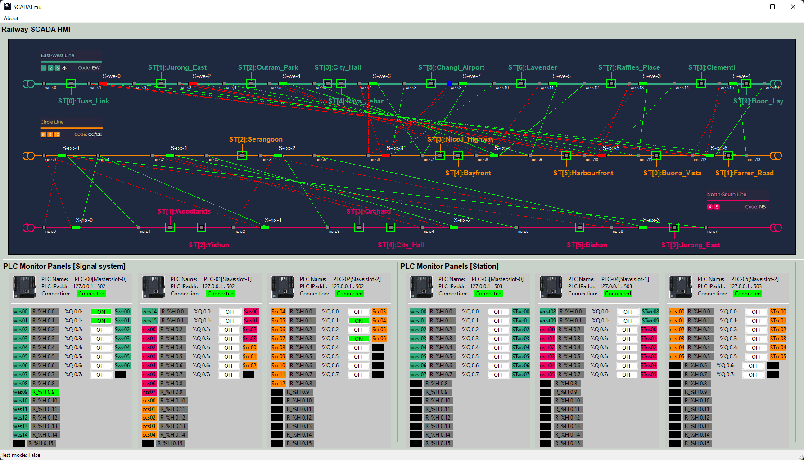
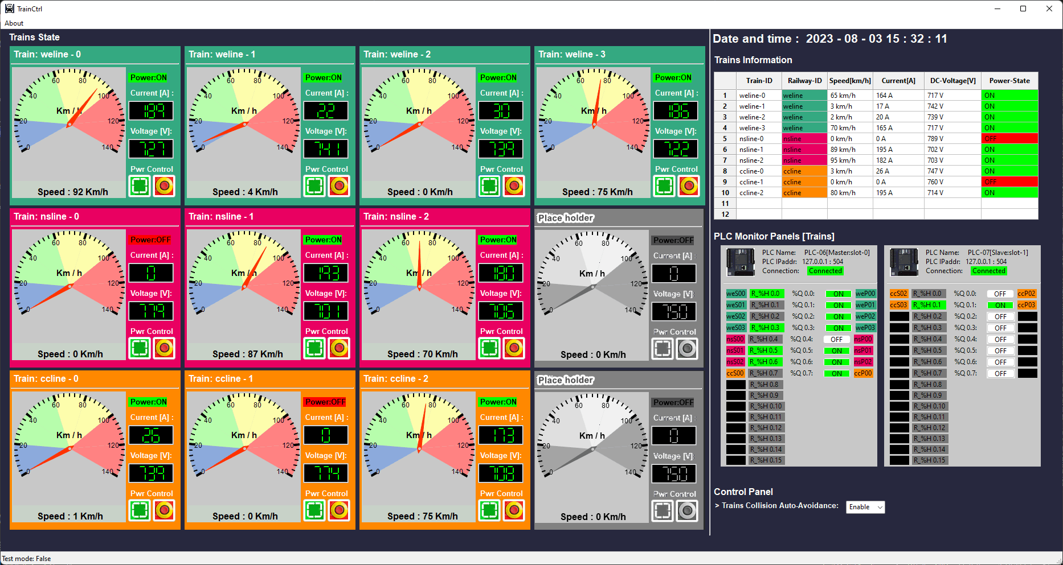


Implementing Different Human-Machine Interfaces (HMI) for a Land-Based Railway Cyber Range
Real World Railway HQ Center HMI View
Cyber Exercise Simulated HQ HMI View
Cyber Range HQ Management HMI
Human Machine Interface
Show the cyber range HQ Management HMI on the cyber exercise main screen to simulate the Supervisory HMI in the real world
Show the Signal, Track-block and Train HMI on small TVs or monitors to simulate the Machine-Level HMIs
HQ Railway Block Control HMI
HQ Signal System Monitor HMI
HQ Railway Train Control HMI
HQ System Operators
Cyber Exercise Blue Team Defenders

