Slide 1

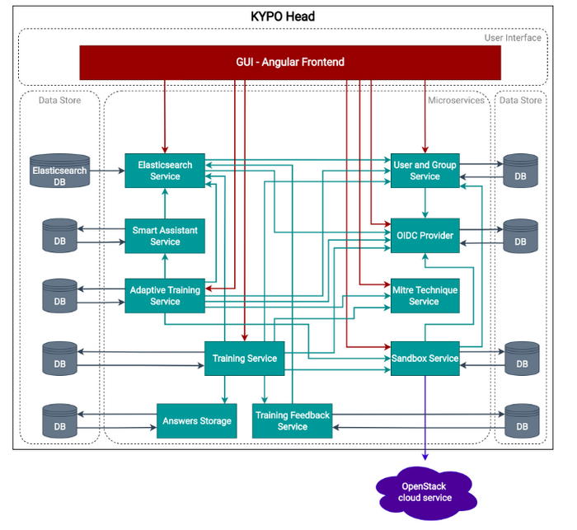
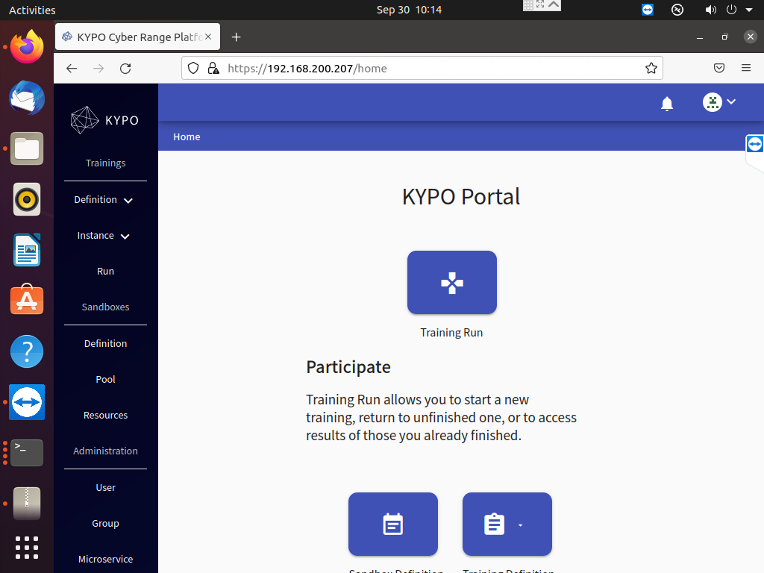

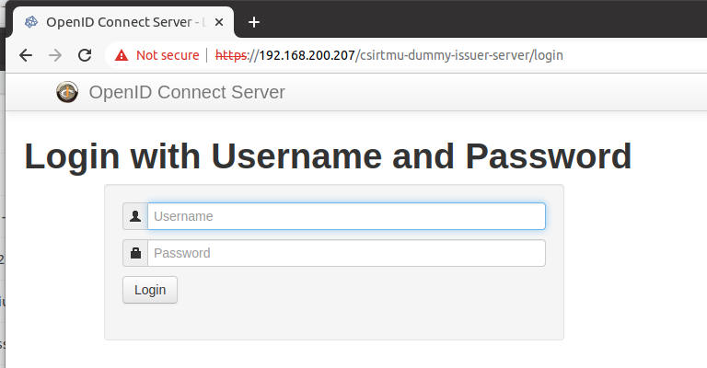
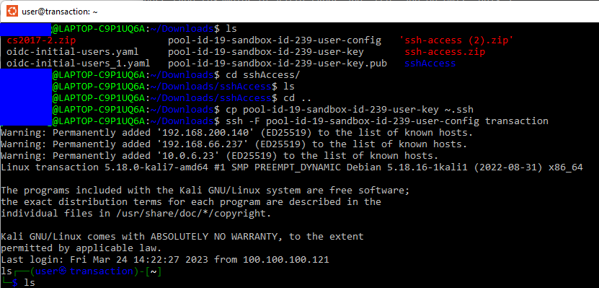



Detailed Steps to Deploy KYPO Cyber Range Platform on OpenStack-YOGA
KYPO Base terraform files
Pre-config all the OpenStack settings
Deploy OpenStack base resources
Deploy KYPO-CRP Helm application
Finish Kypo-K8s cluster and dashboard config

Slide 2
KYPO Base terraform files
KYPO Head terraform files
Step1: Pre-config all the OpenStack settings
Step 2: Deployment of OpenStack base resources
Step 3: Deployment of KYPO-CRP Helm application
Step 4: Finish kypo-K8s cluster and dashboard config
Deploy KYPO on OpenStack

