Slide 1
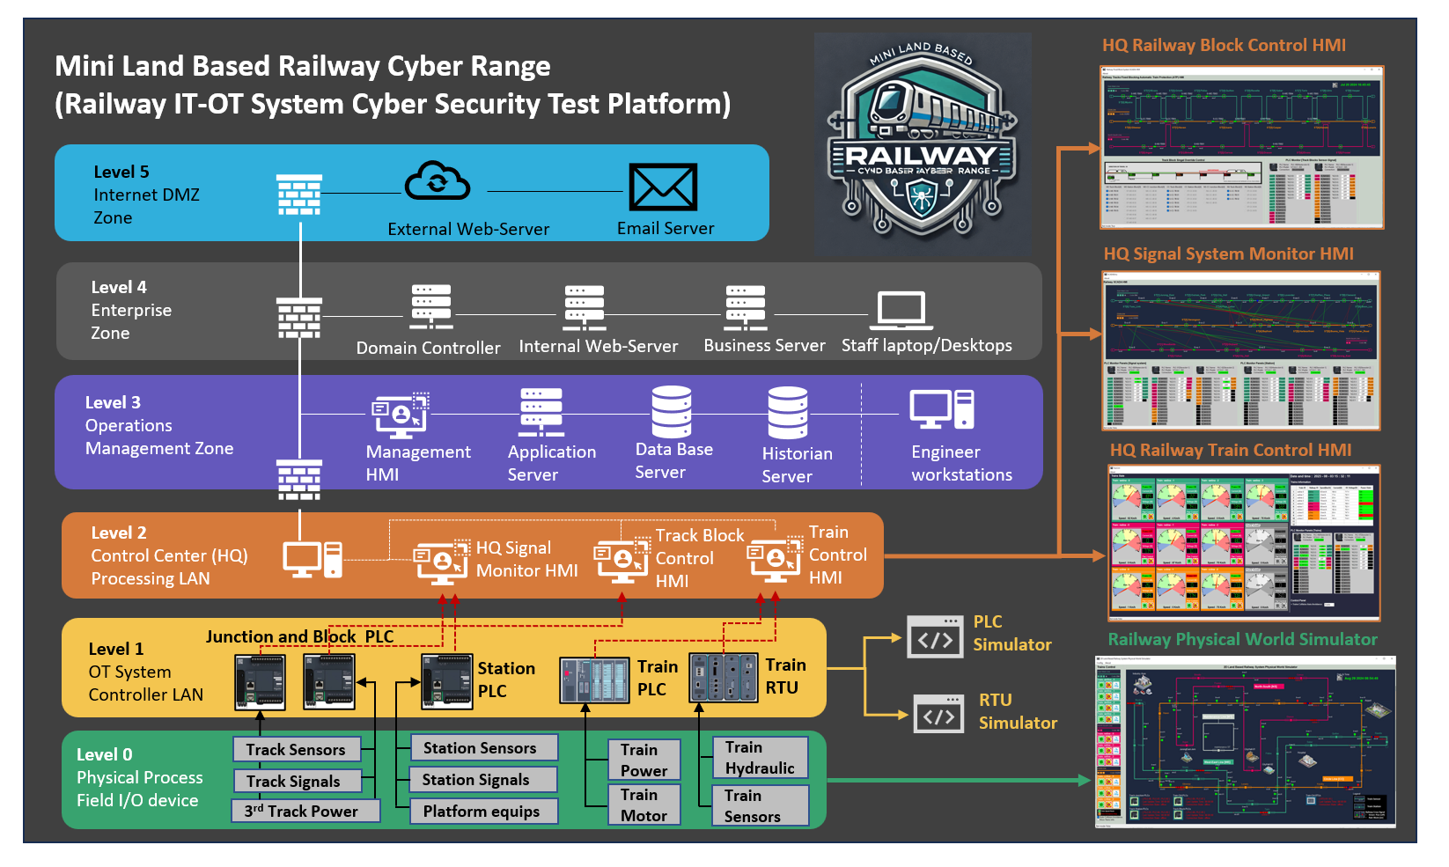
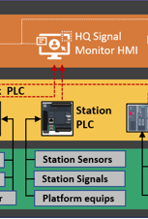
Railway Station OT Control Part in the whole system

Slide 2
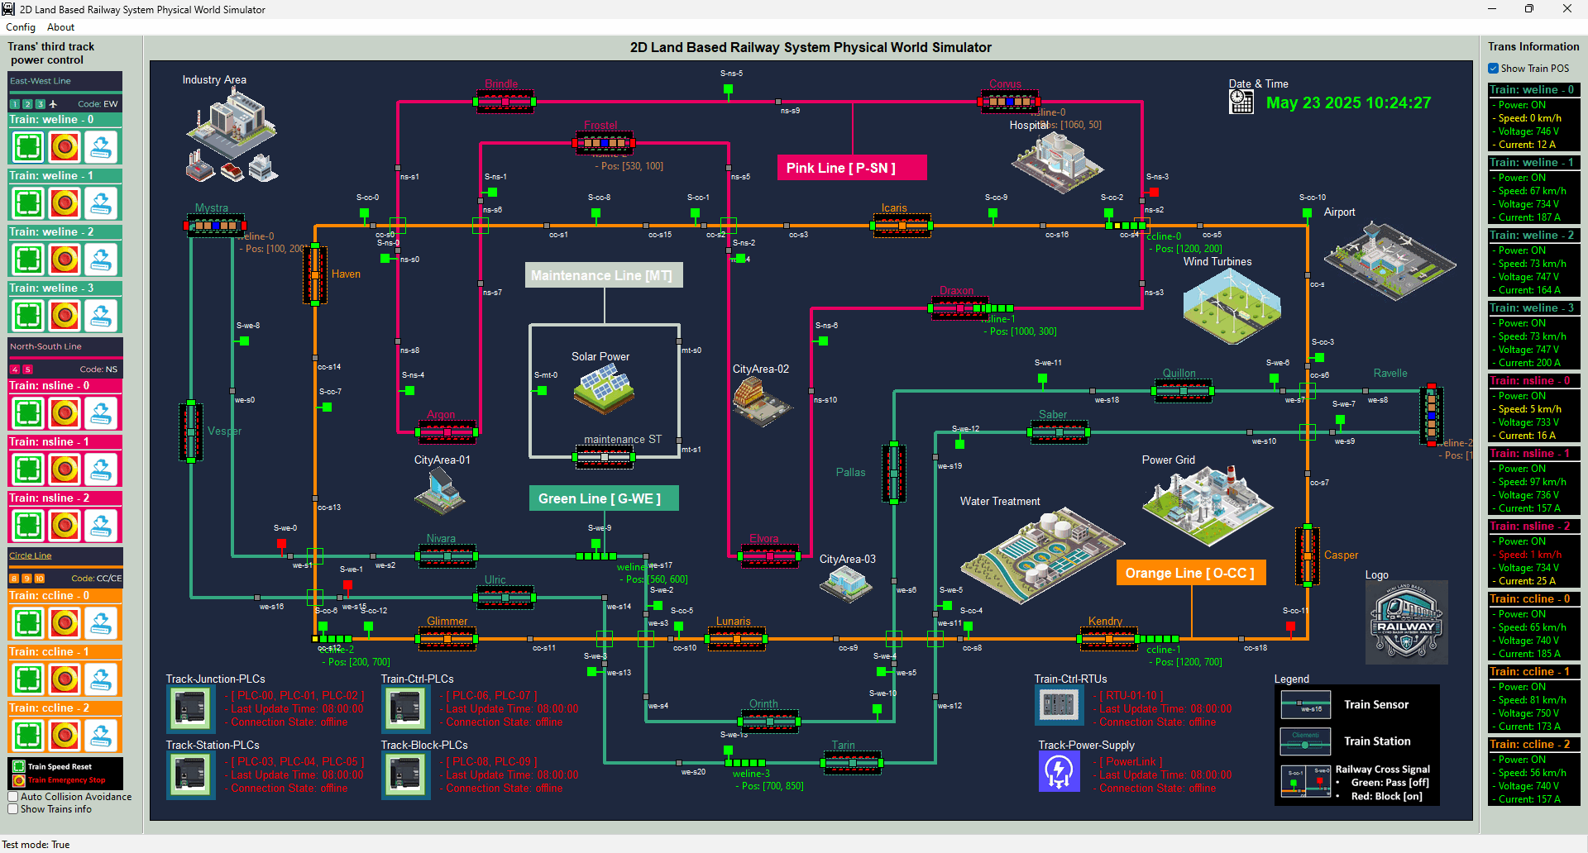
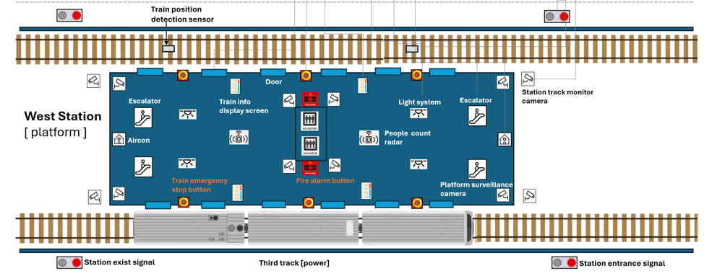
Railway Station Physical World Simulation

Slide 3
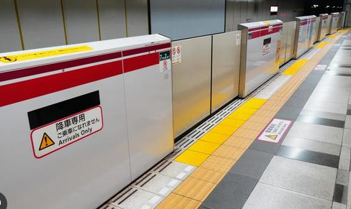
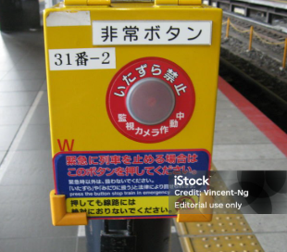
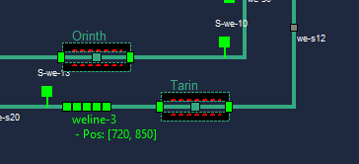
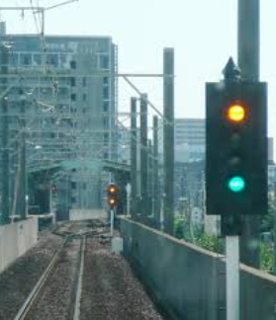
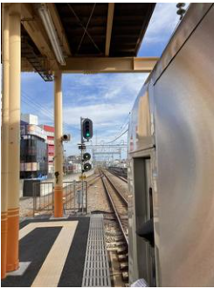
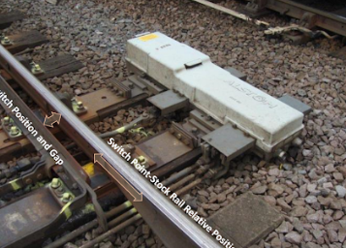
Station Platform Emergency Buttons
Railway Station Platform Safety Doors
Physical Simulation Program
Railway Station Train Entrance Dock Signal
Railway Station Train Position Sensors
Railway Station Exist Train departure signal

Slide 4
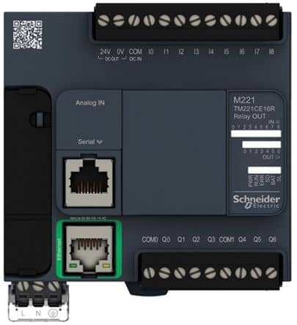
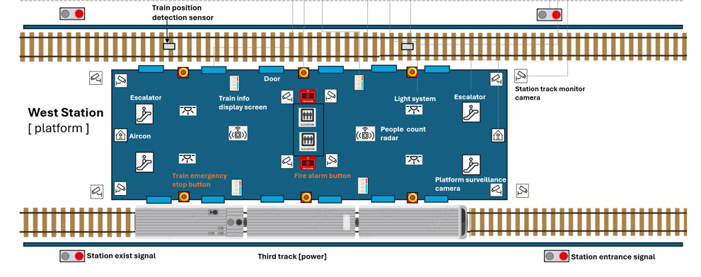
PLC2
PLC1
PLC0

Slide 5



%C [000011]
HMI Overload Switch
IN_STATE1
IF IN_STATE1 == STEP.HIGHER
OUT = TRUE
ELIF IN_STATA1 == STEP.LOWER
OUT = FALSE
ELSE
OUT = IN_STATE2
END IF
%M [000002]
Train sensor 1
%M [000005]
Entrance Dock Signals
IN_STATE2
OUT
%C [000012]
HMI Overload Switch
IN_STATE1
IF IN_STATE1 == STEP.HIGHER
OUT = TRUE
ELIF IN_STATA1 == STEP.LOWER
OUT = FALSE
ELSE
OUT = IN_STATE2
END IF
%M [000002]
Train sensor 1
%M [000006]
Train Exit Departure Signal
IN_STATE2
OUT

Slide 6
%C [000111]
HMI Door Overload Switch
IN_STATE1
IF IN_STATE1 == STEP.HIGHER
OUT = TRUE
ELIF IN_STATA1 == STEP.LOWER
OUT = FALSE
ELSE
OUT = IN_STATE2
END IF
%M [000102]
Train sensor 2
%M [000105]
Platform Door Motor
IN_STATE2
OUT
COUNT DOWN TIMER
COUNT = 10
OUT
CLK
NOT OUT
IN_STATE1
IF IN_STATE2 == STEP.HIGHER
OUT = TRUE
ELIF IN_STATA2 == STEP.LOWER
OUT = FALSE
ELSE
OUT = IN_STATE1
END IF
%M [000006]
Train Exit Departure Signal
%C [000112]
HMI Signal Overload Switch
OUT
IN_STATE2

Slide 7
%C [001000] Platform emergency button
IN_STATE1
IF IN_STATE1 == STEP.HIGHER
OUT =False
ELSE
OUT = IN_STATE2
END IF
%M [000106]
Platform Door Motor
%M [000106] Platform Door Motor
IN_STATE2
OUT
IN_STATE1
%M [000009]
Station Train 3rd track power
IF IN_STATE1 == STEP.HIGHER
OUT =False
ELSE
OUT = IN_STATE2
END IF
%M [000009]
Train 3rd track power
IN_STATE2
OUT
%M [000005]
Entrance Dock Signals
IN_STATE1
IF IN_STATE1 == STEP.HIGHER
OUT =False
ELSE
OUT = IN_STATE2
END IF
%M [000005]
Entrance Dock Signals
IN_STATE2
OUT
%M [000006]
Train Exit Departure Signal
IN_STATE1
IF IN_STATE1 == STEP.HIGHER
OUT =False
ELSE
OUT = IN_STATE2
END IF
%M [000006]
Train Exit Departure Signal
IN_STATE2
OUT

