Slide 1
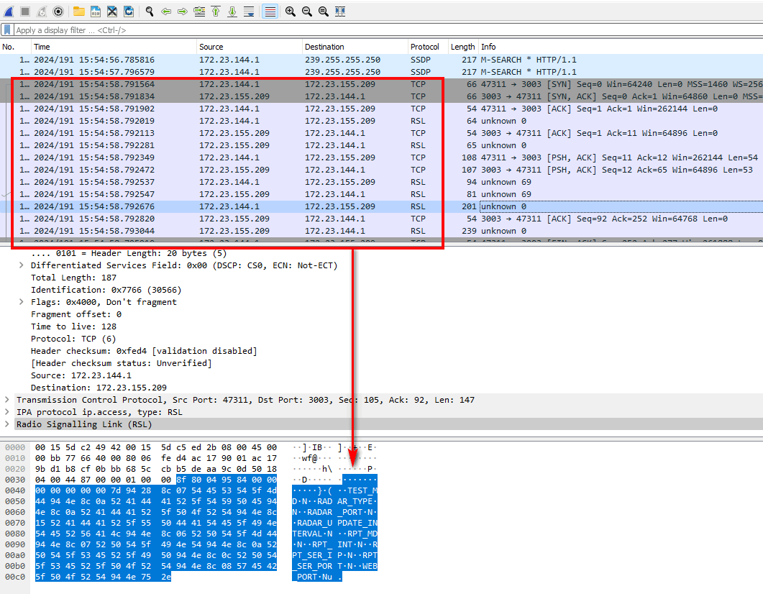
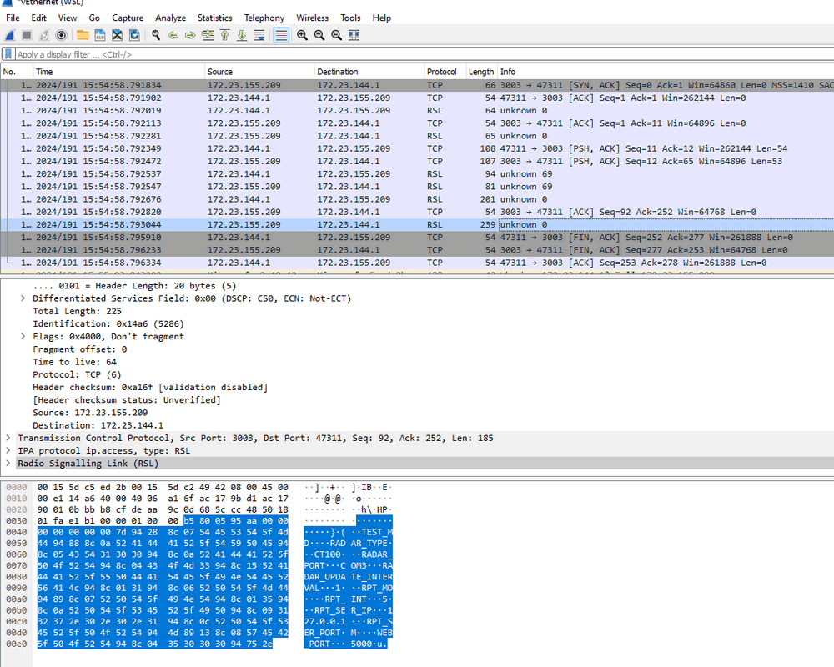
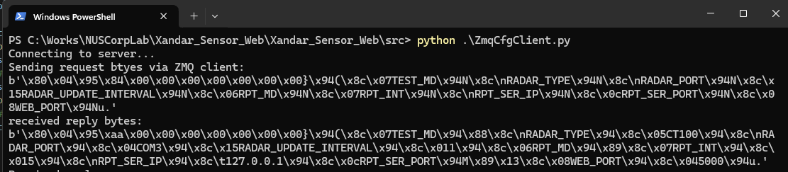
Attacker’s ZMQ client send data
Attacker’s ZMQ client received data
Text format data converted by Wireshark
Text format data converted by Wireshark
Map to bytes data
Map to bytes data

Slide 2



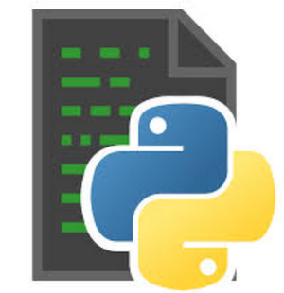


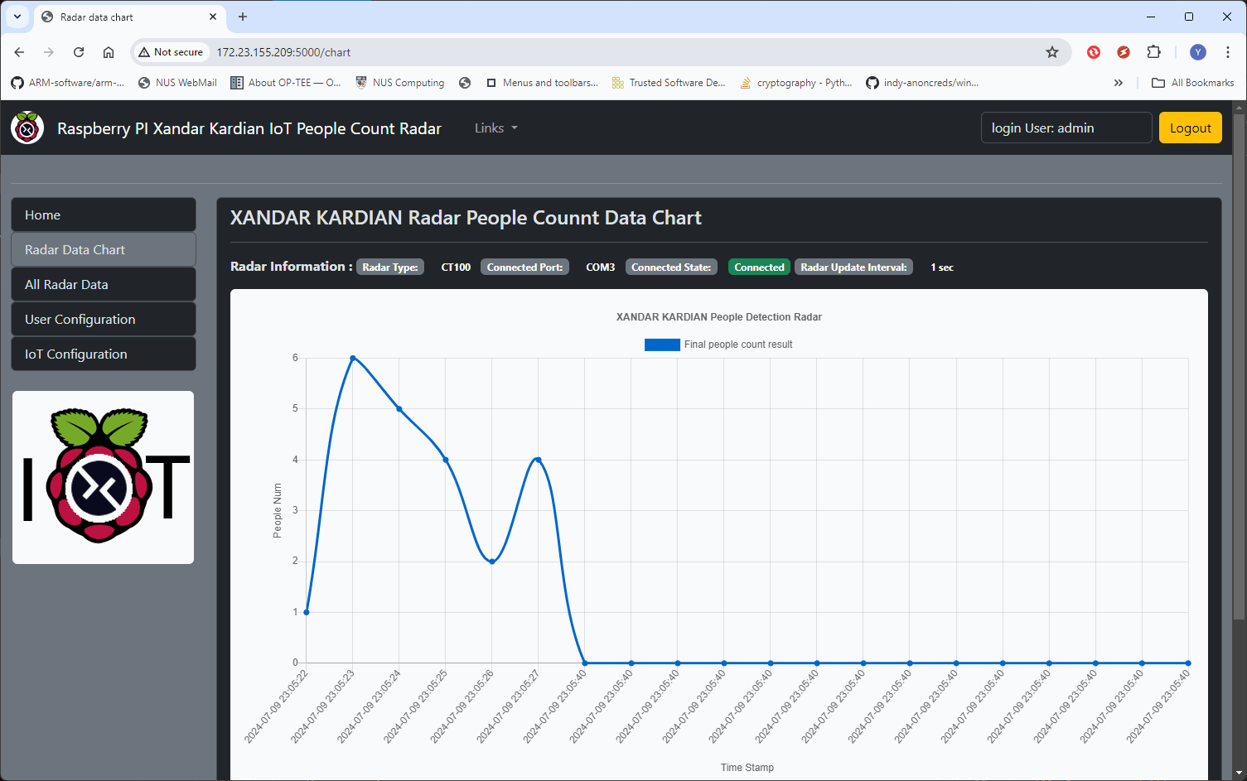

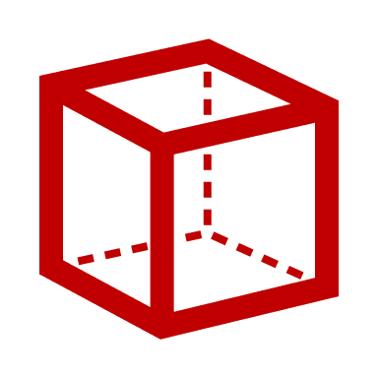
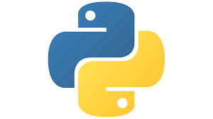

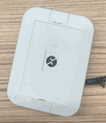
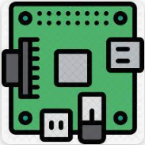



IoT System Cyber Attack Case Study 02 : Python Deserialization Attack and Library Hijacking Attack
Python Deserialization Attack
IoT Users
IoT Cloud server
People Detection Radar IoT
Pickle Bomb
Python Package Hijacking Attack
Red Team Attacker
Fake serial Com lib
Python Web Shell Attack
Flask web shell
Error IoT Radar Reading Data

Slide 3

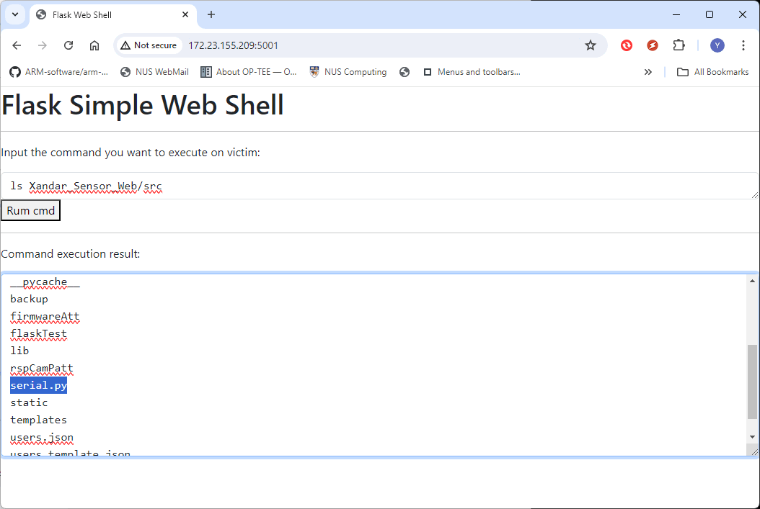

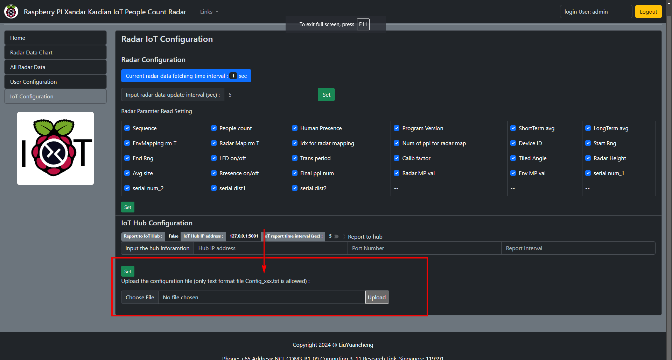

2. Build web Shell Pickle Bomb
11 Steps IoT Cyber Attack Path
3. Inject Bomb as data stream
1. Traffic eavesdrop and packet analyse
People Detection Radar IoT
IoT locate request
ZMQ Server
Port: 3000
IoT basic Config Info
6. Steal secret information
4. Deserialization Bomb activated
IoT Engineer
Database
5. Remote command execution request
Backdoor Web Shell Port : 5001
9. Upload the disguised attack script via IoT web UI
Backdoor web shell interface
Http server
Port: 5000
7. Build attack hijacking lib file
8. Disguise attack lib file
10. Fake Com reading lib interrupted radar data reading progress
11. Reply Error IoT data to the user

