Slide 1
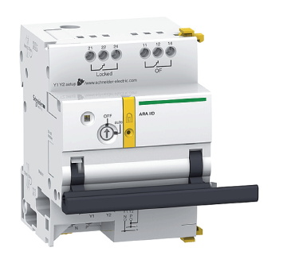
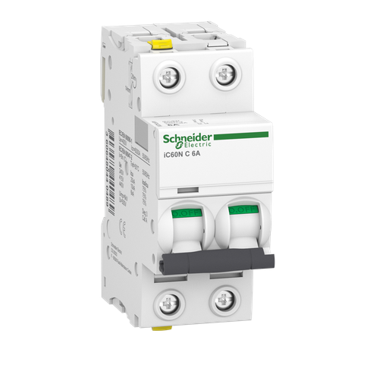
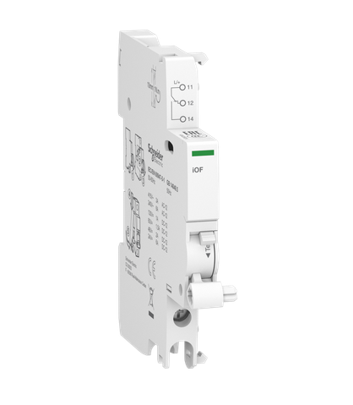
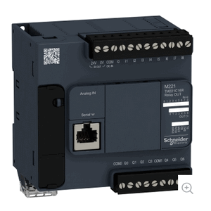
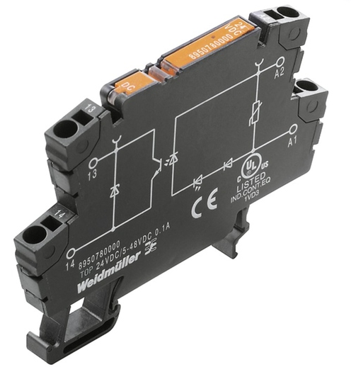
5V-DC Relay with 48V-DC Contact
Breaker Control Motor
High Voltage AC Circuit Breaker
Breaker State Sensor
Programmable Logic Controller (PLC)
Weidmuller 2614860000 TOP 5VDC 48VDC0.1A
Schneider Electric Acti 9 - ARA auto recloser aux for iID 2P
Schneider Electric A9F04206 MCBs IC60N 2P, 6A C
Schneider Electric A9A26924 - Acti 9 - Auxiliary contact iOF - 1 C/O - AC/DC
Schneider Electric Modicon M221 Nano PLC

Slide 2

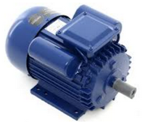
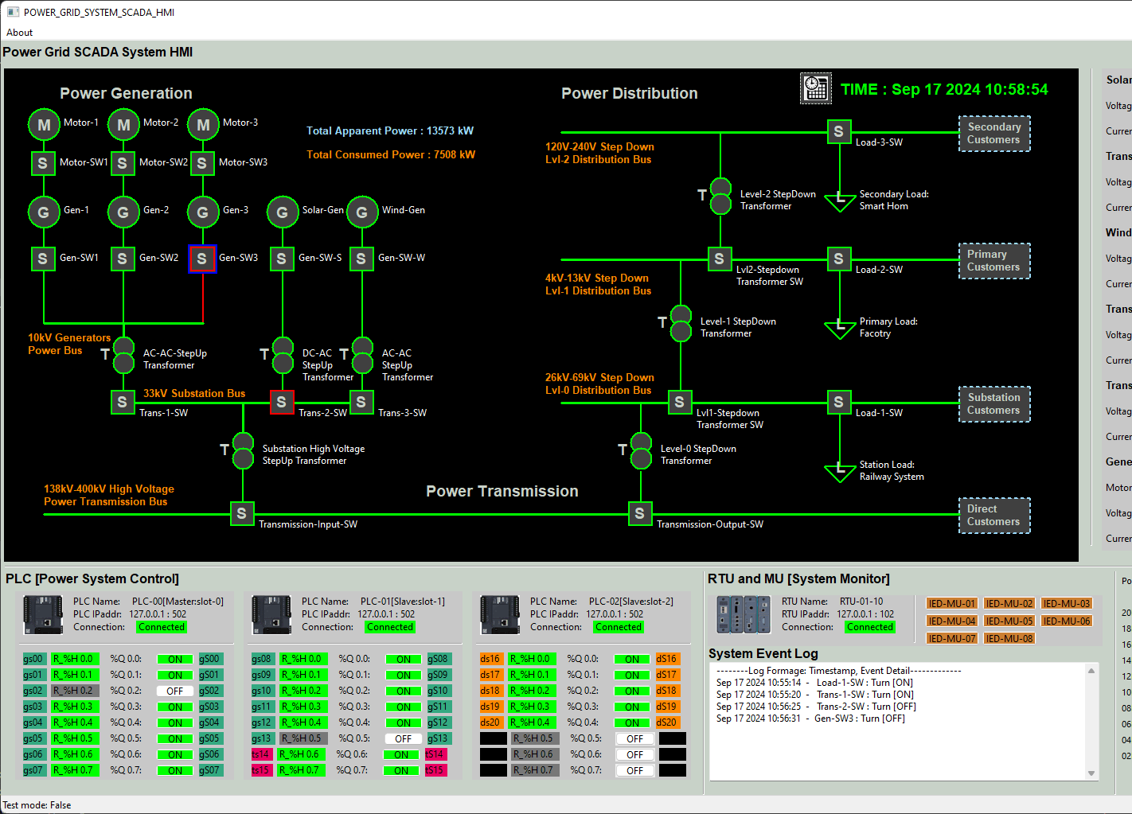
Control motor AC power input
Circuit breaker input ( Can be other high voltage AC/DC bus )
AC lift 220V
PLC AC power input
AC Neutral
AC Protective Earth
3.3K Ohm Ω resistor
Motor control signal
PLC Contact signal input
OT-ICS network
Breaker State Sensor
Breaker Control Motor
High Voltage AC Circuit Breaker
5V-DC Relay with 48V-DC Contact
Power System SCADA HMI
PLC Coil signal output
5V DC +
AC power load device
48V DC +
DC- GND

Slide 3
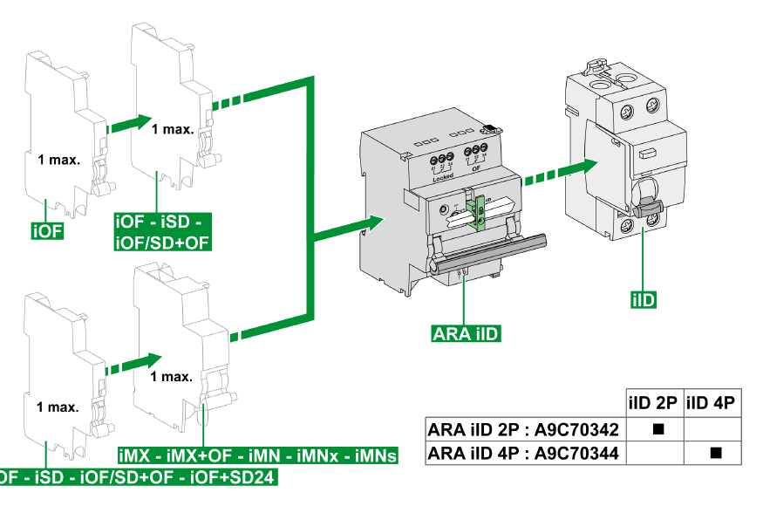
[1] Circuit breaker handle used to control the breaker on and off
[2] Circuit breaker Motor handle used to flip the breaker
[3] Sensor handle used to detect breaker and motor handle position

Slide 4






PLC first scan bit
PLC Contact state
PLC coil output [motor]
PLC coil state
%S13
%I0.0
%Q0.0
Rung0
%Q0.0

Slide 5
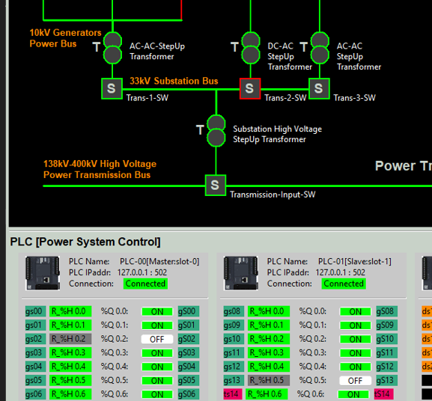
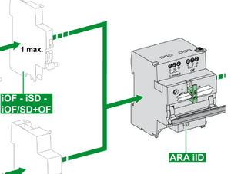
Power system HMI
Circuit break is turned [on]
Hardware device
Circuit break is turned [off]
Show breaker state on the HMI UI
PLC Coils Pin Index
Electrical signal
Fetch sensor data from PLC holding register
PLC Coils State and Control
PLC Holding Register index and state
PLC Contacts
Pin Index
PLC
Set motor state by change the state of the coils

Slide 6
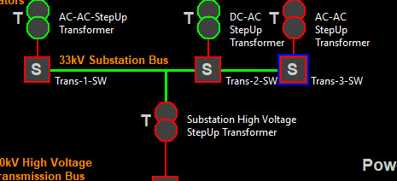
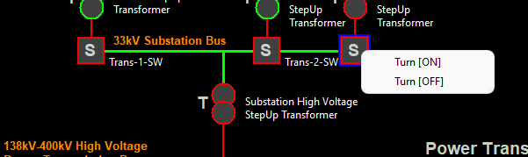
Operator needs to check the breaker state, then change the breaker to correct state to clear the alert.
When Circuit Breaker Exception Detected, show the flash alert signal under the breaker to remind operator.

Slide 7
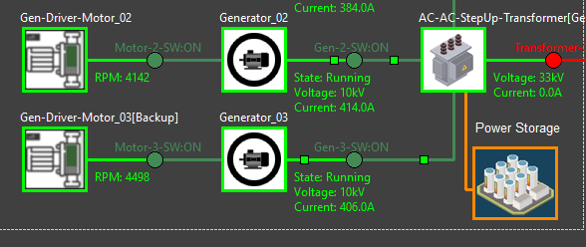
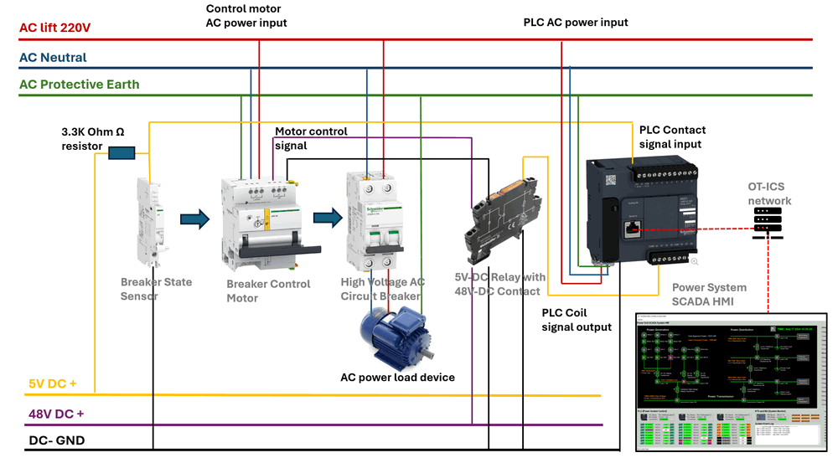
Use PLC to Remote Control Circuit Breaker in Power Grid System
Digital Equivalent Simulation (With Virtual PLC)
Power Grid SCADA System HMI
Modbus TCP
Physical Circuit Breaker ( with motor and sensor)
Modbus TCP

Slide 8
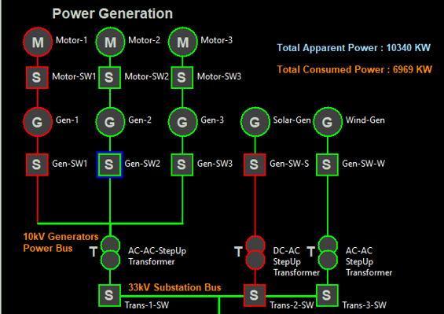

Physical Simulation
Power System HMI
Function setCurrent() interact with generator
Function setMotor() to get the motor change from PLC
Function getSensorState() to send the state to PLC
Virtual PLC Program
Modbus TCP

