Slide 1
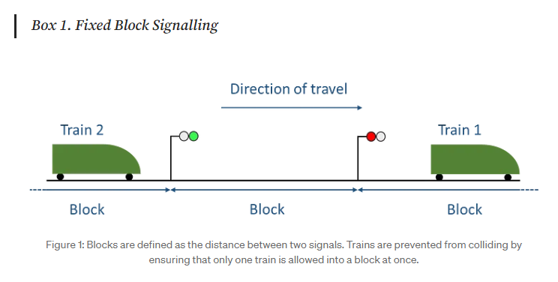
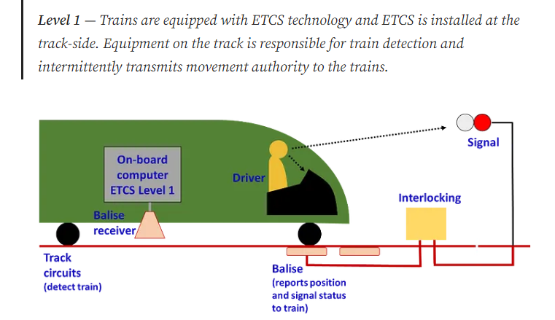
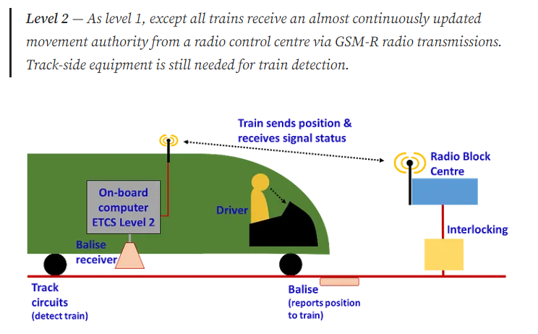
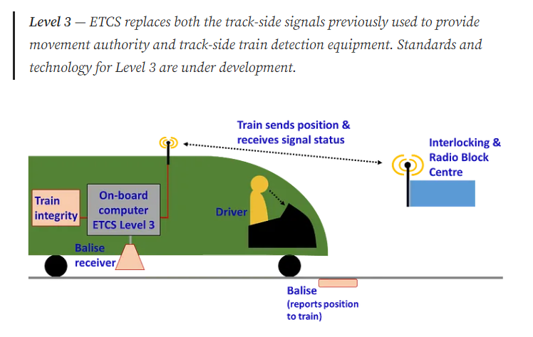

Slide 2
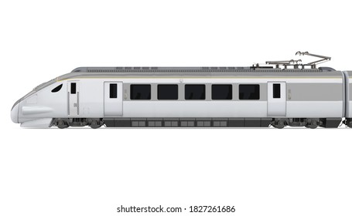


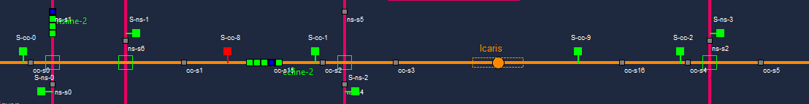
Brake or procedure based on signal state
Train Control Signal
Train
Detect Train
Train Detection Sensor
Locked Block
Free Block
Free Block
Block
Train Control Signal [ on ]
Train
Train Control Signal [ off ]
Junction block
Train Detection Sensor
Locked block
Free block
Station block
Free block

Slide 3
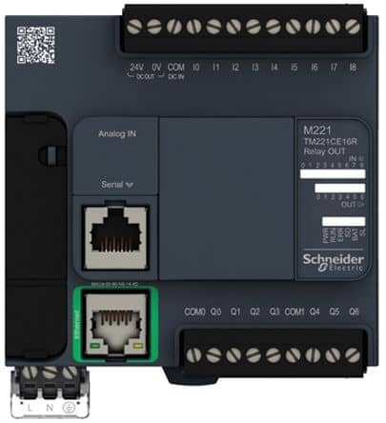
OT Railway System Development :
Use PLC to Implement Land Based Railway Track Fixed Block Signaling OT System
Brake or procedure based on signal state
Train Control Signal
Train
Detect Train
Train Detection Sensor
Locked Block
Train Control Signal
Free Block
Free Block
Locked Block
Track Fixed Block Controller PLC
Track Fixed Block Controller PLC
Track Fixed Block Controller PLC
Track Fixed Block Controller PLC
Train Control Signal [ on ]
Train
Train Control Signal [ off ]
Junction block
Train Detection Sensor
Locked block
Free block
Station block
Free block

Slide 4
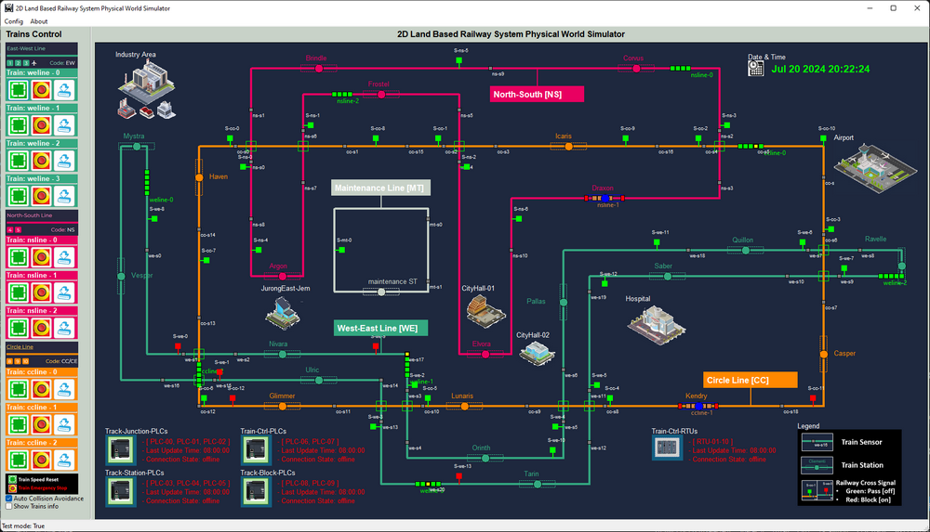
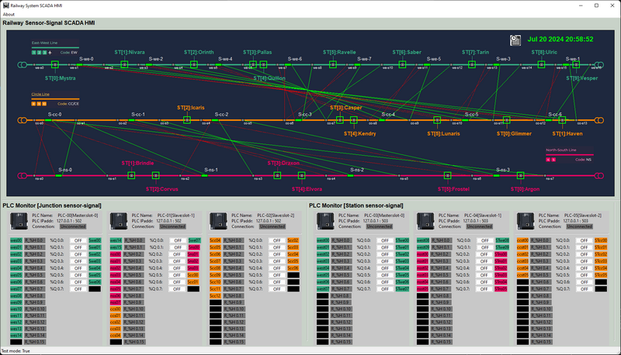
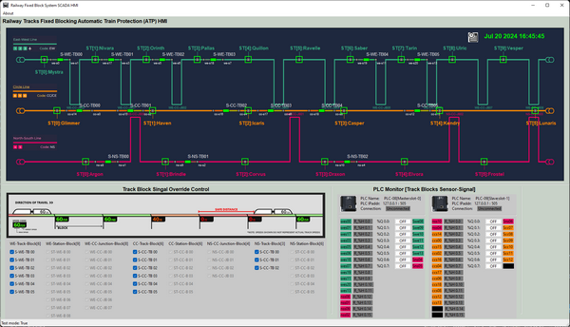
Railway signaling system physical world simulator
HQ Junction and Station ATC Monitor HMI
OT-System-lvl0:
Physical Process Field I/O device
OT-System-lvl2: Control Center (HQ) Processing LAN
HQ Track ATC Monitor and Control HMI
Railway Junction Block Signaling Control PLCs
Railway Station Block Signaling Control PLCs
Railway Track Block Signaling Control PLCs
OT-System-lvl1: Controller LAN
Modbus

Slide 5
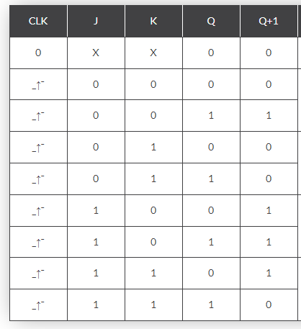
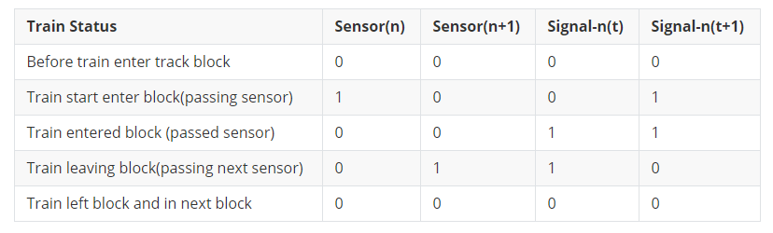
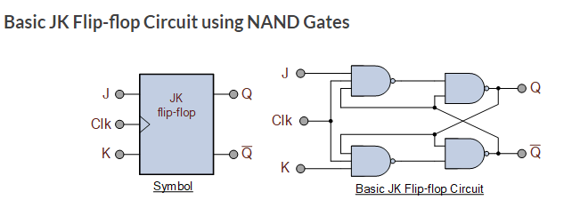
Characteristics Table for the JK Function

Slide 6
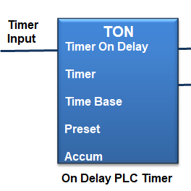


Incorrect implementation
Correct implementation
J
J state unknown
J
J state voltage high
CLK
CLK pulse
CLK
CLK pulse
Time-T0
Time-T0’
HR1
C0
J
JK
Q
HR2
K
HR1
HR3
Delay Timer
TON
CLK
HR2
Delay (1sec)

Slide 7

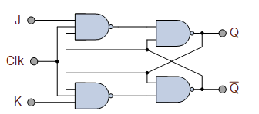
Signal(n)
Sensor(n)
Sensor(n+1)

Slide 8
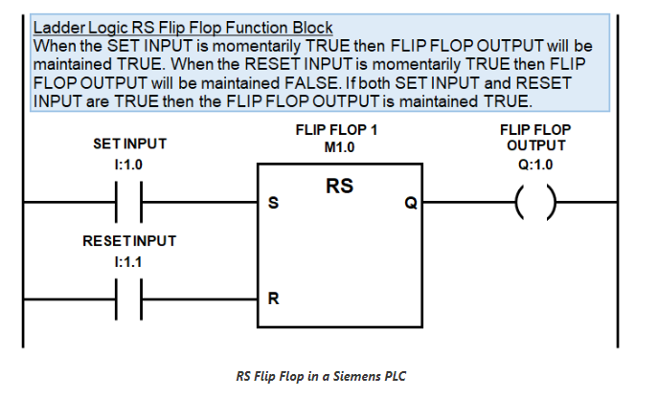
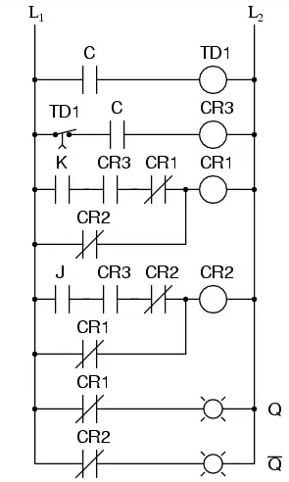
HR1
FLIP FLOP 1
M1.0
C0
J
JK
Q
HR2
K
HR1
Delay Timer
TON
CLK
HR2
Delay (1sec)

Slide 9
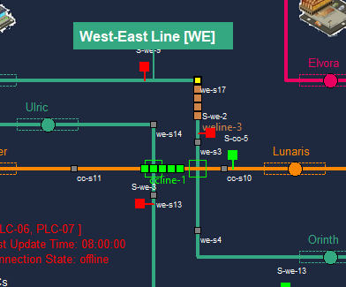
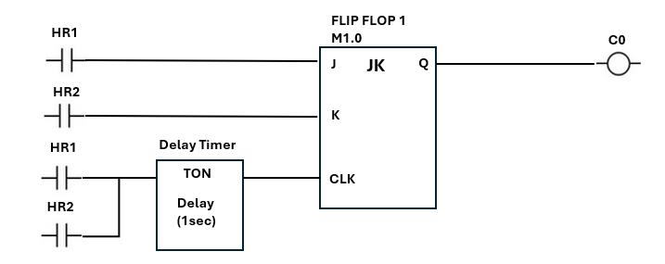
Junction’s Fixed Block Controllers Connection
Orange Line (right) block controller
Green Line (left) block controller
Green Line (right) block controller

Slide 10
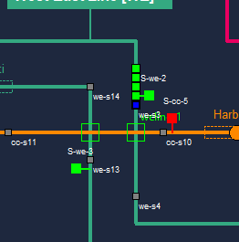
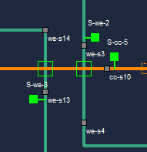
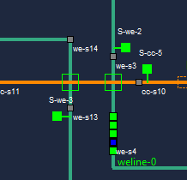
Junction’s Senor-Signal physical wire connection and operating logic
Operation Scenario 1: Junction block when train pass through
Step 1: When a train is entering the junction and trigger the entrance block sensor (sensor color change from grey to blue )
Junction entrance block sensor
Junction entrance block sensor
Train entrance block signal
Step 2: Junction entrance block signal will turn on (red) to block the train on yellow track to enter the junction
Junction Area
Junction entrance release sensor [off]
Step 3: When a train is leaving the junction and trigger the entrance release sensor (sensor color change from grey to blue )
Operation Scenario 2: Junction release when train leaving
Step 4: Junction entrance block signal will turn OFF (green) to allow the train on orange track to enter the junction
PLC Fixed block automated control ladder logic
Junction entrance release sensor [on]

Slide 11

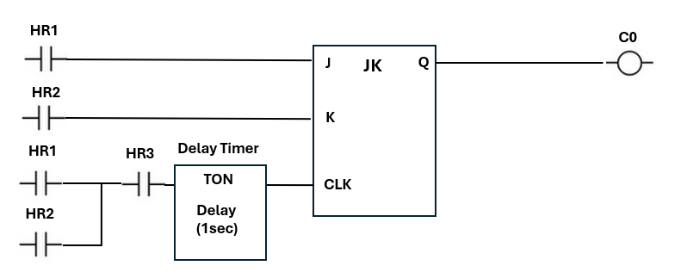

Signal(n)
Track Block Controller Circuit Diagram without ATC override function
Signal(n)
Track Block Controller Circuit Diagram with ATC override function
Sensor(n)
Sensor(n+1)
Sensor(n)
Sensor(n+1)
Track Block Controller Ladder Diagram with ATC override function
Track Block HQ Control HMI
Railway HQ Operator

