Slide 1


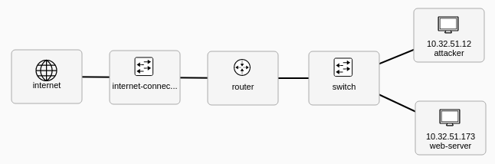
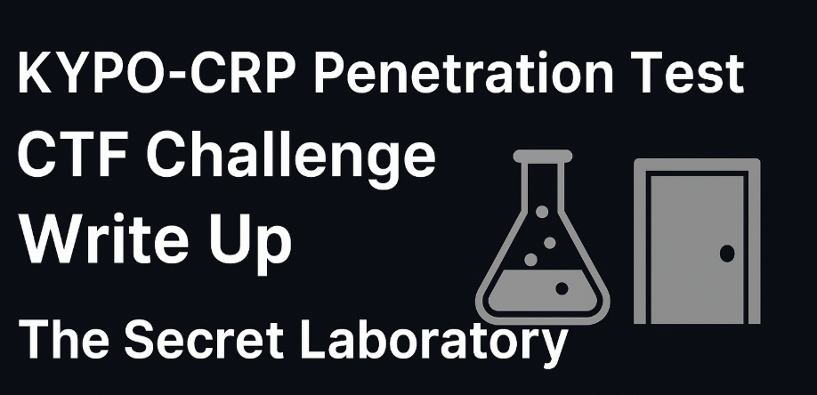
Kypo-CRP Penetration Test CTF Challenge Write Up : The Secret Laboratory
Task Q1: Network Probing (Target Discovery)
Task Q2 : Target Service Scanning (Service Enumeration)
Task Q3 : Identify the Vulnerability
Task Q4 : Exploit the Vulnerability
Task Q5: Find the Secret Information

