Slide 1
Digital Forensics and Incident Response
The topic we focus on in this article
File system forensics
E01 Disk Image
Security Incident response
Digital Forensics
Analysis
Memory forensics
Memory Dump
Respond
Network forensics
TCP Dump
Recover
Follow
Minimize
Log and record analysis
Logs Data
Assist
Strengthen

Slide 2
Digital Forensics and Incident Response
File system forensics
E01 Disk Image
Security Incident response
Digital Forensics
Analysis
Memory forensics
Memory Dump
Respond
Network forensics
TCP Dump
Recover
Follow
Minimize
Log and record analysis
Logs Data
Assist
Strengthen

Slide 3



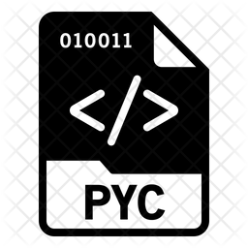



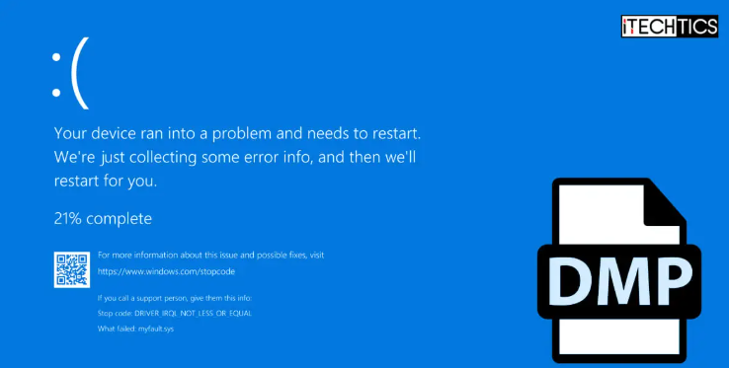

Reverse Engineering to Get the Python Malware Source Code via Memory Dump For Digital Forensics and Incident Response (DFIR) operations
Backdoor Trojan Python Code
False Software Installation exe file
Extracted Malware Process Data
PyInstaller
Volatility3
uncompyle6
Malware Execution On Victim Machine
Red Team Attacker
System Error Memory Dump Collection
Decompiled python code
Malware Creation
Victim Node Configuration
Evidence Collection
Data Extraction
Reverse Engineering

