Slide 1
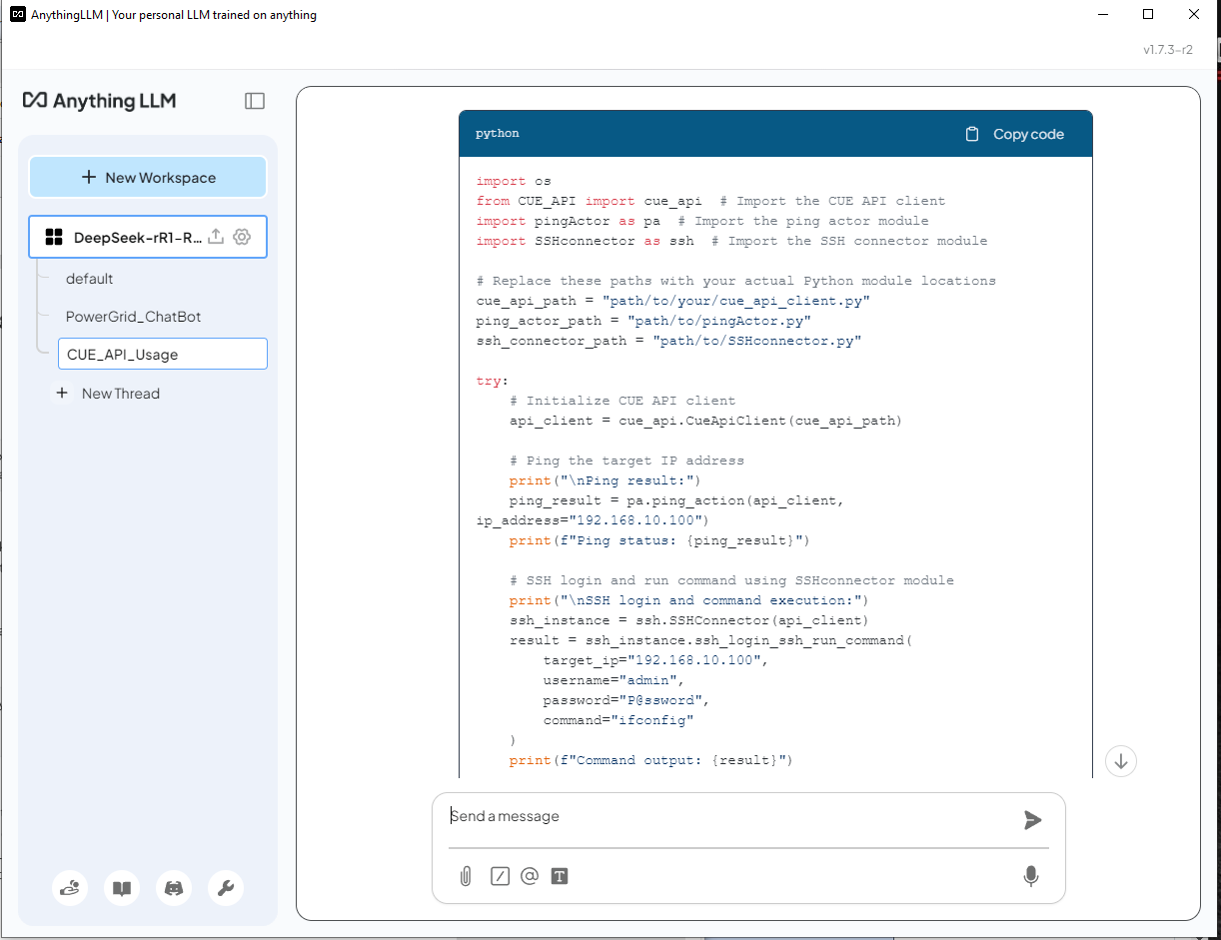
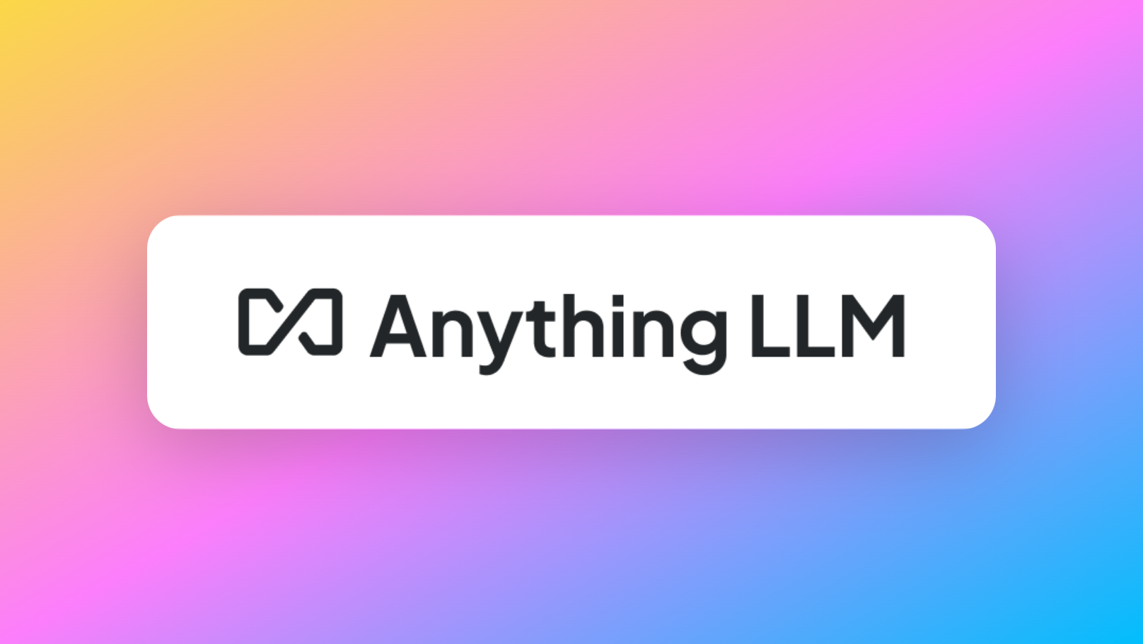















Deploying DeepSeek-R1 Locally with a Custom RAG Knowledge Data Base
Local PC/Server
Anything LLM Chat
Embed
Private data or data not included in pre-training knowledge
User
User
Local LLM Models

Slide 2
Normal AI LLM Question-Answer Flow
Question-Answer Flow Compare between Normal LLM and LLM with Retrieval-Augmented Generation
Ask a question
LLM
1
2
User
General Answer based on pre-trained knowledge (No RAG answer)
Pre-Trained LLM
LLM with RAG Question-Answer Flow
Embedding
Retrieves relevant information
Vector Database
Ask a question
RAG
2
1
retrieved data
3
User
4
More accurate answer based on pre-trained knowledge and Retrieved data
Original question + Retrieved data
LLM
Private data or data not included in pre-training knowledge
5
Pre-Trained LLM

Slide 3
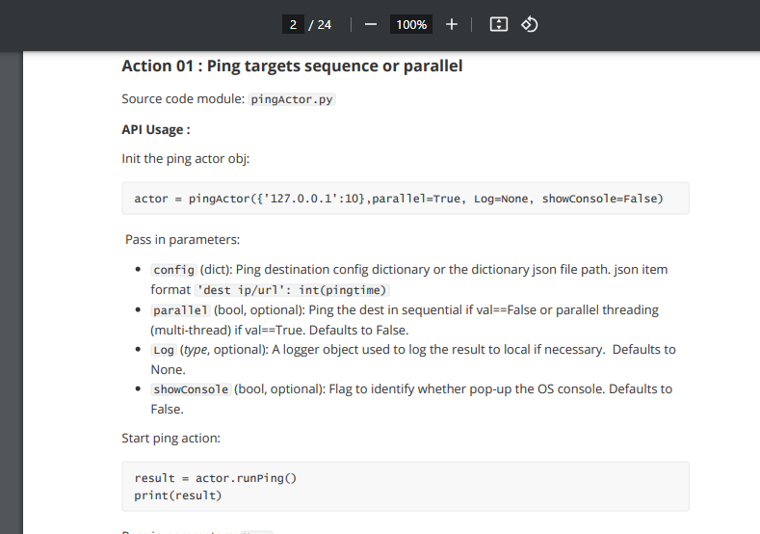
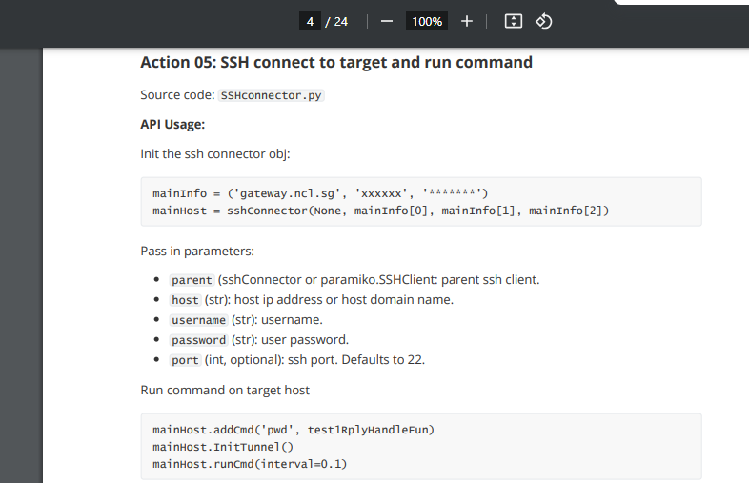
Find the API Function and use correctly
Find the API Function but didn’t use correctly

