Slide 1
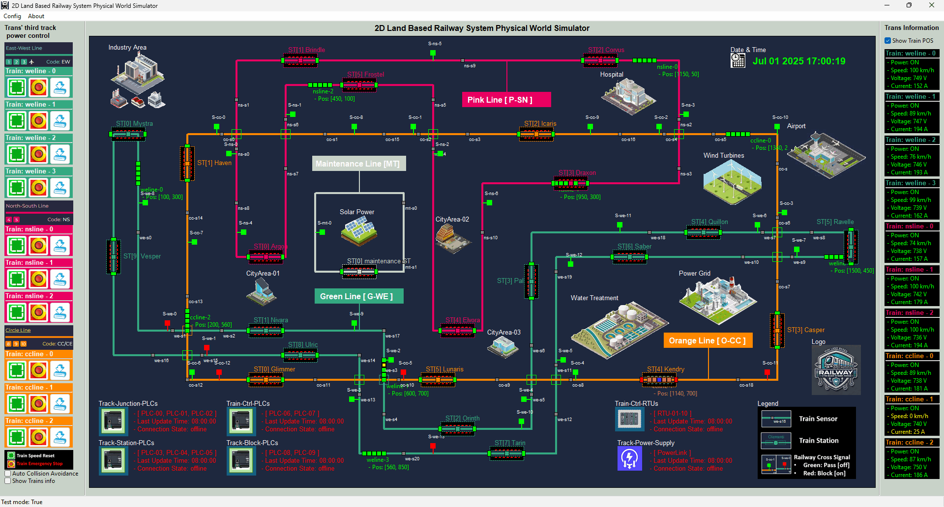

Slide 2



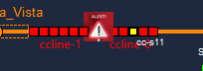
Operation Scenario 1(Red) :
Train power : OFF
Train speed: 0 km/h
Input current: 0A
Operation Scenario 2(Orange) :
Train power : ON ,
Train speed : low (0 km/ h – 20km/h)
Input current: 10 ~ 20 A
Operation Scenario 2(Green) :
Train power : ON ,
Train speed : Running (56 km/ h – 90 km/ h)
Input current : 140A ~ 180A
Operation Scenario 1(Red + Alert) :
Train power : OFF
Train speed: 0 km/h
Input current: 0A

