Slide 1
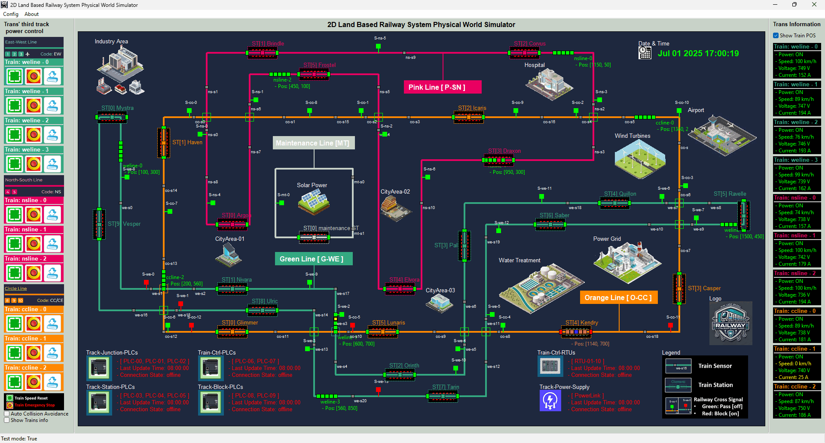

Slide 2
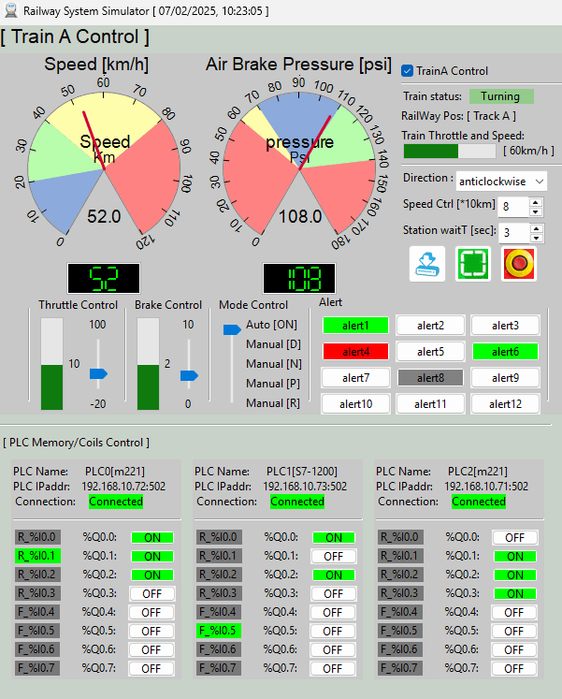
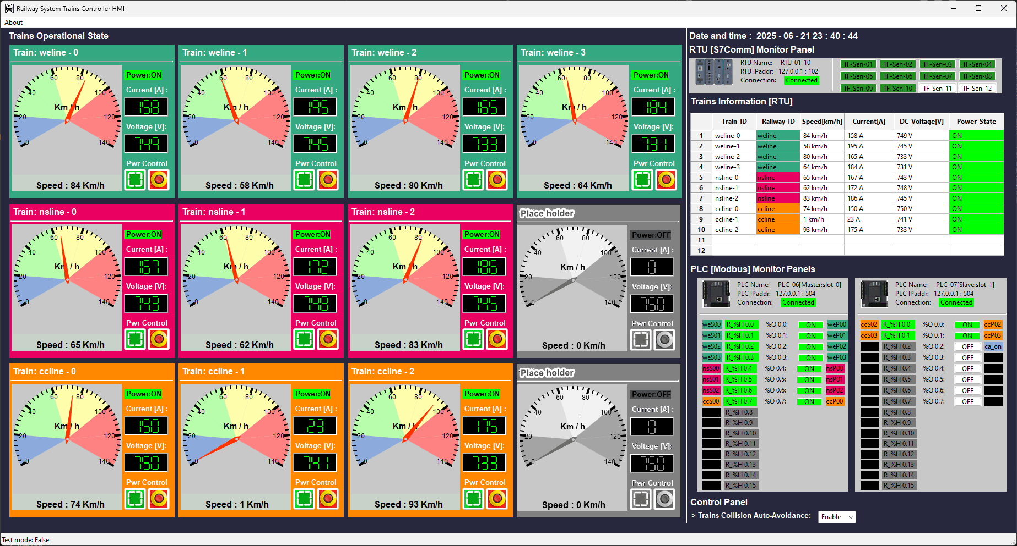
On-Train Driver Console
HQ Train Monitoring HMI

Slide 3



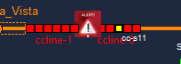
Operation Scenario 1(Red+Gray blinking) :
Train power : OFF
Train speed: 0 km/h
Input current: 0A
Operation Scenario 2(Orange) :
Train power : ON ,
Train speed : low (0 km/ h – 20km/h)
Input current: 10 ~ 20 A
Operation Scenario 2(Green) :
Train power : ON ,
Train speed : Running (56 km/ h – 90 km/ h)
Input current : 140A ~ 180A
Operation Scenario 4(Red + Alert) :
Train power : OFF
Train speed: 0 km/h
Input current: 0A

Slide 4
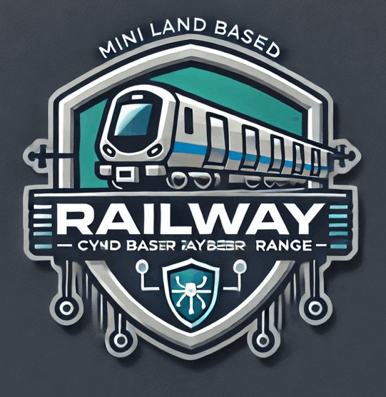
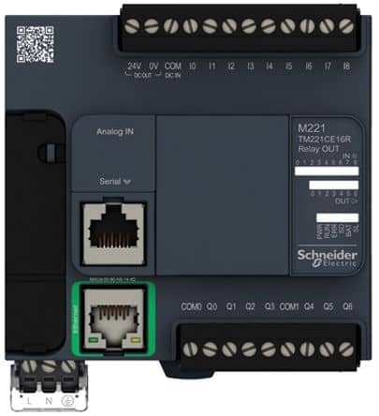

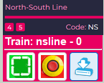
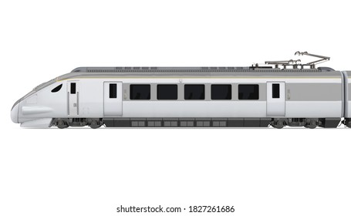



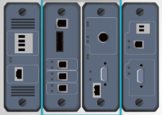

Third track block power control PLC
HQ Trains Operation & Monitor HMI
Third track power block Input control breakers
Railway SCADA Modbus-TCP Link
Railway third track 750V DC
3rd track power to train link
2D Train in physical world simulation
Electrical Signal to PLC
latching relay or switch
Sensors and meters
Electrical Signal to RTU
Train Driver Console [ on Train ]
DC power link
On train Emergency power control breaker
Real-world train module function mapping
Train front radar detection area
Train input power control breaker
Train input electric current meter
Train input electric voltage meter
Train front signal state receiver
Train front radar
On train antenna
Train speed meter
Train driving
DC motor
Train driving control PLC
On-Train Modbus-TCP Link
Wireless connection
Railway train communication antenna
Train onboard RTU
Air Brake Pressure meter
On-Train S7comm Bus
Railway SCADA S7comm Link

Slide 5





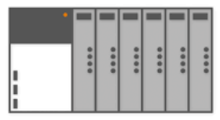
Railway Physical-world Simulator
Railway HQ Trains Monitor HMI(s)
Users
4
5
3
Railway engineer
1
9
Train driver consoles
Electrical signal communication simulation module (10.0.10.100)
HMI network 192.168.10.x
10 train front radar state ( input to PLC)
50 RTU input ( trains throttle, brake, voltage, current ,speed sensors)
10 PLC coils state (output to 3rd track power switch)
0
20 PLC coils ( output to moto and brake)
10.0.10.12X
10.0.10.13X
Railway 3rd tack power switches control PLC network
On train operation control PLC network
On train RTU network
6
7
Train drivers
2
PLC-11
PLC-12
Serial Comm link between PLC and RTU
RTU 00 - 09
PLC-06
PLC-07
[Master, Slot-0]
I/O: 0/8
[Slave, Slot-1] I/O: 0/2
[Master, Slot-0]
I/O: 8/16
[Slave, Slot-1] I/O: 2/4
Register read request and Coils set request
RTU Memory data
Coils set request
Railway Modbus 192.168.100.0/24
Trains Modbus 192.168.101.0/24
Railway S7Comm bus 192.168.102.0/24
Train S7Comm bus 192.168.101.0/24

Slide 6



Throttle & break
Speed sensor
Front detection sensor
Front radar detection area
Overall train
power
Train HMI control panel
Front sensor state holding register
HR0
Coil output to throttle
Train Auto control logic
HR1
Speed sensor state holding register
Coil00
Modbus data
Coil01
Coil output to train brake
Modbus command

Slide 8
Train ID
Train air brake pressure gauge
Train current speed gauge
Manual control enable checkbox
Train current operation state
Train average speed display
Train moving direction control
Train max speed configuration
Train station waiting time configuration
Current throttle state indicator
Train power emergency cut off button
Train power turn on button
Manual throttle control slider
Train control reset button
Train alert indicators display area
Current brake state indicator
Train mode control slider
Manual brake control slider
On Train PLC ID
Train Control PLC information
PLC IP address and port
PLC connection state
PLC Input contact ID and State
PLC output coil state
PLC output coil ID

Slide 9
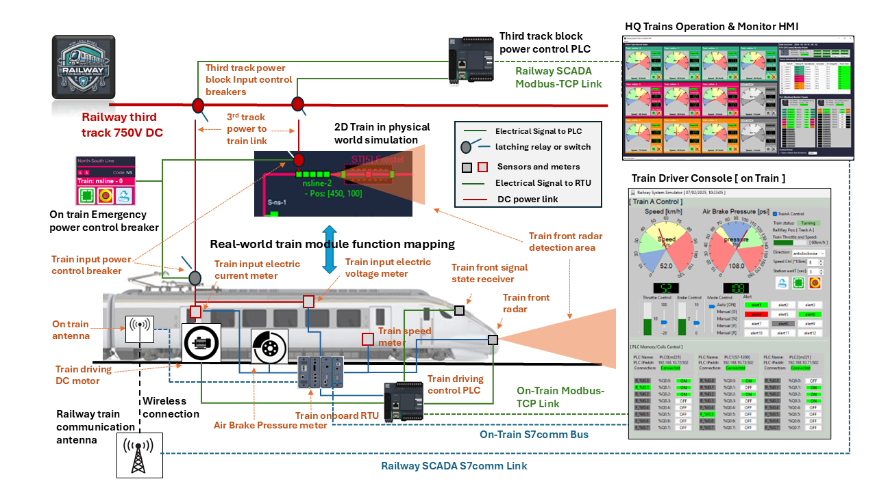
Design of the Train Control for Land-Based Railway Cyber Range

