Slide 1
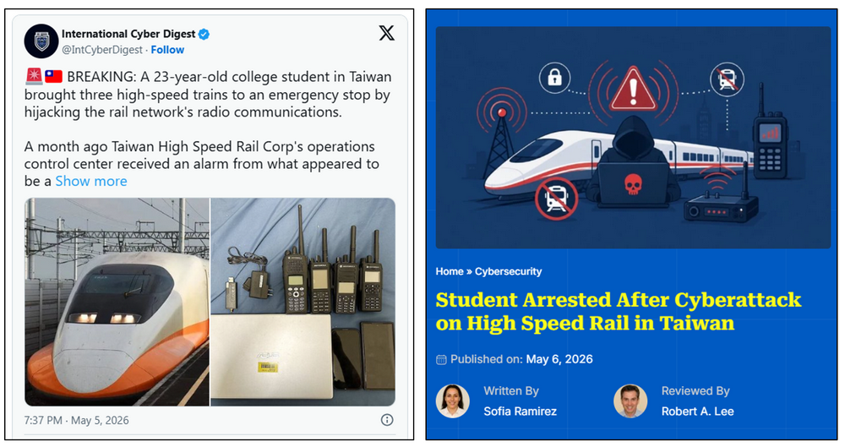
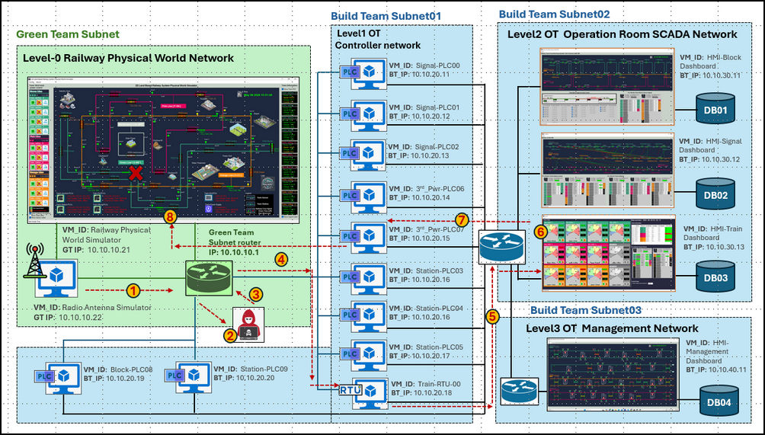


Slide 2
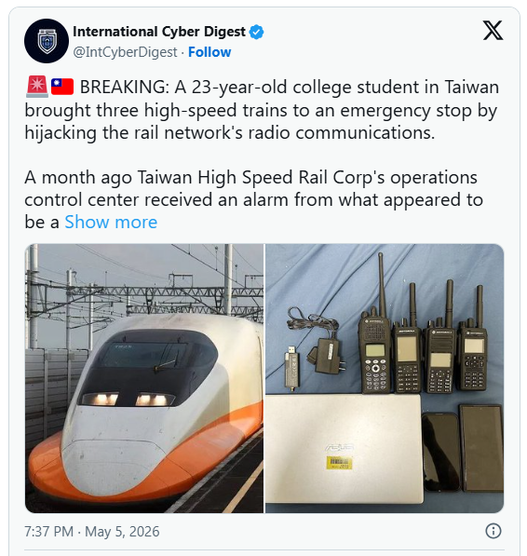


Slide 3

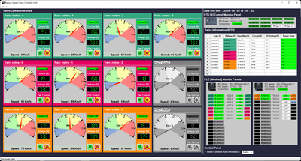
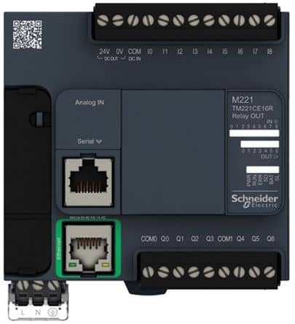


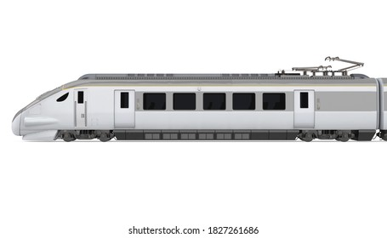

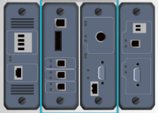
Radio Communication System and Remote Power Control in Land-Based Railway Cyber Twin platform
Railway OCC
OCC Train Monitor HMI
750V DC Transformer
Third track block power control PLC
Modbus-TCP Bus
48V one to one control link
Siemens
S7Comm Bus
Motorized control breaker
CR01
CR02
Train Radio Antenna
CR03
CR04
CR05
B01
B02
B03
B04
B05
Railway third track 750V DC [Power]
Train Broadcast Operation Information
Radio Antenna Next to the Track
T01
T02
Train Operation Information Data Bus
T03
Radio Link Data Management RTU

Slide 4
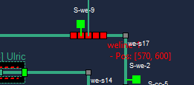

Radio Communication System and Remote Power Control in Land-Based Railway Cyber Twin platform
Railway OCC
OCC Train Monitor HMI
Trigger Alarm Mechanisms
5
750V DC Transformer
Third track block power control PLC
Emergency Stop Activated Power Supply cutoff
Modbus-TCP Bus
6
Protection Mechanism Triggered send action control command to PLC
48V one to one control link
7
Siemens
S7Comm Bus
Motorized control breaker
CR01
CR02
Train Radio Antenna
CR03
CR04
CR05
B01
B02
B03
B04
B05
Railway third track 750V DC [Power]
8
False Data Transfer to OCC HMI
Train Broadcast Operation Information
5
8
Train Lose Power
Radio Antenna Next to the Track
1
Eavesdrop Radio Signal
T01
T02
Train Operation Information Data Bus
T03
Radio Link Data Management RTU
Decode Parameters
4
4
Inject Spoofing Signal
Impacted Components in Cyber Twin
2
3
Create False Train Data

Slide 5
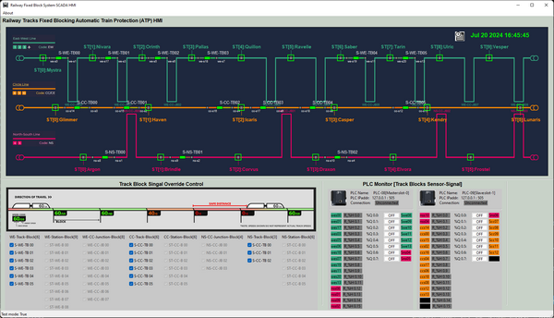


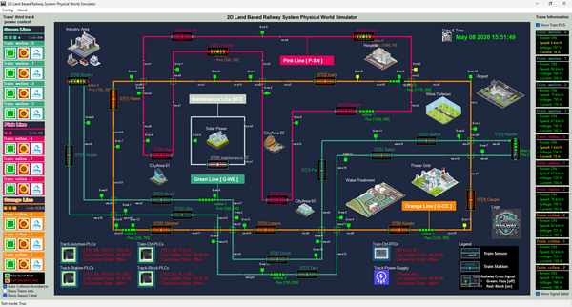
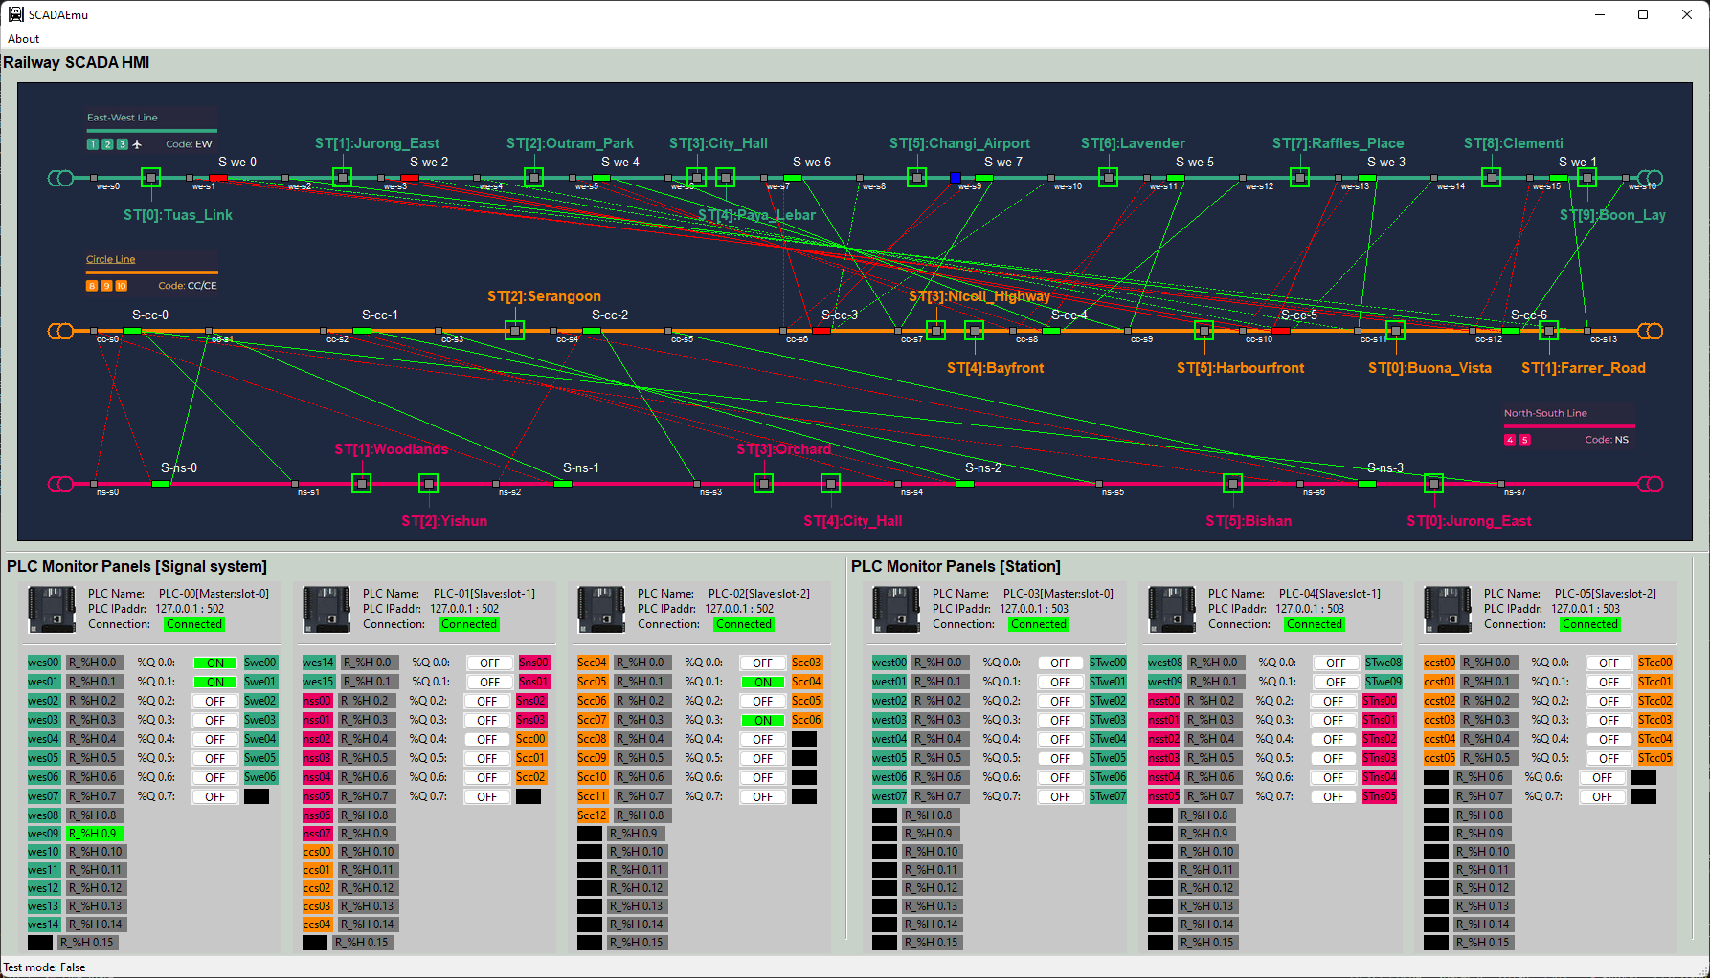
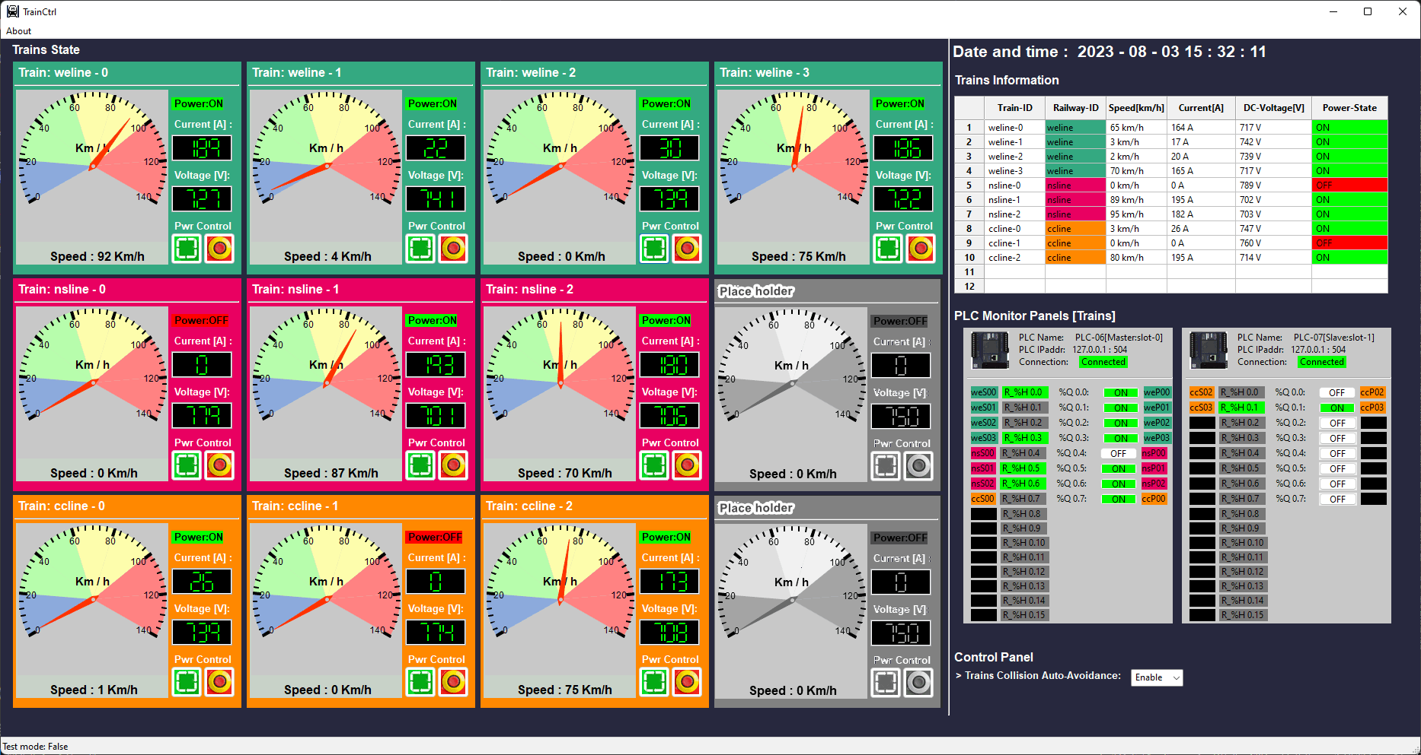

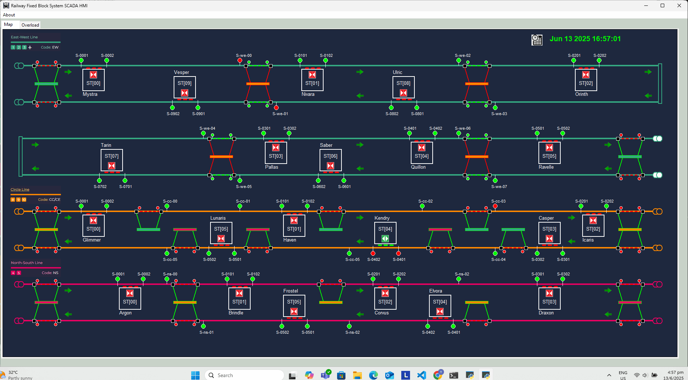

Build Team Subnet01
Build Team Subnet02
Green Team Subnet
Level1 OT
Controller network
Level2 OT Operation Room SCADA Network
Level-0 Railway Physical World Network
VM_ID: HMI-Block
Dashboard
BT_IP: 10.10.30.11
VM_ID: Signal-PLC00
BT_IP: 10.10.20.11
VM_ID: Signal-PLC01
BT_IP: 10.10.20.12
DB01
VM_ID: Signal-PLC02
BT_IP: 10.10.20.13
VM_ID: HMI-Signal
Dashboard
BT_IP: 10.10.30.12
VM_ID: 3rd_Pwr-PLC06
BT_IP: 10.10.20.14
DB02
VM_ID: Railway Physical World Simulator
GT IP: 10.10.10.21
Green Team
Subnet router
IP: 10.10.10.1
VM_ID: 3rd_Pwr-PLC07
BT_IP: 10.10.20.15
VM_ID: HMI-Train
Dashboard
BT_IP: 10.10.30.13
VM_ID: Station-PLC03
BT_IP: 10.10.20.16
DB03
VM_ID: Radio Antenna Simulator
GT IP: 10.10.10.22
VM_ID: Station-PLC04
BT_IP: 10.10.20.16
Build Team Subnet03
Level3 OT Management Network
VM_ID: Station-PLC05
BT_IP: 10.10.20.17
VM_ID: HMI-Management
Dashboard
BT_IP: 10.10.40.11
VM_ID: Block-PLC08
BT_IP: 10.10.20.19
VM_ID: Station-PLC09
BT_IP: 10.10.20.20
VM_ID: Train-RTU-00
BT_IP: 10.10.20.18
DB04

Slide 6
Build Team Subnet01
Build Team Subnet02
Green Team Subnet
Level1 OT
Controller network
Level2 OT Operation Room SCADA Network
Level-0 Railway Physical World Network
VM_ID: HMI-Block
Dashboard
BT_IP: 10.10.30.11
VM_ID: Signal-PLC00
BT_IP: 10.10.20.11
VM_ID: Signal-PLC01
BT_IP: 10.10.20.12
DB01
VM_ID: Signal-PLC02
BT_IP: 10.10.20.13
VM_ID: HMI-Signal
Dashboard
BT_IP: 10.10.30.12
VM_ID: 3rd_Pwr-PLC06
BT_IP: 10.10.20.14
DB02
8
7
VM_ID: Railway Physical World Simulator
GT IP: 10.10.10.21
Green Team
Subnet router
IP: 10.10.10.1
VM_ID: 3rd_Pwr-PLC07
BT_IP: 10.10.20.15
6
VM_ID: HMI-Train
Dashboard
BT_IP: 10.10.30.13
4
DB03
VM_ID: Station-PLC03
BT_IP: 10.10.20.16
1
3
VM_ID: Radio Antenna Simulator
GT IP: 10.10.10.22
VM_ID: Station-PLC04
BT_IP: 10.10.20.16
Build Team Subnet03
5
Level3 OT Management Network
2
VM_ID: HMI-Management
Dashboard
BT_IP: 10.10.40.11
VM_ID: Station-PLC05
BT_IP: 10.10.20.17
VM_ID: Block-PLC08
BT_IP: 10.10.20.19
VM_ID: Station-PLC09
BT_IP: 10.10.20.20
VM_ID: Train-RTU-00
BT_IP: 10.10.20.18
DB04

Slide 7
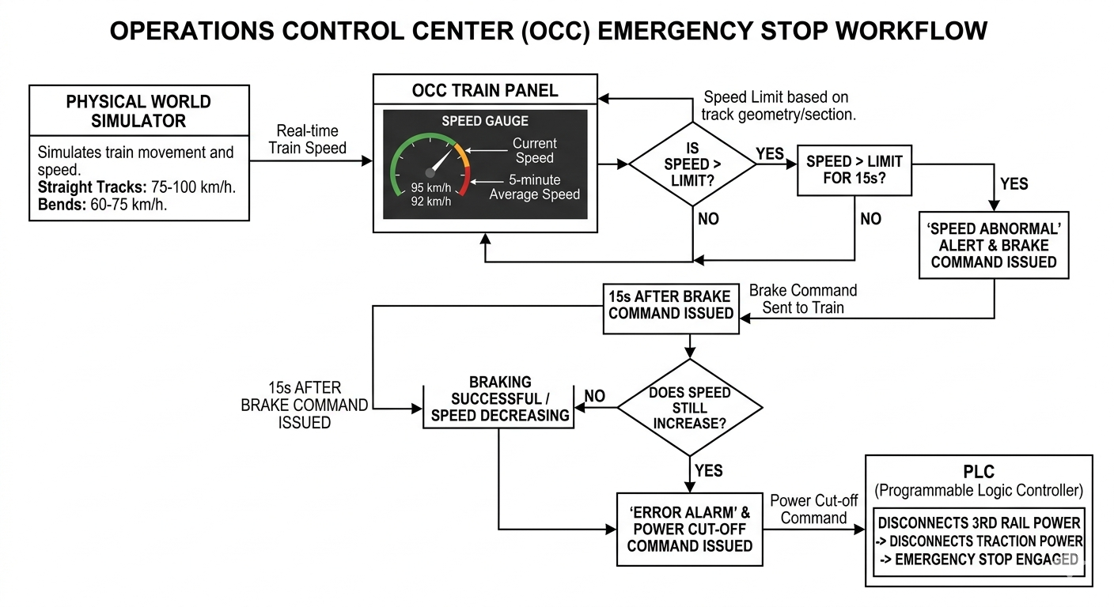
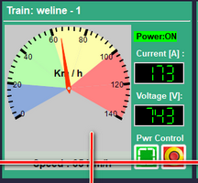
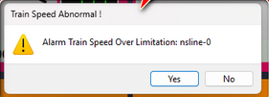


Slide 8
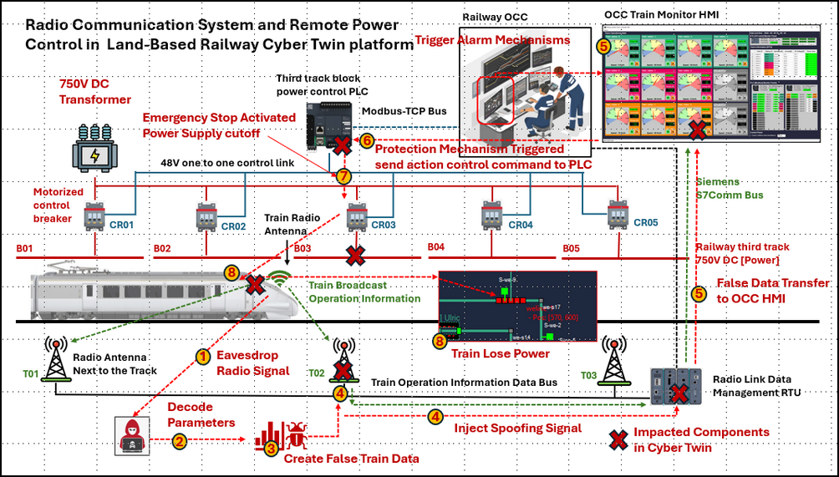
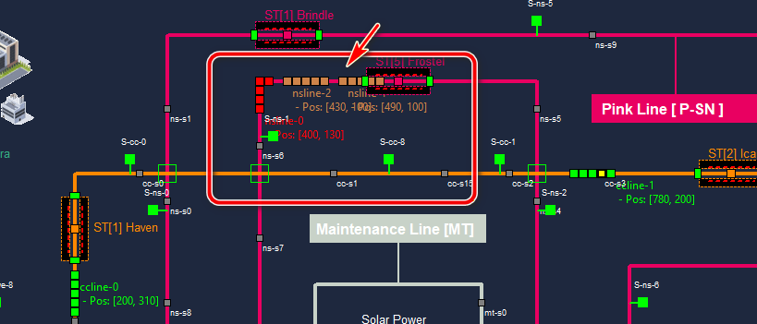
High Speed Rail Spoofing Cyber Attack Case Study : Use Cyber Twin to Simulate the Cyber Incident Happened in Taiwan High Speed Rail in April 2026
Eavesdrop Railway Radio Signals
Decode S7 Comm Parameters
Create and Inject Spoofed Comm Signals
Emergency Stop Protection Activation
Trigger Railway Alarm Mechanisms
False Data Transfer to OCC HMI

