Slide 1




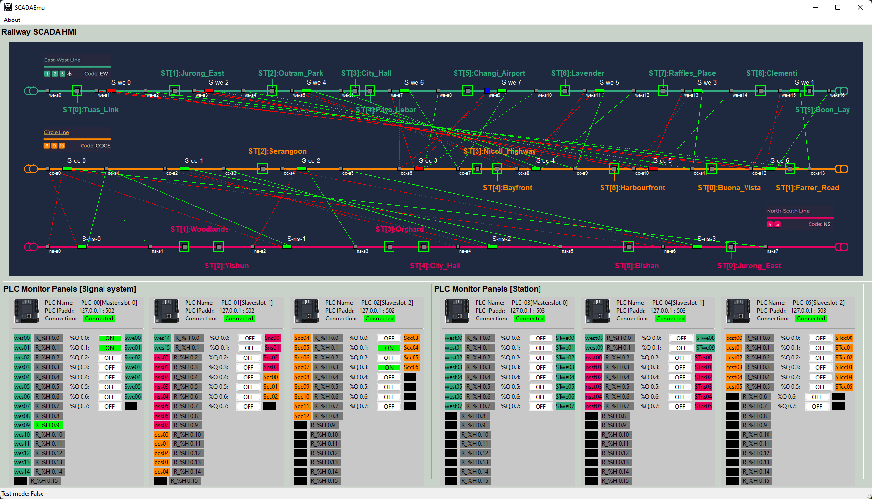





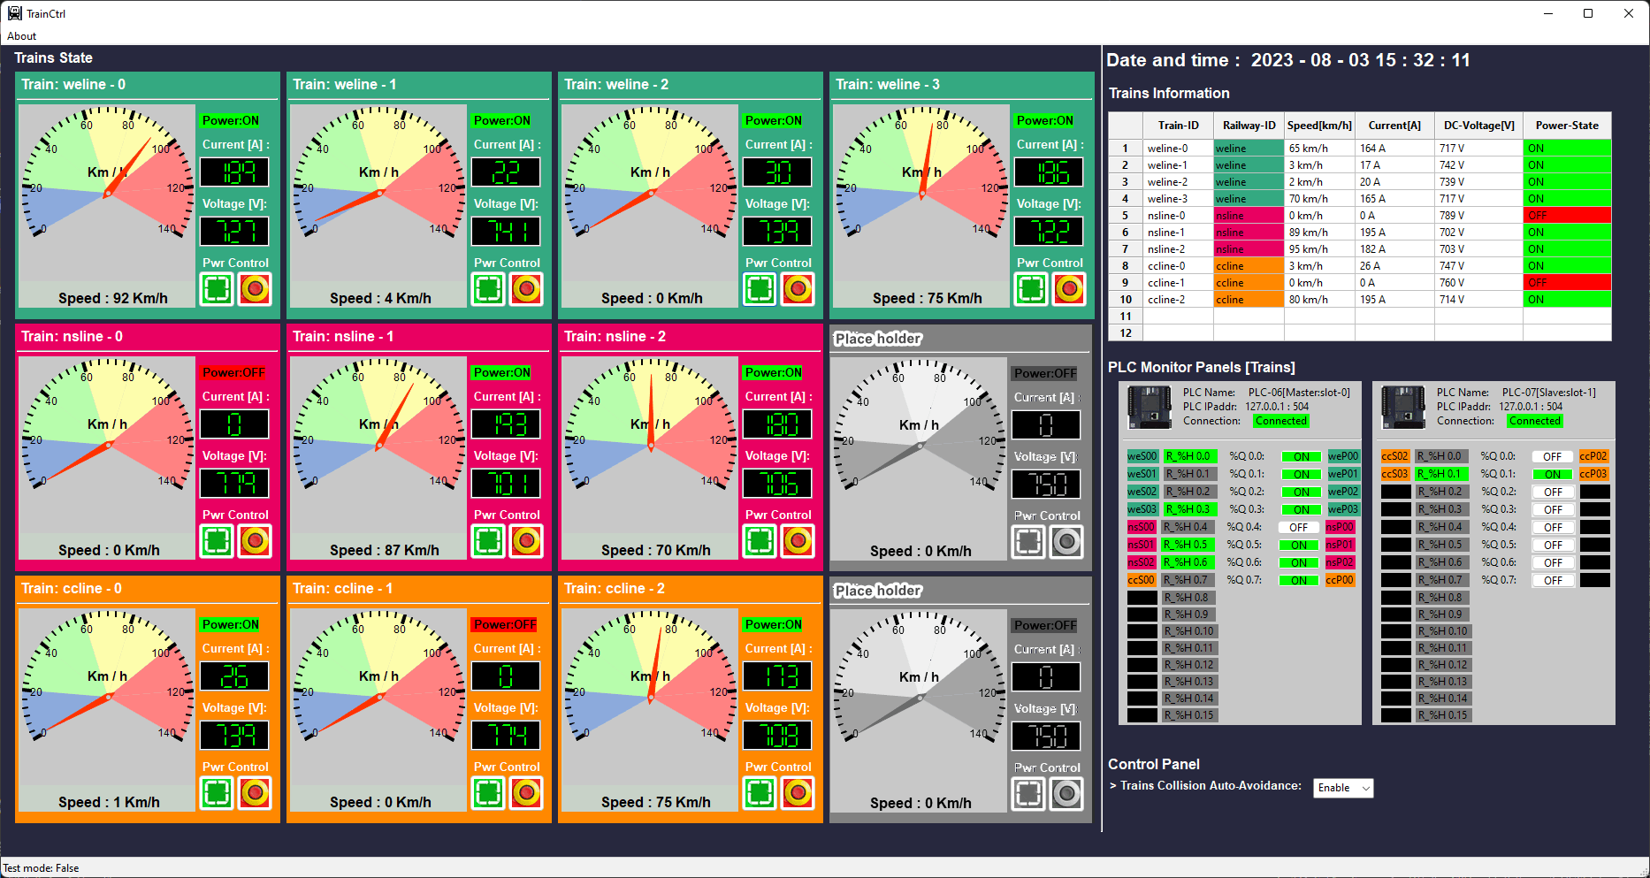

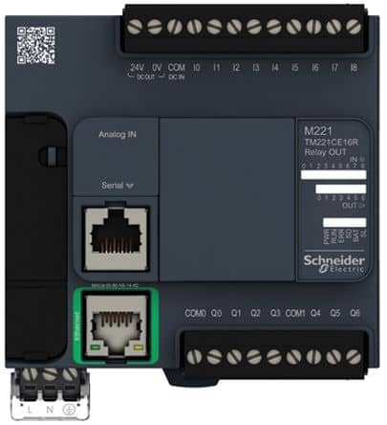
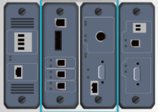
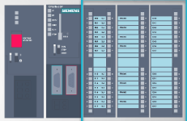
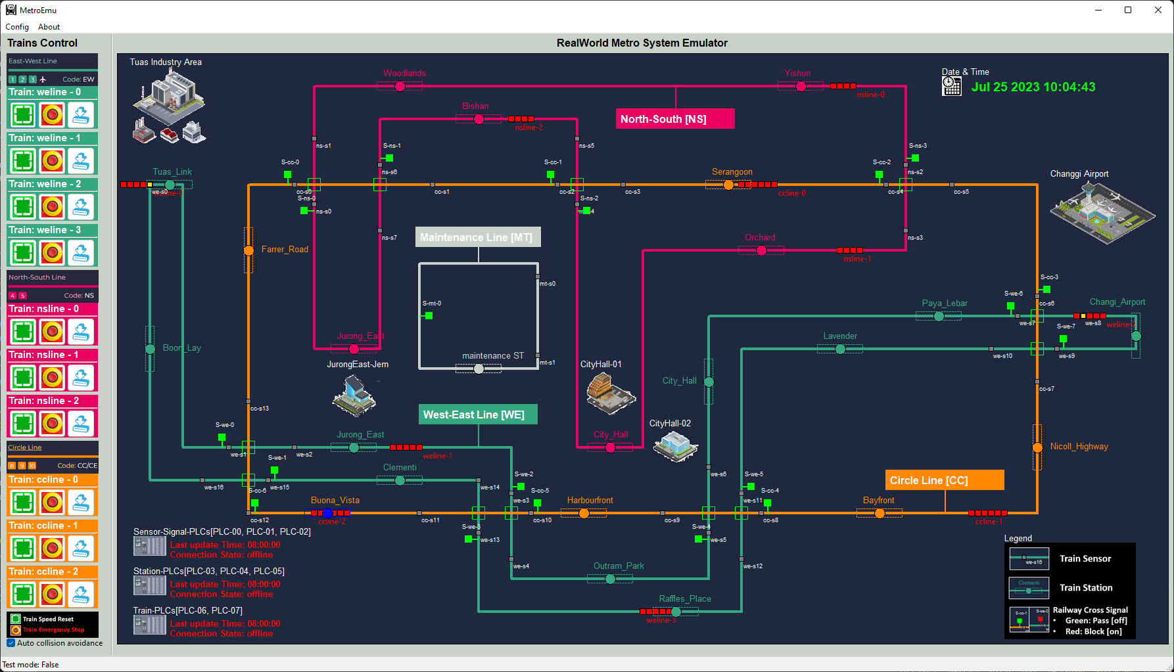
Mini Railway Cyber Range (Railway IT-OT System Cyber Security Test Platform)
Level 5
Internet DMZ
Zone
External Web-Server
Email Server
Railway Track Control HMI
Level 4
Enterprise
Zone
Domain Controller
Internal Web-Server
Business Server
Staff laptop/Desktops
Level 3
Operations Management Zone
Data Base Server
Railway Train Control HMI
Management HMI
Application Server
Historian Server
Engineer workstations
Level 2
Control Center (HQ) Processing LAN
Railway Train Control HMI
Railway Track Control HMI
PLC Simulator
Railway Physical World Simulator
Level 1
Controller LAN
Railway PLC
Train RTU
Train PLC
RTU Simulator
Level 0
Physical Process
Field I/O device
Track Sensors
Track Signals
Train Sensors
Train Moto
Train Brake

Slide 2

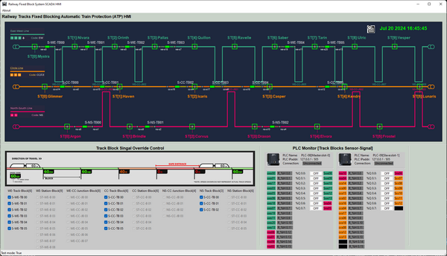
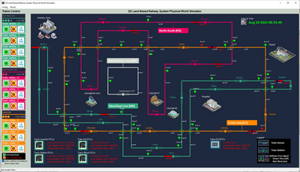
Mini Land Based Railway Cyber Range
(Railway IT-OT System Cyber Security Test Platform)
HQ Railway Block Control HMI
Level 5
Internet DMZ
Zone
External Web-Server
Email Server
HQ Signal System Monitor HMI
Level 4
Enterprise
Zone
Domain Controller
Internal Web-Server
Business Server
Staff laptop/Desktops
Level 3
Operations Management Zone
Management HMI
Application Server
Data Base Server
Historian Server
Engineer workstations
HQ Railway Train Control HMI
Level 2
Control Center (HQ) Processing LAN
HQ Signal Monitor HMI
Track Block Control
HMI
Train
Control
HMI
Junction and Block PLC
PLC Simulator
Railway Physical World Simulator
Level 1
OT System Controller LAN
Train PLC
Train RTU
Station PLC
RTU Simulator
Level 0
Physical Process
Field I/O device
Track Sensors
Station Sensors
Train Power
Train Hydraulic
Track Signals
Station Signals
Train Motor
Train Sensors
3rd Track Power
Platform equips

Slide 3
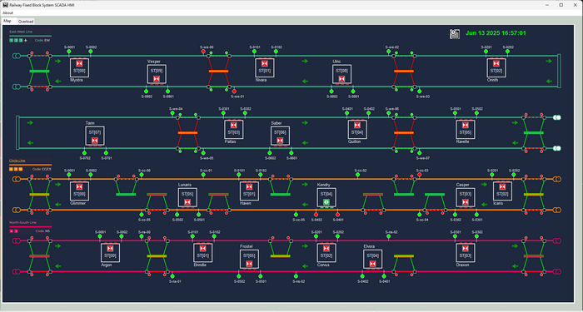
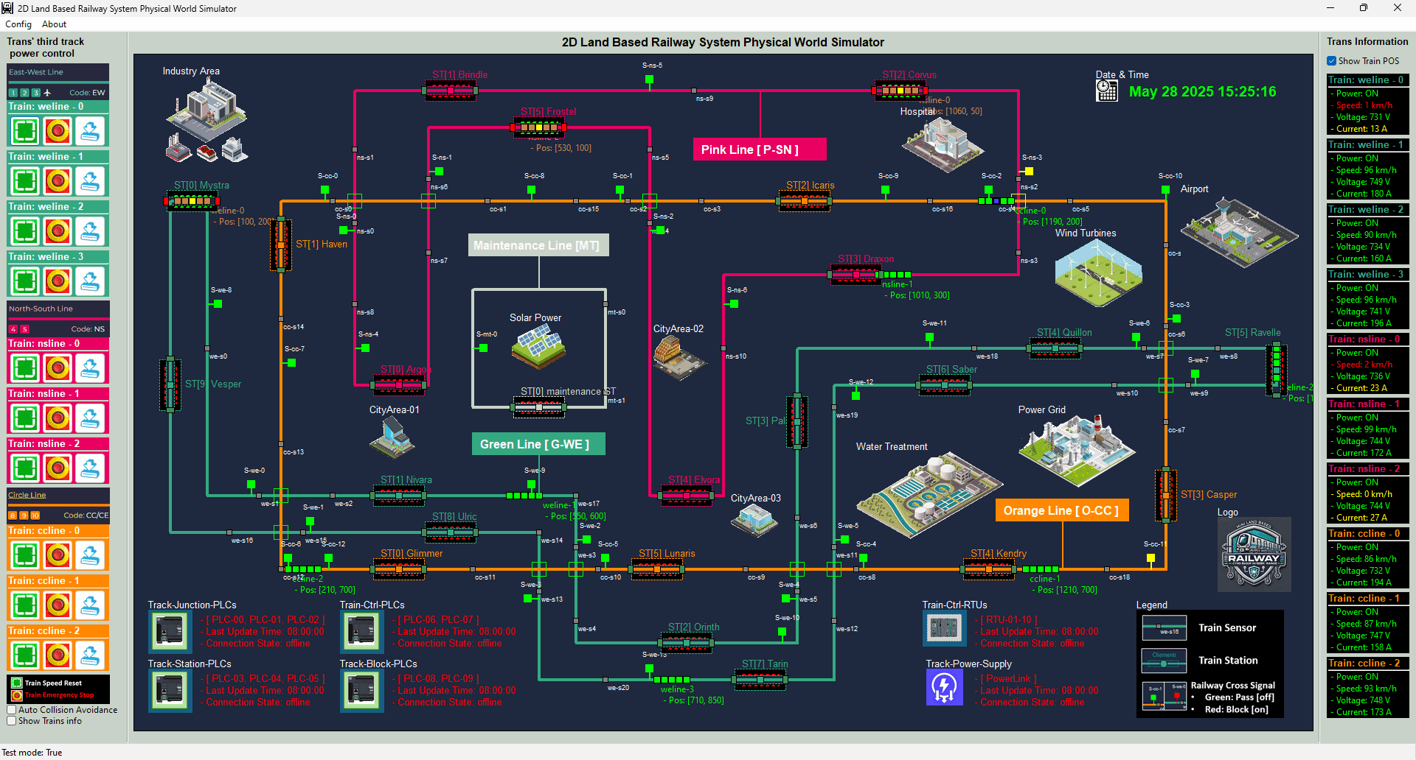
Mini Land Based Railway Cyber Range
(Railway IT-OT System Cyber Security Platform)
HQ Management HMI
HQ Railway Block Control HMI
Level 5
Internet DMZ
Zone
External Web-Server
Email Server
HQ Signal System Monitor HMI
Level 4
Enterprise
Zone
Domain Controller
Internal Web-Server
Business Server
Staff laptop/Desktops
Level 3
Operations Management Zone
Management HMI
Application Server
Data Base Server
Historian Server
Engineer workstations
HQ Railway Train Control HMI
Level 2
Control Center (HQ) Processing LAN
HQ Signal Monitor HMI
Track Block Control
HMI
Train
Control
HMI
PLC Simulator
Junction and Block PLC
Railway Physical World Simulator
Level 1
OT System Controller LAN
Train PLC
Train RTU
Station PLC
RTU Simulator
Level 0
Physical Process
Field I/O device
Track Sensors
Station Sensors
Train Power
Train Hydraulic
Track Signals
Station Signals
Train Motor
Train Sensors
3rd Track Power
Platform equips

Slide 4






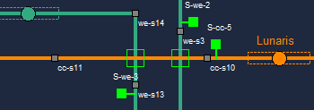
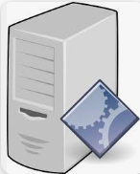




Mini Railway Cyber Range Network Diagram and Components View
Physical World Simulation Network
ICS [OT Environment Network ]
Physical world simulator
Corporate network
[IT Environment Network]
Corporate Network
Supervision network SCADA
Production network
Junction sensor-signal control PLCs set [emulator]
IT management computers
Maintenance laptops
Electrical signal I/O
IT engineer
ICS engineer
Ethernet TCP/IP
Ethernet TCP/IP and Modbus TCP
Fixed Block sensor-signal control PLCs set [emulator]
Junction sensors-signals control system
Corporate IT servers
ERP servers
Railway system SCADA server
Trains system SCADA server
Station control PLCs [emulator]
Fixed block track ATC system
Modbus TCP
and
S7Comm
Train controller PLCs [emulator]
Production management workstation
Railway monitor & control HMIs
Trains monitor & control HMI
Train Monitor RTUs [emulator]
station sensors
signals control
System
Local HW-Engineering admin laptop
Railway Trains emulators
Users, staff and manager
Railway HQ operator
Trains driver /operator
Field device admin

Slide 5
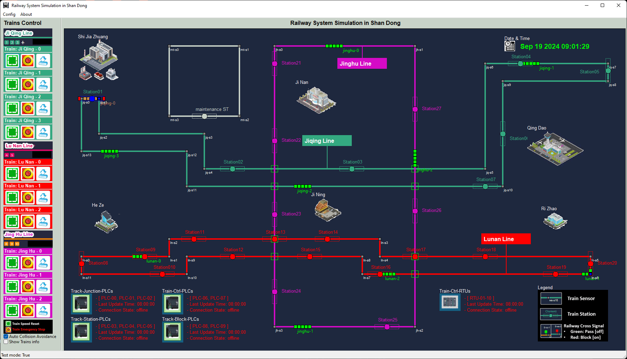
Mini Railway Cyber Range Network Diagram and Components View
Physical Real World Simulation Network
ICS [OT network ]
Physical world simulator
Corporate network [IT network]
Corporate Network
Supervision network SCADA
Production network
Junction sensor-signal control PLCs set [emulator]
IT management computers
Maintenance laptops
Electrical signal I/O
IT engineer
ICS engineer
Ethernet TCP/IP
Ethernet TCP/IP and Modbus TCP
Fixed Block sensor-signal control PLCs set [emulator]
Junction sensors-signals control system
Corporate IT servers
ERP servers
Railway system SCADA server
Trains system SCADA server
Station control PLCs [emulator]
Fixed block track ATC system
Modbus TCP
and
S7Comm
Train controller PLCs [emulator]
Production management workstation
Railway monitor & control HMIs
Trains monitor & control HMI
Train Monitor RTUs [emulator]
station sensors
signals control
System
Local HW-Engineering admin laptop
Railway Trains emulators
Railway HQ operator
Trains driver /operator
Field device admin
Users, staff and manager

Slide 6
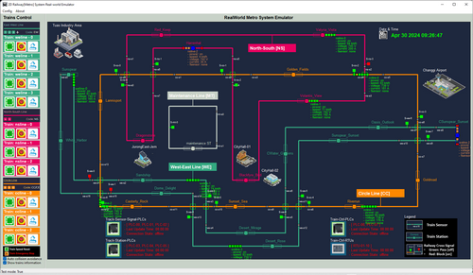



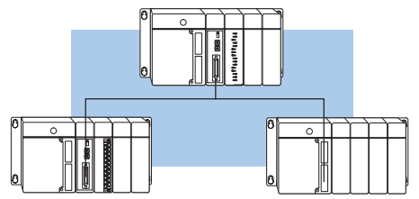

Railway Physical-world Simulator
Railway Track SCADA Monitor HMI(s)
Users
Railway engineer
Slave HMI(s)
Electrical signal communication simulation module (10.0.10.100)
39 track sensors state ( input to PLC)
Master HMI IP: 192.168.10.100
Slave HMI(S) IP:192.168.10.10X
22 PLC coils state (output to signals )
22 station sensor state (input to PLC)
19 PLC coils ( output to signal)
10.0.10.10X
10.0.10.11X
Railway track station signaling control PLC network
Railway track junction signaling control PLC network
HMI network 192.168.10.x
Legend
[Master, Slot-0]
I/O: 8/8
[Master, Slot-0]
I/O: 15/7
Modbus-TCP data flow
PLC-03
PLC-00
UDP data flow (simulate electrical signal )
PLC-04
PLC-05
PLC-01
PLC-02
[Slave, Slot-1] I/O: 8/8
[Slave, Slot-2] I/O: 6/6
[Slave, Slot-1] I/O: 15/7
Switch or Router
[Slave, Slot-2] I/O: 9/5
Modbus IP: 192.168.100.1X/24
Modbus IP: 192.168.101.2X/24
Modbus Network 192.168.100.0/24
Register read request and Coils set request
Register read request and Coils set request

Slide 7
Railway Physical-world Simulator
Railway Track SCADA Monitor HMI(s)
Users
Railway engineer
5
6
Slave HMI(s)
2
3
Electrical signal communication simulation module (10.0.10.100)
39 track sensors state ( input to PLC)
Master HMI IP: 192.168.10.100
9
Slave HMI(S) IP:192.168.10.10X
22 PLC coils state (output to signals )
22 station sensor state (input to PLC)
1
19 PLC coils ( output to signal)
10.0.10.10X
10.0.10.11X
Railway track station signaling control PLC network
Railway track junction signaling control PLC network
HMI network 192.168.10.x
Legend
[Master, Slot-0]
I/O: 8/8
4
[Master, Slot-0]
I/O: 15/7
7
Modbus-TCP data flow
PLC-03
PLC-00
UDP data flow (simulate electrical signal )
PLC-04
PLC-05
PLC-01
PLC-02
[Slave, Slot-1] I/O: 8/8
[Slave, Slot-2] I/O: 6/6
[Slave, Slot-1] I/O: 15/7
Switch or Router
[Slave, Slot-2] I/O: 9/5
Modbus IP: 192.168.100.1X/24
Modbus IP: 192.168.101.2X/24
Modbus Network 192.168.100.0/24
Register read request and Coils set request
Register read request and Coils set request
8

Slide 8
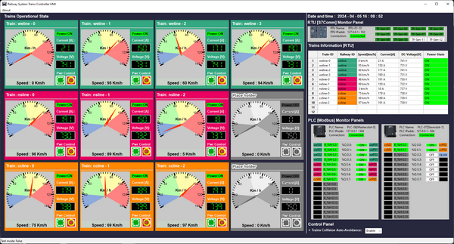
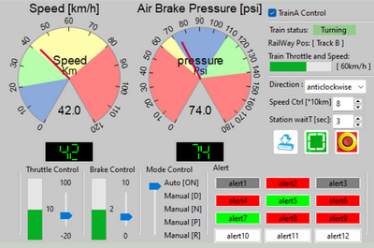

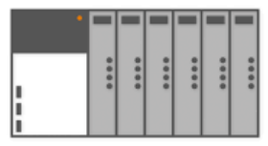
Railway Physical-world Simulator
Railway HQ Trains Monitor HMI(s)
Users
Railway engineer
Electrical signal communication simulation module (10.0.10.100)
HMI network 192.168.10.x
Train driver consoles (on train HMI)
10 train front radar state ( input to PLC)
50 RTU input ( trains throttle, brake, voltage, current ,speed sensors)
10 PLC coils state (output to 3rd track power switch)
20 PLC coils ( output to moto and brake)
10.0.10.12X
10.0.10.13X
Railway 3rd tack power switches control PLC network
On train operation control PLC network
On train RTU network
PLC-08
PLC-09
Serial Comm link between PLC and RTU
RTU 00 - 09
PLC-06
PLC-07
[Master, Slot-0]
I/O: 0/8
[Slave, Slot-1] I/O: 0/2
[Master, Slot-0]
I/O: 8/16
[Slave, Slot-1] I/O: 2/4
Register read request and Coils set request
RTU Memory data
Coils set request
Railway Modbus 192.168.100.0/24
Train drivers
Trains Modbus 192.168.101.0/24
Trains S7Comm bus 192.168.102.0/24

Slide 9
Railway Physical-world Simulator
Railway HQ Trains Monitor HMI(s)
Users
4
5
3
Railway engineer
1
9
Electrical signal communication simulation module (10.0.10.100)
HMI network 192.168.10.x
Train driver consoles (on train HMI)
10 train front radar state ( input to PLC)
50 RTU input ( trains throttle, brake, voltage, current ,speed sensors)
10 PLC coils state (output to 3rd track power switch)
0
20 PLC coils ( output to moto and brake)
10.0.10.12X
10.0.10.13X
8
Railway 3rd tack power switches control PLC network
On train operation control PLC network
On train RTU network
6
7
2
PLC-11
PLC-12
Serial Comm link between PLC and RTU
RTU 00 - 09
PLC-06
PLC-07
[Master, Slot-0]
I/O: 0/8
[Slave, Slot-1] I/O: 0/2
[Master, Slot-0]
I/O: 8/16
[Slave, Slot-1] I/O: 2/4
Register read request and Coils set request
RTU Memory data
Coils set request
Railway Modbus 192.168.100.0/24
Train drivers
Trains Modbus 192.168.101.0/24
Trains S7Comm bus 192.168.102.0/24

Slide 10

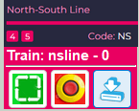
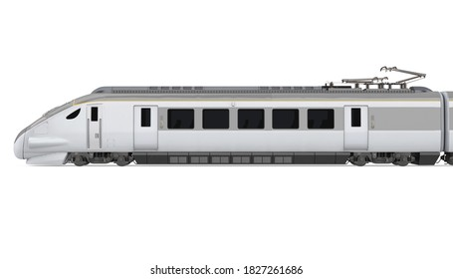


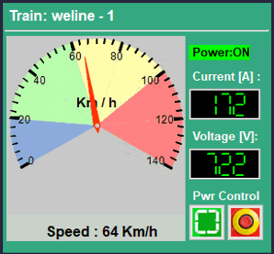

Track power control PLC
Third Railway Power Input Switch
Modbus-TCP
Third Rail 750V DC
2D Train in real-world emulator
HQ Trains Operation & Monitor HMI
On Train Emergency Power Control
Train input power switch
Front radar detection area
Real-world train module function mapping
Train DC moto
Train front collision detection radar
Input voltage sensor
Current sensor
Train speed sensor
S7comm
DC power
Train Driver Console [ on Train ]
Electrical Signal to PLC
latching relay or switch
On train antenna
Train driving control PLC
Wireless connection
Train sensors RTU
Sensors
Modbus-TCP
Electrical Signal to RTU
Railway antenna
S7comm
Modbus
S7comm-Bus

Slide 11






LS24 rail deployment for Green Team
LS24 External
VM_ID:LS2024_Hacker
OS: [Windows 10]
BT_IP: 192.168.1.111
GT_IP: 192.168.254.214
CUE / CUE hub
LS24 HQ Operation Room [OP]
PLC service
VM_ID:C2 Server
OS: [Windows 10]
BT_IP: 100.101.1.69
GT_IP: 192.168.254.213
Malware
VM_ID:LS2024_EPT_Staff
Exis-ID: ls24_bt_staff01-rail_t01
OS: [Windows 10]
BT_IP: 10.107.107.10
GT_IP: 192.168.254.204
LS24 Internal Cooperation [INT]
VM_ID:Train HMI emulator VM
Exis-ID: ls24_bt_railway-op-scadahmi_t01
OS: [Windows 10]
BT_IP: 10.27.34.105
GT_IP: 192.168.254.231
VM_ID:LS2024_officer
Exis-ID: ls24_bt_staff03-rail_t01
OS: [Windows 10]
BT_IP: 10.27.34.10
GT_IP: 192.168.254.225
VM_ID:SCADA HMI emulator VM
Exis-ID: ls24_bt_railway-op-scadahmi_t01
OS: [Windows 10]
BT_IP: 10.27.34.104
GT_IP: 192.168.254.232
Firewall
100.66.119.254/30
100.101.1.70/30
INT switch
10.107.104.0/24
VM_ID:LS2024_EPT_Staff
Exis-ID: ls24_bt_staff04-rail_t01
OS: [Windows 10]
BT_IP: 10.107.104.10
GT_IP: 192.168.254.204
VM_ID:LS2024_Itsupport
Exis-ID: ls24_bt_staff02-rail_t01
OS: [Windows 10]
BT_IP: 10.107.107.11
GT_IP: 192.168.254.209
OP switch
10.107.107.0/24
router
100.66.119.253/30
10.107.105.1
10.107.104.1
10.107.106.1
10.107.107.1
LS24 Maintenance Department [MD]
LS24 Engineer Department [ED]
VM_ID:Train Control PLC VM
Exis-ID: ls24-bt-rail-ed-plc03-t01
OS: [Ubuntu22]
BT_IP: 10.27.34.37
GT_IP: 192.168.254.223
MD switch
10.107.106.0/24
Green Team router
192.168.254.0/24
ED switch 10.27.34.32/27
VM_ID:Station Control PLC VM
Exis-ID: ls24-bt-rail-ed-plc03-t01
OS: [Ubuntu22]
BT_IP: 10.27.34.36
GT_IP: 192.168.254.222
VM_ID:LS2024_MtEng VM
Exis-ID: ls24_bt_maintws-rail_t01
OS: [Windows 10]
BT_IP: 10.107.106.10
GT_IP: 192.168.254.207
VM_ID:Real world emulator VM
Exis-ID: ls24_bt_rail-md-realworld _t01
OS: [Windows 10]
BT_IP: 10.27.34.75
GT_IP: 192.168.254.226
NCL developer
VM_ID:Junction Control PLC VM
Exis-ID: ls24_bt_rail-ed-plc01_t01
OS: [Ubuntu22]
BT_IP: 10.27.34.35
GT_IP: 192.168.254.221
VM_ID:LS2024_MtEng VM
Exis-ID: ls24_bt_adminws-rail_t01
OS: [Windows 10]
BT_IP: 10.107.106.11
GT_IP: 192.168.254.208
VM_ID:LS2024_CUD_Hub
Exis-ID: N.A
OS: [Windows 10]
BT_IP: N.A
GT_IP: 192.168.254.170

Slide 12
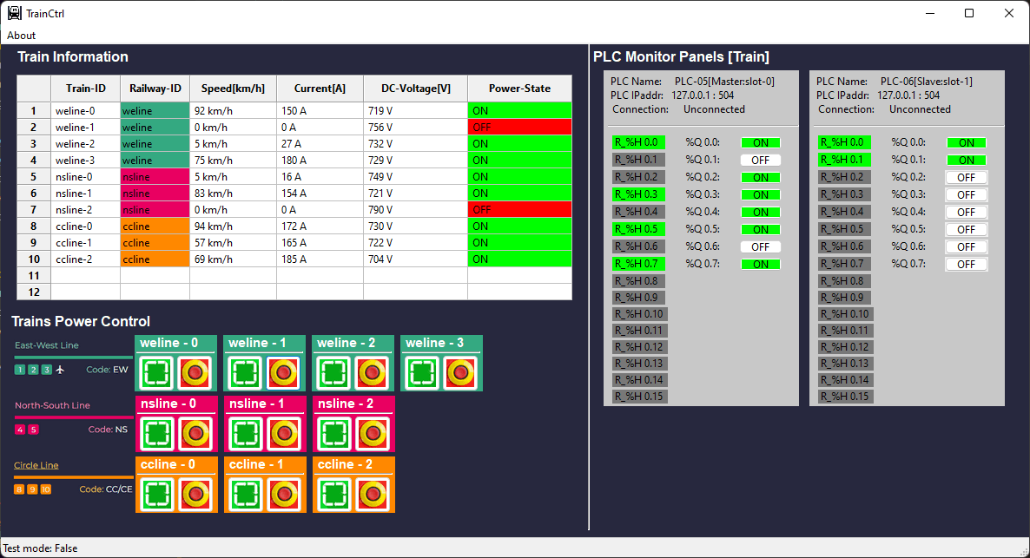
Railway real-world Emulator
Railway SCADA HMIs
Slave HMI(s)
Master HMI
Slave HMI IP: 192.168.10.10X
Master HMI IP: 192.168.10.100
Electrical signal communication simulation module (10.0.10.100)
39 sensors input
10 train throttle
input
19 signal coils output
Register control
Coils control
Register data fetch
Coils data fetch
Train control PLC network [under progress ]
22 station
Sensors input
22 station
Signal output
HMI network 192.16.10.x
Junction Signal control PLC network
10.0.11.10
10.0.13.10
Station Signal control PLC network
10.0.12.10
[Master, Slot-0]
I/O: 15/7
Train Control panel
[Master, Slot-0]
I/O: 0/8
[Master, Slot-0]
I/O: 8/8
PLC-00
PLC-06
PLC-03
PLC-01
PLC-02
[Slave, Slot-1] I/O: 0/2
PLC-04
PLC-05
PLC-07
[Slave, Slot-1]
I/O: 15/7
[Slave, Slot-2]
I/O: 9/5
[Slave, Slot-1] I/O: 8/8
[Slave, Slot-2] I/O: 6/6
Modbus IP: 192.168.100.13
Coils control request
Modbus IP: 192.168.100.12
Register control request
Coils control request
Modbus IP: 192.168.100.11
Register control request
Coils control request
Coils control request
Modbus IP: 192.168.100.2xx
Modbus Network 192.168.100.0/24
UDP data flow:
Modbus TCP data flow:

Slide 13
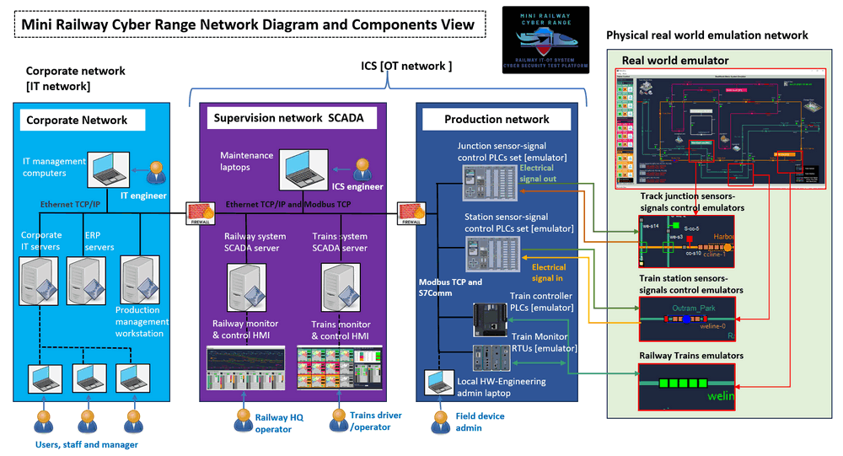
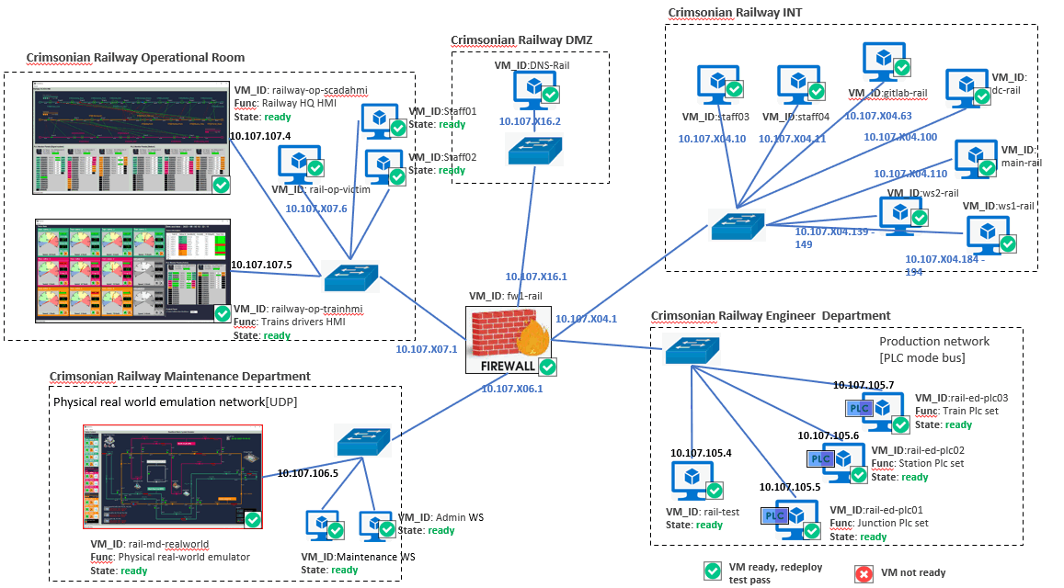
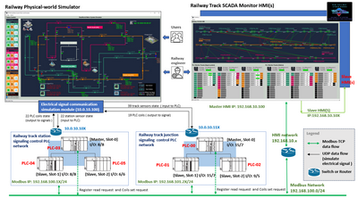
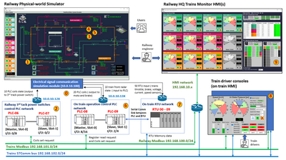
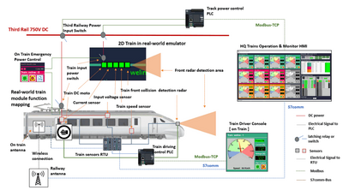
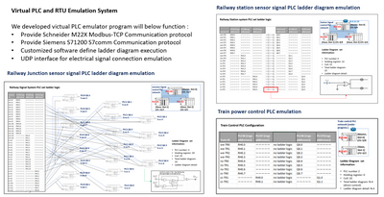
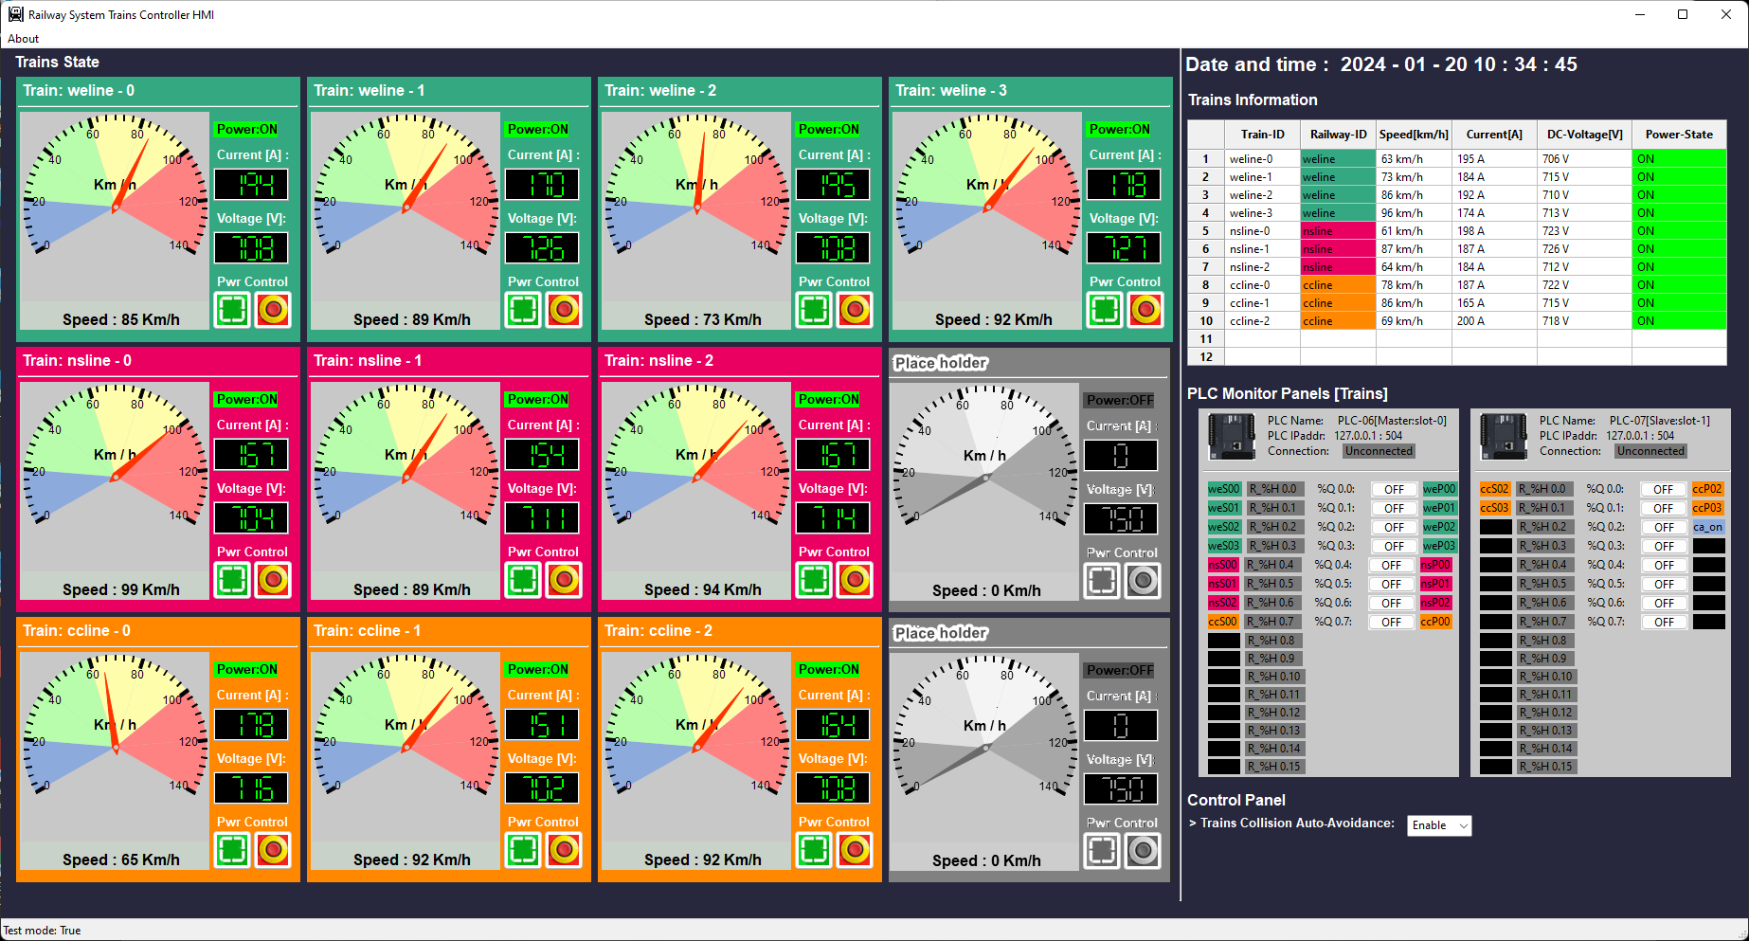
System Design Overview
Railway Company IT-System Cyber Range
Track Signaling System Overview
Trains Signaling System Overview
Trains Control System Overview
PLC and RTU Design Overview
Railway system real world emulation
Railway HQ SCADA HMI System
Railway Train Operator HMI System

Slide 14
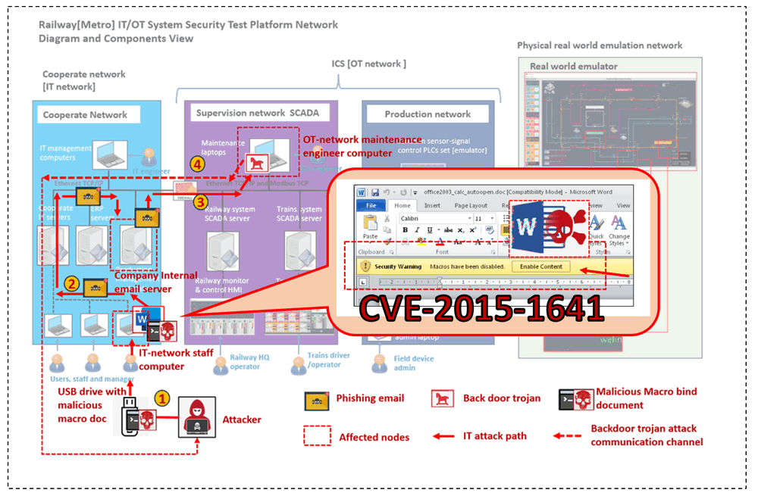
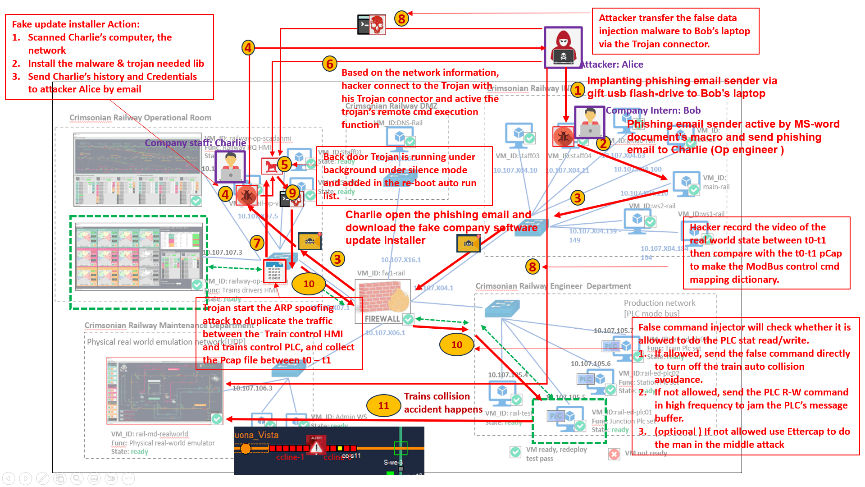
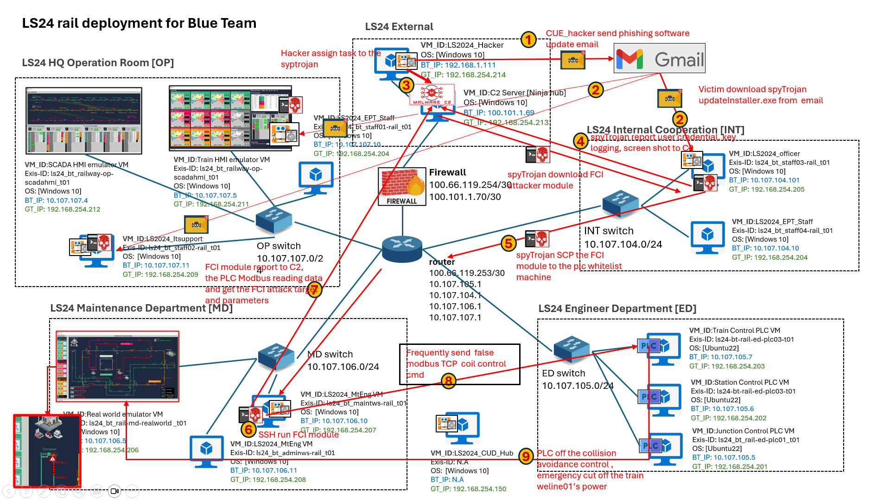

Slide 15






Train Sensor
Train Station
Railway Cross Signal
Green: Pass [off]
Red: Block [on]
Train Speed Reset
Train Emergency Stop

Slide 16
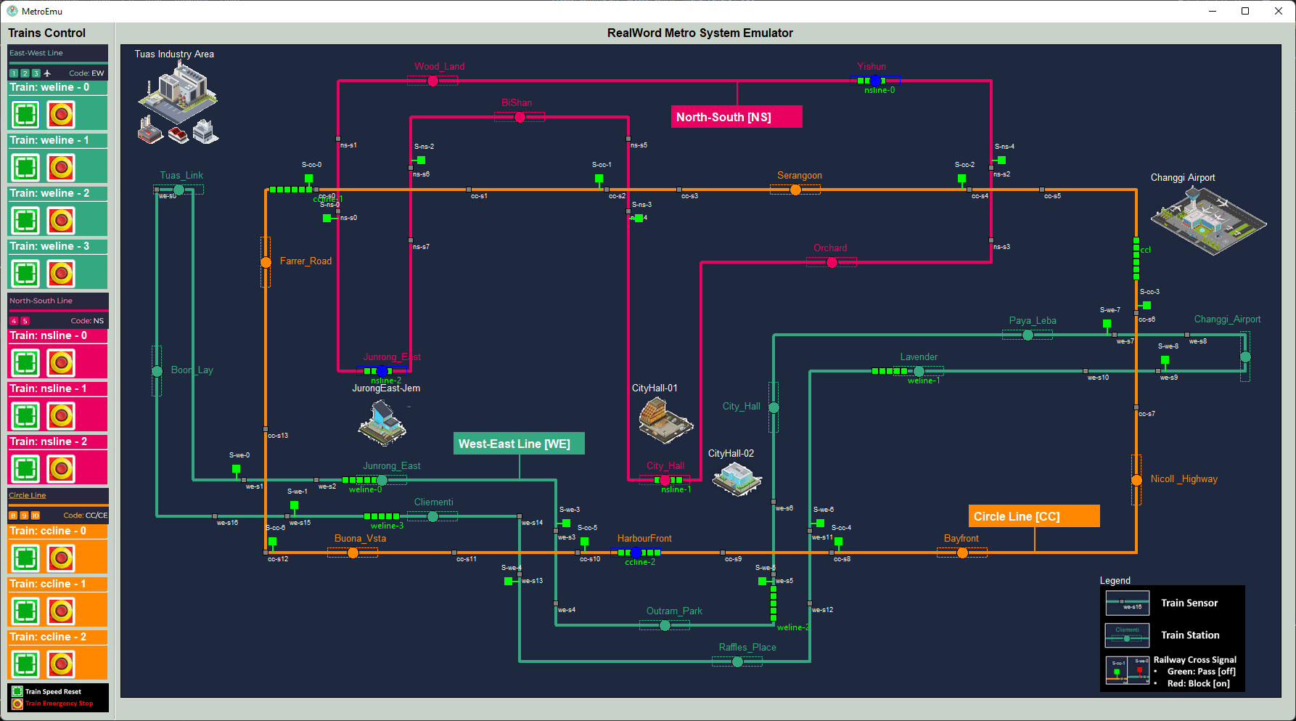
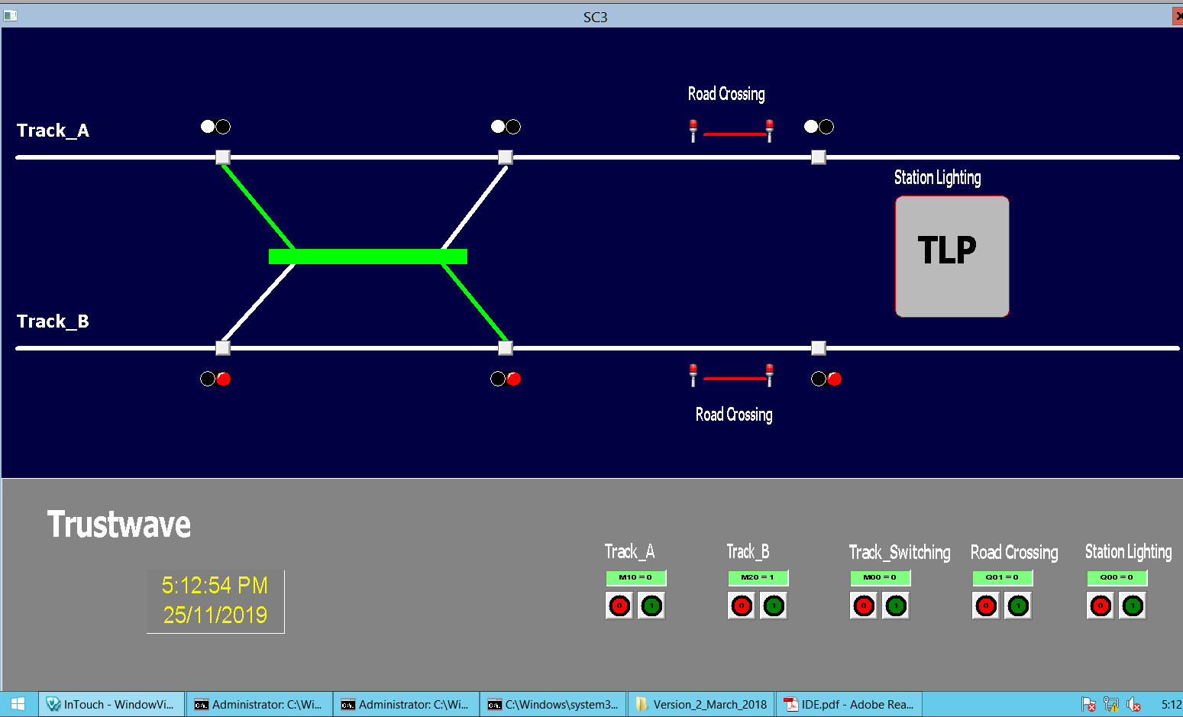
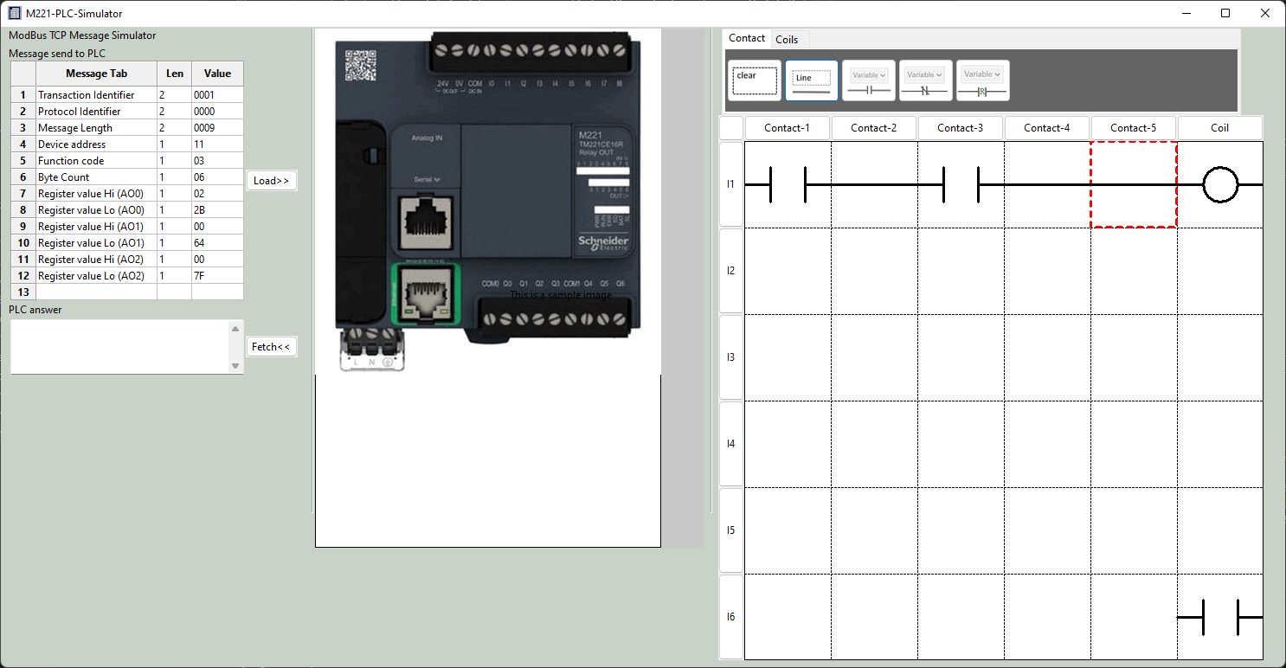
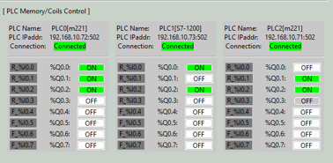
Metro Control HMI
Real work sensor data
PCL coil output data
Database
PLC simulator VM
SCADA HMI data Visualization
PCL input data
ModBus TCP
Communication manager
PCL coil output data

Slide 17
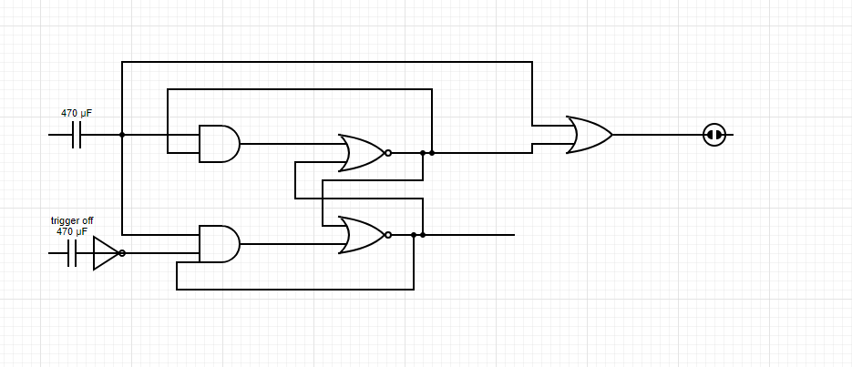
Use PLC to create a T Flip – Flop latching relay with signal trigger on has high priority
Signal Trigger on sensor
Railway control signal
Signal Trigger off sensor

Slide 18


Railway System Emulator [ Program workflow diagram]
Network
Program system config file
Station config file
Scenario config file
Program start
Loading config files
Init main UI (main thread)
Init PLC request handler (sub thread )
Holding register data
PLC data controller (data manager)
Use UDP to simulate the real-word electrical system wires connection
UI data controller (map manager)
Coil state change data
PLC state data
Other PLC modules
Control event
Display UI map panel
PLC Connector (UDP server)
Other PLC modules
Train power control panels
Components state data
Other PLC modules
Display UI refresh loop
All Plc connection and data update state
System auto controller ( if test mode )

Slide 19
Scenario load drop down menu
Train
Station
Date and Time
Trains power control panels
PLC connection state
Trains collision auto avoidance control
Train position sensors
Railway track signals

Slide 20
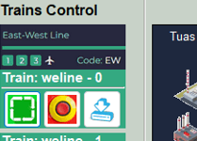
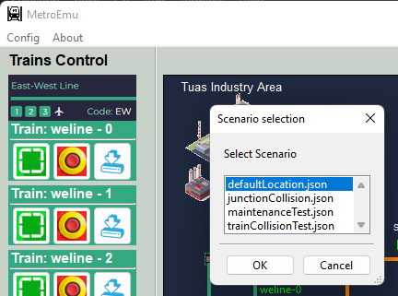
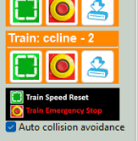

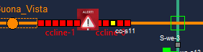
Train control panel
Step 1: click config dropdown menu and select “load scenario”
Step 2:When the Scenario selection window pop-up,
Click the Scenario you want to load
Train position reset button
Emergency Stop button (power cut off)
Train power on Button
Step 3: Click “OK” to load to the real-world simulator
Train auto collision avoidance ON:
Behind train will change speed to 0 to wait the front train if the train’s sensor detects a train in it front in the safety threshold distance.
UI scenario :
Train auto collision avoidance OFF:
Behind train will “hit” the front stopped train directly and stop. An accident indicator will flash at the accident position
UI scenario :
Train auto collision avoidance on/off control

Slide 21
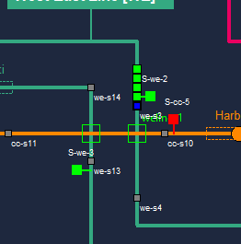
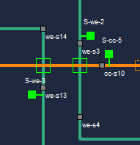
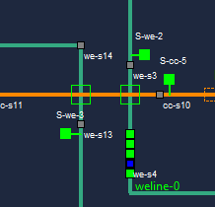
Junction’s Senor-Signal physical wire connection and operating logic
Operation Scenario 1: Junction block when train pass through
Step 1: When a train is entering the junction and trigger the entrance block sensor (sensor color change from grey to blue )
Junction entrance block sensor
Train entrance block signal
Step 2: Junction entrance block signal will turn on (red) to block the train on yellow track to enter the junction
Step 4: Junction entrance block signal will turn OFF (green) to allow the train on yellow track to enter the junction
Junction Area
Junction entrance release sensor
Operation Scenario 1: Junction release when train leaving
Step 3: When a train is leaving the junction and trigger the entrance release sensor (sensor color change from grey to blue )
Physical wire
T-flip-flop latching relay implemented by PLC ladder logic

Slide 22
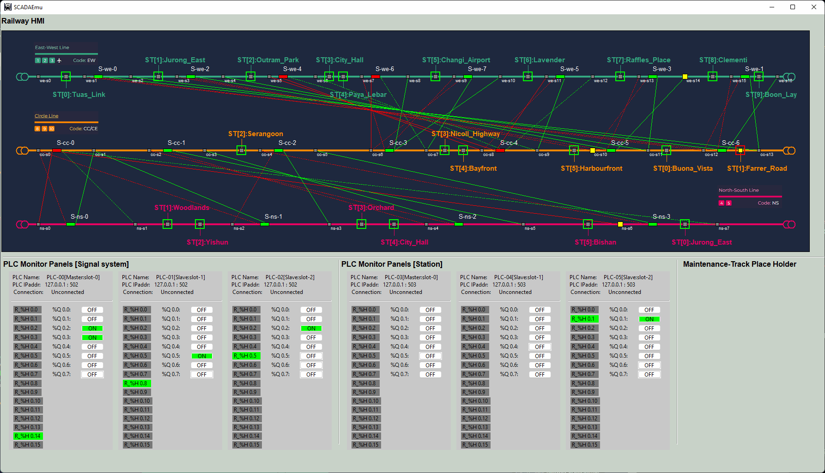
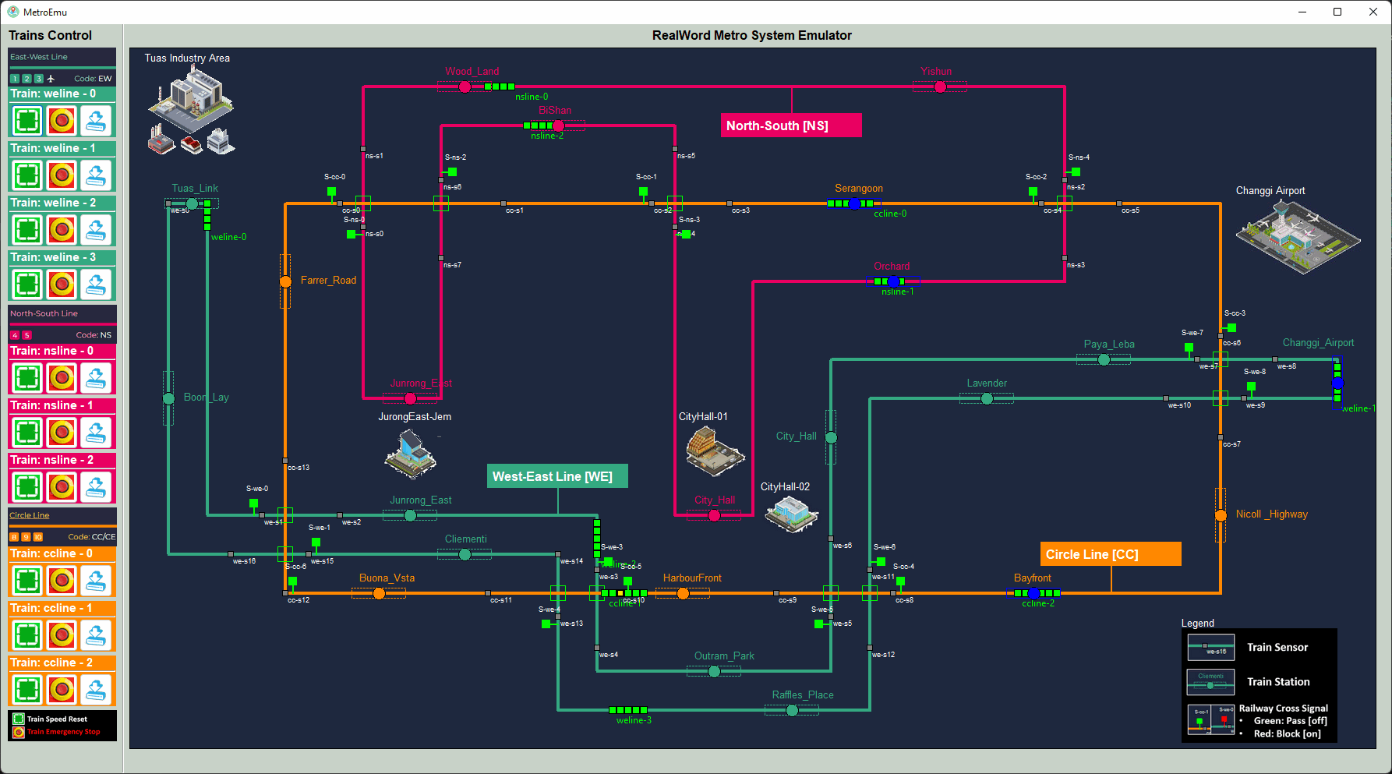
Railway System Emulator [ Program workflow diagram]
Network
Network
Program system config file
Program start
2D Railway[Metro] System Real-world Emulator
Loading config files
Ladder logic bank
Real world connector (thread1)
Logic calculator (thread2)
Modbus server (thread3)
Holding register state change data
Coils state change data
Railway[Metro] System SCADA-HMI
real-world input sensor data
UDP data flow
Real world Communication loop
Register and coils state manager
Modbus request queue handling loop
Change Coils state
real-world output signal data
Read holing register state

Slide 24


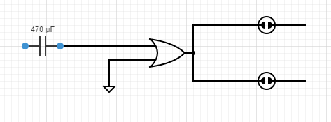

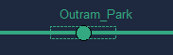
Station’s Senor-Signal physical wire connection and operating logic
Operation Scenario 1: Train enter the station and trigger the docking sensor:
Train docking sensor
Operation Scenario 2: Station turn on train exit signal to stop the train for docking, also turn on the station enter block signal to avoid other trains enters the station:
Train exit station block signal light
Operation Scenario 3: When the train finished docking, turn off both signal light to allow train left the station:
Train enter station block signal light
Station waits another train dock:
Physical wire
Direct trigger latching relay implemented by PLC ladder logic

Slide 25


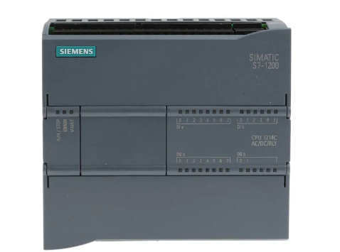
Train’s Senor-Power physical wire connection and operating logic
Operation Scenario 1(Red) : Train power off, Train speed is 0 km/ h
Train speed sensor
Operation Scenario 2(Orange) : Train power on , Train speed is low (0 km/ h – 20km/h)
Train power (moto)
Operation Scenario 2(Green) : Train power on , Train speed is normal (56 km/ h – 90 km/ h)
PLC input connector
PLC output connector

Slide 26
Railway System Emulator [ Program workflow diagram]
Network
Network
Program system config file
Program start
2D Railway[Metro] System Real-world Emulator
Loading config files
Real world connector (thread1)
Modbus server (thread2)
Trains Control HMI
real-world input sensor data
UDP data flow
Real world Communication loop
Register and coils state manager
Modbus request queue handling loop
Change Coils state
real-world output signal data
Read holing register state

Slide 27
Program system config file
Network
Program start
Loading config files
Init main UI (main thread)
Init PLC Connector (sub thread )
Holding register data
UI data controller (map manager)
PLC data controller (data manager)
Trains information
Coil state change data
PLC state data
Display UI info panel
Modbus TCP data
PLC client (Modbus TCP client)
Trains Sensor-Power System Control PLC Simulator module
Train power control panels
Power Control event
PLC state panels
PLC state data
Display UI refresh loop

Slide 28
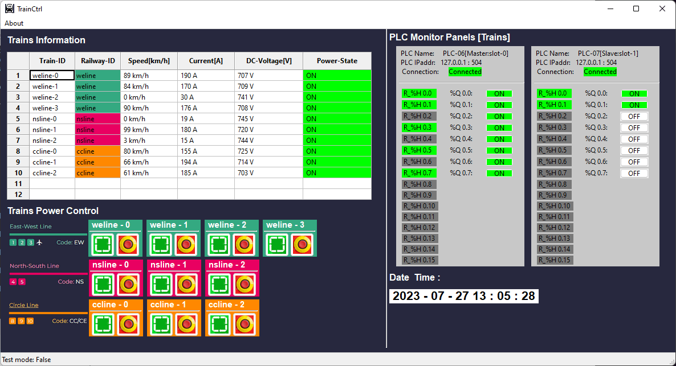
Trains information display grid
PLC state panel
PLC connection state
PLC coils state indicator
PLC holding register state indicator
Critical information and error state display bar
Turn train power ON button
Turn train power OFF button (emergency stop)
Date & time

Slide 29

Train normal operation mode A-1 (docking/waiting):
Train power on, Train speed very low [<5km/h], Current drop low. Voltage range in (Min. permanent , Normal)
PLC speed sensor (Register) indicator OFF (grey).
PLC train motor power indicator ON (green)
Train normal operation mode A-2 (running)
Emergency Stop button pressed (Mode-B) :
Train power off, Train totally stop[speed=0], Current cut off. Voltage range in (Normal , Max. permanent)
PLC speed sensor (Register) indicator OFF (grey).
PLC train motor power indicator OFF (white)

Slide 30
Program system config file
Network
Program start
Loading config files
Init main UI (main thread)
Init PLC Connector (sub thread )
Holding register data
UI data controller (map manager)
PLC data controller (data manager)
Digital I/O Information
Coil state change data
Map display panel
PLC state data
Modbus TCP data
Railway Junctions Sensor-Signal System Control PLC Simulator
Junction PLC client (Modbus TCP client)
PLC set 1 state display panels
PLC state data
Modbus TCP data
PLC state data
Station PLC client (Modbus TCP client)
Railway Stations Sensor-Signal System Control PLC Simulator
PLC set 2 state display panels
PLC state data
Display UI refresh loop

Slide 31

Scenario load drop down menu
Train
Station
Date and Time
Trains power control panels
PLC connection state
Trains collision auto avoidance control
Train position sensors
Railway track signals

Slide 32

Train station docking sensor [Grey]
Junction block signal ON [Red]
Junction release sensor triggered [ Yellow]
Junction block signal OFF [Green]
Junction block sensor [with red dash line]
Junction block sensor [with green dash line]
Train station signal [green]
Junction block sensor triggered [ Yellow]
Train station docking sensor triggered [Yellow]
PLC information
PLC coil voltage low
PLC coil voltage high
Digital input connected
Digital input empty
PLC register state voltage high
PLC register state voltage low
Digital output connected
Digital output empty

Slide 33

Train station block display
Track block display
Junction block display
PLC information
PLC coil voltage low
Digital output empty
Digital output connected
PLC register state
Block controller override enabled
Block controller override disabled
Digital input connected
Digital input empty

Slide 34

Station triggered example
Step 1.1 :Map station sensor changed to triggered state (yellow color)
Step 2.0: Map station signal changed to block state (red color)
Step 1.0: In real-world emulator, train triggered the station docking sensor, Digital input signal change the register’s state
Step 2.0: PLC executes the ladder logic, turn on coils to change the digital output
Step 3: Real-world emulator signal turn on to block the train.

Slide 35

Step 2.1: digital output will change the related signal connect to it to block the junction
Step 3.1: digital output will change the related signal connect to it to release the junction
Step 1.1: In the map the sensor will show triggered state (yellow color)
Step 3.0: In real-world emulator, train triggered the junction release sensor, Digital input change the register’s state
Step 1.0: In real-world emulator, train triggered the junction entrance sensor, Digital input change the register’s state
Step 2.0: PLC execute the ladder logic, then change the coil sate

Slide 36


IT-Network
SCADA HMI Monitor VM/Node
Railway Real-world Emulator VM/Node
SCADA HMI Operation VM/Node
Real world emulator program
Railway HMI program [master]
Railway HMI program
192.168.10.100
192.168.11.10
192.168.11.1X
192.168.10.10X
10.0.10.100
SCADA HMI subnet
Real world electrical signal simulation subnet
OT-Network
Train control program
Train Control PLC VM/VMs
10.0.10.13
Station Control PLC VM/VMs
10.0.10.12
Signal Control PLC VM/VMs
10.0.10.11
192.168.100.2xx
PLC Simulator Program
Train driver subnet
PLC Simulator Program
PLC Simulator Program
192.168.100.11
192.168.100.13
192.168.100.12

Slide 37
Railway[Metro] IT/OT System Security Test Platform Network Diagram and Components View
Physical real world emulation network
ICS [OT network ]
Real world emulator
Corporate network [IT network]
Corporate Network
Supervision network SCADA
Production network
IT management computers
Maintenance laptops
Junction sensor-signal control PLCs set [emulator]
IT engineer
ICS engineer
Electrical signal out
Track junction sensors-signals control emulators
Ethernet TCP/IP
Ethernet TCP/IP and Modbus TCP
Corporate IT servers
ERP servers
Railway system SCADA server
Trains system SCADA server
Station sensor-signal control PLCs set [emulator]
Modbus TCP
Train station sensors-signals control emulators
Electrical signal in
Production management workstation
Train controller PLCs [emulator]
Railway monitor & control HMI
Trains monitor & control HMI
Train emulators
Local HW-Engineering admin laptop
Railway HQ operator
Trains driver /operator
Field device admin
Users, staff and manager

Slide 38
Railway[Metro] IT/OT System Security Test Platform Network Diagram and Components View
Physical real world emulation network
ICS [OT network ]
Corporate network [IT network]
Corporate Network
Supervision network SCADA
Production network
IT management computers
Maintenance laptops
Junction sensor-signal control PLCs set [emulator]
IT engineer
ICS engineer
Electrical signal out
Track junction sensors-signals control emulators
Ethernet TCP/IP
Ethernet TCP/IP and Modbus TCP
Corporate IT servers
ERP servers
Railway system SCADA server
Trains system SCADA server
Station sensor-signal control PLCs set [emulator]
Modbus TCP
Train station sensors-signals control emulators
Electrical signal in
Production management workstation
Train controller PLCs [emulator]
Railway monitor & control HMI
Trains monitor & control HMI
Train emulators
Local HW-Engineering admin laptop
Railway HQ operator
Trains driver /operator
Field device admin
Users, staff and manager

Slide 39


Railway system cyber range system on OpenStack
Network Map Info:
Physical wire connection emulation network
Network Map Info:
Supervision network SCADA.(For OT attack test )
OpenStack provider network used as the Green team development network
Next Step work:
Add one subnet (jump host link to OT network) with 10 small empty ubuntu VMs named as HR server, Web billing server , finance server, file server, email server … to simulate the corporate network.
Add one subnet (jump host link to corporate network) with 5 small empty ubuntu VMs named as DC server, NTP server , DNS server, VPN server … to simulate the DMZ network.

Slide 40


Railway Signal System PLC set ladder logic
Junction Signal control PLC network
PLC-00
[Master, Slot-0]
I/O: 15/7
PLC0 Q0.3
S-we-3
PLC1 Q0.1
S-ns-0
PLC-01
PLC-02
[Slave, Slot-1]
I/O: 15/7
[Slave, Slot-2]
I/O: 9/5
PLC0 Q0.5
S-we-5
PLC1 Q0.2
S-ns-1
PLC2 Q0.1
S-cc-3
PLC1 Q0.0
S-we-7
PLC1 Q0.3
S-ns-2
PLC0 Q0.6
S-we-6
PLC2 Q0.2
S-cc-4
Ladder Diagram set information:
PLC number: 3
Holding register: 39
Coil: 19
Total ladder diagram: 19
Ladder diagram detail:
PLC1 Q0.4
S-ns-3
PLC2 Q0.3
S-cc-5
PLC0 Q0.4
S-we-4
PLC1 Q0.5
S-cc-0
PLC0 Q0.2
S-we-2
PLC2 Q0.4
S-cc-6
PLC1 Q0.6
S-cc-1
PLC0 Q0.0
S-we-0
PLC0 Q0.1
S-we-1
PLC2 Q0.0
S-cc-2

Slide 41

Railway Station system PLC set ladder logic
Station Signal control PLC network
10.0.12.10
PLC-03
[Master, Slot-0]
I/O: 8/8
PLC-04
PLC-05
[Slave, Slot-1] I/O: 8/8
[Slave, Slot-2] I/O: 6/6
Ladder Diagram set information:
PLC number 3
Holding register: 22
Coil: 22
Total ladder diagram: 22
Ladder diagram detail:

Slide 42

Train control PLC network [under progress ]
Train Control PLC Configuration
[Master, Slot-0]
I/O: 0/8
PLC-06
[Slave, Slot-1] I/O: 0/2
PLC-07
Ladder Diagram set information:
PLC number 2
Holding register: 0
Coil: 10
Total ladder diagram: N.A (direct control)
Ladder diagram detail: N.A
Fetch PLC Input sensor voltage and set the register
t0
t2
t3
t4
Low frequence false data injection attack not success on real PLC because the false data is overwritten by the sensor data read on t2 and t3.
Real PLC with 20ms clock cycle
10ms
10ms
t1: Inject false register value to overwrite sensor reading
False data injection attack success, the PLC execute the ladder logic based on the false injected sensor volage value.
PLC Emulator with 80ms clock cycle
80ms
Execute the ladder logic

Slide 43
Train State Panel
Train ID
Train DC power state
Train DC Current(A)
Train DC Voltage(V)
Train state history table
Train average speed indicator
Train poser state reset button
Train emergency stop button
Train’s Control PLC state panel
Train’s collision avoidance overload control
Train current speed gauge

Slide 44




Modbus-TCP
Junction PLC
Station PLC
Real word junction sensors and signal
UDP simulate electrical signal
UDP simulate electrical signal
Real word station sensors and signal

Slide 45


Train Control PLC
Modbus-TCP
UDP simulate electrical signal
Real word trains PLC throttle and brake control

Slide 46
Railway Physical-world Simulator
HQ Signal System Monitor HMI(s)
Users
Railway engineer
Slave HMI(s)
Electrical signal communication simulation module (10.0.10.100)
39 track sensors state ( input to PLC)
Master HMI IP: 192.168.10.100
Slave HMI(S) IP:192.168.10.10X
22 PLC coils state (output to signals )
22 station sensor state (input to PLC)
19 PLC coils ( output to signal)
10.0.10.10X
10.0.10.11X
Railway track station signaling control PLC network
Railway track junction signaling control PLC network
HMI network 192.168.10.x
Legend
[Master, Slot-0]
I/O: 8/8
[Master, Slot-0]
I/O: 15/7
Modbus-TCP data flow
PLC-03
PLC-00
UDP data flow (simulate electrical signal )
PLC-04
PLC-05
PLC-01
PLC-02
[Slave, Slot-1] I/O: 8/8
[Slave, Slot-2] I/O: 6/6
[Slave, Slot-1] I/O: 15/7
Switch or Router
[Slave, Slot-2] I/O: 9/5
Modbus IP: 192.168.100.1X/24
Modbus IP: 192.168.101.2X/24
Modbus Network 192.168.100.0/24
Register read request and Coils set request
Memory Point read request and Coils set request
IEC 104 Network 192.168.103.0/24

Slide 47
Railway Physical-world Simulator
Railway HQ Trains Monitor HMI(s)
Users
4
5
3
Railway engineer
1
9
Electrical signal communication simulation module (10.0.10.100)
HMI network 192.168.10.x
Train driver consoles (on train HMI)
10 train front radar state ( input to PLC)
50 RTU input ( trains throttle, brake, voltage, current ,speed sensors)
10 PLC coils state (output to 3rd track power switch)
0
20 PLC coils ( output to moto and brake)
10.0.10.12X
10.0.10.13X
8
Railway 3rd tack power switches control PLC network
On train operation control PLC network
On train RTU network
6
7
2
PLC-08
PLC-09
Serial Comm link between PLC and RTU
RTU 00 - 09
PLC-06
PLC-07
[Master, Slot-0]
I/O: 0/8
[Slave, Slot-1] I/O: 0/2
[Master, Slot-0]
I/O: 8/16
[Slave, Slot-1] I/O: 2/4
Register read request and Coils set request
RTU Memory data
Coils set request
Railway Modbus 192.168.100.0/24
Train drivers
Trains Modbus 192.168.101.0/24
Trains S7Comm bus 192.168.102.0/24

Slide 48
Railway Physical-world Simulator
HQ Railway Block Control HMI
Users
Railway engineer
Electrical signal communication simulation module (10.0.10.100)
Legend
HMI network 192.168.10.x
Modbus-TCP data flow
Fixed block ATP PLCs
UDP data flow (simulate electrical signal )
PLC-10
[Master, Slot-0]
I/O: 16/8
PLC-11
[Slave, Slot-1] I/O: 16/8
Railway Modbus 192.168.100.0/24
Switch or Router
Coils set request

Slide 49
Railway Physical-world Simulator
Cyber Range HQ Management HMI
Users
Railway engineer
Electrical signal communication simulation module (10.0.10.100)
Internal HMI connection Switch
OT IEC104 Switch
Database
Trains operation information data base
22 PLC coils state (output to signals )
22 station sensor state (input to PLC)
10.0.10.10X
Railway track station signaling control PLC network
[Master, Slot-0]
I/O: 8/8
PLC-03
PLC-04
PLC-05
[Slave, Slot-1] I/O: 8/8
[Slave, Slot-2] I/O: 6/6
Modbus IP: 192.168.100.1X/24
HQ Railway Block Control HMI
HQ Signal System Monitor HMI
HQ Railway Train Control HMI
Memory Point read request and Coils set request
IEC 104 Network 192.168.103.0/24

