Slide 1
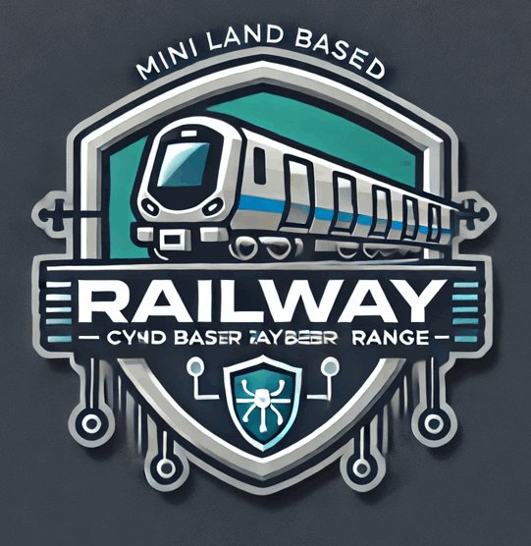
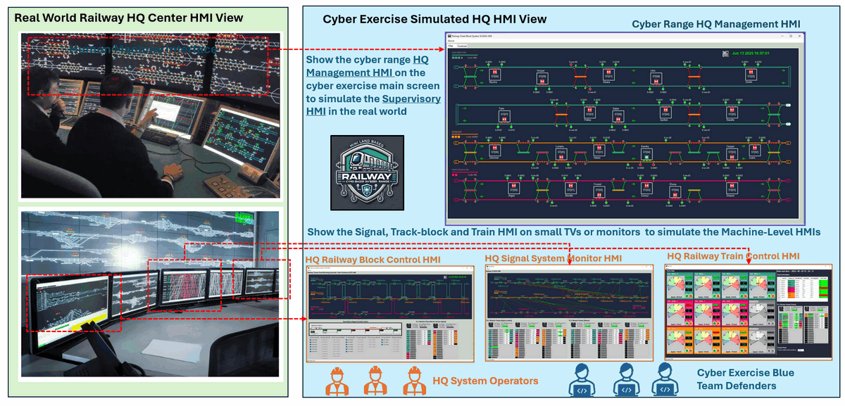


Land Based Railway Simulation Cyber Range System
Land Based Railway Cyber Range System
Mini Railway IT-OT System Cyber Security Platform Introduction
Version: V_3.0.1
Disclaimer: This presentation is intended solely for internal use and may contain confidential and/or privileged information. Unauthorized use, disclosure, distribution, or copying of the contents in this presentation is strictly prohibited.

Slide 2
Land Based Railway Simulation Cyber Range System
Product Introduction
What it is …
The Land Based Railway Simulation Cyber Range System is a fully digital distributed cyber security platform software to simulate all SIX different levels OT and IT environment of a railway company. It provides the simulation modules from pure railway OT system such as the physical track signaling systems, railway ATC and ATP system and station control system to the company IT system such as the train ticket web.
What it is NOT
The cyber range is using the same OT protocols as in the real world, but it is NOT a Digital-Twin. It is not built to be one, and it is not meant to be used as one.
The cyber range will distill (NOT 1:1 emulate) a few OT processes from the real world and use digital constructs to represent them. These digital construct will interact with Human-Machine Interface to reflect the real world. OT protocols will be used to enable the communication between the OT devices (PLC/RTU/MU) and the HMI.

Slide 3
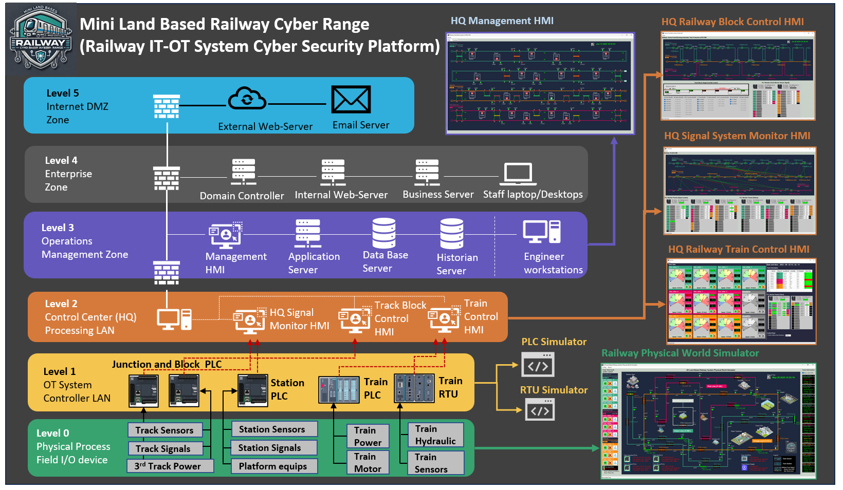
Land Based Railway Simulation Cyber Range System
Product ISA-95/IEC-62264 Architecture Overview
4 layers of OT system
2 layers of IT system
1 Physical world simulator
2 Types of PLC simulator
1 Type of RTU, and MU simulator
3 OCC Operation HMI (Track-ATC, Stations and Trains)
1 HQ Management HMI
1 Set of standard Internal IT Env (DB, Email, historian)
1 Set of standard external IT
Env (Web, Email)
1 Ticket Web

Slide 4
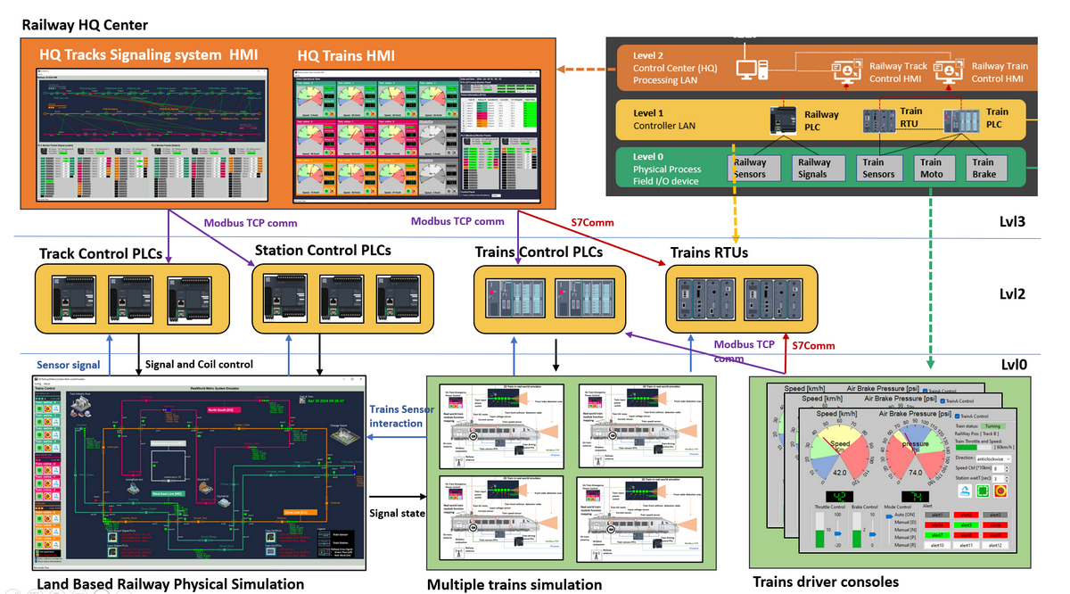
Land Based Railway Simulation Cyber Range System
System OT Components Spec
Railway-Tracks: Three different crossed tracks (Green-Line, Pink-Line, Orange Line) with signaling system.
Fix-Block-ATP : Track fixed block signaling ATP system with total 67 train pos detection sensors and 31 signals.
Auto-Station-Mgm: Train-Docking-Departure and Platform auto-management system with 22 stations with total 44 sensors and 44 signals, and 88 passenger protect doors.
Trains’ Power: Train and third rail track power supply simulation with 10 trains, total equipped with 40 sensors (4 per train) and 20 latching relays.
PLC/RTU/MU: Four types of OT controller simulations: 8 Track PLCs(Modbus-TCP), 2 Station PLCs(IEC61870-104) and 10 Train RTUs + 60MU with Siemens S7Comm protocols.
Operator HMI : Train driver console, 3 OCC railway operator HMIs (Track, Station and Trains)
Monitor HMI: One Control Center Management Monitor HMI

Slide 5
Land Based Railway Simulation Cyber Range System
User Interface : Physical World Simulation

Slide 6
Land Based Railway Simulation Cyber Range System
User Interface : OCC Human Machine Interface

Slide 7
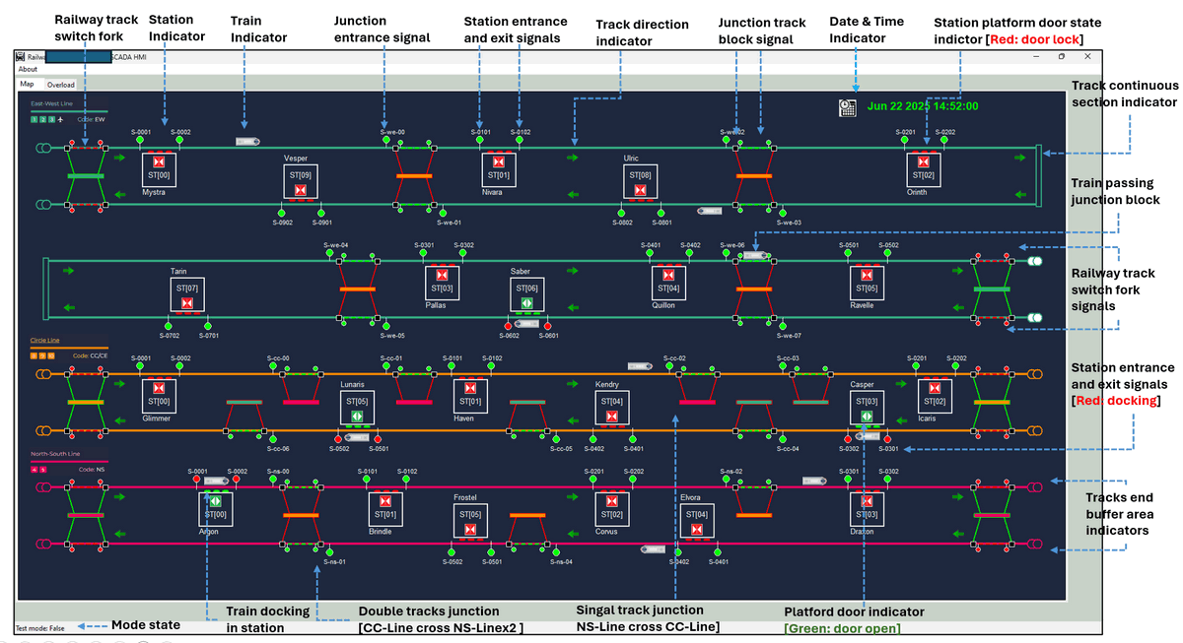
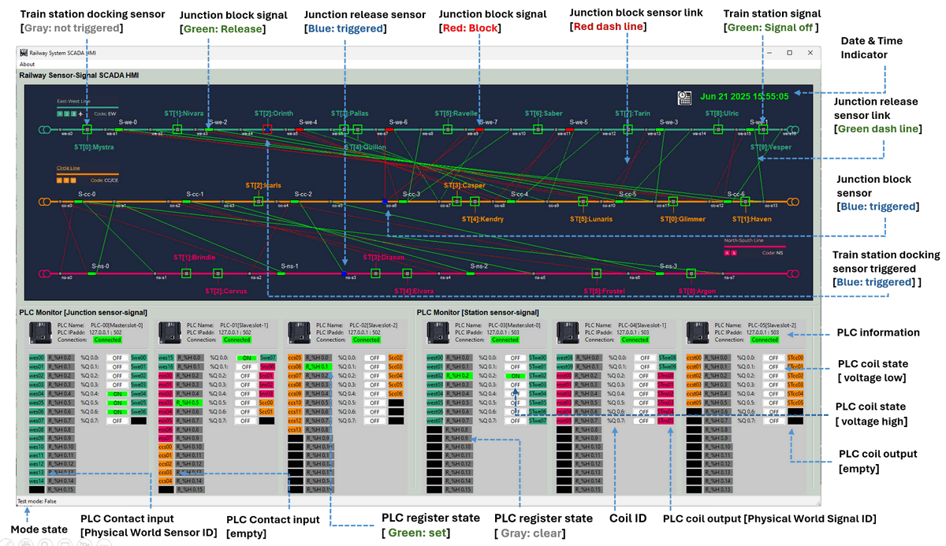
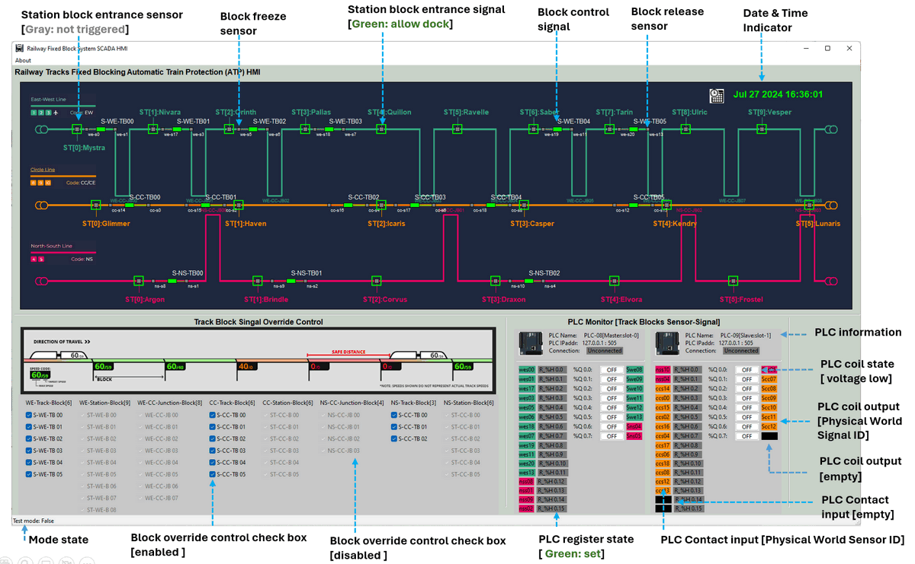
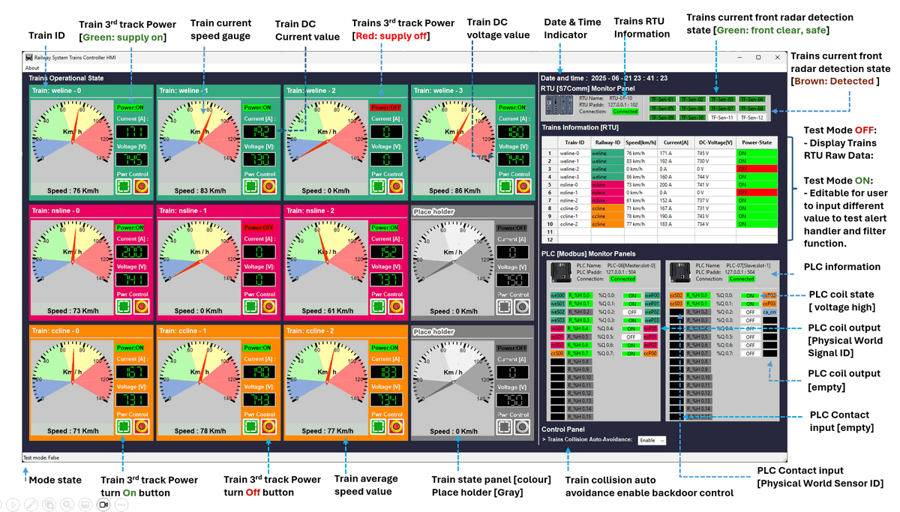
Land Based Railway Simulation Cyber Range System

Slide 8
Land Based Railway Simulation Cyber Range System
Why there are several differences between the UI and real world one ?
Real-World vs. Cyber Range HMI Design
Aspect | Real-World OT Training HMI | Cyber Range Simulated HM
Main Purpose | Operator skill training | Cyber defense awareness, anomaly detection
Protocols Used | Single vendor-specific protocol | Multiple open/standard protocols
Information Display | Minimal, focused on critical data | Detailed, includes low-level system metrics
User Interaction | Manual interaction required | Mostly automated or scripted behavior
UI Layout | Tabbed views | All-in-one view for continuous recording
Alert Configuration | Fixed, pre-configured | Customizable via config files
Logging Focus | Operational logs only | Full data/event/packet logging for forensics

Slide 9
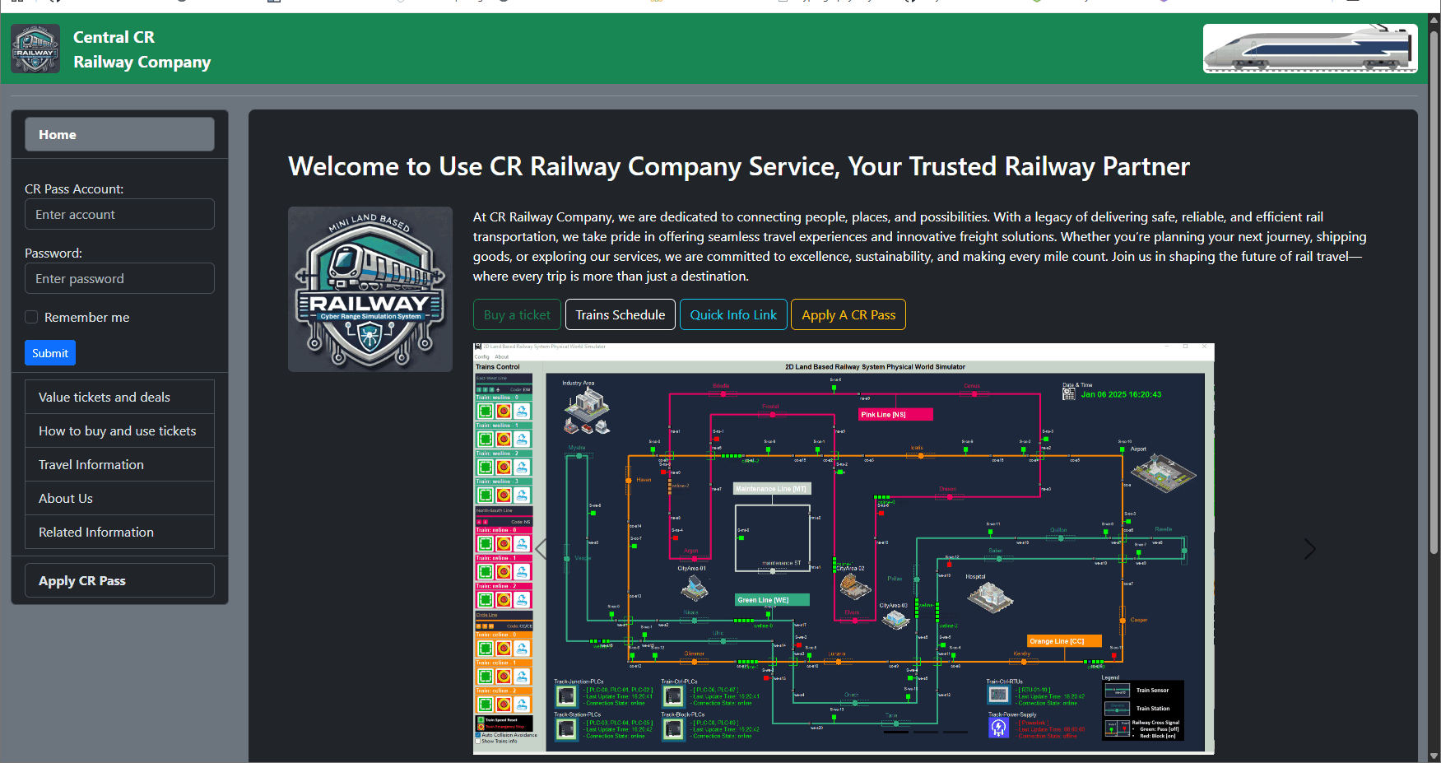
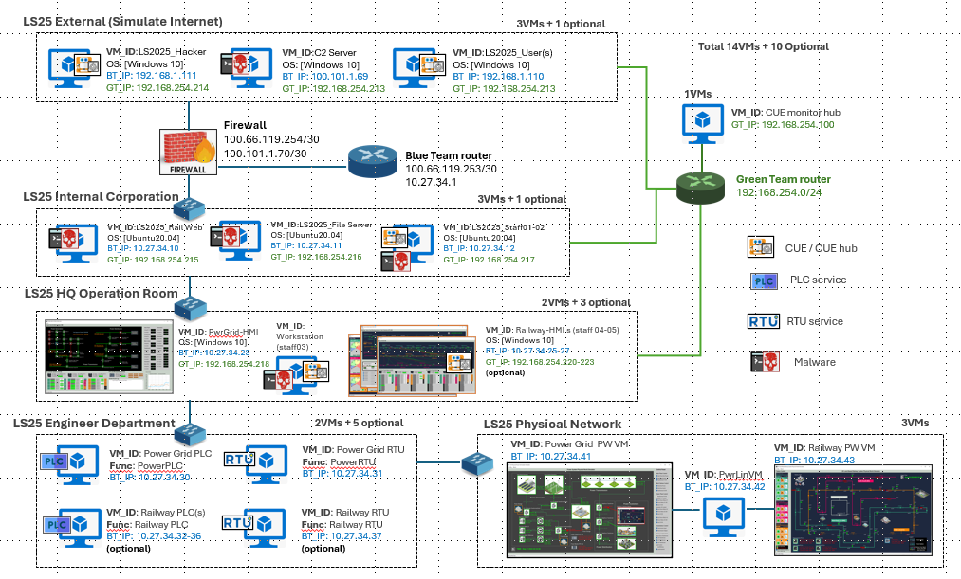
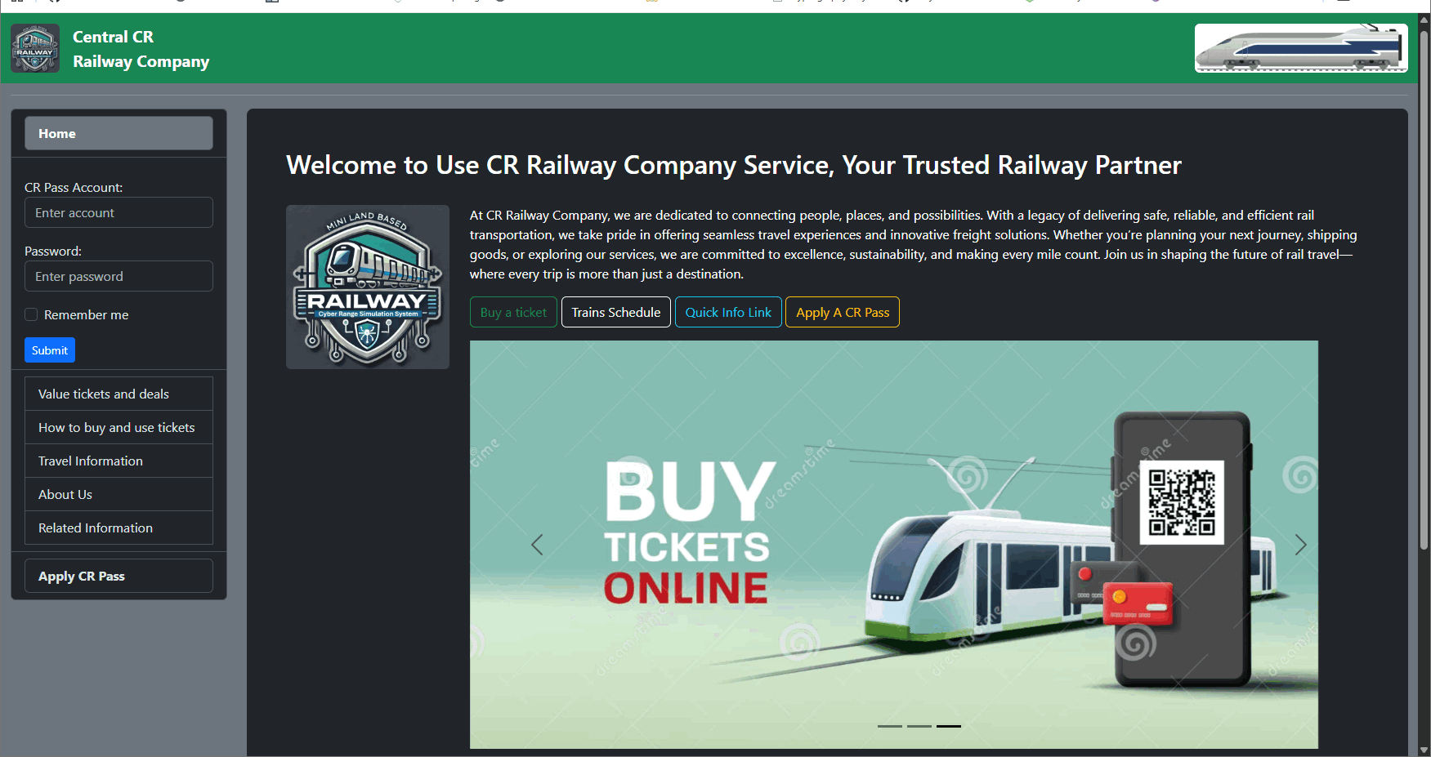
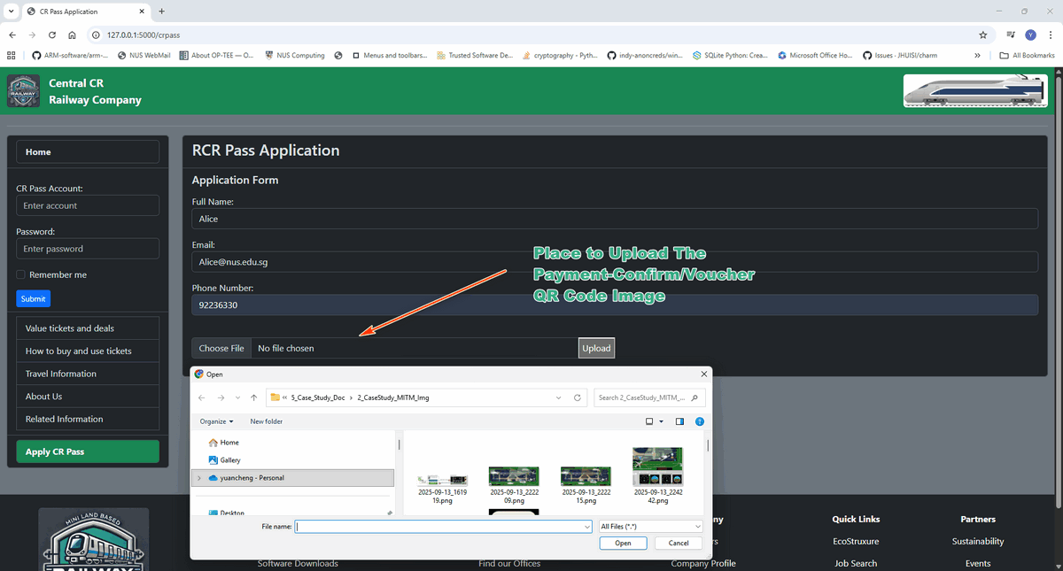
Land Based Railway Simulation Cyber Range System
Railway Company IT Network and Simulated User Action Integration
Railway Company Web + Railway Internal/External file sharing system.
Railway Cyber Range (RCR) Ticket Purchase System + Databases.
Automated 3 types of passenger and 4 types of railway staff action simulation.
RCR Web Home Page
RCR Ticket Purchase system
RCR Pass Application Page

Slide 10
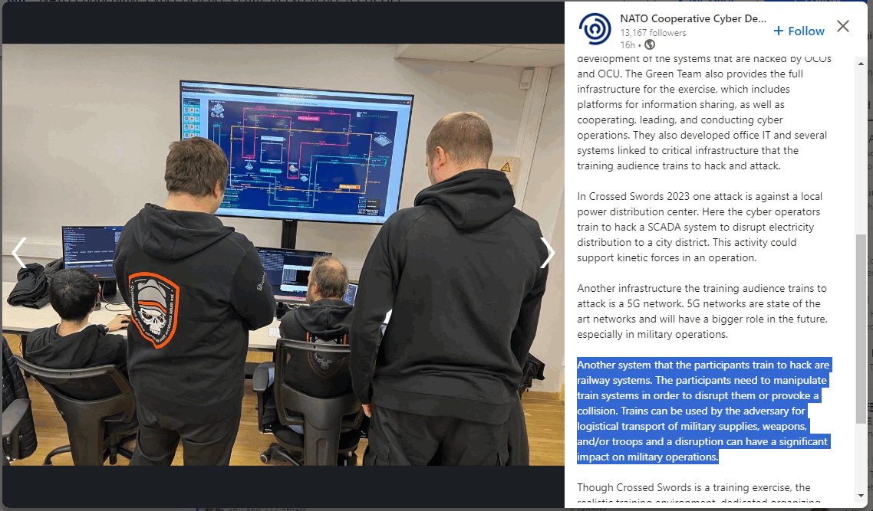
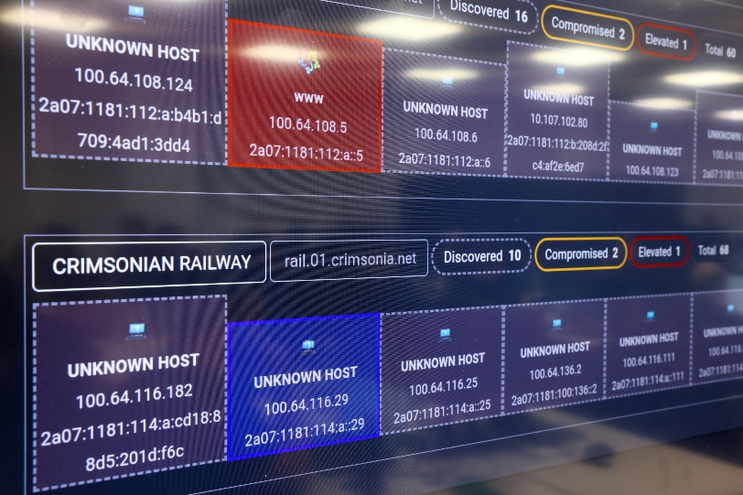
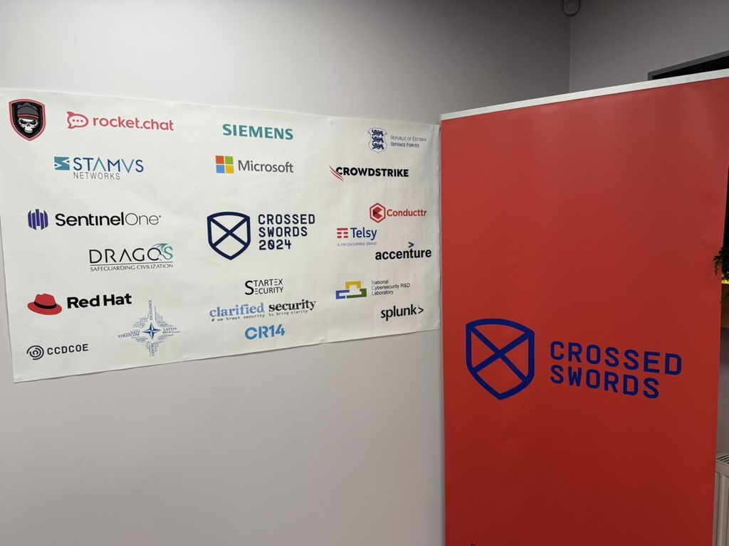


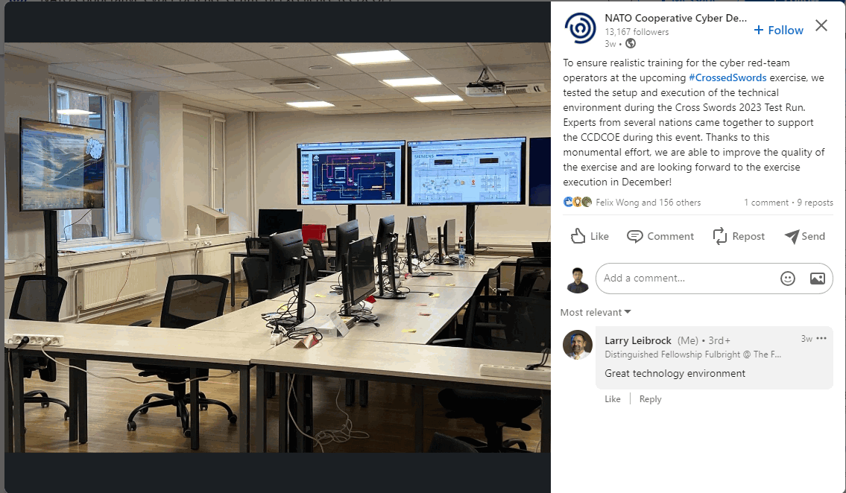
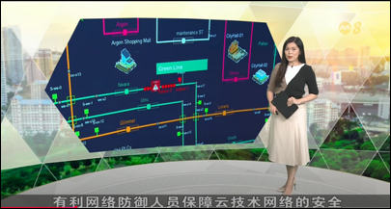



Land Based Railway Simulation Cyber Range System
Project Use Cases [International Cyber Exercise]
NATO CCDCOE Crossed Swords 2023
NATO CCDCOE Locked Shields 2023
NATO CCDCOE Crossed Swords 2024
NATO CCDCOE Locked Shields 2024
Singapore CIDeX 2024

Slide 11
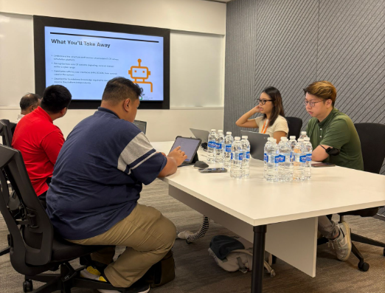
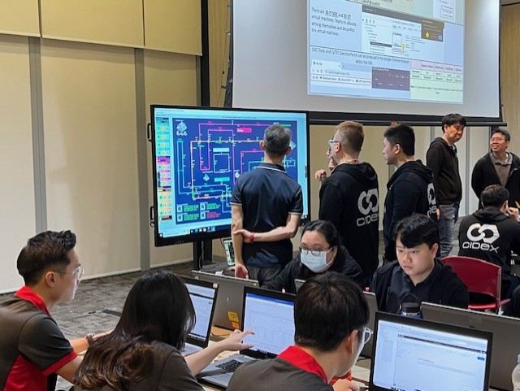
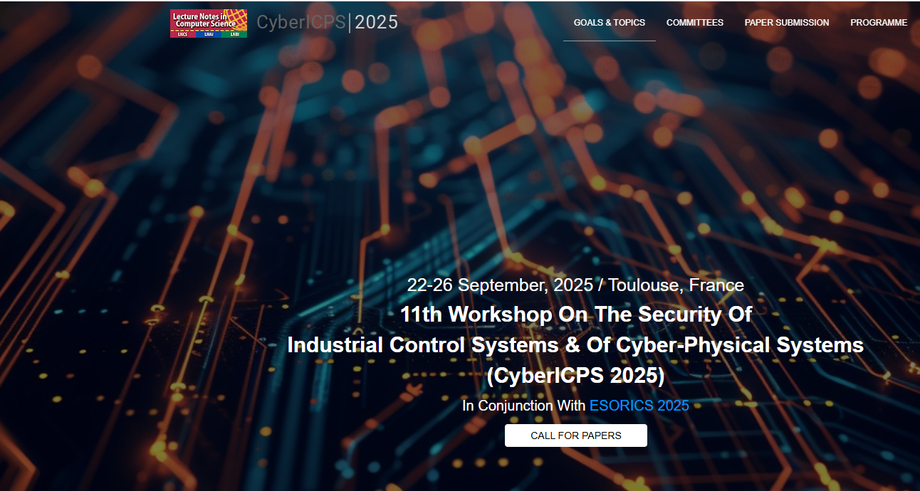
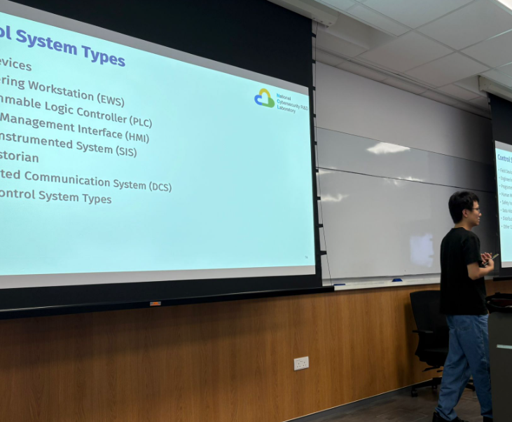
Land Based Railway Simulation Cyber Range System
Project Use Cases [Academic and Training]
Singapore CIDeX 2025 Singapore
NCL-SBST OT Cyber Security Training 2025
Data Set + Paper will be presented in CyberICPS 2025 Workshop of 30th European Symposium on Research in Computer Security (ESORICS) 2025 Conference
NUS Summer School 2025 Cyber Security OT-Env Pentest Course

Slide 12
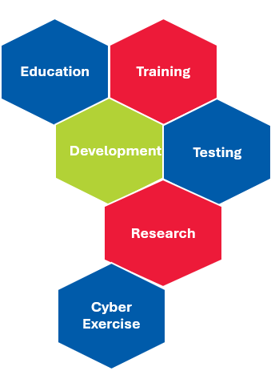
Land Based Railway Simulation Cyber Range System
Cyber Range Service
Cyber Exercise : On site deployed live system used for cyber exercise red team attack and blue team defense.
Education : Remote access simplified cyber range system for hands on training.
Data Generation : Automate attack scenario recurrent for threats detection, data collection.
Data Set : Data set of cyber attack for cyber security DFIR, AI training and research.
OT-Training : Materials (video, slides and document) for OT system and OT security course.
Workshop : IT and OT Cyber attack case studies for general OT security demo and workshop.

Slide 13
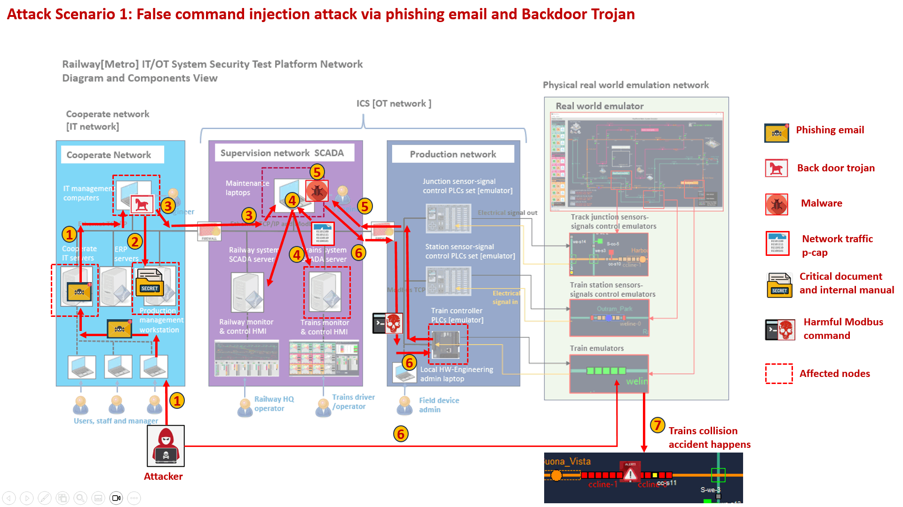
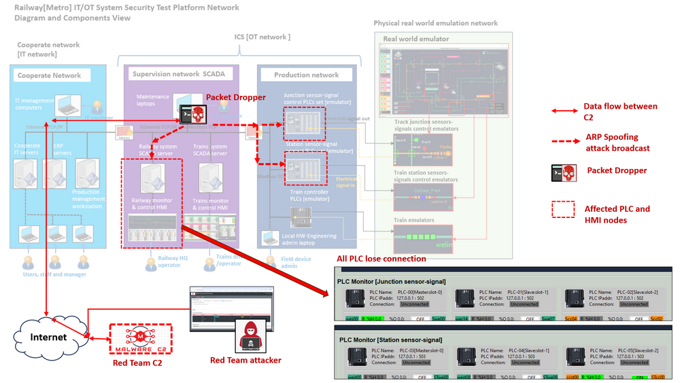
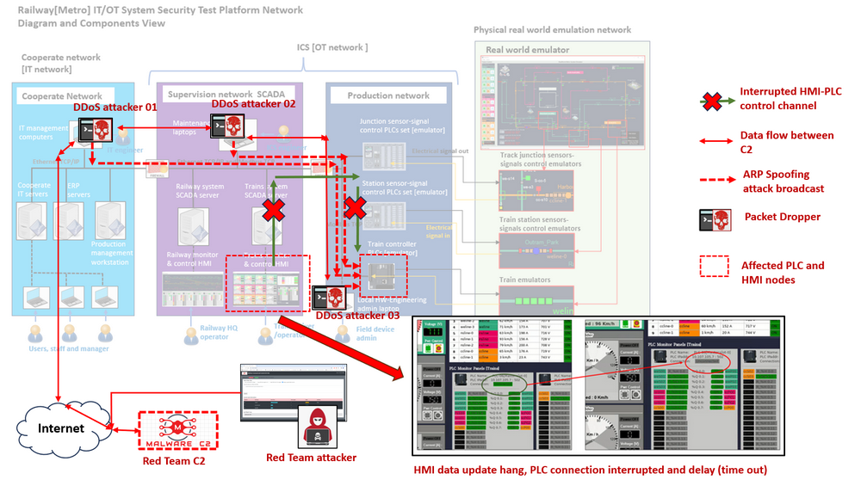
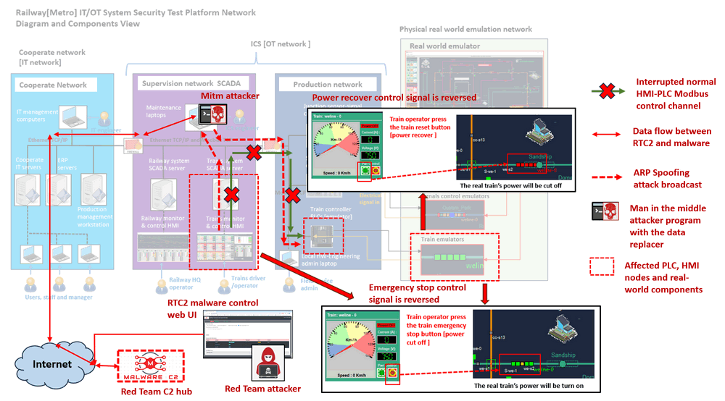
Land Based Railway Simulation Cyber Range System
OT Cyber Attack Case Studies and Data Set
OT Cyber Attack Case Study 1: False Data/Command Injection Attack on PLC (PLC reg, memory or coil data overwrite)
OT Cyber Attack Case Study 2: OT-Network ARP Spoofing Attack on SCADA-HMI-PLC control channel (Modbus packet drop)
OT Cyber Attack Case Study 3: DDoS on PLC Modbus Channel Attack (Denial of PLC Modbus service
OT Cyber Attack Case Study 4: Man-in-the-Middle Attack on HMI-PLC Control Chain

Slide 14
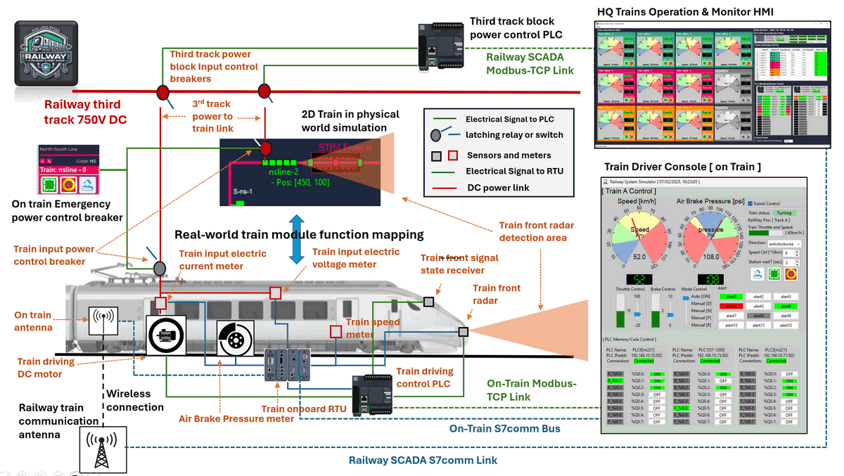
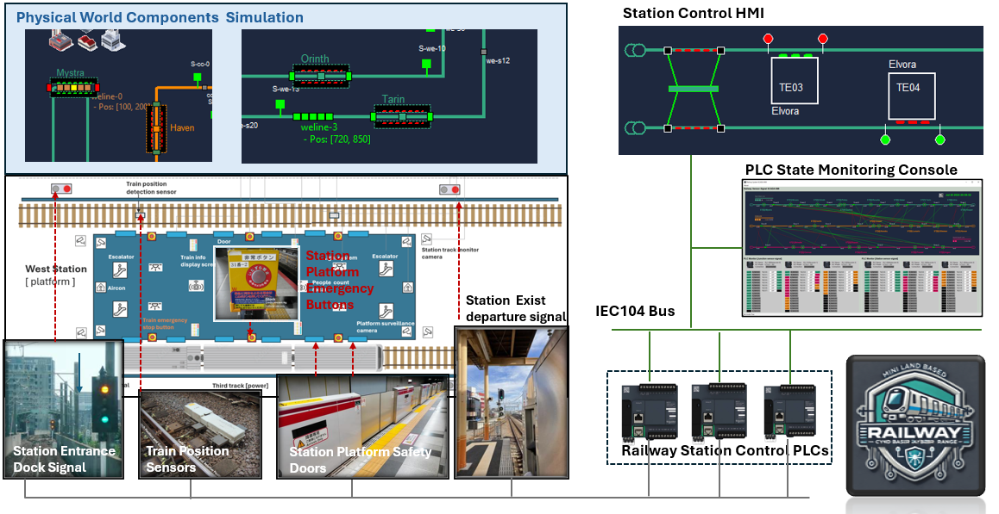
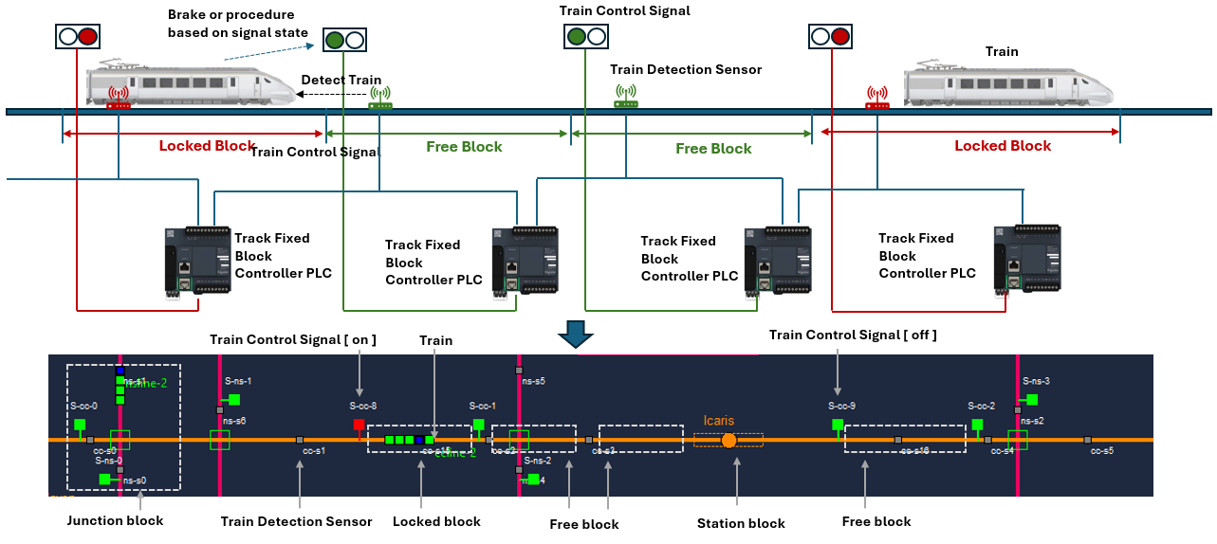
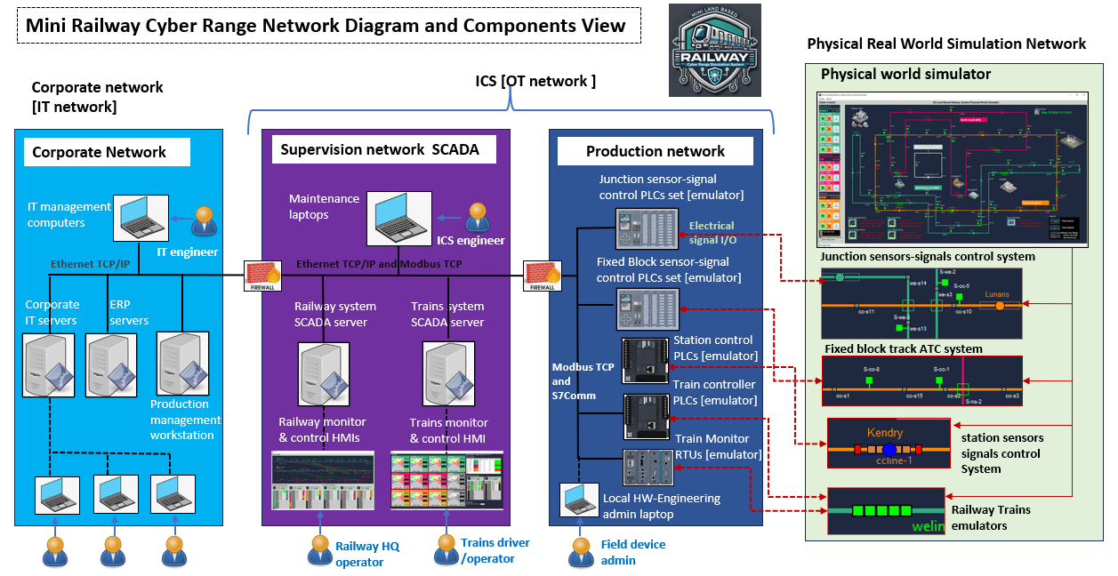
Land Based Railway Simulation Cyber Range System
More Technology Spec …

Slide 15

Land Based Railway Simulation Cyber Range System
Thank you very much
Q & A

