Slide 1
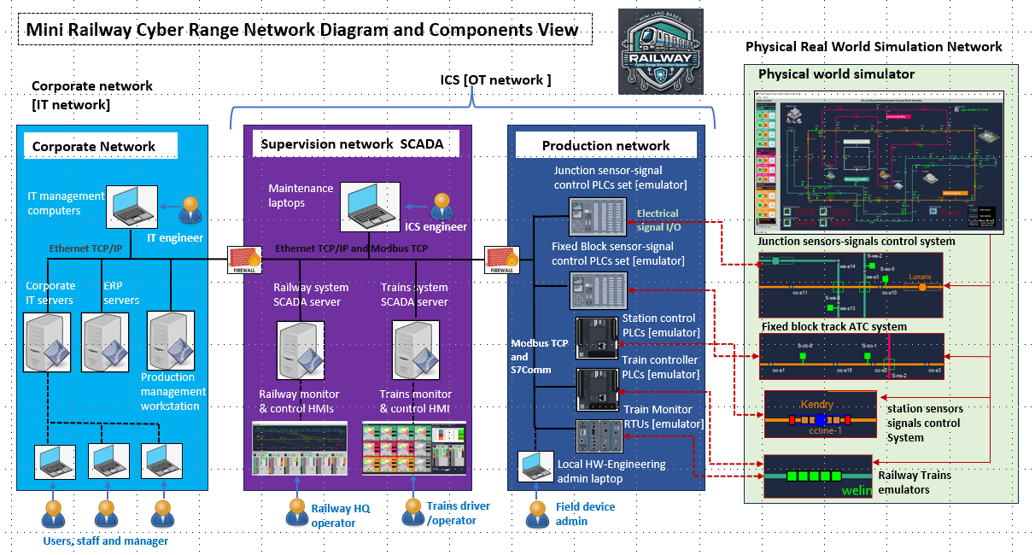


The Dolibarr will be setup here in the Enterprise Resource Planning Service Nodes

Slide 2
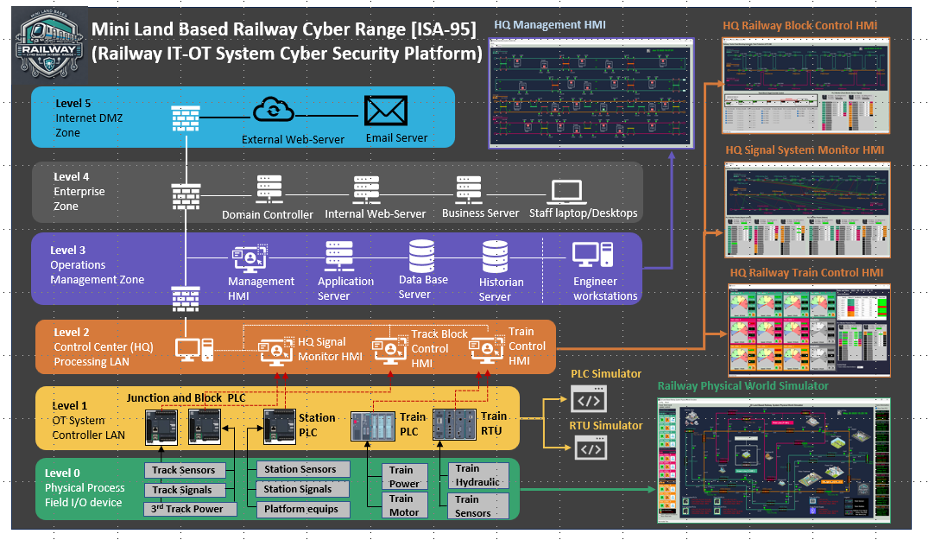

Slide 3
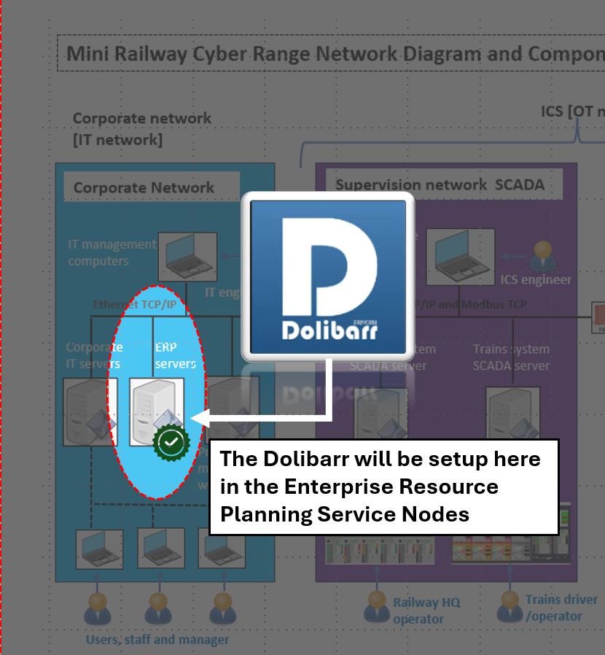
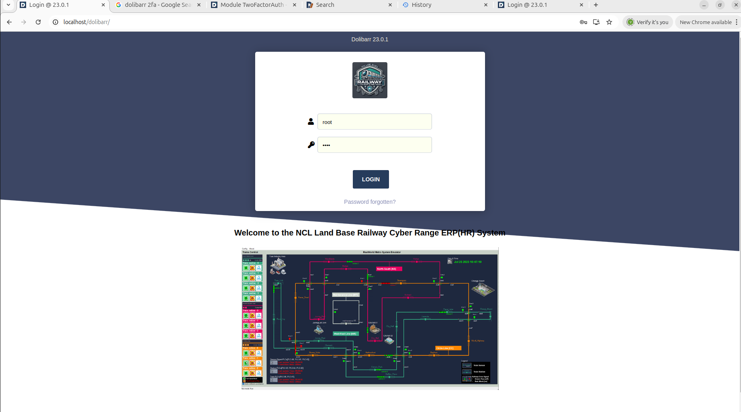







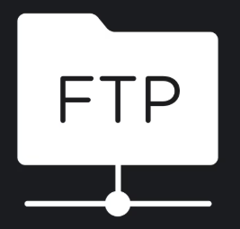
DMZ Zone Firewall
Dolibarr
ERP Web
Portal
Corporation Network Router/Switch
Railway Company Staffs
ERP Front End Server
ERP Back End Server
ERP File Server
Dolibarr Application
MySQL Database
Python FTP

Slide 4
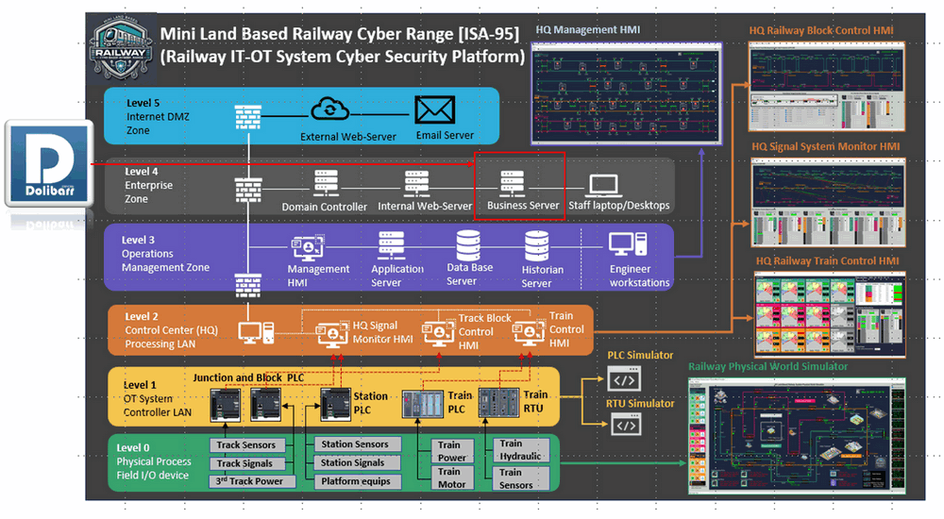
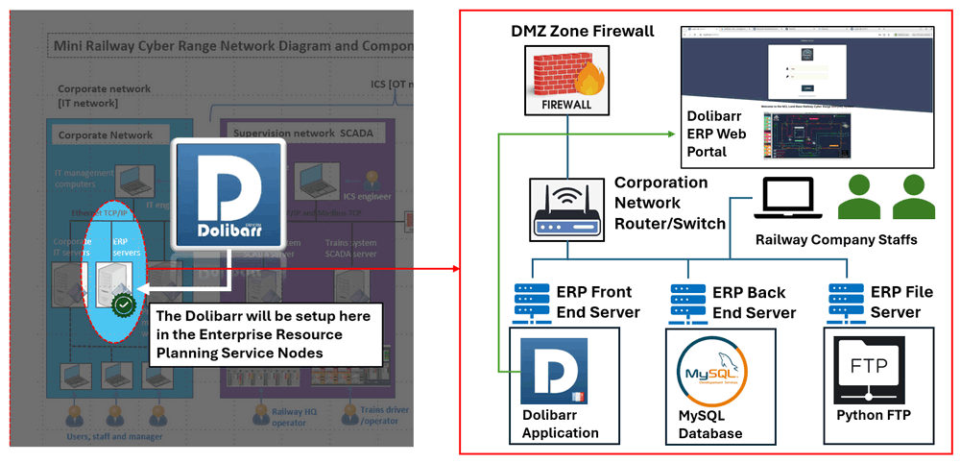
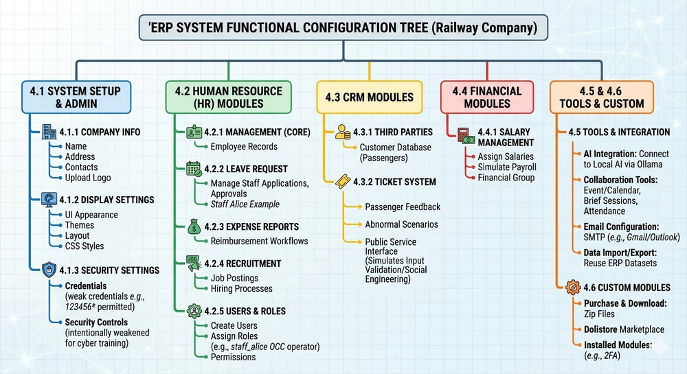
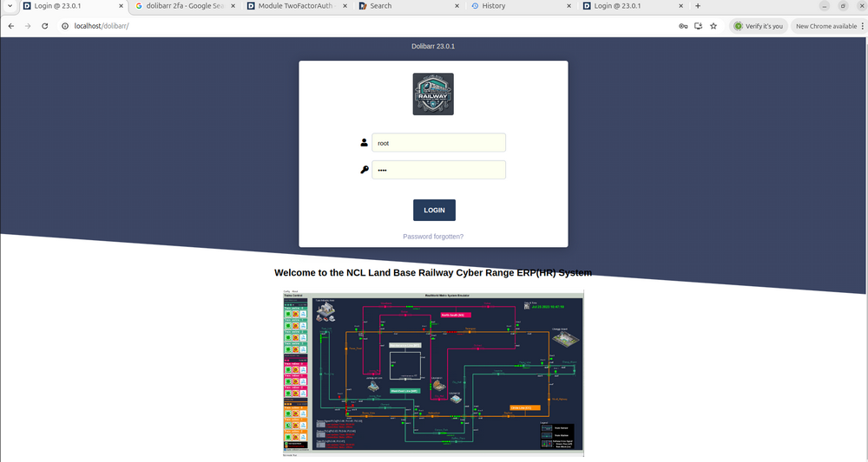
Fast Way to Setup an ERP(IT) System For the Critical Infra Cyber Range

