Slide 1

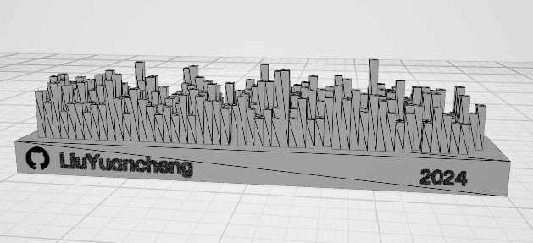
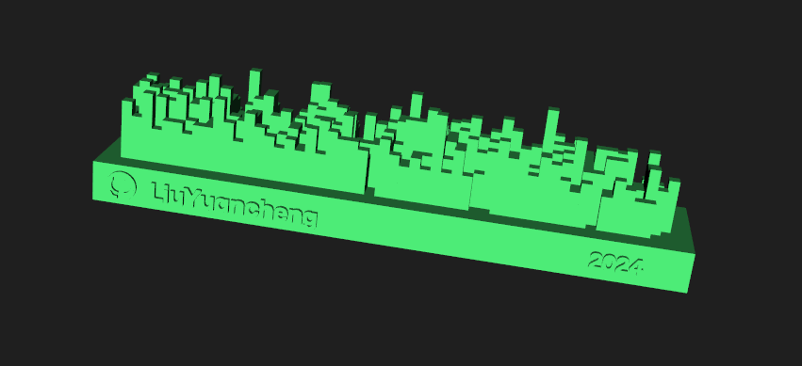
3D Visualize Your GitHub Yearly Contributions Matrix

