Slide 1
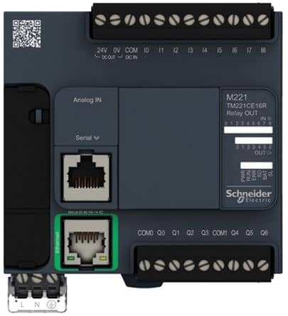
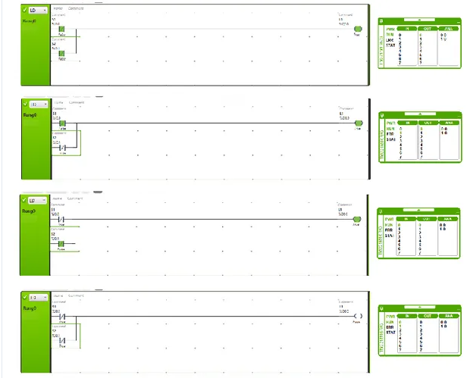
ModBus TCP
Simulator
M221 PLC HW Simulator
Ladder Diagram Editor
Byte IDx | Val
00 | 0A
01 | 1B
02 | 32
03 | 10
04 | 01
05 | ..
..
…
….
Sum | ..
Load

Slide 2
Line
clear

