Slide 1

















Security Exam MCQ
MCG-GPT-BOT
Answers + Correct %
Security Multi-choice question source
Question scenario prompt
PDF format
Text format
Markdown format
LLM-AI MCQ parser
HTML format
URL
( Without login)
Json format
Text Format MCQ question back file
MCQ answer file (with/without AI correctness rate )
CTF-D URL + login cookie
Image format
LLM-AI MCQ Solver

Slide 2

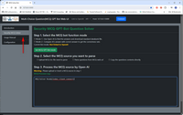

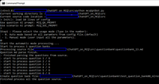
Program system config file
System Workflow
Program control or function call flow
MCQ-GPT Bot start
Communication
with Open AI
OpenAI
Security Multi-choice question source
Config file loader
PDF format
Text format
Markdown format
Data flow or file I/O
Batch loading all MCQ source
Web User Interface
MCQ source parser
HTML format
URL
( Without login)
Json format
Text Format MCQ question back file
CTF-D URL + login cookie
Image format
Question scenario prompt .
Question categorizer
Command line User interface
Question Solver
Archive result to the result DB
Standard MCQ result file.
MCQ-GPT-Robot data manager
Result DB

Slide 3
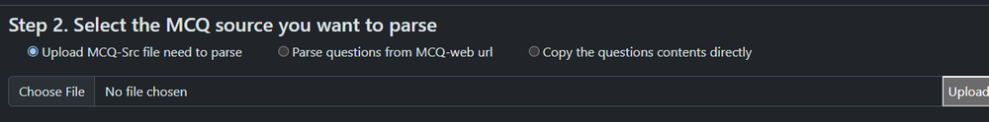
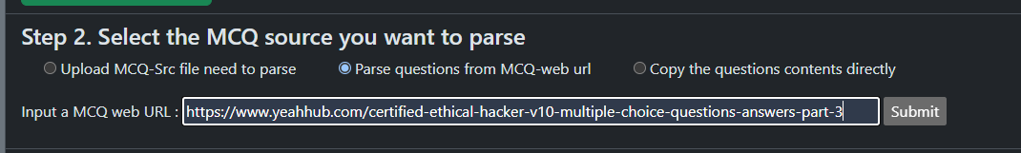
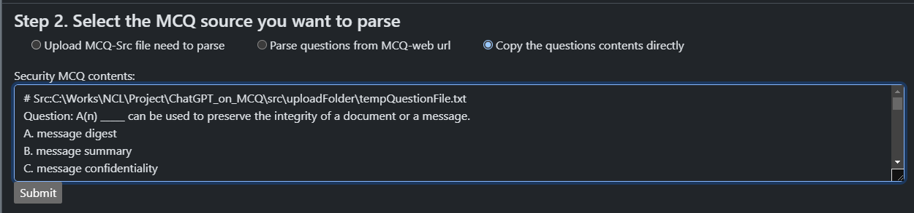

Slide 4
Program system config file
MCQ-GPT Bot start
Multi-choice question source set
PDF format
Text format
Markdown format
OpenAI
Loading config file
Batch loading all MCQ source
HTML format
URL
( Without login)
Json format
Search MCQ source and load questions
CTF-D url + login cookie
Image format
Question categorizer
Question parser [ langchain + MCQ- prompt ]
+
Question scenario prompt .
MCQ-GPT-Bot data manager
Standard MCQ data/file.
Program control/function call flow
Question Solver [ OpenAI + scenario prompt ]
Network communication with Open AI
Result files.
Data flow or file I/O

Slide 5

Program system config file
PWN-GPT Bot start
OpenAI
Loading config files
Question and file
Load and CTF-Pwn question
Question categorizer
Question parser [ langchain + Ret2GPT]
Question scenario prompt .
Pwn-Tools bank
Question Solver [ OpenAI + scenario prompt ]
Py-pwntools
GDB
Command executer
Ghidra
Result analyzer [langchain + prompt]
radare2
Possible Flag

Slide 6
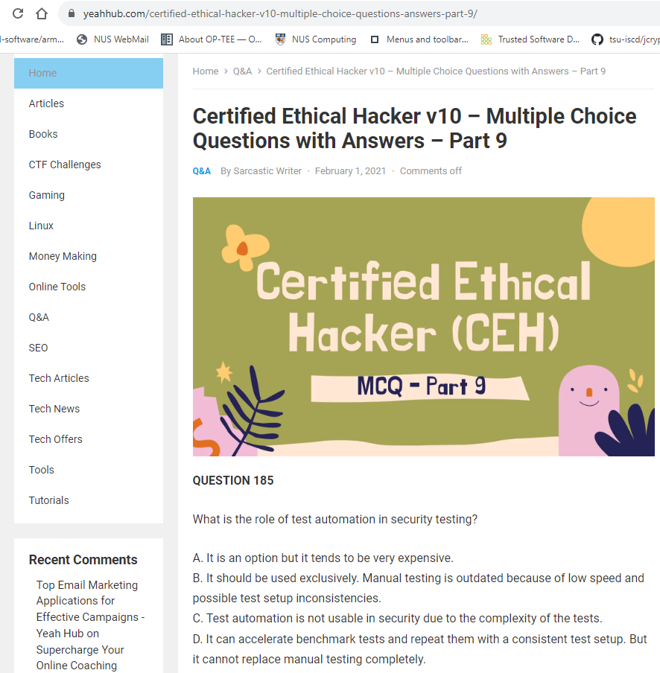
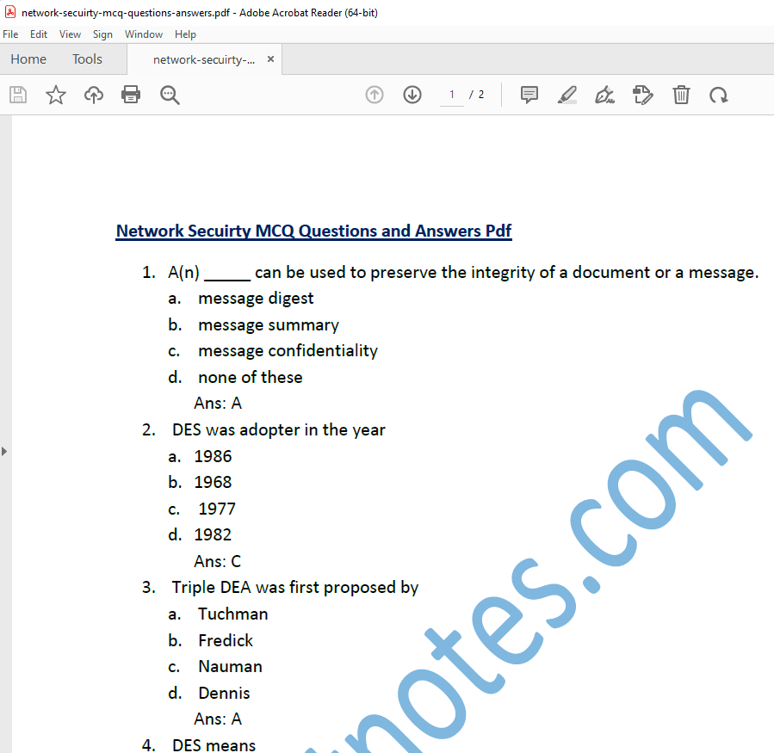
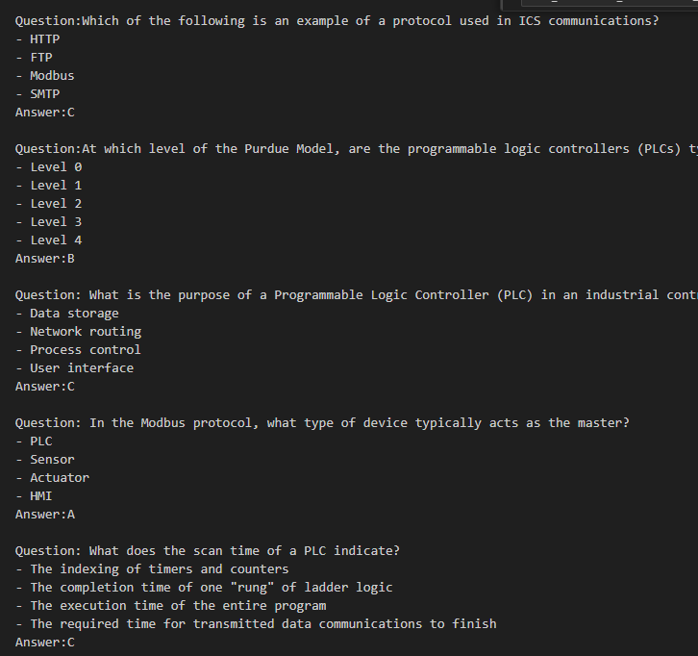
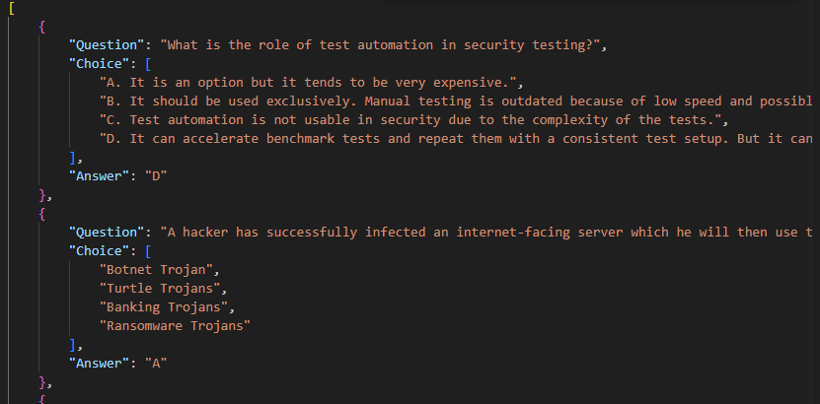
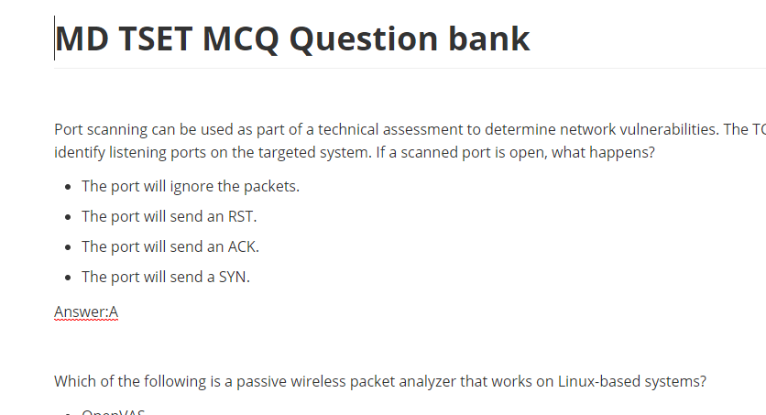
Html file or URL source
PDF format source
Text format source
Json format
Txt, CSV, markdown or Json
MCQ-GPT Bot
Standard question bank:
Question: You perform a scan of your company’s network and discover that TCP port 123 is open. What services by default run on TCP port 123?
A. Telnet
B. POP3
C. Network Time Protocol
D. DNS
Answer: C
AiAns:C
AI Answer compare (correct / total) : 19 / 23 Correctness rate : 0.8260869565217391

