Slide 1
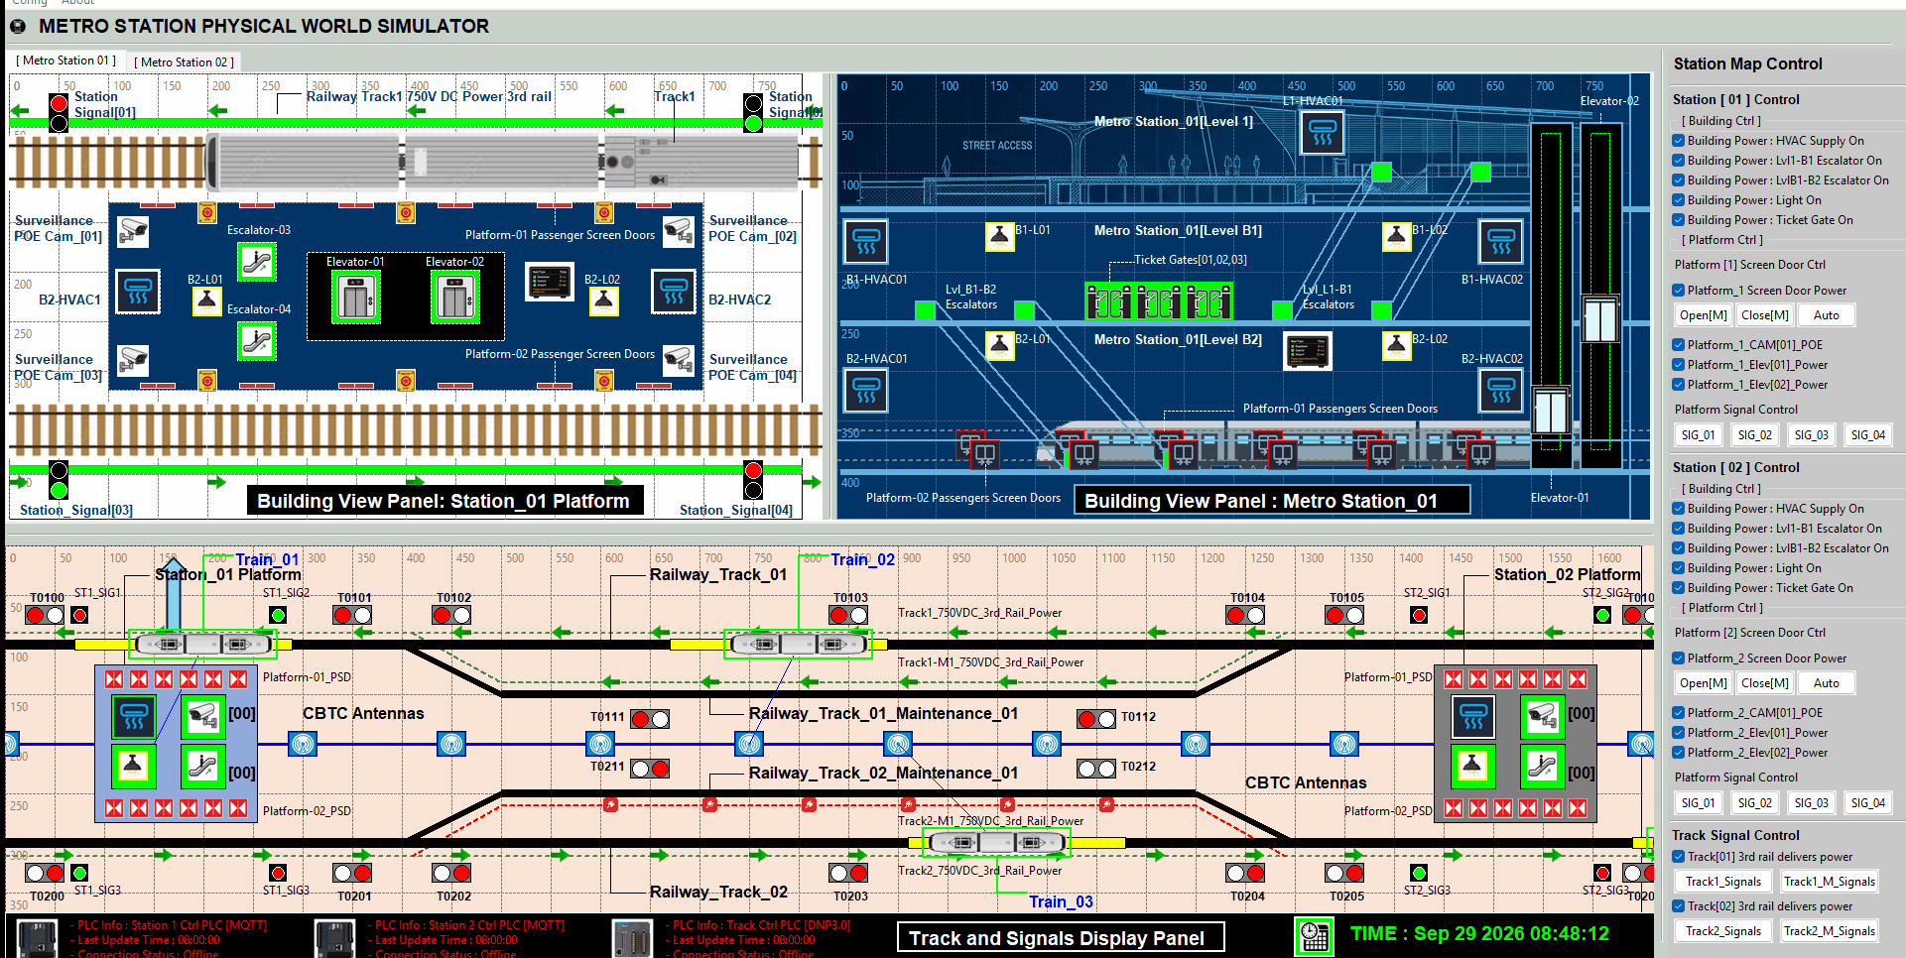
Metro Railway Station Cyber Twin System
Main Components:
One physical world simulator
1 SCADA HMI
3 PLC with 2 kinds o OT protocol
2 Metro Stations
4 Tracks
4 Trains on 2 track
4 3rd rail power supply
CBTC train signalling
3 level station control
Light system
HVAC system
Ticket gates system
Elevators
Escalators
Platform Passenger protection screen door.
POE surveillance cameras
2 Train Information board screen
Emergency and fire alarm buttons.
Auto train dock and departure control
20 direction signal
16 station signal
Critical Infrastructure Sectors : OT security for Public Transport System and Public Critical Building System

Slide 2
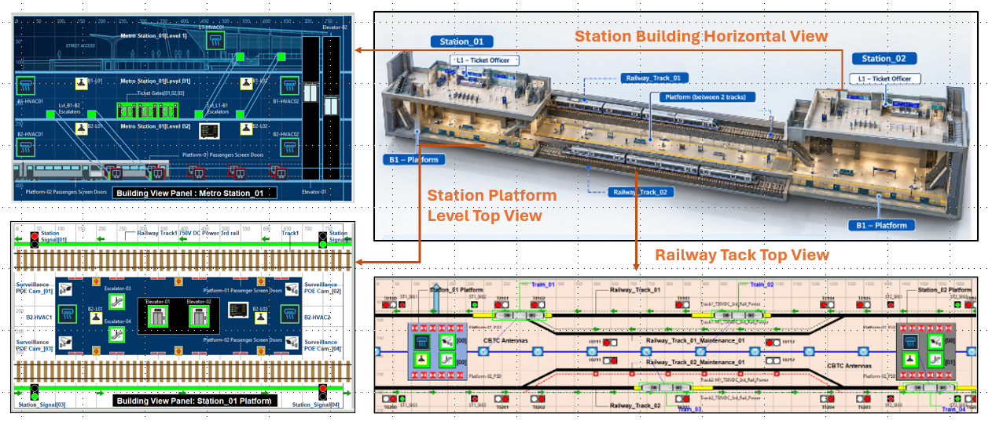
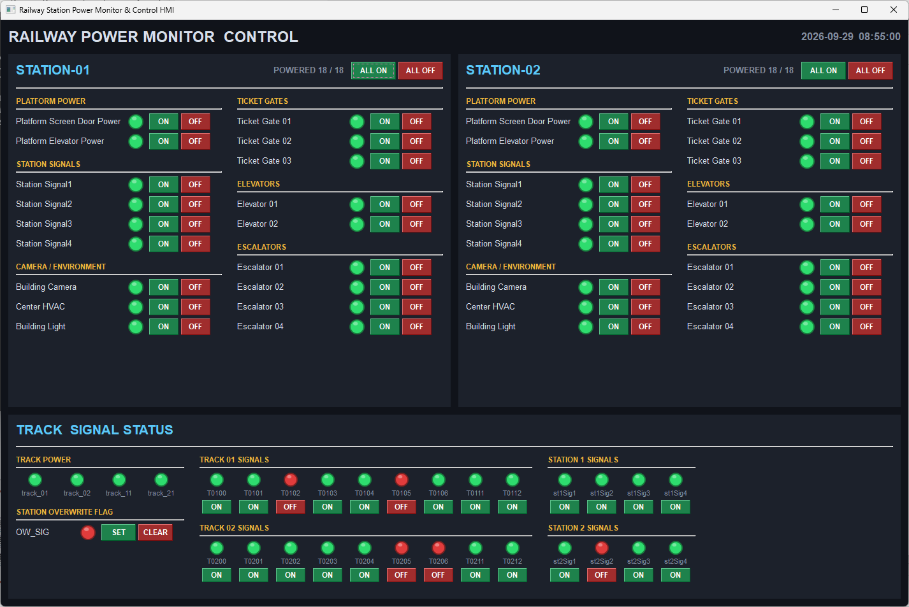


System view and network configuration
Three Level ISA-95/IEC-62264 Architecture:
Level 0 : Physical Field I/O device
Level 1 : OT System Controllers
Level 2 : OCC Processing Lan
Two OT Protocol :
IEC-20922 MQTT
IEEE 1815-2021 DNP3.0
Two subnet:
Green team physical signal subnet
Blue Team OT SCADA subnet
Station Control HMI VM
UPD Port 3001
UPD Port 3001
UPD Port 3001
Railway Station-01 Building Control PLC
Railway Station-02 Building Control PLC
Railway Track Control PLC
Port1883
Port1883
MQTT BUS
DNP3.0 BUS
Port20000

