Slide 1






Train Sensor
Train Station
Railway Cross Signal
Green: Pass [off]
Red: Block [on]
Train Speed Reset
Train Emergency Stop

Slide 2
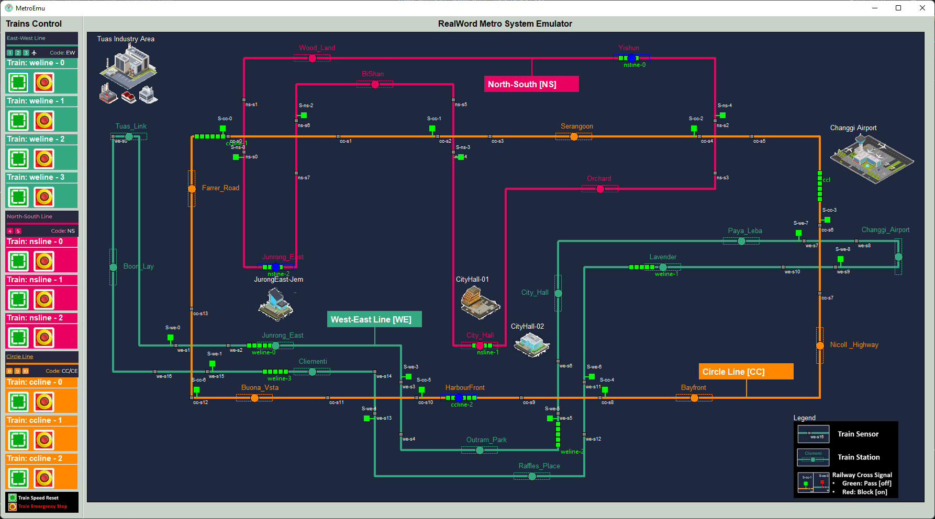
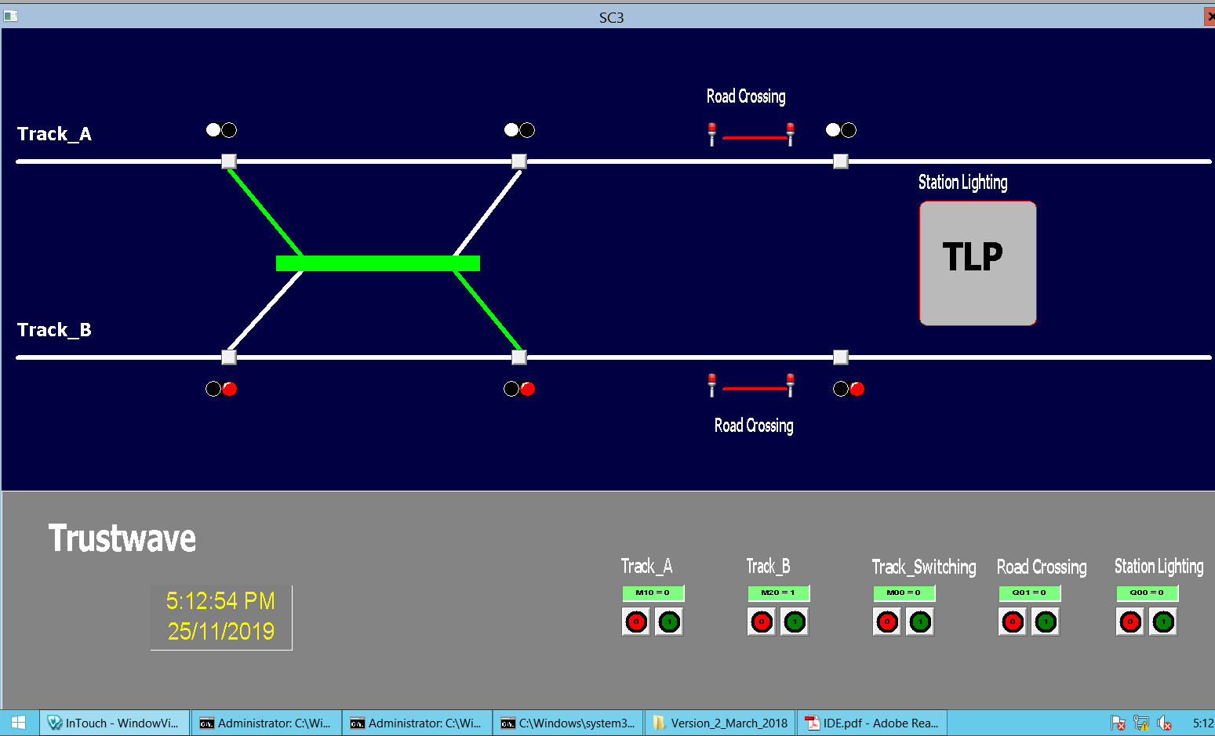
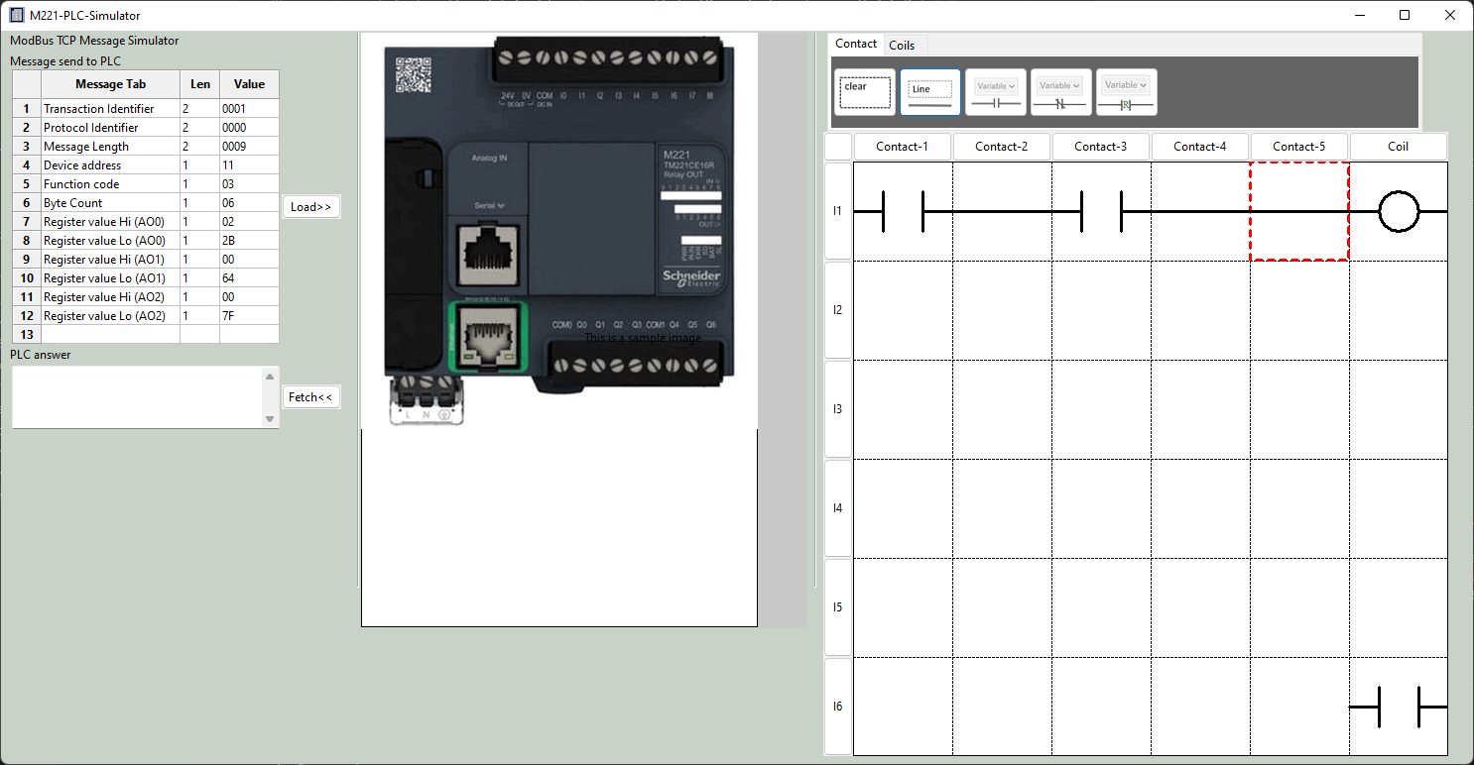
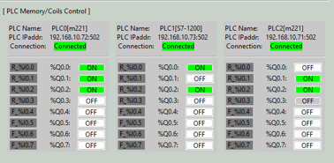
Metro Control HMI
Real work sensor data
PCL coil output data
Database
PLC simulator VM
SCADA HMI data Visualization
PCL input data
ModBus TCP
Communication manager
PCL coil output data

Slide 3
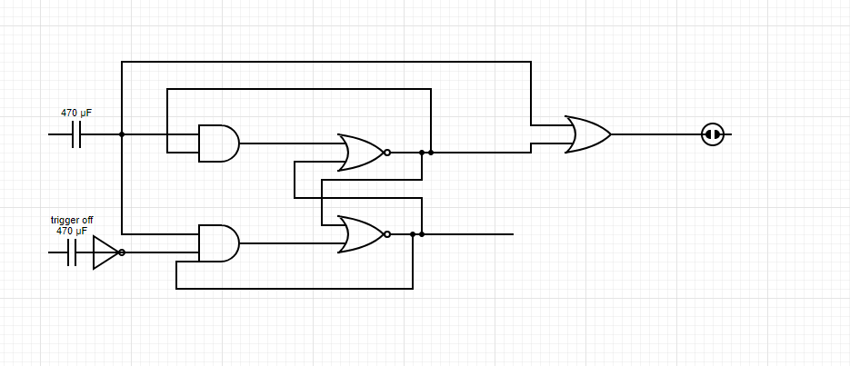
Use PLC to create a T Flip – Flop latching relay with signal trigger on has high priority
Signal Trigger on sensor
Railway control signal
Signal Trigger off sensor

Slide 4
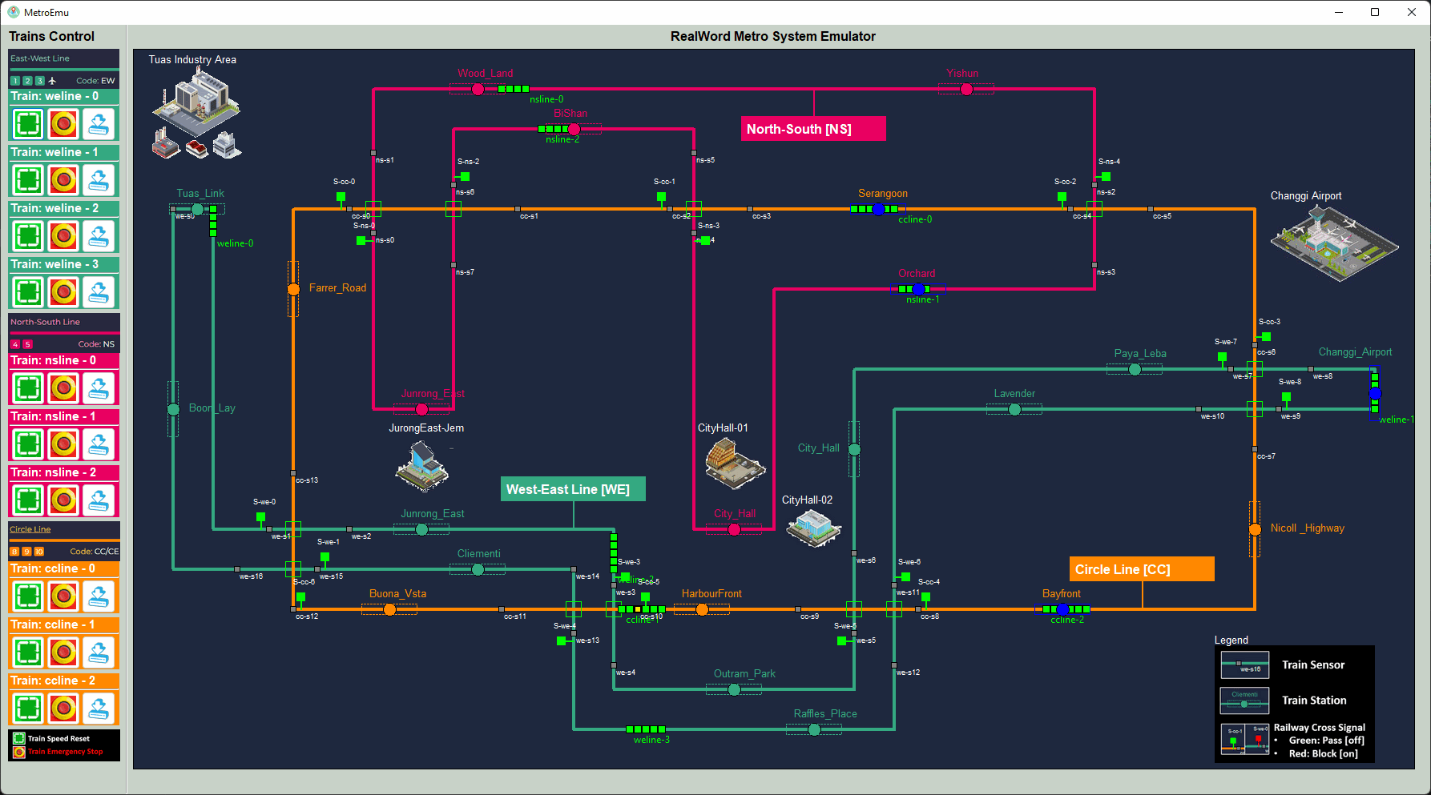
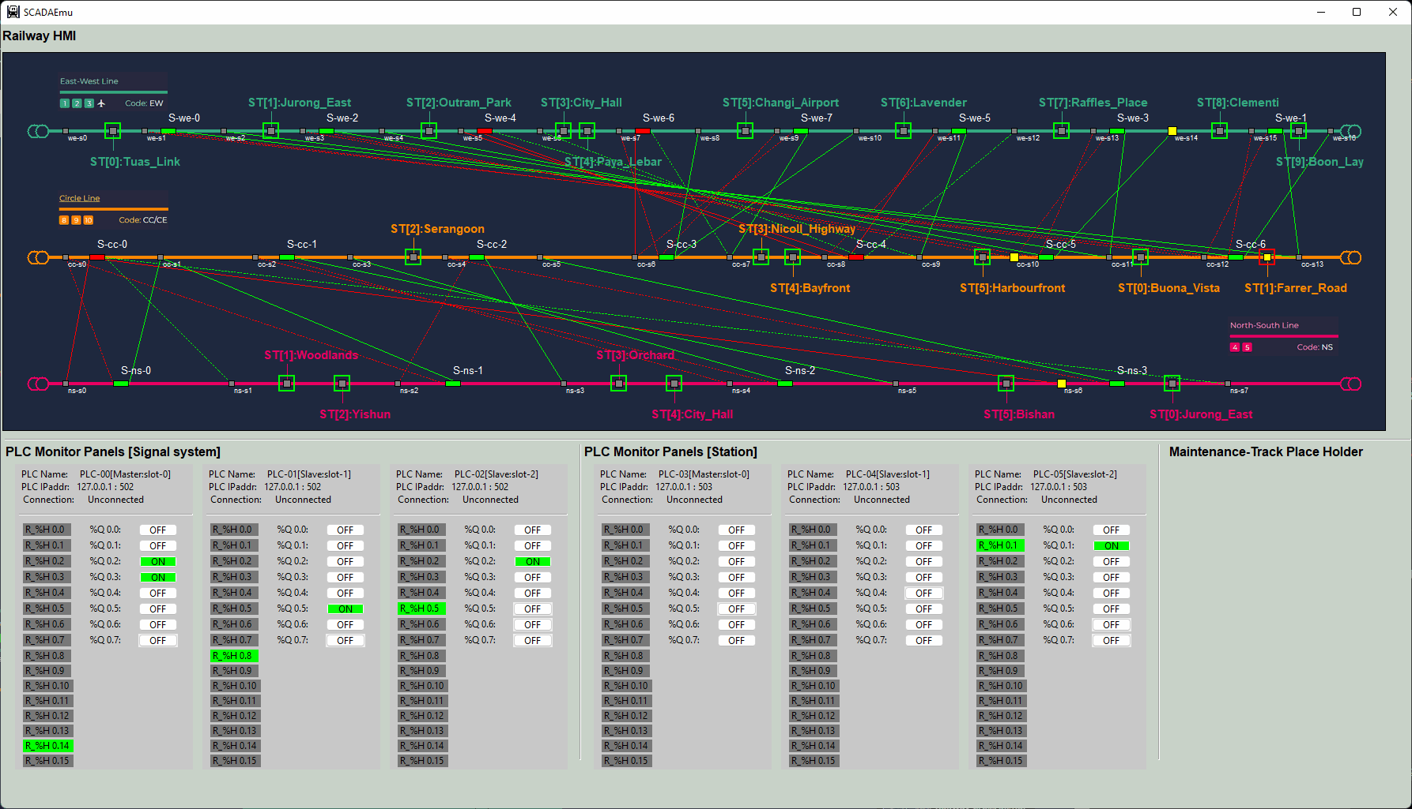

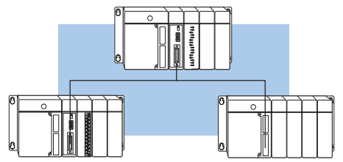

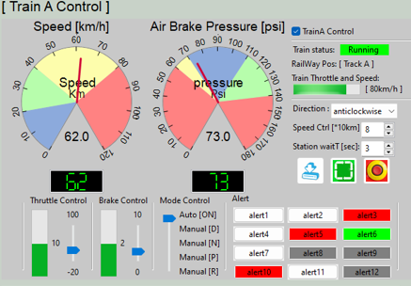
Railway real-world Emulator
Railway SCADA HMIs
Master HMI
Slave HMI(s)
Slave HMI IP: 192.168.10.10X
39 sensors input
Master HMI IP: 192.168.10.100
Electrical signal communication simulation module (10.0.10.100)
10 train throttle
input
19 signal coils output
Register control
Coils control
Register data fetch
Coils data fetch
Train control PLC network [under progress ]
22 station
Sensors input
22 station
Signal output
HMI network 192.16.10.x
Junction Signal control PLC network
10.0.11.10
10.0.13.10
Station Signal control PLC network
10.0.12.10
[Master, Slot-0]
I/O: 15/7
Train Control panel [under progress]
[Master, Slot-0]
I/O: 0/8
[Master, Slot-0]
I/O: 8/8
PLC-00
PLC-06
PLC-03
PLC-01
PLC-02
[Slave, Slot-1] I/O: 0/2
PLC-04
PLC-05
PLC-07
[Slave, Slot-1]
I/O: 15/7
[Slave, Slot-2]
I/O: 9/5
[Slave, Slot-1] I/O: 8/8
[Slave, Slot-2] I/O: 6/6
Modbus IP: 192.168.100.13
Coils control request
Modbus IP: 192.168.100.12
Register control request
Coils control request
Modbus IP: 192.168.100.11
Register control request
Coils control request
Coils control request
Modbus IP: 192.168.100.2xx
Modbus Network 192.168.100.0/24

Slide 5
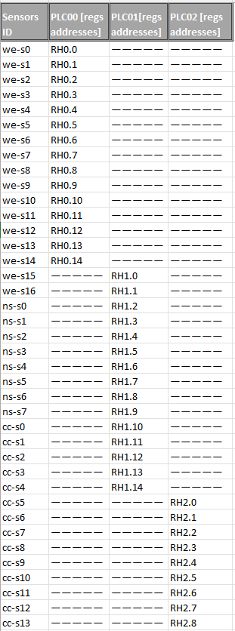
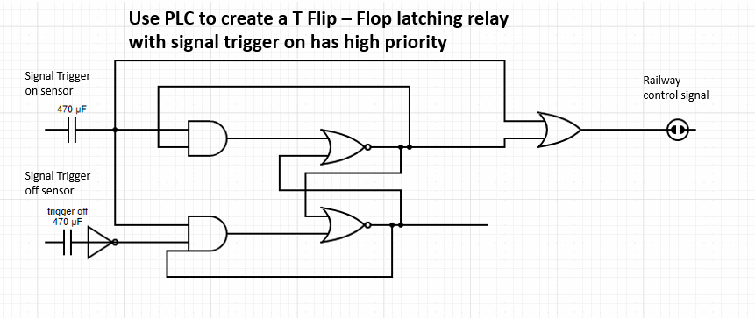
Railway Signal system ladder logic
Junction Signal control PLC network
PLC-00
[Master, Slot-0]
I/O: 15/7
PLC0 Q0.3
S-we-3
PLC1 Q0.1
S-ns-0
PLC-01
PLC-02
[Slave, Slot-1]
I/O: 15/7
[Slave, Slot-2]
I/O: 9/5
PLC0 Q0.5
S-we-5
PLC1 Q0.2
S-ns-1
PLC2 Q0.1
S-cc-3
PLC1 Q0.0
S-we-7
PLC1 Q0.3
S-ns-2
PLC0 Q0.6
S-we-6
PLC2 Q0.2
S-cc-4
PLC1 Q0.4
S-ns-3
PLC2 Q0.3
S-cc-5
Ladder Diagram set information:
Holding register: 39
Coil: 19
Total ladder diagram: 19
Ladder diagram detail:
PLC0 Q0.4
S-we-4
PLC1 Q0.5
S-cc-0
PLC0 Q0.2
S-we-2
PLC2 Q0.4
S-cc-6
PLC1 Q0.6
S-cc-1
PLC0 Q0.0
S-we-0
PLC0 Q0.1
S-we-1
PLC2 Q0.0
S-cc-2

Slide 6
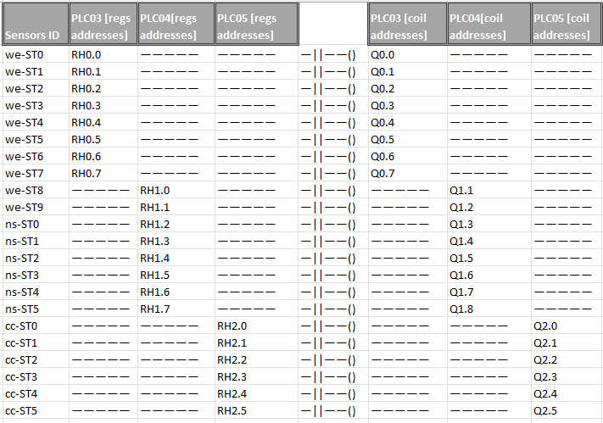
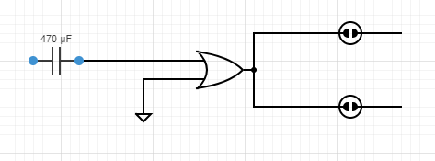
Railway Station system ladder logic
Station Signal control PLC network
10.0.12.10
PLC-03
[Master, Slot-0]
I/O: 8/8
PLC-04
PLC-05
[Slave, Slot-1] I/O: 8/8
[Slave, Slot-2] I/O: 6/6
Ladder Diagram set information:
Holding register: 22
Coil: 22
Total ladder diagram: 22
Ladder diagram detail:

