Slide 1






Train Sensor
Train Station
Railway Cross Signal
Green: Pass [off]
Red: Block [on]
Train Speed Reset
Train Emergency Stop

Slide 2
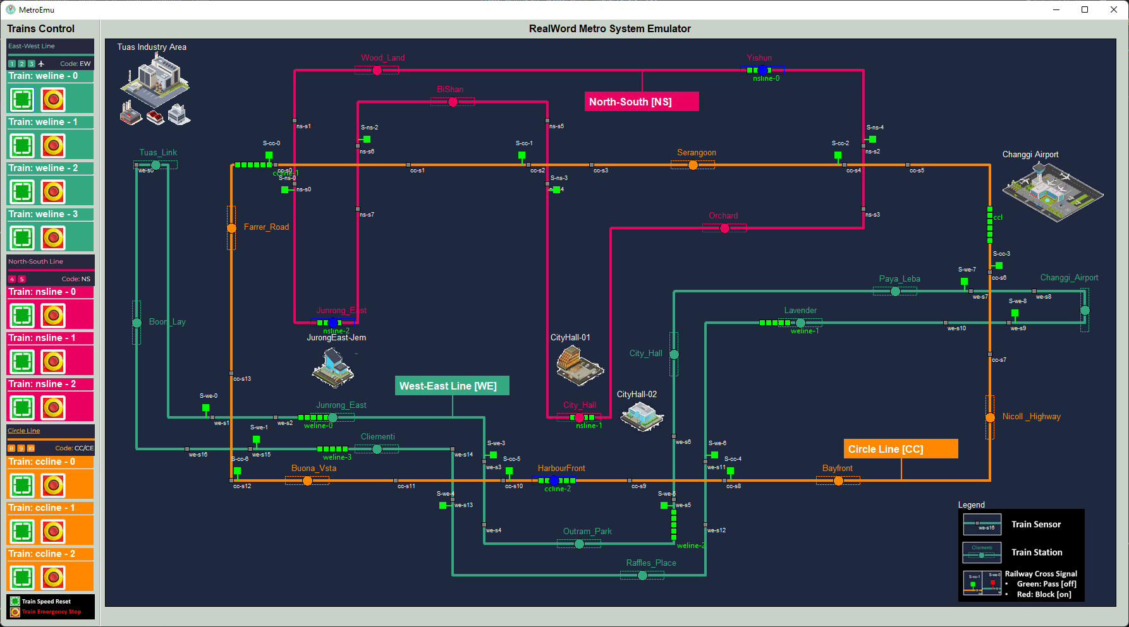
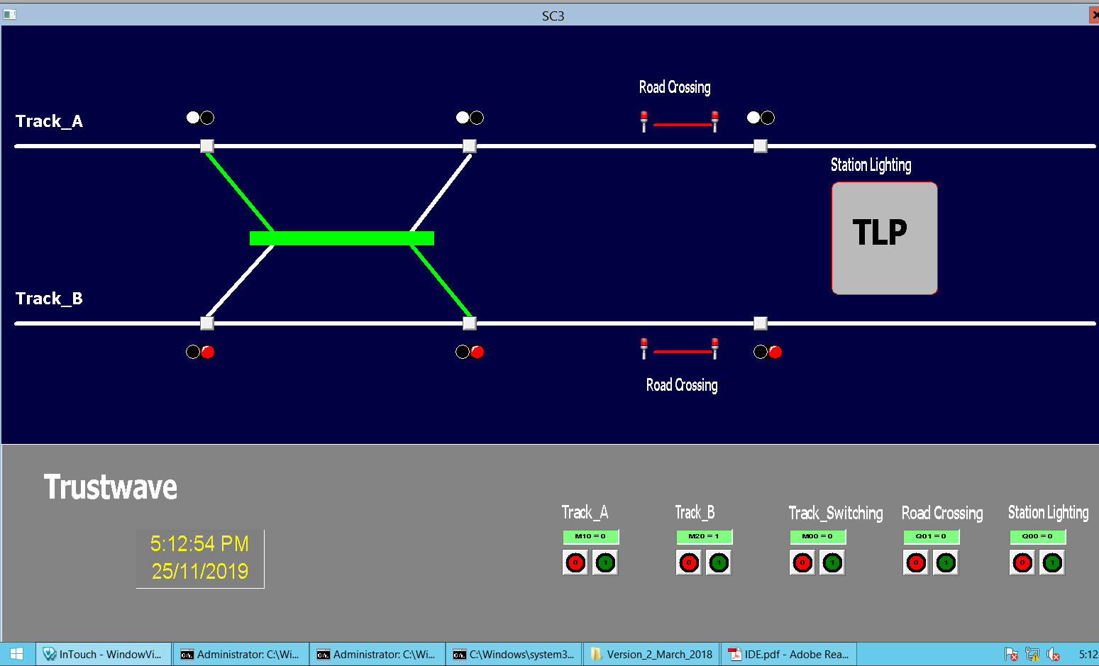
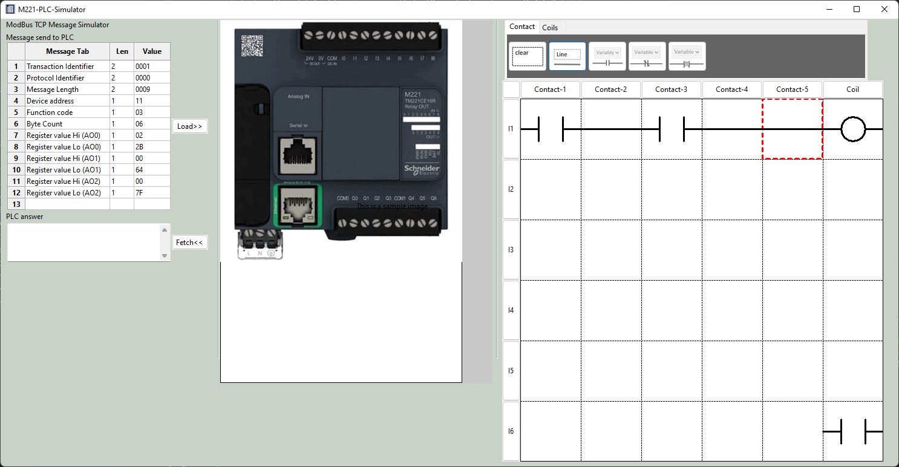
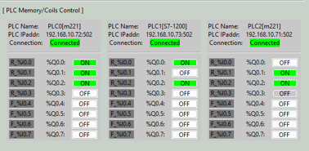
Metro Control HMI
Real work sensor data
PCL coil output data
Database
PLC simulator VM
SCADA HMI data Visualization
PCL input data
ModBus TCP
Communication manager
PCL coil output data

