Slide 1






Train Sensor
Train Station
Railway Cross Signal
Green: Pass [off]
Red: Block [on]
Train Speed Reset
Train Emergency Stop

Slide 2
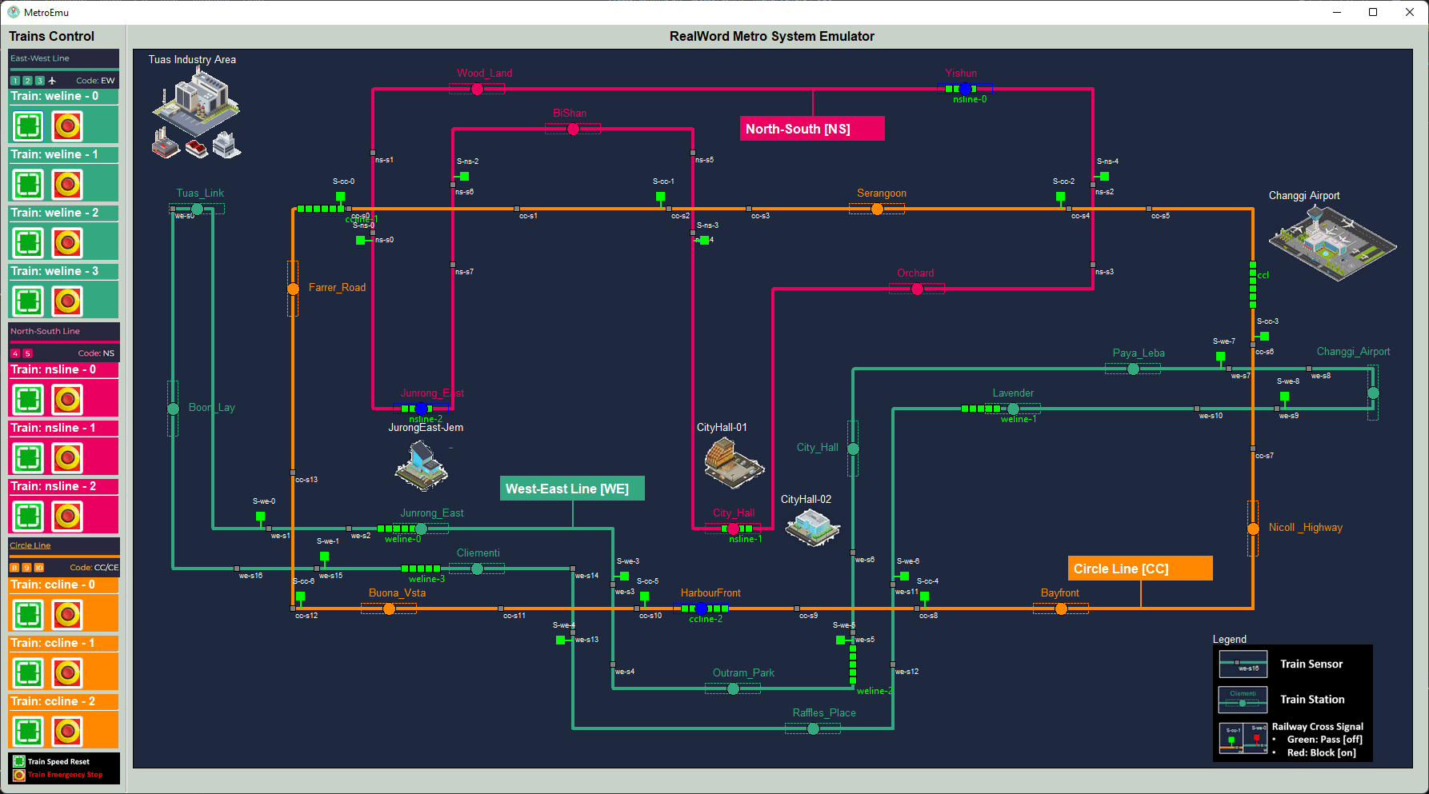
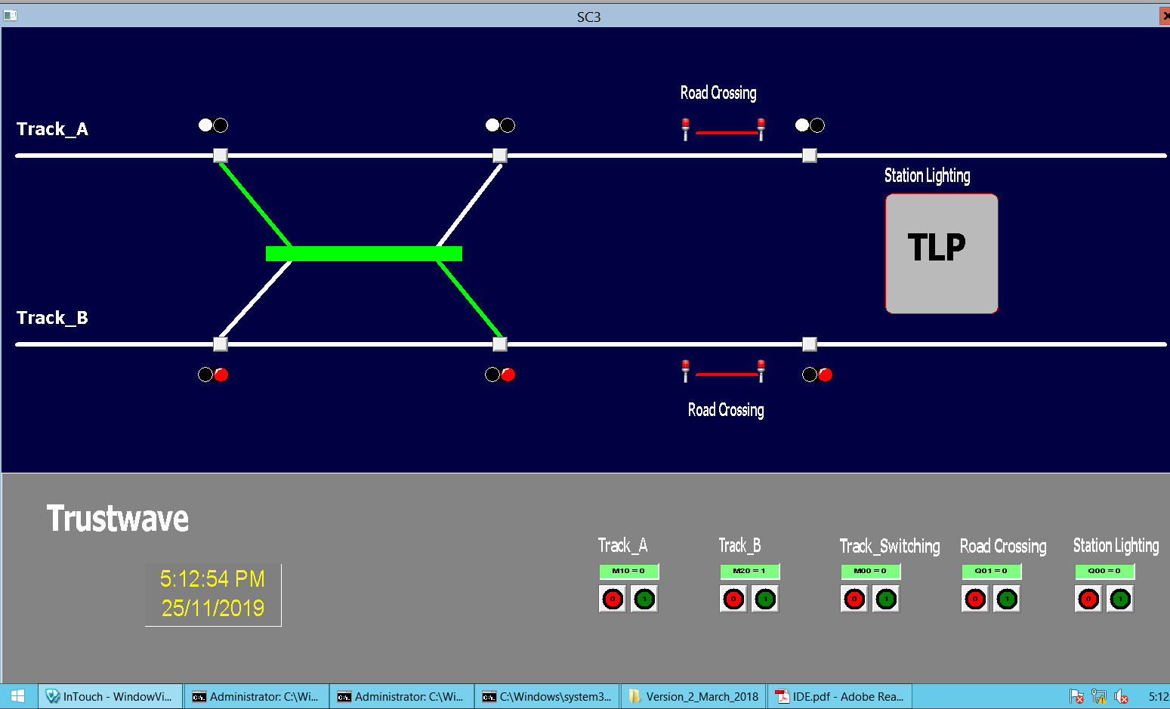
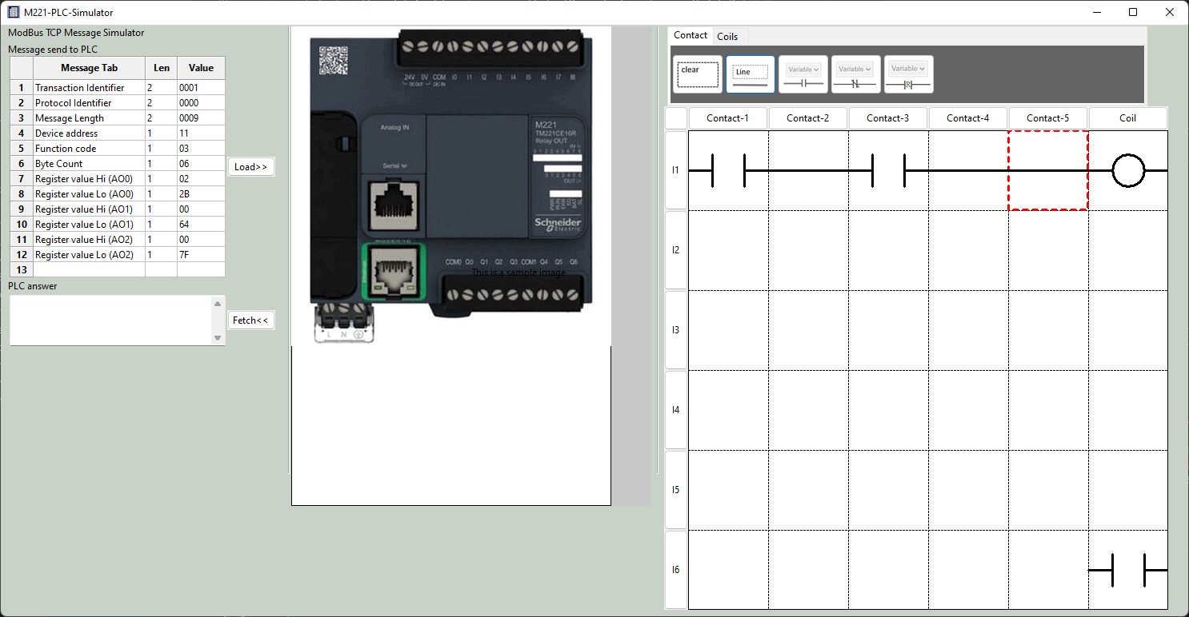
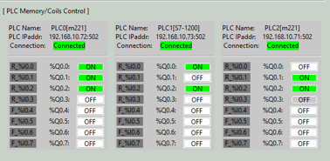
Metro Control HMI
Real work sensor data
PCL coil output data
Database
PLC simulator VM
SCADA HMI data Visualization
PCL input data
ModBus TCP
Communication manager
PCL coil output data

Slide 3
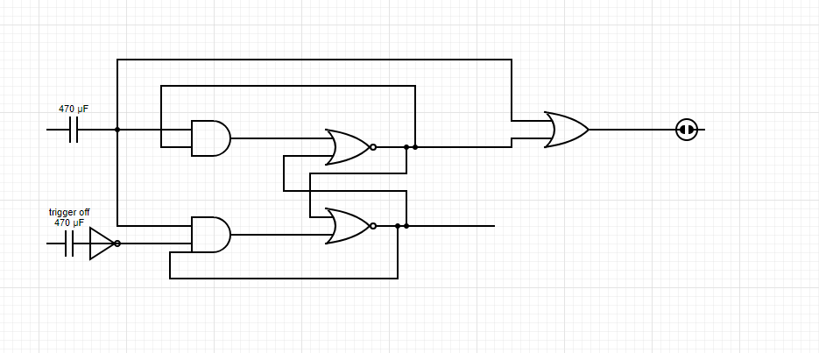
Use PLC to create a T Flip – Flop latching relay with signal trigger on has high priority
Signal Trigger on sensor
Railway control signal
Signal Trigger off sensor

