Slide 1















Infra Connection Monitor Hub
User
Public IP
Web-Browser
Telegram
SUTD, Singtel, gov.sg
Public network
Hub server
SoC network
Http:3000
tcp:8086
Telegram client
PingClient
Server cluster
Filtered data
UDP:3001
Ajax page:5000
All data
Connection map module
Summarized data
Data manager
Alert raise module
Exception data
server
switch
Alert History DB
UDP:3001
COM3-MPH
Cyber event scenario
User PC
PingClient
CIDEX- SUTD-Cluster
CIDEX-CR1-Cluster
Ping
Event server
gateway
vCenter
Internet
Ping
VPN tunnel
Local storage [text log file]
Gateway and switch
VPN tunnel

Slide 2

NCL-CIDEX Connection Monitor Hub
Oversea IP
BBC.CO.UK
SG IP
Web-Browser
ssh -L 127.0.0.1:4000:127.0.0.1:3000 yc@172.26.191.95
SUTD, Singtel, gov.sg
Public network
Network Connection hub
SoC network
NCL-server
Ping
Ping
Http:3000
tcp:8086
COM3-MPH
Ajax:5000
UDP:3001
Connection map module
Data manager
PingClient
alert raise module
Alert History DB
Local storage [text log file]
CIDEX- SUTD-Cluster
CIDEX-CR1-Cluster
Ping
gateway
vCenter
VPN tunnel
Ping
VPN tunnel

Slide 3
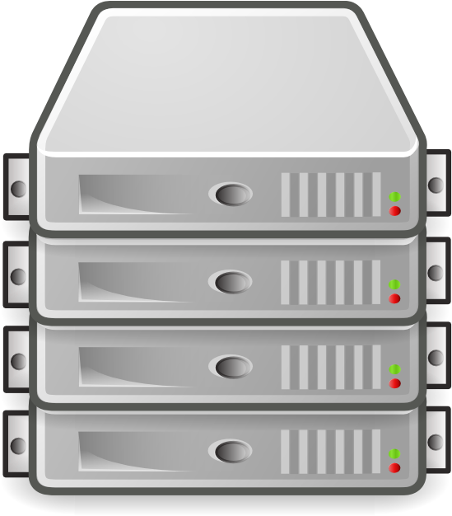

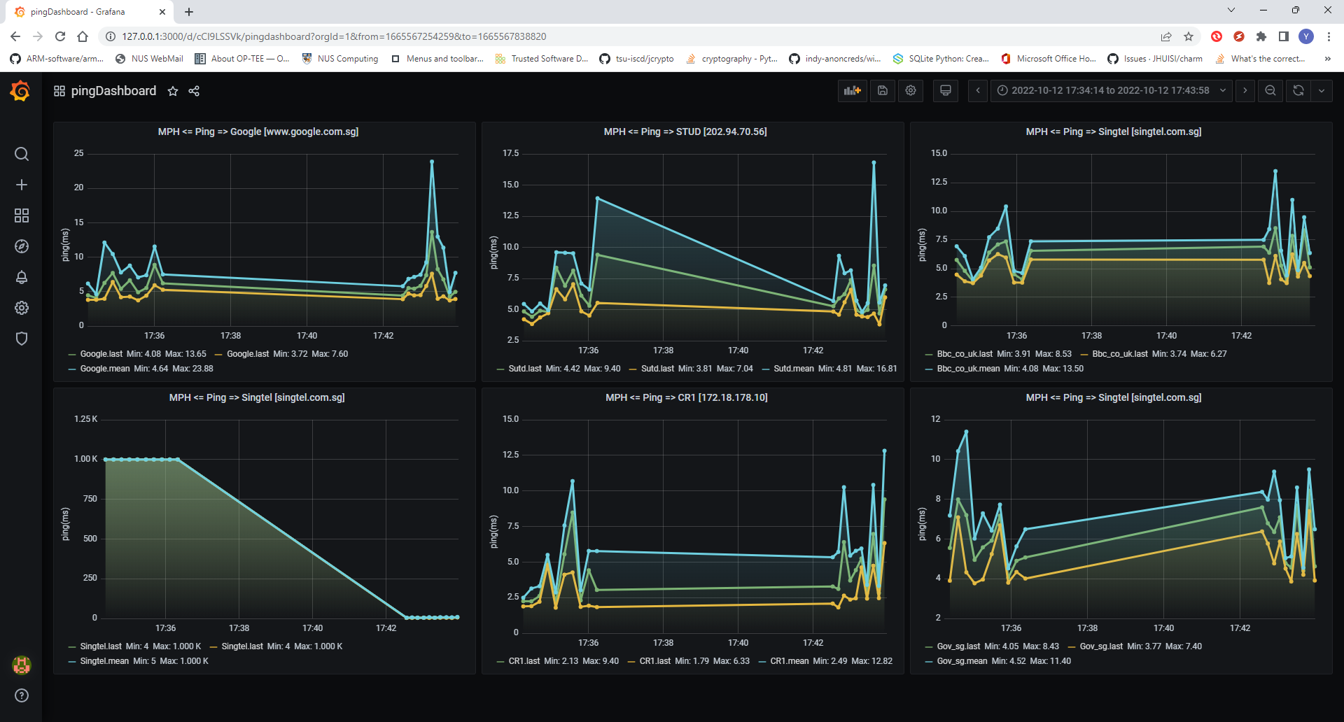
Cluster internal network
Cluster internal network
Internet
Internet
Connection monitor hub
Monitor dashboard
Cluster internal network
Ping request
Report msg

