Slide 1
Communication Quantum Attack resistance scanner
Introduction :

Slide 2
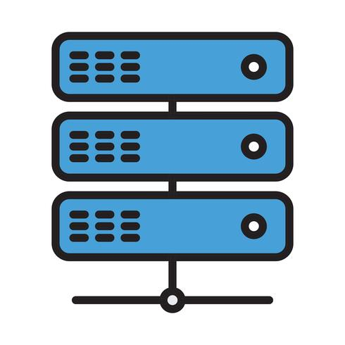


Communication Quantum Attack resistance scanner
Server A
Server B
Server A
Server B
pyShark_
tShark_

