Slide 1
Communication Quantum Attack resistance scanner
Introduction :

Slide 2
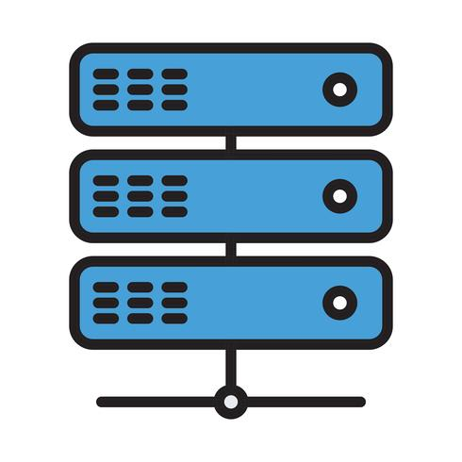


Communication Quantum Attack resistance scanner
Server A
Server B
Server A
Server B
pyShark_
tShark_

Slide 3


Network traffic packet collection module
Packet cap
Matching with the QS standard info in the data base
Protocol parsing and matching module
DataBase
Result Visualization dashboard

