Slide 1

Communication Quantum Attack resistance scanner
Product logo:

Slide 2
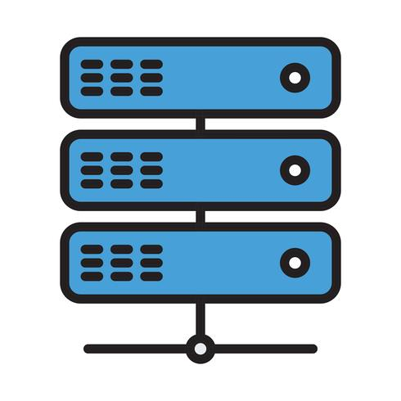


Communication Quantum Attack resistance scanner
Server A
Server B
Server A
Server B
pyShark_
tShark_

Slide 3


Binary file to text file convert
Packet layer data detail information
Pcap filter
Layer ETH:
Destination: 02:50:41:00:00:01 …
…
Layer IP:
0100 .... = Version: 4
….
Layer TCP:
Source Port: 443
…
Layer TLS:
TLSv1.2 Record Layer: Application Data Protocol: http2
……
DATALayer TLS:
TLSv1.2 Record Layer: Application Data Protocol: http2 …..
Network traffic packet collection module
Packet Parser
Packet cap
Packet protocol detail information
Matching with the QS standard info in the data base
{'Src': '52.163.231.110', 'Dist': '172.27.127.219', 'Prot': 'Application Data Protocol', 'Layer': ['Layer ETH', 'Layer IP', 'Layer TCP', 'Layer TLS', 'TLSv1.2 Record Layer: Application Data Protocol: http-over-tls']}
Protocol parsing and matching module
DataBase
Data Counting
Data Categorization
Communication encryption summary
src: 52.163.231.110
dist: 172.27.127.219
pktCount: 29
tcpCount: 0
udpCount: 0
encriptDict: {'notEncript': 14,
'Layer TLS': 13, 'DATALayer TLS': 2,
'TLSv1.2 Record Layer: Handshake Protocol: Multiple Handshake Messages': 2,
'TLSv1.2 Record Layer: Change Cipher Spec Protocol: Change Cipher Spec': 3,
'TLSv1.2 Record Layer: Handshake Protocol: Encrypted Handshake Message': 3,
'TLSv1.2 Record Layer: Application Data Protocol: http-over-tls': 8, ‘
TLSv1.2 Record Layer: Handshake Protocol: Server Hello': 1}
Result Visualization dashboard
PQC attack resistance score detail score information
Algorithm Checker
Connection: 172.27.127.219-52.114.15.112 QS-Confidence lvl: 3.5
Connection: 52.114.15.112-172.27.127.219 QS-Confidence lvl: 4.285714285714286
Connection: 120.53.124.160-172.27.127.219 QS-Confidence lvl: 5.0
Connection: 172.27.127.219-120.53.124.160 QS-Confidence lvl: 3.3333333333333335
Connection: 175.24.251.10-172.27.127.219 QS-Confidence lvl: 0.0
Connection: 172.27.127.219-175.24.251.10 QS-Confidence lvl: 0
Connection: 172.27.127.219-164.52.39.44 QS-Confidence lvl: 2.0
Connection: 164.52.39.44-172.27.127.219 QS-Confidence lvl: 5.0
Result generator

Slide 4


Communication Quantum Attack resistance scanner
Server A
Server B
Quantum crypto attack resistance confidence level (0-10):
0
1
2
3
4
5
6
7
8
9
10
0: Vulnerable for any Quantum attack
10:Defensive for most Quantum attack

Slide 5
Visualization UI
Encryption QS evaluation Info
DataBase
network
UI Thread (User action handing thread)
User control act
Data Source Capture Thread
Cap files
P2P protocol data
Raw packet data
Data Parsing Thread
Protocol Encryption Layer data
Encryption Layer QS Score
History record data
Result Display

Slide 6

Network PQC Attack Resistance Evaluator Program workflow
Encryption Quantum attack resistance evaluation Info DB
Database
Program init
Data source processing thread
Main thread
Evaluation thread
Pre-captured network packet file (pcap/tcp dump)
Network PQC Attack Resistance Evaluator UI
Packet encryption protocol evaluator
Network data capture module
Real time network data
User interface thread
Packet filter
Packet encryption algo checker
Program internal flow
History record data
Packet parser
User action handler functions
User
Encryption algorithm data
Quantum attack resistance score generator
Condition station
Normalized packet data summary
File I/O ( load or wite )
Protocol network Layer data
Internal data flow
Evaluation Result Display
Quantum attack resistance score
User action

Slide 7
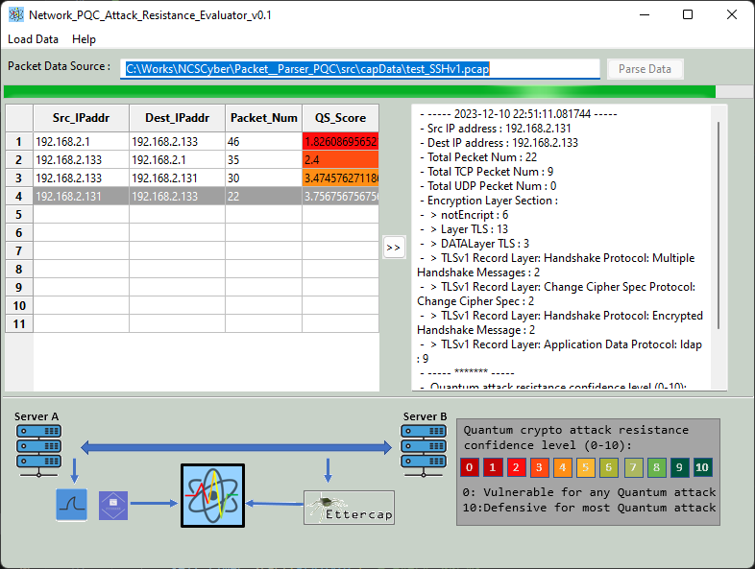
Source selection drop menu button
Source detail information
Process start button
Peer to peer
Communication detail display
All connection score summary table
Score example

