Slide 1

Communication Quantum Attack resistance scanner
Product logo:

Slide 2
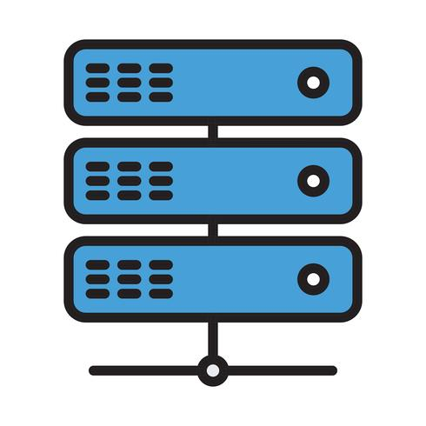

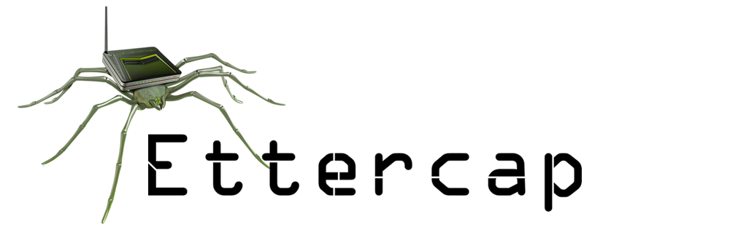
Communication Quantum Attack resistance scanner
Server A
Server B
Server A
Server B
pyShark_
tShark_

Slide 3
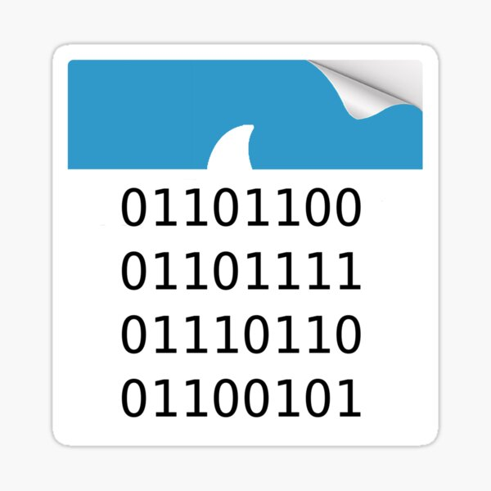

Binary file to text file convert
Layer ETH:
Destination: 02:50:41:00:00:01 …
…
Layer IP:
0100 .... = Version: 4
….
Layer TCP:
Source Port: 443
…
Layer TLS:
TLSv1.2 Record Layer: Application Data Protocol: http2
……
DATALayer TLS:
TLSv1.2 Record Layer: Application Data Protocol: http2 …..
Network traffic packet collection module
PacketParser
Packet cap
Matching with the QS standard info in the data base
{'Src': '52.163.231.110', 'Dist': '172.27.127.219', 'Prot': 'Application Data Protocol', 'Layer': ['Layer ETH', 'Layer IP', 'Layer TCP', 'Layer TLS', 'TLSv1.2 Record Layer: Application Data Protocol: http-over-tls']}
Protocol parsing and matching module
DataBase
DataCounting
Result Visualization dashboard
src: 52.163.231.110
dist: 172.27.127.219
pktCount: 29
tcpCount: 0
udpCount: 0
encriptDict: {'notEncript': 14,
'Layer TLS': 13, 'DATALayer TLS': 2,
'TLSv1.2 Record Layer: Handshake Protocol: Multiple Handshake Messages': 2,
'TLSv1.2 Record Layer: Change Cipher Spec Protocol: Change Cipher Spec': 3,
'TLSv1.2 Record Layer: Handshake Protocol: Encrypted Handshake Message': 3,
'TLSv1.2 Record Layer: Application Data Protocol: http-over-tls': 8, ‘
TLSv1.2 Record Layer: Handshake Protocol: Server Hello': 1}
Connection: 172.27.127.219-52.114.15.112 QS-Confidence lvl: 3.5
Connection: 52.114.15.112-172.27.127.219 QS-Confidence lvl: 4.285714285714286
Connection: 120.53.124.160-172.27.127.219 QS-Confidence lvl: 5.0
Connection: 172.27.127.219-120.53.124.160 QS-Confidence lvl: 3.3333333333333335
Connection: 175.24.251.10-172.27.127.219 QS-Confidence lvl: 0.0
Connection: 172.27.127.219-175.24.251.10 QS-Confidence lvl: 0
Connection: 172.27.127.219-164.52.39.44 QS-Confidence lvl: 2.0
Connection: 164.52.39.44-172.27.127.219 QS-Confidence lvl: 5.0
ProtocolCheker

Slide 4


Communication Quantum Attack resistance scanner
Server A
Server B
Quantum crypto attack resistance confidence level (0-10):
0
1
2
3
4
5
6
7
8
9
10
0: Vulnerable for any Quantum attack
10:Defensive for most Quantum attack

Slide 5
Visualization UI
Encryption QS evaluation Info
DataBase
network
UI Thread (User action handing thread)
User control act
Data Source Capture Thread
Cap files
P2P protocol data
Raw packet data
Data Parsing Thread
Protocol Encryption Layer data
Encryption Layer QS Score
History record data
Result Display

