Slide 1

Communication Quantum Attack resistance scanner
Introduction :

Slide 2
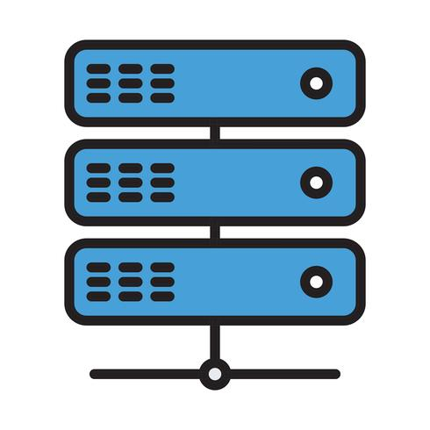


Communication Quantum Attack resistance scanner
Server A
Server B
Server A
Server B
pyShark_
tShark_

Slide 3


Binary file to text file convert
Layer ETH:
Destination: 02:50:41:00:00:01 …
…
Layer IP:
0100 .... = Version: 4
….
Layer TCP:
Source Port: 443
…
Layer TLS:
TLSv1.2 Record Layer: Application Data Protocol: http2
……
DATALayer TLS:
TLSv1.2 Record Layer: Application Data Protocol: http2 …..
Network traffic packet collection module
PacketParser
Packet cap
Matching with the QS standard info in the data base
{'Src': '52.163.231.110', 'Dist': '172.27.127.219', 'Prot': 'Application Data Protocol', 'Layer': ['Layer ETH', 'Layer IP', 'Layer TCP', 'Layer TLS', 'TLSv1.2 Record Layer: Application Data Protocol: http-over-tls']}
Protocol parsing and matching module
DataBase
DataCounting
Result Visualization dashboard
src: 52.163.231.110
dist: 172.27.127.219
pktCount: 29
tcpCount: 0
udpCount: 0
encriptDict: {'notEncript': 14,
'Layer TLS': 13, 'DATALayer TLS': 2,
'TLSv1.2 Record Layer: Handshake Protocol: Multiple Handshake Messages': 2,
'TLSv1.2 Record Layer: Change Cipher Spec Protocol: Change Cipher Spec': 3,
'TLSv1.2 Record Layer: Handshake Protocol: Encrypted Handshake Message': 3,
'TLSv1.2 Record Layer: Application Data Protocol: http-over-tls': 8, ‘
TLSv1.2 Record Layer: Handshake Protocol: Server Hello': 1}
Connection: 172.27.127.219-52.114.15.112 QS-Confidence lvl: 3.5
Connection: 52.114.15.112-172.27.127.219 QS-Confidence lvl: 4.285714285714286
Connection: 120.53.124.160-172.27.127.219 QS-Confidence lvl: 5.0
Connection: 172.27.127.219-120.53.124.160 QS-Confidence lvl: 3.3333333333333335
Connection: 175.24.251.10-172.27.127.219 QS-Confidence lvl: 0.0
Connection: 172.27.127.219-175.24.251.10 QS-Confidence lvl: 0
Connection: 172.27.127.219-164.52.39.44 QS-Confidence lvl: 2.0
Connection: 164.52.39.44-172.27.127.219 QS-Confidence lvl: 5.0
ProtocolCheker

Slide 4


Communication Quantum Attack resistance scanner
Server A
Server B
Quantum crypto attack resistance confidence level (0-10):
0
1
2
3
4
5
6
7
8
9
10
0: Vulnerable for any Quantum attack
10:Defensive for most Quantum attack

