Slide 1

NCL OT attack training test bed
OT simulation test bed
This test bed will provide a simulation platform for the Operational Technology system. It will provide a simplified PLC OT system to simulate the OT system used in industry.
The OT Security training part will focus on how IT attach will make influence of the OT system. The test bed will simulate and show the trainers how the OT system will perform when the cyberattach happens.
The OT Security training will as show how the attach happens and what can the system developer/engineer detect and defence the attack.
https://www.railway-technology.com/products/train-control-management-systems-tcms/

Slide 2





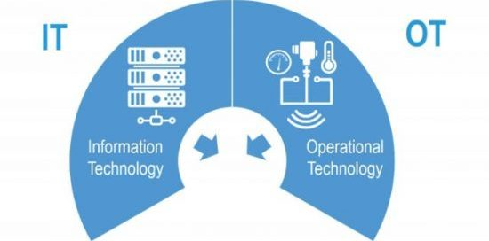






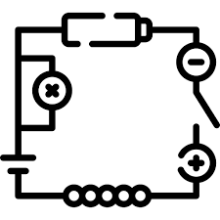

NCL OT System simulation
NCL OT Attack Simulator
IT attack Simulation
System attack Simulation
OT attack Simulation
Attack tools/ malware sandbox
NCL OT Training Test Bed
NCL OT component simulator
OT engineer
IT engineer
IT network traffic simulator
PCL
sensors
NCL OT firmware attestation tool
circuit
NCL SCADA system simulator
NCL HMI system simulator
NCL IT traffic analyze/detection tool
OT system user
NCL System performance analyze tool
OT system admin/developer

Slide 3
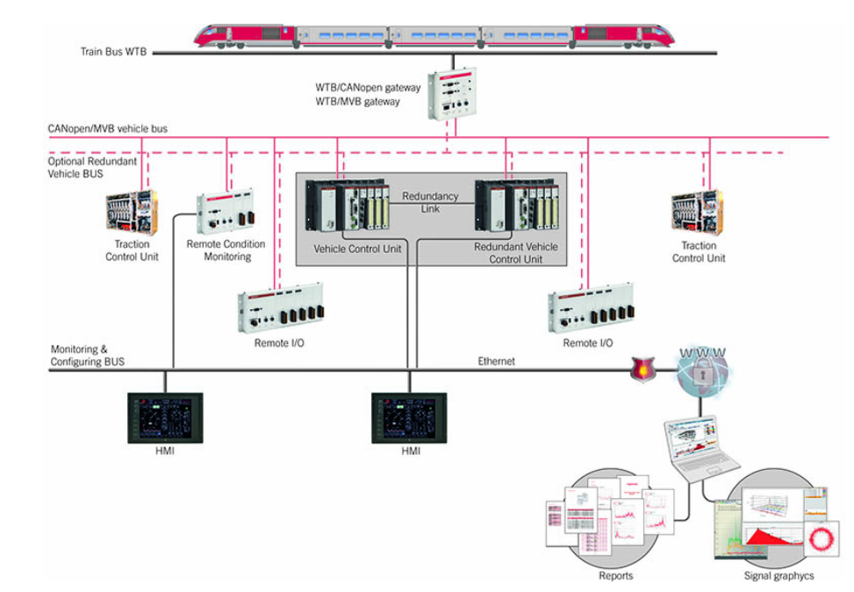
Railway system OT attack test bed
OT simulation test bed: Railway Control System Simulation.
Simulated components:
PLC signal control system
Railway sensor system.
HMI and monitoring system.

Slide 4
False data injection attack

Slide 5
Man in the mid attach HMI and monitoring system

Slide 6
Trojan attack on OT system firmware

