Slide 1

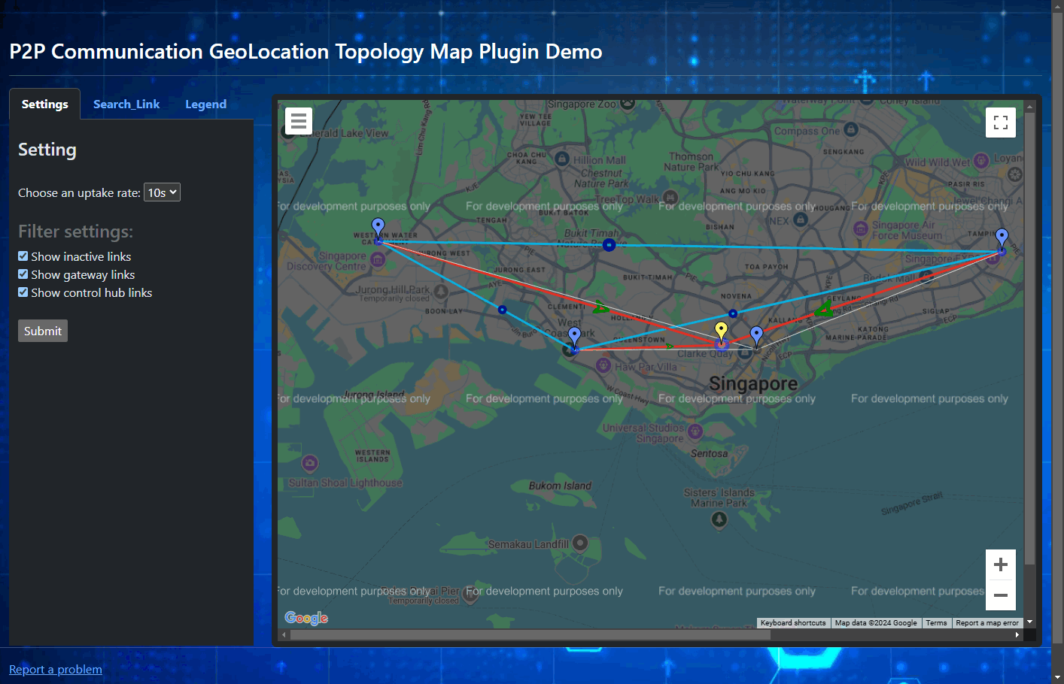
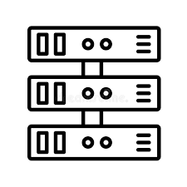



SIEM Big Data Visualization: P2P Communication Geolocation Topology Map Plugin
Monitored devices
Web Host Program [FE]
…
Display Config Setting request
Flask Web host
Internet
Network
Communication and Connection State Data
P2PComm_GeoTopology_Map_Plugin
P2P Comm data
database
Data Collection Module
Security Information and Event Management System Dashboard
Users, Security Managers

