Slide 1

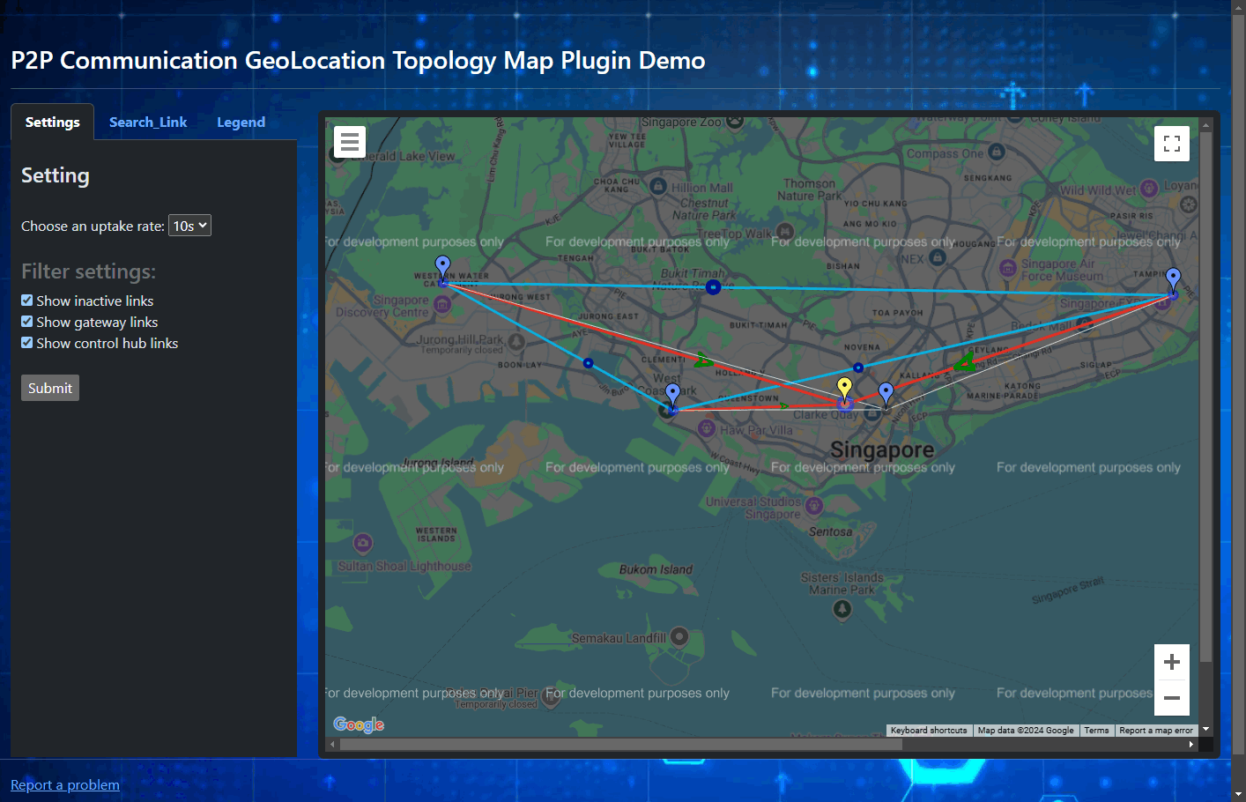




SIEM Big Data Visualization: P2P Communication Geolocation Topology Map Plugin
Monitored devices
Web Host Program [FE]
…
Display Config Setting request
Flask Web host
Internet
Network
Communication and Connection State Data
P2PComm_GeoTopology_Map_Plugin
P2P Comm data
database
Data Collection Module
Security Information and Event Management System Dashboard
Users, Security Managers

Slide 2
P2P Communication Geolocation Topology Map Plugin Workflow
Program init
p2pCommMapApp.py
Monitored devices
Main thread
Users, Security Managers
Load Configuration
Random test generate module
Data Processing thread
Data Manager
DB Data Fetch Module
JSON
object
Node data
Data Collection module
Flask Web Host App
Data Process Module
User’s setting
Create Node, comm-link Json
Database
Update the data fetch request based on the user’s setting

Slide 3
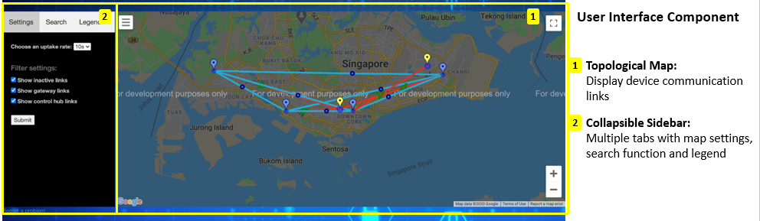
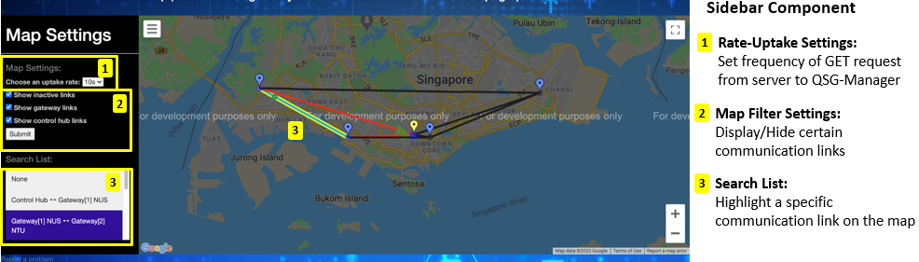

Slide 4
