Slide 1




Privacy-Preserving Biometric Authentication
Enabling biometric-based authentication of individual on potentially untrusted cloud platform without revealing the underlying biometric templates

Slide 2
Outlines
Introduction
System Overviews
Guidelines to start
Libraries Required
PBio System Flows

Slide 3
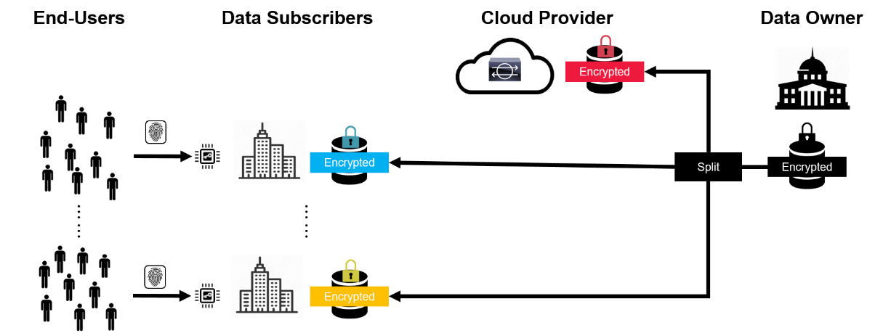
Introduction
PBio is a cross-organizational cloud-based biometric authentication system.
PBio enables a data owner (government authority), who holds users’ raw biometrics, to share an encrypted set of biometrics to data subscribers (agencies).
The subscribers then authenticate an individual remotely based on the encrypted biometrics.
Hence, the data subscribers do not need to collect user biometrics, which reduces operation cost and the efforts to collect, and protect the biometrics.
2
1
4
3

Slide 4
System Overviews

Slide 5





















System Overviews
End-Users
Data Subscribers
Cloud Provider
Data Owner
User Key
Encrypted Partial Templates I
Encrypt-then-split
2
Raw Biometric Templates
Subscriber 1 Encrypted Templates
1
Key Generation
Key Hierarchy
Subscriber 1
$m$ users
Master Key
Sub 1 Key
$$⋯⋯$$
Encrypt
Encrypted Partial Templates II
$$⋯$$
User Key
Biometrics
3
User 1 Key
User $λ$ Key
4
Tamper-proof
device
Sub $i$ Key
$$⋯$$
$$⋯$$
Subscriber $i$
Encrypted Templates
Encrypt
Sub 1 Key
Sub $i$ Key
Sub 1 Key
Sub $i$ Key
Subscriber $i$
PBio Setup and Registration Phase.
Data owner generates a master key. The key is used to derive a user key for every user. The user key is used to derive a subscriber key for every data subscriber;
Data owner encrypt-then-split each user's raw biometric template into two encrypted partial templates using the user key. One set of encrypted partial templates is passed to the cloud provider;
Data owner uses the subscriber keys to encrypt each user's encrypted partial template in another set of encrypted partial templates. The resulting set of re-encrypted partial templates is given to the subscribers;
Data owner delivers user keys to the users' registered devices.

Slide 6



System Overviews
End-Users
Data Subscribers
Cloud Provider
Tamper-proof
device
Subscriber 1 Encrypted Templates
Encrypted Partial Templates I
Biometric Features
Subscriber 1
Key Hierarchy
1
User 1 Key
2
Sub 1 Key
Subscriber 1
Encrypted Features
3
Encrypt-then-split
Encrypt
Authentication
Encrypted Partial Features I
Encrypted Partial Features II
5
Authentication
4
Early Rejection
6
Combine
or
PBio Authentication Phase.
User's device encrypt-then-split freshly submitted biometric features;
User's device generates the subscriber's encrypted partial feature;
Data subscriber verifies the received subscriber's encrypted features;
Authentication fails if verification returns non-match in step (3);
Else cloud provider verifies the received encrypted partial features;
User's device receives and combines the results from (3) and (5) and outputs the final authentication result.

Slide 7
Parties
Data Owner
A PC that stores the biometrics template.
It generates security parameters and keys to encrypt the template and outsource to other parties.
Cloud Provider
A cloud provider that holds a partial encrypted database and hosts the authentication service.
Data Subscriber
A party who subscribes the authentication service.
A partial encrypted database is given for early rejection
Client device (smartphone/ PC)
An android device that can capture face image and perform authentication with our scheme (Key Registration in setup phase if necessary)
A PC (on premise device) that is pre-set with a key. It allows every user to capture their face images and perform authentication.

Slide 8
Guidelines to start

Slide 9
Data Owner
Setup Phase
Ensure that all user images are stored in “/images” directory.
Each user image should be sorted into a new folder, where the folder name indicates the user identity, e.g. “/images/user_identity”
To execute the program, use command “python3 main.py”.
The output of the program as follows:
A “DataOwner” directory, which consists of the extracted vectors, master secret, and user keys.
A “Cloud” directory, which consists of the encrypted partial templates I & II
A “Subscriber” directory, which consists of the subscriber templates
Web service Phase
To execute web service program, use command “python3 web_service.py”
This is for prototype demo purpose, where users can register through the web service at http://0.0.0.0:5001.
Every success registration give the user a new user identity, where users can use the identity for the client device later

Slide 10
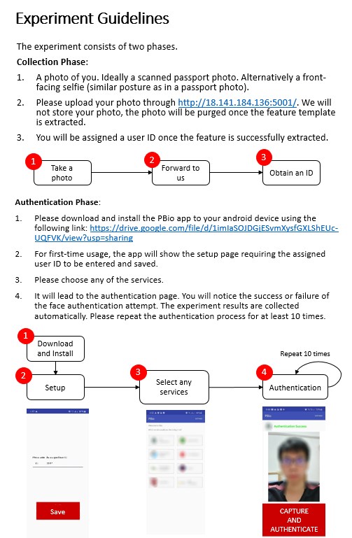
Client Device
Please refer to “PBio User Manual v5.pptx” for the guideline to install .apk to user smartphone
The registration and authentication steps are well documented.

Slide 11
Cloud & Subscribers
Ensure that you have “dst.so” file and “/util” directory in this program
The encrypted templates should be stored in “/Cloud” or “/Subscriber” directory for the cloud and subscribers respectively
To execute the program, use command “python3 web_service_example.py”
Cloud is running at http://0.0.0.0:5002
Subscriber is running at http://0.0.0.0:5003

Slide 12
Libraries Required

Slide 13
Packages
Languages | Libraries | Descriptions
Python | NumPy | Generate vectors and matrices Linear Operation
 | face_recognition | Face detection and extraction Generate feature vectors for similarity checking
 | flask | A web service, or backend server
 | hmac, hashlib, math, secrets, random | To generate cryptography hash function and random value
 | ctypes, multiprocessing | To allow C/C++ program to be run in python
 | dict, list, pickle | To manage a list/dictionary of data
C/C++ | GSHADE | A secure distance computation
 | OTExtension, Encrypto_utils, Miracl | Dependencies for GSHADE (Included in GSHADE package)
 | cmake, libgmp, libgmpx, clang++ | GSHADE dependencies C/C++ compiler

Slide 14
Packages
Languages | Libraries | Descriptions
 | Chaquopy | Python to Android java wrapper Enable python to be called in Android
 | CrystaX Native Development Kit (NDK) | Compile and build shared/static libraries from C/C++ code Enable libraries to be compatible to multiple CPU architectures
 | Java Native Interface (JNI) | Allow C/C++ shared/static libraries to be called in Android

Slide 15
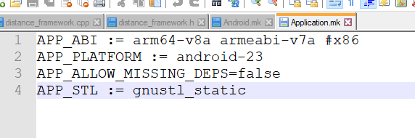
CrystaX v10.3.2: To build libraries
navigate to /jni/ folder
Check Application.mk and Android.mk, and ensure dependencies are all there
run "C:\Users\xxxxx\AppData\Local\Android\crystax-ndk-10.3.2\ndk-build” on the folder
The above setting supports only arm64 and amd32.
Note that we can also enable x86 to enable 32bits windows emulator
https://www.crystax.net/en/download

Slide 16
Installation
All python libraries can be installed through “pip3 install” command. (Please note that it is python3)
E.g. a NumPy library can be installed using “pip3 install numpy”
C/C++ library, the source code of GSHADE can be downloaded here https://github.com/encryptogroup/GSHADE
Please ensure you have install the dependencies:
OpenSSL v 1.0.2h: https://www.openssl.org/source/old/1.0.2/
Miracl: https://github.com/miracl/MIRACL
GMP : https://gmplib.org/ or “apt-get install libgmp-dev”
CLang++: “apt-get install clang++”

Slide 17
Libraries Required
Parties | Libraries
Data Owner | NumPy
 | face_recognition
 | hmac, hashlib, secrets
 | dict, list, pickle
Parties | Additional Libraries
Data Owner (Key Distribution) | flask
 | math, random
 | flask
Functions:
MKGen
save_key
load_key
Extract
Enc_then_split
full_enc
Additional Functions:
upload_file
request_OTP
key_distribute

Slide 18
Libraries Required
Parties | Libraries
Cloud/ Subscribers | NumPy
 | flask
 | dict, list, pickle
 | ctypes, multiprocessing
 | GSHADE
Functions:
Cloud_auth/ Sub_auth
scale_encode

Slide 19
Libraries Required
Parties | Libraries
Client (Kiosk) | NumPy
 | face_recognition
 | ctypes, multiprocessing
 | GSHADE
Parties | Additional Libraries | Descriptions
Client (Android) | ChaquoPy | Python Wrapper
 | JNI | C/C++ Wrapper
Functions:
Capture_and_Extract
Encrypt
Sub_auth
Cloud_auth
Combine
scale_encode
scale_decode
Additional Functions:
request_OTP
request_key

Slide 20
System Implementation

Slide 21
PBio System Flows
User
(Client)
Data
Subscribers
Data Owner
Cloud
KeyGen
Generate EncDB
Store Key
Key Distribution
Capture Img
EncQuery
Sub
Authentication
Cloud Authentication
Ver

Slide 22
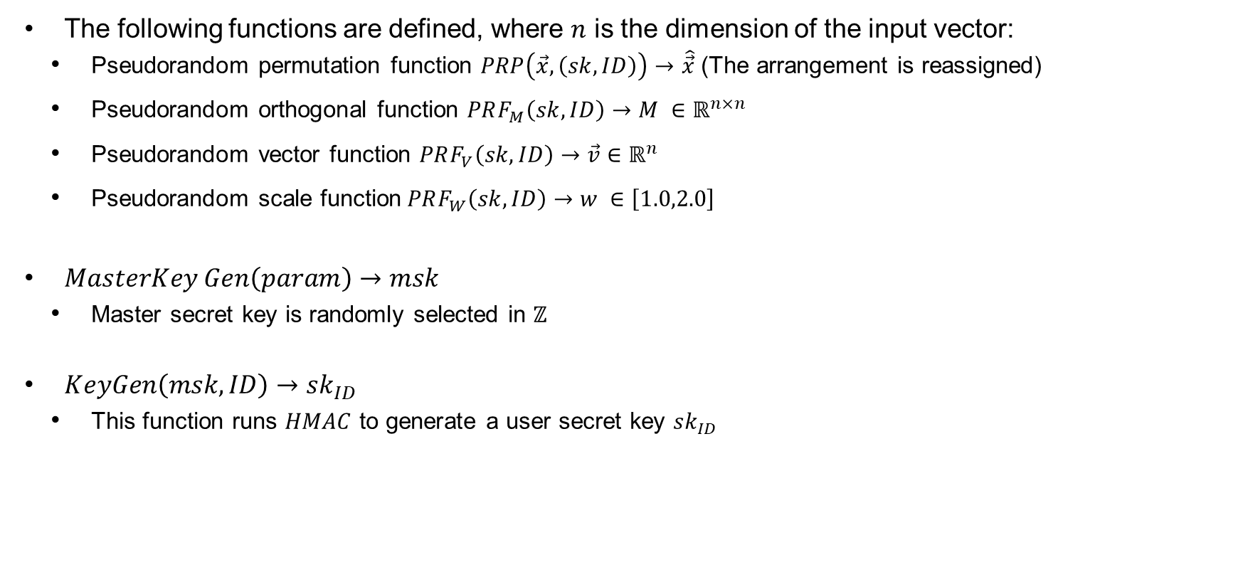
PBio System Flows
Algorithms in KeyGen
The following functions are defined, where $n$ is the dimension of the input vector:
Pseudorandom permutation function $PRP\left(\vec{x},\left(sk,ID\right)\right)→\hat{\vec{x}}$ (The arrangement is reassigned)
Pseudorandom orthogonal function $PRF_{M}\left(sk,ID\right)→M ∈ℝ^{n×n}$
Pseudorandom vector function $PRF_{V}\left(sk,ID\right)→\vec{v}∈ℝ^{n}$
Pseudorandom scale function$PRF_{W}\left(sk,ID\right)→w ∈\left[1.0,2.0\right]$
$MasterKey Gen\left(param\right)→msk$
Master secret key is randomly selected in $ℤ$
$KeyGen\left(msk,ID\right)→sk_{ID}$
This function runs $HMAC$ to generate a user secret key $sk_{ID}$

Slide 23
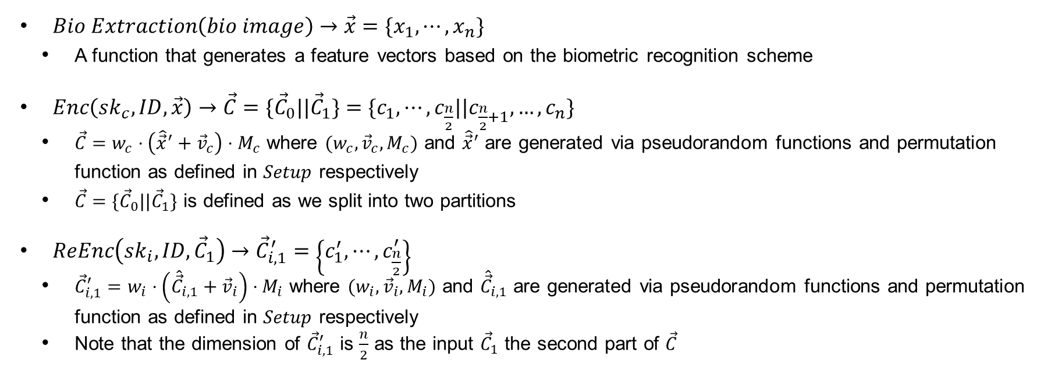
PBio System Flows
Algorithms in Generate EncDB
$Bio Extraction\left(bio image\right)→\vec{x}=\{x_{1},⋯,x_{n}\}$
A function that generates a feature vectors based on the biometric recognition scheme
$Enc\left(sk_{c},ID,\vec{x}\right)→\vec{C}=\{{\vec{C}}_{0}||{\vec{C}}_{1}\}=\{c_{1},⋯,c_{\frac{n}{2}}||c_{\frac{n}{2}+1},…,c_{n}\}$
$\vec{C}=w_{c}⋅\left({\hat{\vec{x}}}^{′}+{\vec{v}}_{c}\right)⋅M_{c}$ where $(w_{c},{\vec{v}}_{c},M_{c})$ and ${\hat{\vec{x}}}^{′}$ are generated via pseudorandom functions and permutation function as defined in $Setup$ respectively
$\vec{C}=\{{\vec{C}}_{0}||{\vec{C}}_{1}\}$ is defined as we split into two partitions
$ReEnc\left(sk_{i},ID,{\vec{C}}_{1}\right)→{\vec{C}}_{i,1}^{′}=\left\{c_{1}^{′},⋯,c_{\frac{n}{2}}^{′}\right\}$
${\vec{C}}_{i,1}^{′}=w_{i}⋅\left({\hat{\vec{C}}}_{i,1}+{\vec{v}}_{i}\right)⋅M_{i}$ where $(w_{i},{\vec{v}}_{i},M_{i})$ and ${\hat{\vec{C}}}_{i,1}$ are generated via pseudorandom functions and permutation function as defined in $Setup$ respectively
Note that the dimension of ${\vec{C}}_{i,1}^{′}$ is $\frac{n}{2}$ as the input ${\vec{C}}_{1}$ the second part of $\vec{C}$

Slide 24
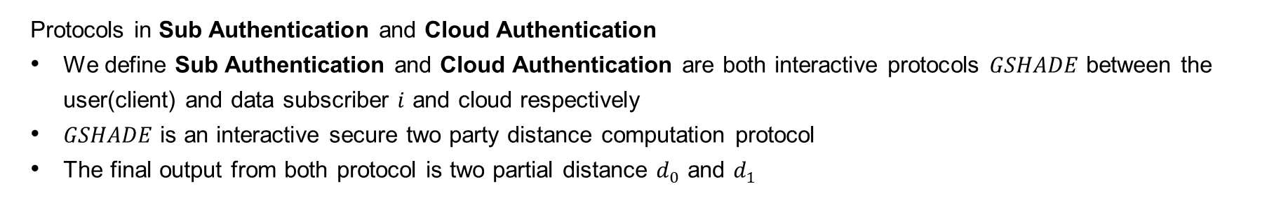
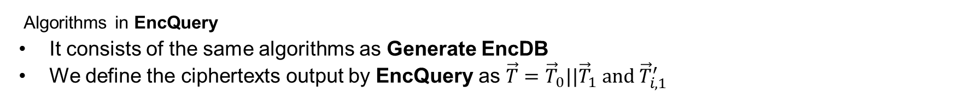
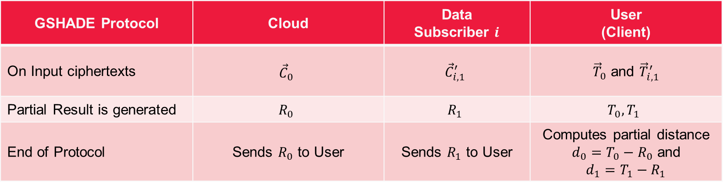
PBio System Flows
Algorithms in EncQuery
It consists of the same algorithms as Generate EncDB
We define the ciphertexts output by EncQuery as $\vec{T}={\vec{T}}_{0}||{\vec{T}}_{1} \text{and} {\vec{T}}_{i,1}^{′}$
Protocols in Sub Authentication and Cloud Authentication
We define Sub Authentication and Cloud Authentication are both interactive protocols $GSHADE$ between the user(client) and data subscriber $i$ and cloud respectively
$GSHADE$ is an interactive secure two party distance computation protocol
The final output from both protocol is two partial distance $d_{0}$ and $d_{1}$
GSHADE Protocol | Cloud | Data Subscriber $i$ | User (Client)
On Input ciphertexts | $${\vec{C}}_{0}$$ | $${\vec{C}}_{i,1}^{′}$$ | ${\vec{T}}_{0}$ and ${\vec{T}}_{i,1}^{′}$
Partial Result is generated | $$R_{0}$$ | $$R_{1}$$ | $$T_{0},T_{1}$$
End of Protocol | Sends $R_{0}$ to User | Sends $R_{1}$ to User | Computes partial distance $d_{0}=T_{0}−R_{0}$ and $$d_{1}=T_{1}−R_{1}$$

Slide 25
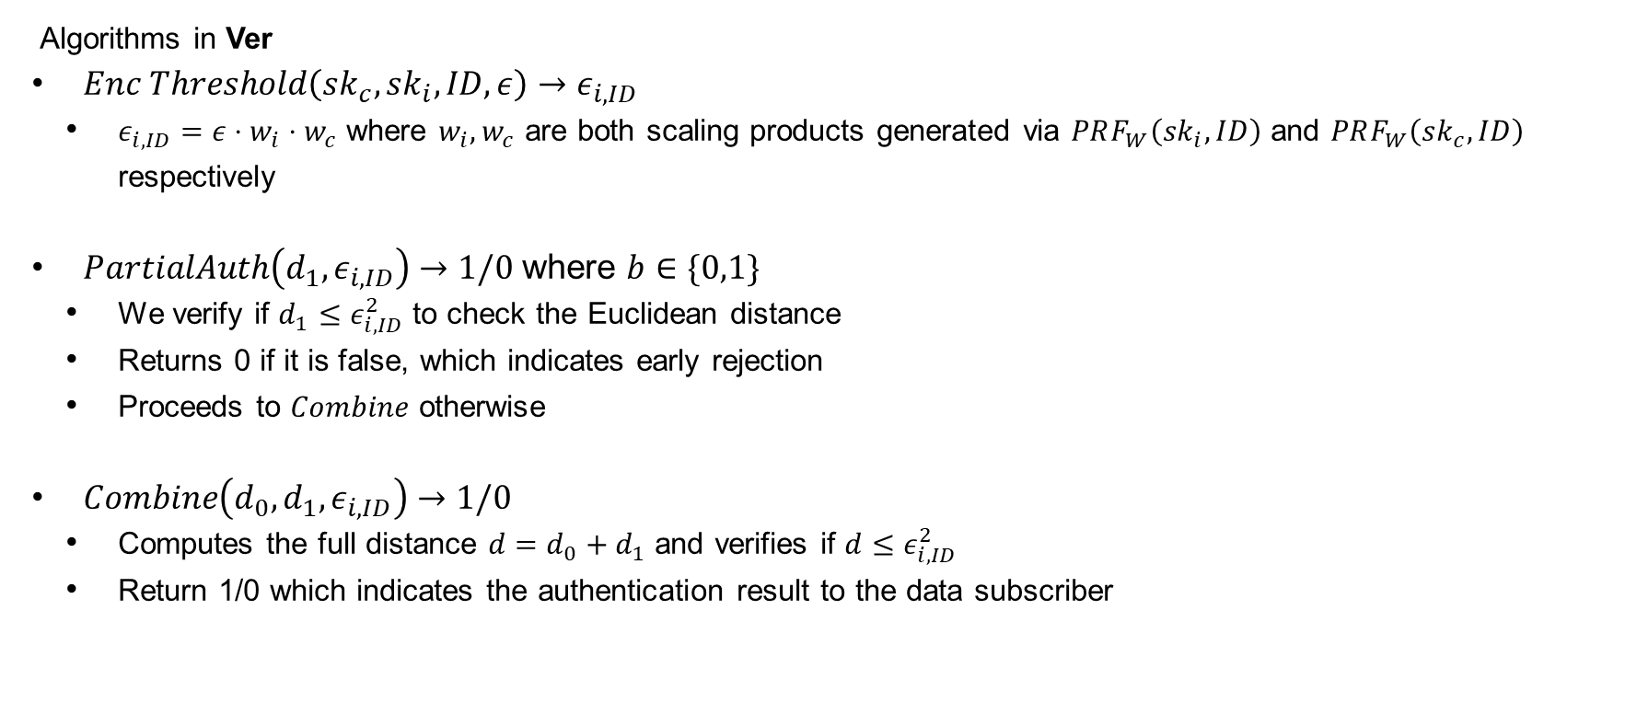
PBio System Flows
Algorithms in Ver
$Enc Threshold\left(sk_{c},sk_{i},ID,ε\right)→ε_{i,ID}$
$ε_{i,ID}=ε⋅w_{i}⋅w_{c}$ where $w_{i},w_{c}$ are both scaling products generated via $PRF_{W}\left(sk_{i},ID\right)$ and $PRF_{W}\left(sk_{c},ID\right)$ respectively
$PartialAuth\left(d_{1},ε_{i,ID}\right)→1/0$ where $b∈\{0,1\}$
We verify if $d_{1}≤ε_{i,ID}^{2}$ to check the Euclidean distance
Returns 0 if it is false, which indicates early rejection
Proceeds to $Combine$ otherwise
$Combine\left(d_{0},d_{1},ε_{i,ID}\right)→1/0$
Computes the full distance $d=d_{0}+d_{1}$ and verifies if $d≤ε_{i,ID}^{2}$
Return 1/0 which indicates the authentication result to the data subscriber

Slide 26





PBio: KeyGen
User
(Client)
Data Owner
Setup
Security Parameters $1^{k}$
System
Parameters
$$param$$
MasterKey
Gen
$$msk$$
Store Key
User Key Derivation
$$usk$$
$$usk=HMAC(msk,"Uid")$$

Slide 27






PBio: Generate EncDB
Data
Subscribers
Cloud
Data Owner
Bio Extraction
Raw Biometric Templates
Features Vectors
Store
$${\vec{C}}_{0}$$
Enc-then-split
$$usk$$
$$\vec{C}={\vec{C}}_{0}||{\vec{C}}_{1}$$
$${\vec{C}}_{i,1}^{′}$$
$${\vec{C}}_{1}$$
Store
ReEnc
$$HMAC(usk,sub_{i})$$

Slide 28




PBio: EncQuery
User
(Client)
Freshly Captured Bio Images
Bio Extraction
Features Vectors
$$usk$$
$$\vec{T}={\vec{T}}_{0}||{\vec{T}}_{1}$$
Enc-then-split
$$HMAC(usk,sub_{i})$$
$${\vec{T}}_{1}$$
ReEnc
$${\vec{T}}_{i,1}^{′}$$

Slide 29












PBio: Ver, Sub Authentication, Cloud Authentication
User
(Client)
Data
Subscriber
Cloud
$${\vec{C}}_{i,1}^{′}$$
$${\vec{T}}_{i,1}^{′}$$
Sub Authentication
Sub Authentication
$$d_{i,1}$$
$$usk,ID,ε$$
Enc Threshold
$$ε_{i,ID}$$
$$d_{i,1}$$
Partial Auth
$invalid$ if $d_{i,1}>ε_{i,ID}$
$${\vec{C}}_{0}$$
$${\vec{T}}_{0}$$
Cloud Authentication
Cloud Authentication
$$d_{0}$$
$$d_{0}$$
Combine
$$valid/invalid$$
$$d_{i,1}$$

Slide 30
Appendixes

Slide 31







System Overviews
End-Users
Data Subscribers
Cloud Provider
Data Owner
User Key
Encrypted Partial Templates I
Encrypt-then-split
1
Key Generation
Sub 1 Ver Keys
2
Key Hierarchy
Raw Biometric Templates
Subscriber 1 Encrypted Templates
Master Key
Subscriber 1
$m$ users
Sub 1 Key
$$⋯$$
Encrypt
Encrypted Partial Templates II
User 1 Key
User $λ$ Key
Biometrics
$$⋯⋯$$
3
$$⋯$$
$$⋯$$
User Key
4
Subr $i$ Ver Keys
Sub 1 Key
Sub $i$ Key
Sub 1 Key
Sub $i$ Key
Tamper-proof
device
Sub $i$ Key
Subscriber $i$
Encrypted Templates
Encrypt
Subscriber $i$
Sub 1 Ver Key
Sub $i$ Ver Key
Sub 1 Ver Key
Sub $i$ Ver Key
PBio Setup and Registration Phase.
Data owner generates a master key. The key is used to derive a user key for every user. The user key is used to derive a subscriber key for every data subscriber. The subscriber key is also used to derive a verification key;
Data owner encrypt-then-split each user's raw biometric template into two encrypted partial templates using the user key. One set of encrypted partial templates is passed to the cloud provider;
Data owner uses the subscriber keys to encrypt each user's encrypted partial template in another set of encrypted partial templates. The resulting set of re-encrypted partial templates is given to the subscribers;
Data owner delivers user keys to the users' registered devices.

Slide 32


System Overviews
End-Users
Data Subscribers
Cloud Provider
Tamper-proof
device
Subscriber 1 Encrypted Templates
Encrypted Partial Templates I
Biometric Features
Subscriber 1
Encrypted Partial Features I
Subscriber 1
Encrypted Features
Encrypt-then-split
Encrypt
Authentication
1
Key
Hierarchy
2
3
User 1 Key
Sub 1 Key
Early Rejection
Encrypted Partial Features II
4
Authentication
Sub 1 Ver Keys
Combine
5
6
Encrypted
Result
Sub 1 Ver Keys
Verify
or
7
Result
PBio Authentication Phase.
User's device encrypt-then-split freshly submitted biometric features;
User's device generates the subscriber's encrypted partial feature;
Data subscriber verifies the received subscriber's encrypted features;
Authentication fails, which skips to (7), if verification returns non-match in step (3);
Else cloud provider verifies the received encrypted partial features;
User's device receives and combines the results from (3) and (5) and outputs the encrypted result.
Data subscriber decrypts and receives the authentication result using the verification key.

Slide 33





PBio: Ver
Data
Subscribers
User
(Client)
$$usk,ID,ε$$
Enc Threshold
$$ε_{i,ID}$$
$$d_{i,1}$$
Partial Auth
$invalid$ if $d_{i,1}>ε_{i,ID}$
$$d_{0}$$
Combine
$$valid/invalid$$

