Slide 1
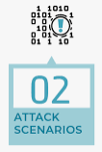








Structured Threat Information Expression (STIX) Attack flow report
Human Language attack/thread scenario description
Technical section contents in CTI report
MITRE ATT&CK Technique mapping report
LLM Attack Scenario analyzer
LLM Technique mapping Verifier
Report generator
Text format summary of the
Attack flow path in the attack scenario
Attack Technique T00xx
…
Attack Technique T00xx
MITRE ATT&CK Technique mapping result
LLM Attack behaviors analyzer
Attack behavior 01
MITRE Tactic Mapper
Attack behavior 02
…
MITRE Technique Mapper
Attack behavior N
LLM MITRE ATT&CK Matrix mapper

Slide 2

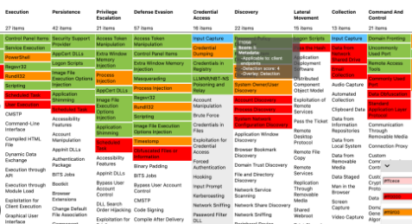
MITRE CWE Framework
MITRE ATT&CK Framework
CWE-74
Matching between the Vulnerabilities(CVE) and the related Attack Technology (TTP)
CWE-79
Child of
CVE-1999-0067
…
Enterprise
Mobile
ICS
CVE-2006-3295
CWE-352
CVE-2014-5198
Peer of
CVE-2009-3520
Techniques
…
…
Matrix
Tactics
CVE-2020-3580
T1143
Parent of
CWE-87
TA0043
MITRE
Adversarial Tactics, Techniques,
&nd Common Knowledge
MITRE
Common
Weakness
Enumeration
Category Base System
…
T1531
CVE-2021-1879
CVE-2002-0738
…
…
TA00xx
Member of
CWE-xxx
T1087
CWE-137
CVE-2024-xxx
.001
.002
.003
…
CVE-2024-xxx
MITRE CWE categorize System
MITRE Att&ck navigator
APT-xxx
A New Common Vulnerabilities and Exposures (CVE)
APT (Advanced Persistent Threat)

