Slide 1
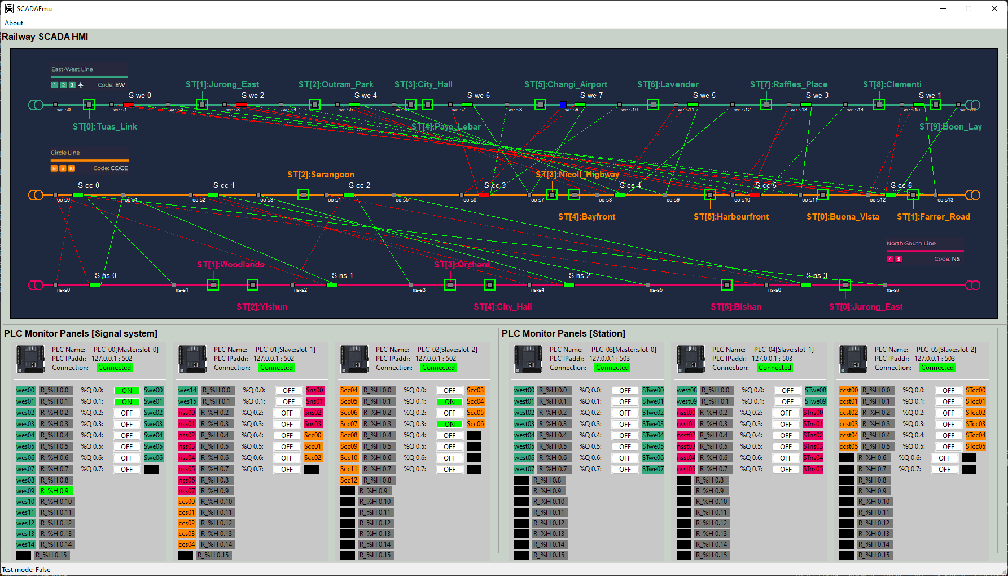
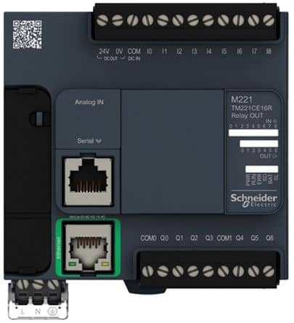
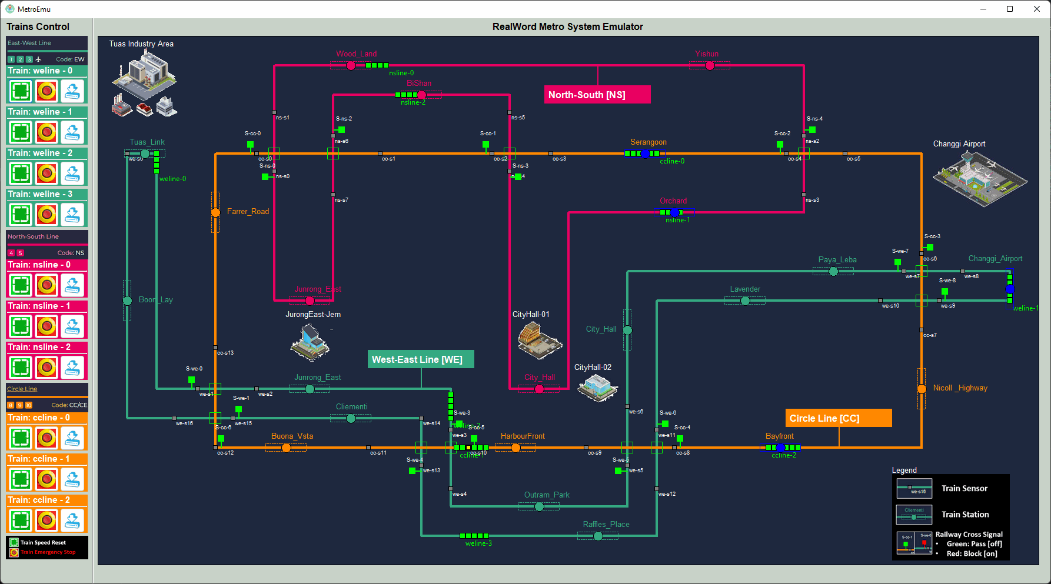
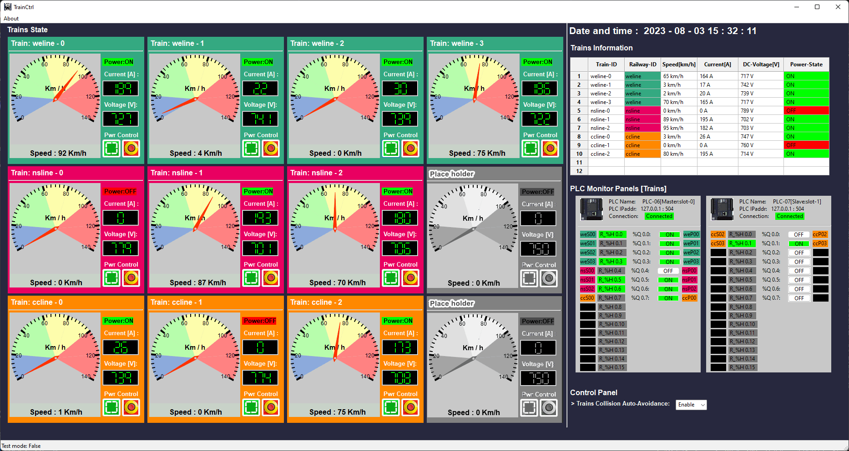
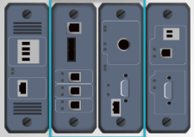
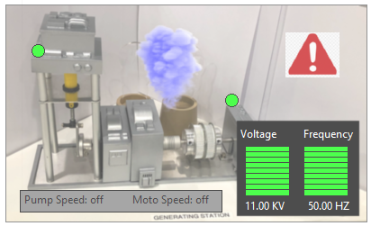
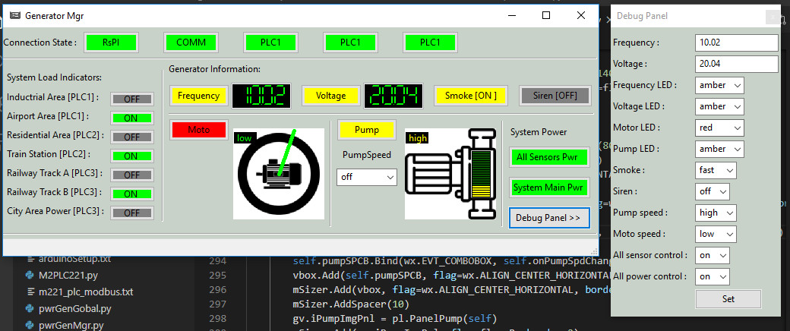
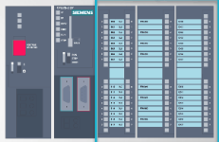
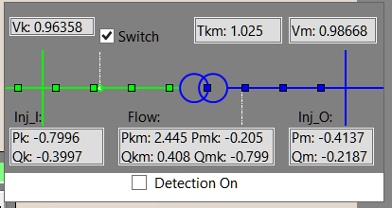
Virtual PLC/RTU System Connection Diagram
PLC simulator [Modbus-TCP]
Railway Signal System HMI
2D Railway[Metro] System Real-world Emulator
Modbus
Electrical signal simulation
Electrical signal simulation
RTU simulator [S7Comm]
Railway Train System HMI
2D Power Grid System Real-world Emulator
Power supply simulation
PLC simulator [S7Comm]
Power Grid and Substation System HMI
Electrical signal simulation
RTU simulator [S7Comm]
Transformer display panel
Modbus-TCP
S7Comm bus
Electrical signal / Physical Wire Simulation
S7Comm bus

Slide 2
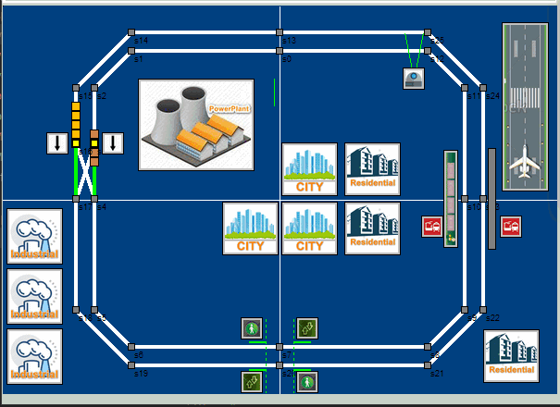


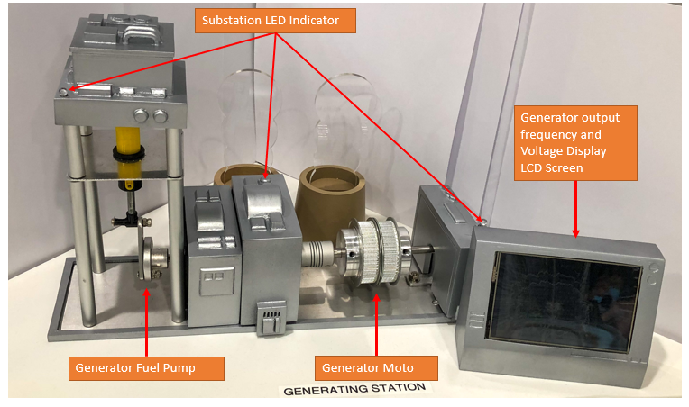

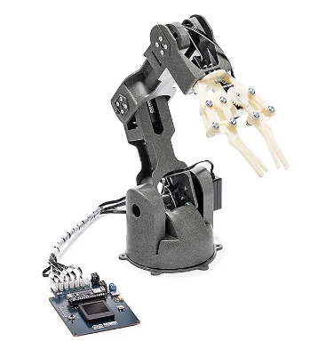
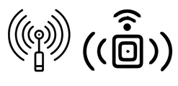

Virtual OT device emulator
Modbus
S7Comm bus
Windows OS VM
UDP/TCP Interface
UDP/TCP Interface
Modbus Interface
SCADA HMI
PLC Simulator
Modbus Interface
Physical OT device
Raspberry PI
S7commInterface
PLC Simulator
GPIO interface
Modbus Interface
ICS Remote Console
BeagleBone-Black
S7commInterface
Physical OT device with serial port
UDP/TCP Interface
RTU Simulator
GPIO interface
S7commInterface
ICS Engineering station
Serial interface
Linus server
Modbus Interface
Modbus Interface
OT wireless sensors
RTU Simulator
UDP/TCP Interface
S7commInterface

Slide 3
Physical electrical signal change to real PLC Contacts
Simulated electrical signal change to virtual PLC
0S
2S
4S
6S
8S
10S
12S
 | 0s | 1s | 2s | 3s | 4s | 5s | 6s | 7s | 8s | 9s | 10 | 11 | 12
W1 | 1 | 1 | 0 | 0 | 0 | 0 | 0 | 0 | 0 | 1 | 0 | 0 | 0
W2 | 1 | 1 | 1 | 1 | 1 | 1 | 1 | 1 | 0 | 1 | 0 | 0 | 0
W3 | 1 | 1 | 1 | 1 | 0 | 0 | 0 | 1 | 1 | 1 | 1 | 1 | 1
W4 | 0 | 0 | 0 | 0 | 0 | 1 | 1 | 0 | 1 | 1 | 0 | 0 | 0
PLC physical Contacts wire 1
Voltage Hight [5V]
Voltage Low [0V]
Voltage Hight [5V]
PLC physical Contacts wire 2
Voltage Low [0V]
Voltage Hight [5V]
PLC physical Contacts wire 3
Voltage Low [0V]
PLC physical Contacts wire 4
Voltage Hight [5V]
Voltage Low [0V]
Physical electrical signal simulation message :

Slide 4


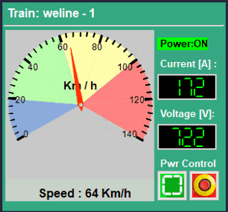


Throttle & break
Speed sensor
Front detection sensor
Overall train
power
Front sensor detection area
False Modbus cmd/data
Train HMI control panel
Front sensor state holding register
HR0
Coil output to throttle & break
Train Auto control logic
HR1
Speed sensor state holding register
Coil00
Modbus data
Coil01
Coil output to train power
Modbus cmd

Slide 5
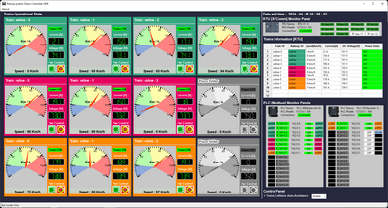
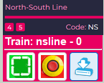
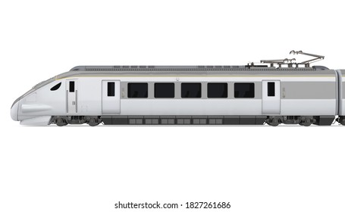



Track power control PLC
Third Railway Power Input Switch
Modbus-TCP
Third Rail 750V DC
2D Train in real-world emulator
HQ Trains Operation & Monitor HMI
On Train Emergency Power Control
Train input power switch
Front radar detection area
Real-world train module function mapping
Train DC moto
Train front collision detection radar
Input voltage sensor
Current sensor
Train speed sensor
S7comm
DC power
Train Driver Console [ on Train ]
Electrical Signal to PLC
latching relay or switch
On train antenna
Train driving control PLC
Wireless connection
Train sensors RTU
Sensors
Modbus-TCP
Electrical Signal to RTU
Railway antenna
S7comm
Modbus
S7comm-Bus

