Slide 1
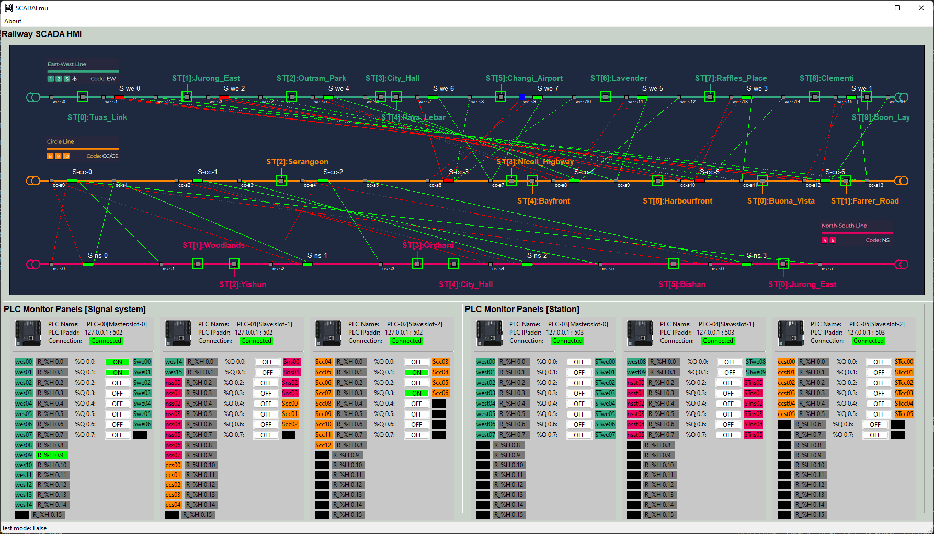
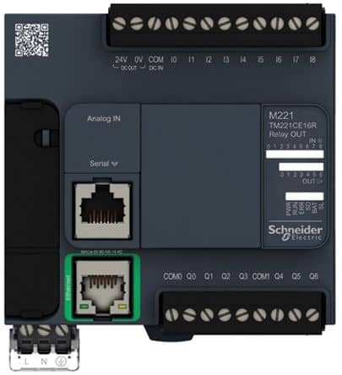
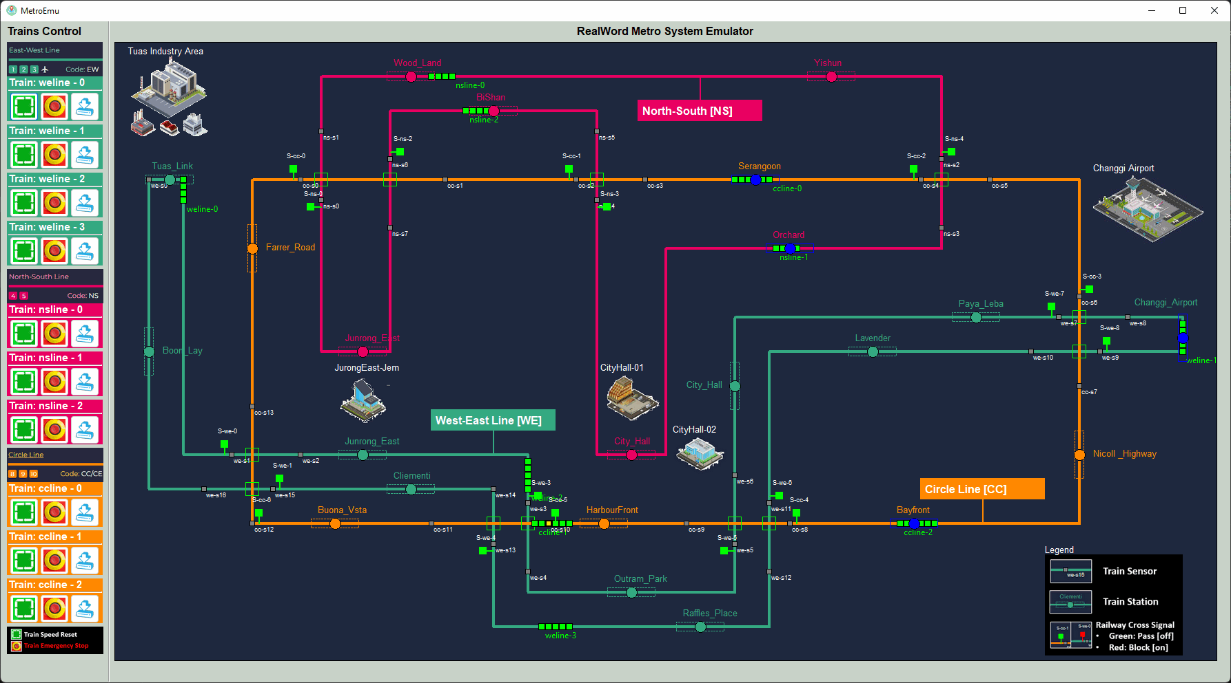
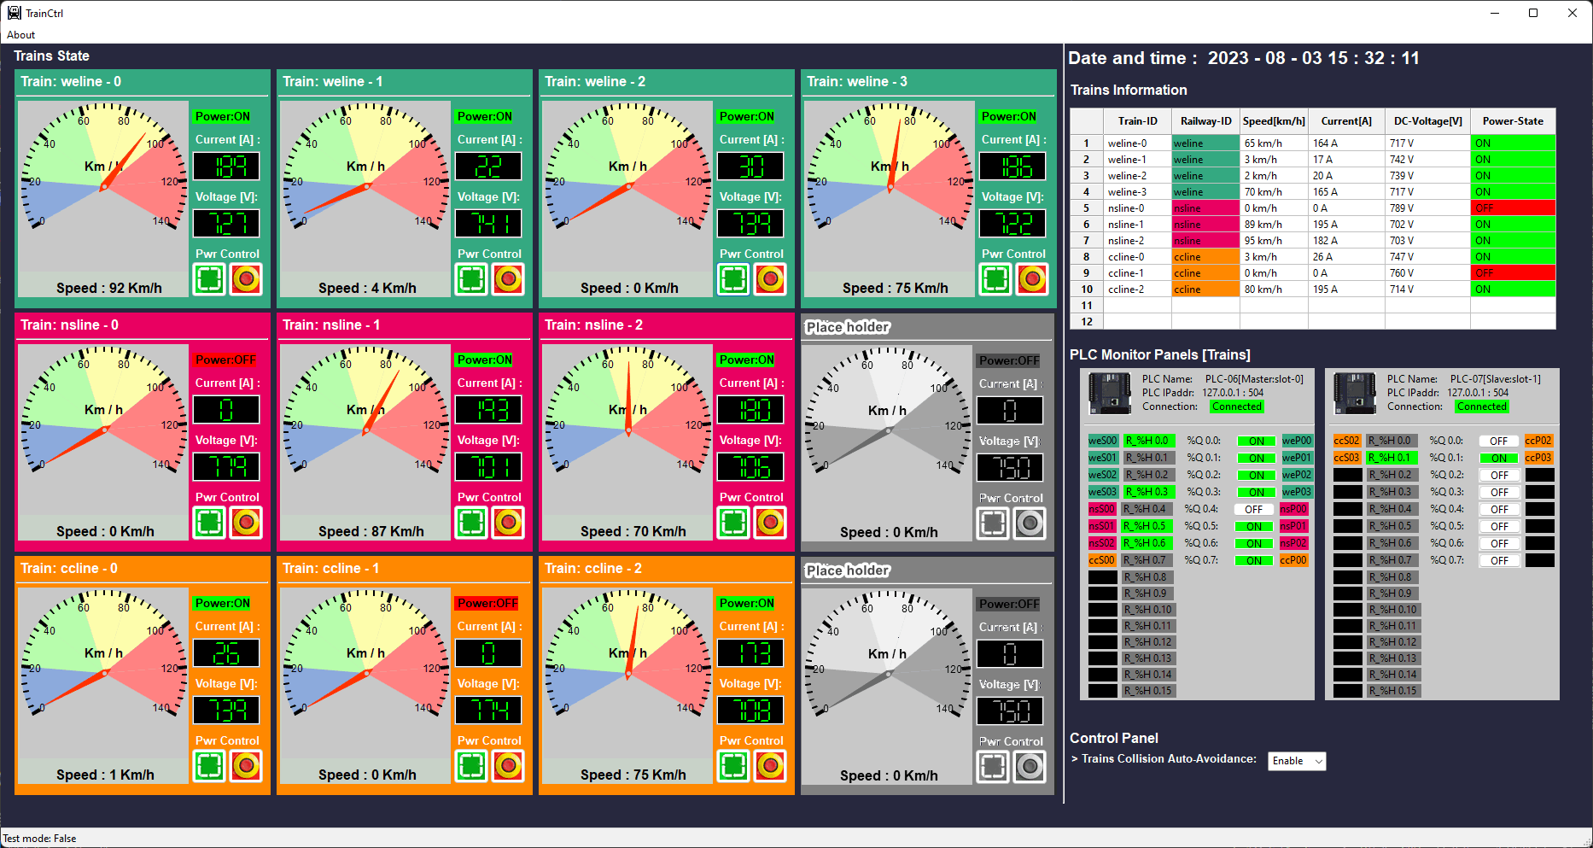
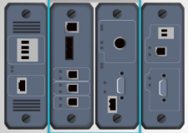
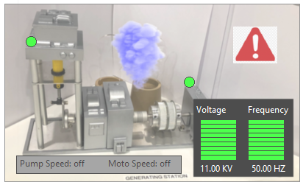
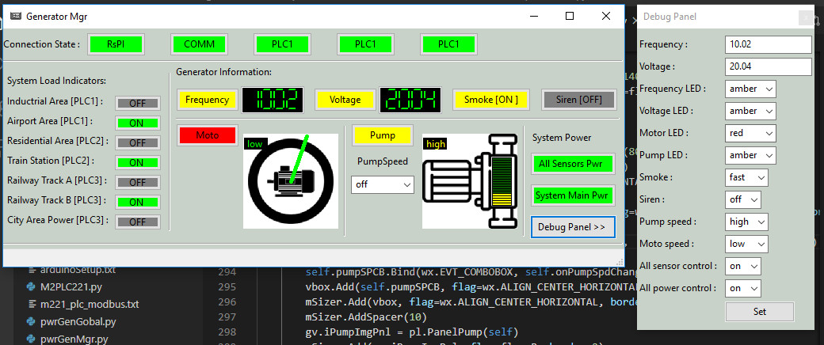
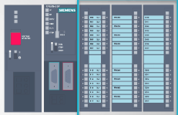
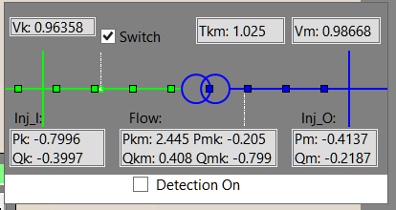
Virtual PLC/RTU System Connection Diagram
PLC simulator [Modbus-TCP]
Railway Signal System HMI
2D Railway[Metro] System Real-world Emulator
Modbus
Electrical signal simulation
Electrical signal simulation
RTU simulator [S7Comm]
Railway Train System HMI
2D Power Grid System Real-world Emulator
Power supply simulation
PLC simulator [S7Comm]
Power Grid and Substation System HMI
Electrical signal simulation
RTU simulator [S7Comm]
Transformer display panel
Modbus-TCP
S7Comm bus
Electrical signal / Physical Wire Simulation
S7Comm bus

