Slide 1
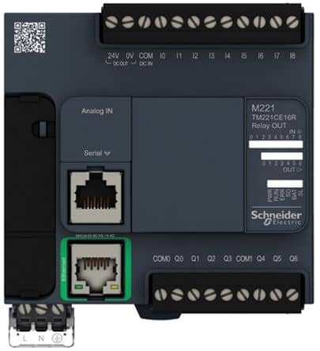
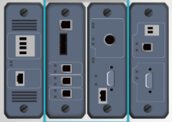
Different OT levels MQTT data follow with related Broker server and Client device configuration
Level 3
Operations Management Zone
Monitor Desktop
Control Touch Screen/Phone
Provide The MQTT Client connection interface lib to subscribe the data from the broker server
MQTT Client
Level 2
Control Center (HQ) Processing LAN
MQTT Broker Server
Control HMI / Console machine
Provide The MQTT Broker interface lib to save the data execution the control logic and handle all the data publish and subscribe request
Level 1
Controller LAN
MQTT Client
PLC
RTU
Provide The MQTT Client connection interface lib to publish the data to the broker server
Railway Track Control HMI
Level 0
Physical Process
Field I/O device
MQTT Client
IIoT
Metering Unit
Sensors
MQTT Communication Channel

Slide 2
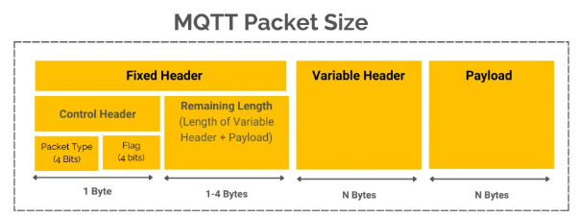
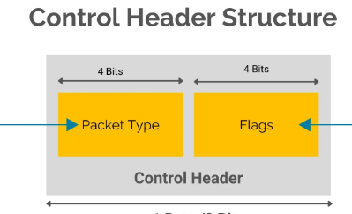
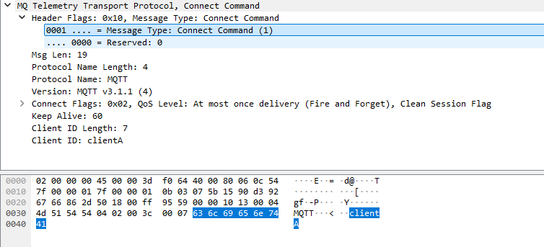
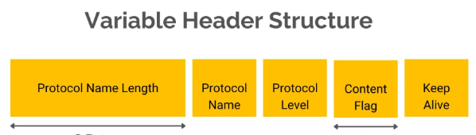

Slide 3


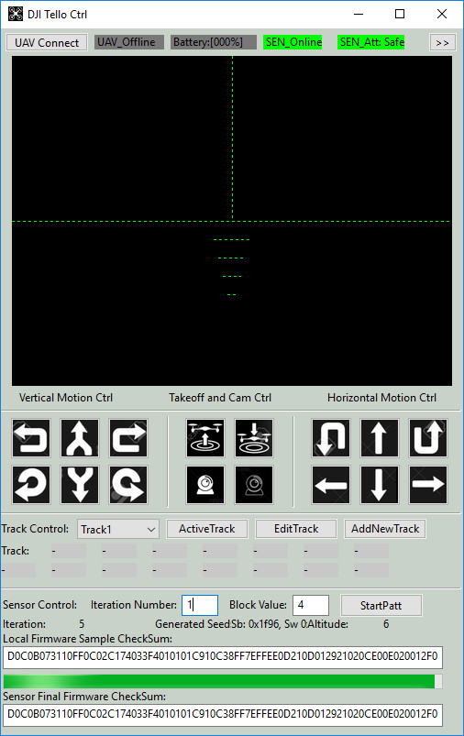
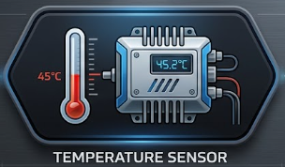
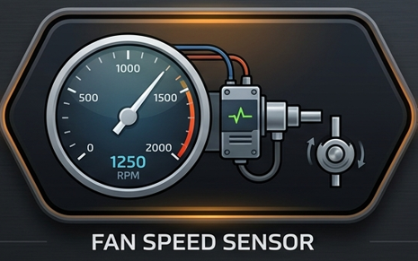
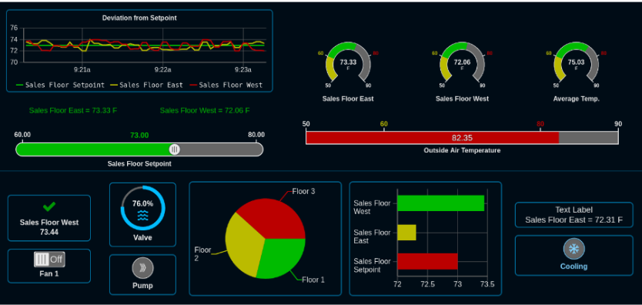
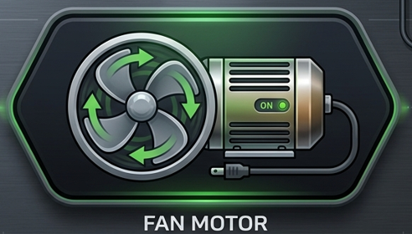
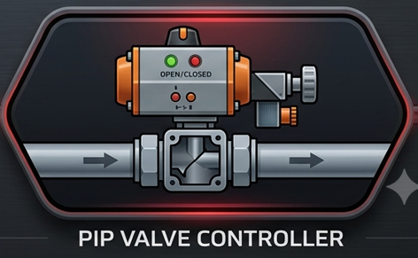
Python RTU/IIoT Simulator with IEC-20922 MQTT Communication Protocol
Level0 OT Physical Field I/O Devices
MQTT Data Subscribe Request
Level2 OT Control Console/HMI/
IIoT Drone Simulator program
MQTT Data Publish Request
Drone State Monitor HMI
Level1 OT Controller Devices
Data Process Logic
IoT 5G Antenna
MQTT Client
Data Publish (Drone fly data)
MQTT Broker
Data Subscribe (Fan and valve moto control request )
MQTT Client
Air Vacuum System Control RTU Simulation Framework
Smart Factory Air Vacuum System
Data Publish ( temp and fan-speed data)
UDP Simulated Electrical Signal RTU Input
Input Parameter Dict
Level3 OT Data Center
Factory Environment Monitor Dashboard
Auto
Control
Logic
MQTT Client
MQTT Client
MQTT Broker
UDP Simulated Electrical Signal RTU Output
Data Publish ( Direct Overwrite control
Output Parameter Dict

