Slide 1
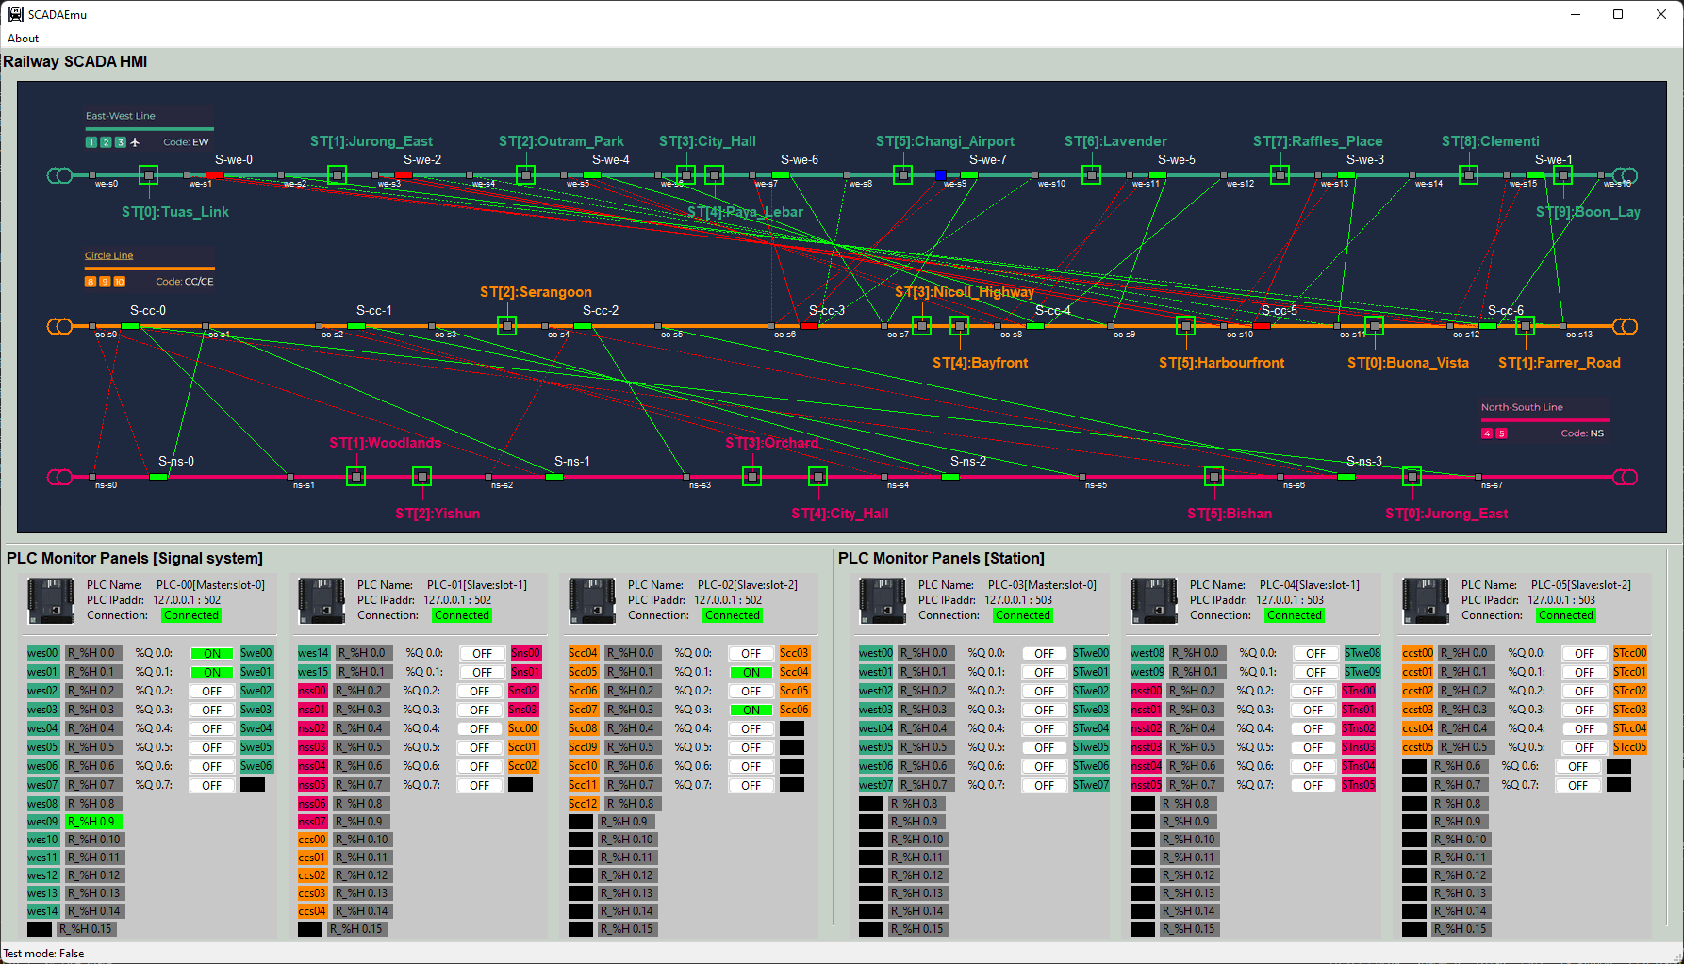
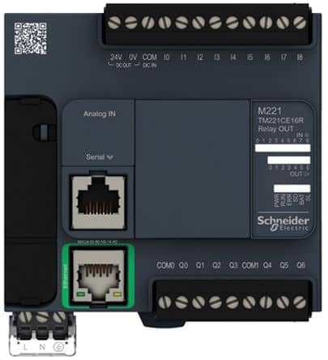
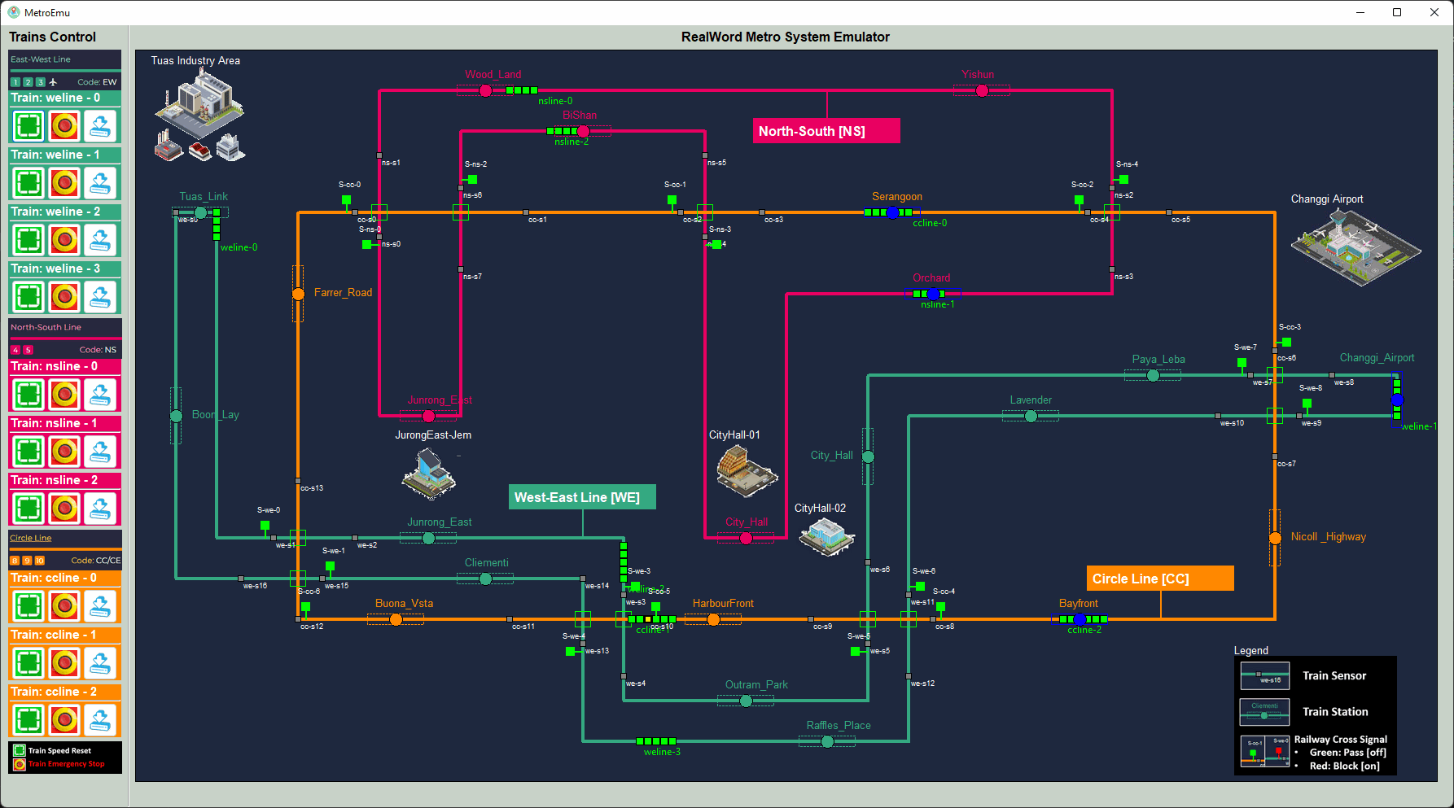
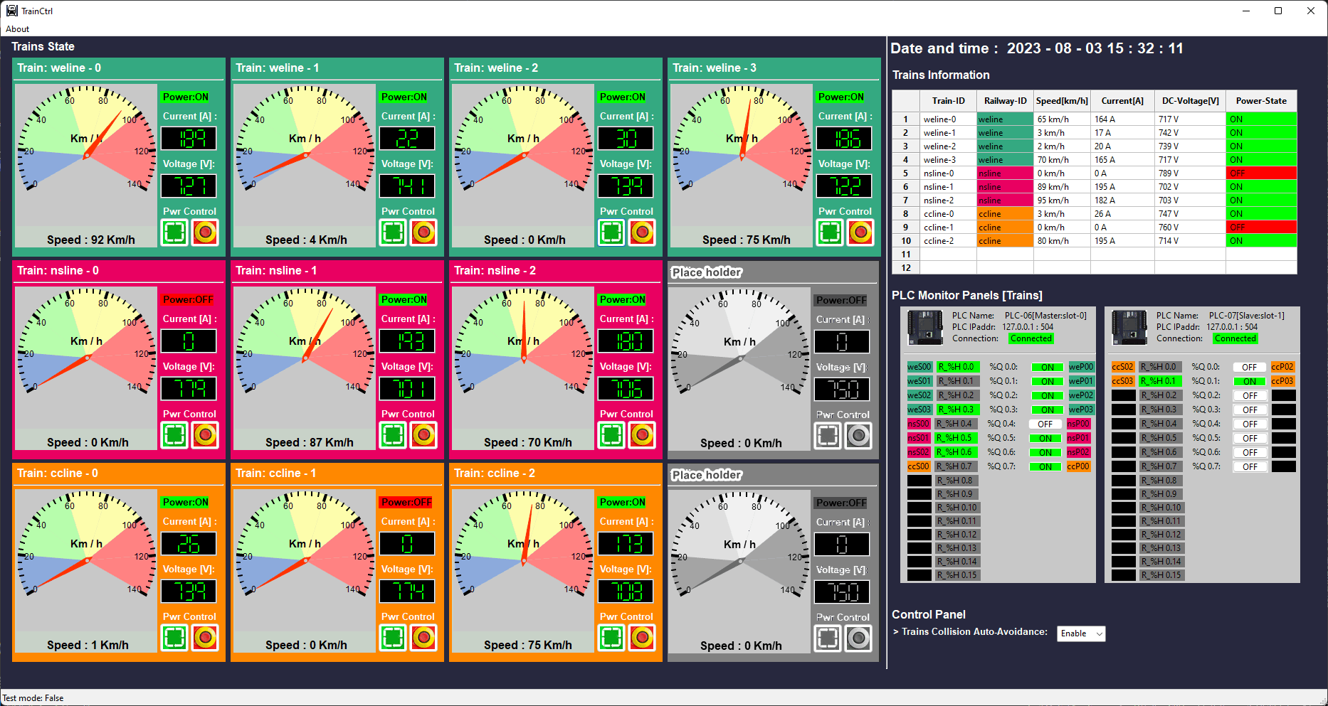
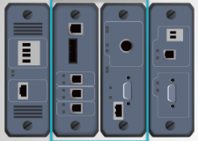
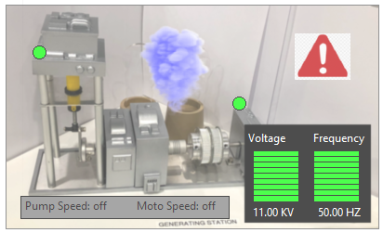
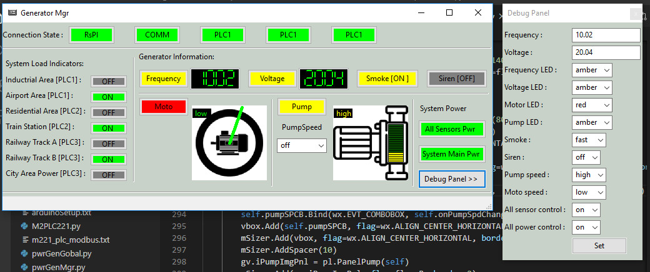
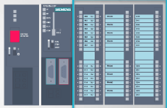
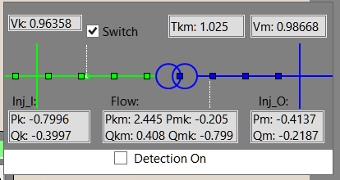
Virtual PLC/RTU System Connection Diagram
PLC simulator [Modbus-TCP]
Railway Signal System HMI
2D Railway[Metro] System Real-world Emulator
Modbus
Electrical signal simulation
Electrical signal simulation
RTU simulator [S7Comm]
Railway Train System HMI
2D Power Grid System Real-world Emulator
Power supply simulation
PLC simulator [S7Comm]
Power Grid and Substation System HMI
Electrical signal simulation
RTU simulator [S7Comm]
Transformer display panel
Modbus-TCP
S7Comm bus
Electrical signal / Physical Wire Simulation
S7Comm bus

Slide 2
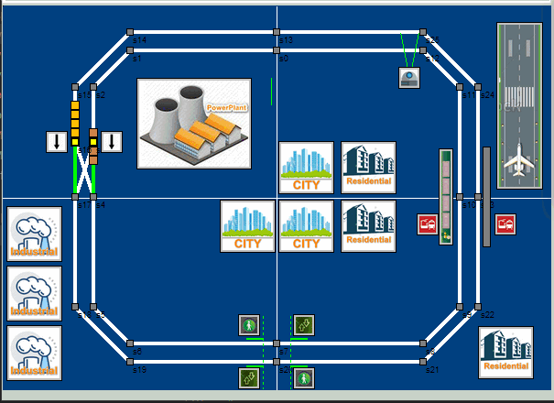


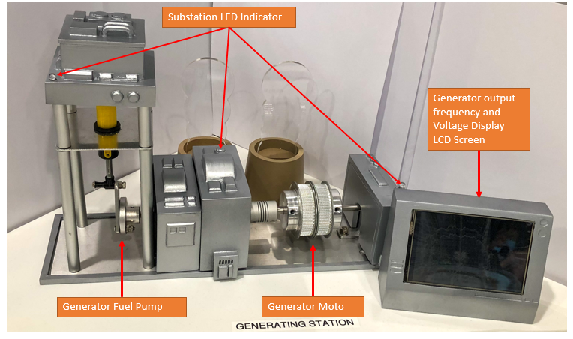

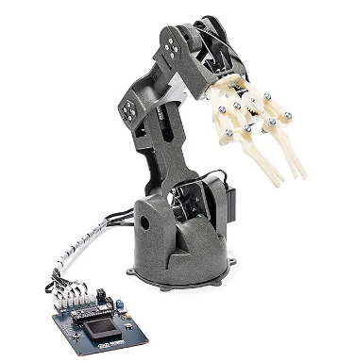



Virtual OT device emulator
Modbus
S7Comm bus
Windows OS VM
SCADA HMI
UDP/TCP Interface
UDP/TCP Interface
PLC Simulator
Modbus server
Modbus Client
Network connection simulate electrical wire
RS422 multi-dop connection
S7Comm Client
Physical OT device
Raspberry PI
PLC Simulator
ICS Remote Console
Physical electrical wire
Modbus Server
GPIO interface
S7Comm Client
BeagleBone-Black
ICS Engineering station
Physical OT device with serial port
UDP/TCP Interface
RTU Simulator
S7Comm Server
Modbus Client
GPIO interface
USB to RS232 adapter
Linus server
Historian
USB to RS485 adapter
Serial interface
Modbus Server
Modbus Client
OT wireless sensors
RTU Simulator
S7Comm Server
UDP/TCP Interface
S7Comm Client
Wireless connection

Slide 3
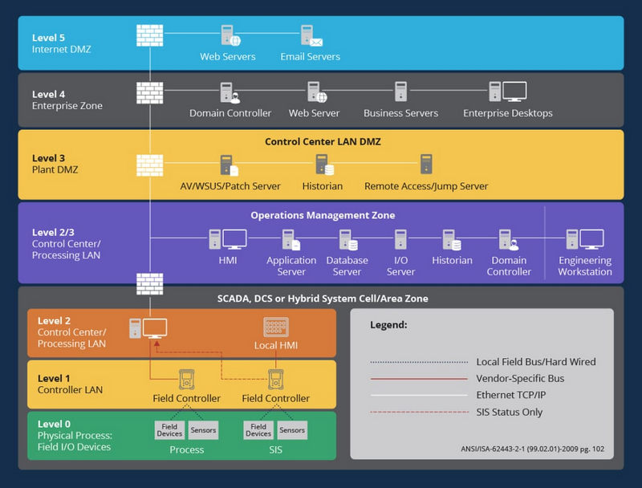
The library is focus on provide different function for simulating the level-0 layer to level-2/3 layer on the OT system
Provide the Modbus-TCP and S7Comm interface for user to build their own HMI and Operation management Zone service
Provide the PLC and RTU simulation program for user to build different Level1 field controller
Provide connection interface lib for user to connect to the virtual or physical level0 OT device

Slide 4
Provide the IEC-60870-5-104 Communication interface for user to build their own HMI and Operation management Zone service
Provide the PLC and RTU simulation program for user to build different Level1 field controller
IEC104 Client
Electrical Signal Simulation Link Clients
IEC104 Server
PLC
RTU
Provide connection interface lib for user to connect to the virtual or physical level0 OT device
Electrical Signal Simulation Link Server

Slide 5
Physical electrical signal change to real PLC Contacts
Simulated electrical signal change to virtual PLC
0S
2S
4S
6S
8S
10S
12S
 | 0s | 1s | 2s | 3s | 4s | 5s | 6s | 7s | 8s | 9s | 10 | 11 | 12
W1 | 1 | 1 | 0 | 0 | 0 | 0 | 0 | 0 | 0 | 1 | 0 | 0 | 0
W2 | 1 | 1 | 1 | 1 | 1 | 1 | 1 | 1 | 0 | 1 | 0 | 0 | 0
W3 | 1 | 1 | 1 | 1 | 0 | 0 | 0 | 1 | 1 | 1 | 1 | 1 | 1
W4 | 0 | 0 | 0 | 0 | 0 | 1 | 1 | 0 | 1 | 1 | 0 | 0 | 0
PLC physical Contacts wire 1
Voltage Hight [5V]
Voltage Low [0V]
Voltage Hight [5V]
PLC physical Contacts wire 2
Voltage Low [0V]
Voltage Hight [5V]
PLC physical Contacts wire 3
Voltage Low [0V]
PLC physical Contacts wire 4
Voltage Hight [5V]
Voltage Low [0V]
Physical electrical signal simulation message :

Slide 6


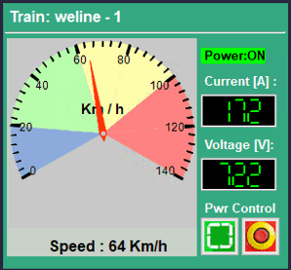


Throttle & break
Speed sensor
Front detection sensor
Overall train
power
Front sensor detection area
False Modbus cmd/data
Train HMI control panel
Front sensor state holding register
HR0
Coil output to throttle & break
Train Auto control logic
HR1
Speed sensor state holding register
Coil00
Modbus data
Coil01
Coil output to train power
Modbus cmd

Slide 7
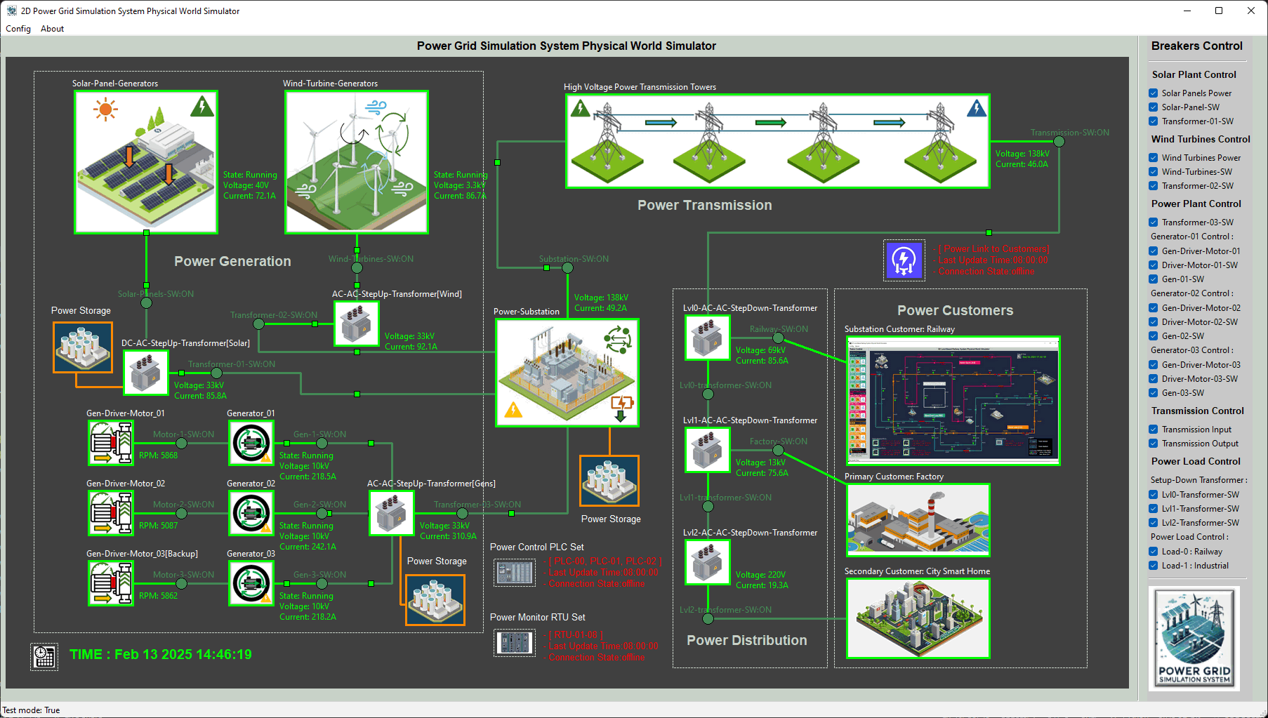
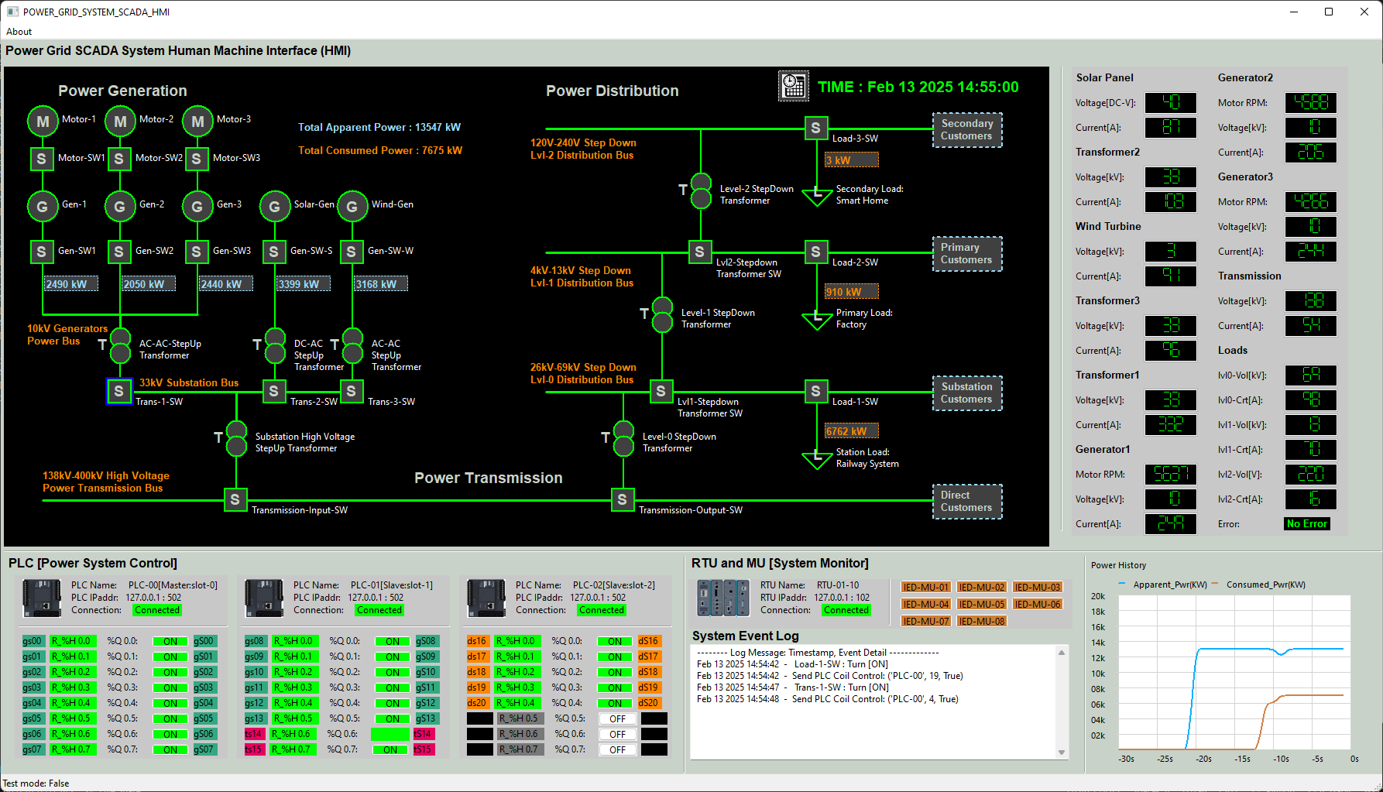
Python Virtual PLC/RTU Simulator with IEC-60870-5-104 Communication Protocol
Level0 OT Physical Field I/O Devices
Level1 OT Controller Devices
Level2 OT Control Center (HQ)
Virtual Power Grid Simulator
PLC/RTU Station Simulation Framework
SCADA HMI/Console Program
Station Main Control Module
IEC 104 Server
Periodic report
RTU report mode
Real time control
Connection Management Module
IEC 104 Server
IEC 104 Client
IEC 104 Client
PLC Fetch mode
Ladder Logic or ST calculation module
RTU Monitoring Module
Memory Management Module
PLC Control Module
Measured Points
Virtual Voltage Meters Unit
M_SP_NA
Data Management Module
UDP Electrical Signal Measure Interface
Virtual Current age Meters Unit
M_DP_NA
LD/ST Input Map module
Simulated
analog /digital electrical
signals
Virtual RPM Meters Unit
M_ME_NB
Virtual Breaker Position Sensor
Changeable Points
UDP Electrical Signal Control Interface
C_SC_NA
LD/ST Output Map module
Virtual Breaker Motor Control
C_RC_NA

Slide 8
IEC104 Value
Example: M_SP_NA_TRUE
Electrical Signal Example: 5V
LD Components Value
Example: Holding Register Set Val=1
Virtual Meter
IEC 104 Measured Point Object
LD/ST Input Map module
IEC104 Value
Example:
C_RC_NA_STEP_HIGHER
Ladder Logic or ST calculation module
Electrical Signal Example: 0V
Virtual Motor Controller
IEC 104 Changeable Point Object
LD/ST Output Map module
LD Components Value
Example: Coil Set Val=0

Slide 9

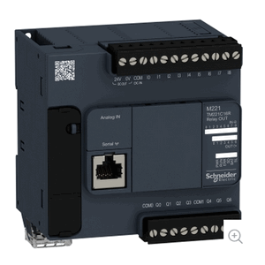

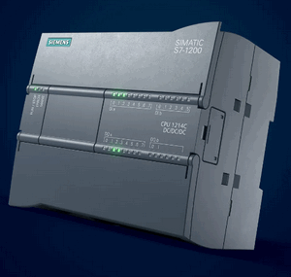

Schneider Modicon M221 PLC
Electrical signals
Python Program
OT Device
Modbus-TCP
Motors
SCADA Network
Siemens SIMATIC S7-1200 PLC
Pumps
Sensors
S7Comm
Signals

Slide 10
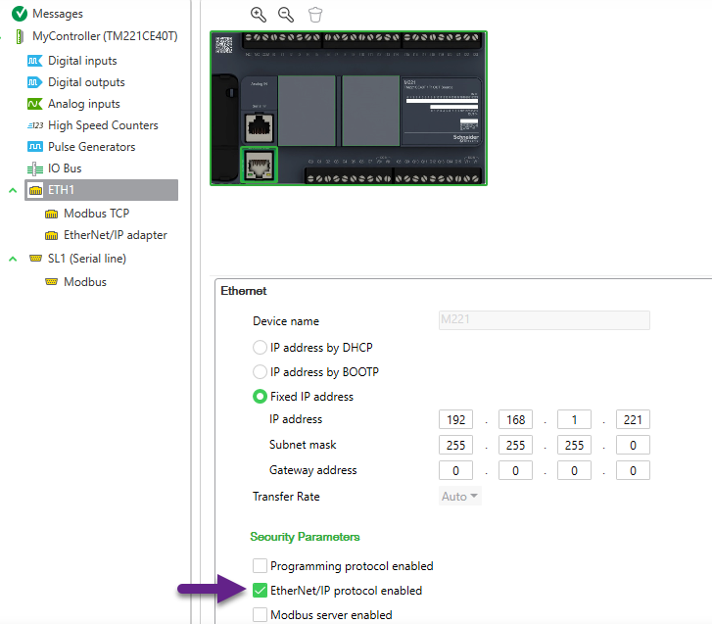

Slide 11
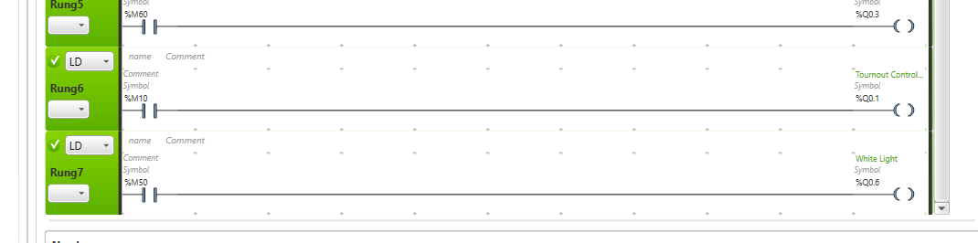
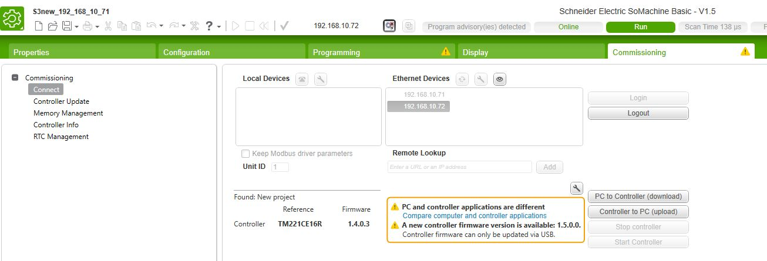
%I0.1
%M10
%M10
%M60
Ladder Logic section
%M60
%Q0.6

Slide 12
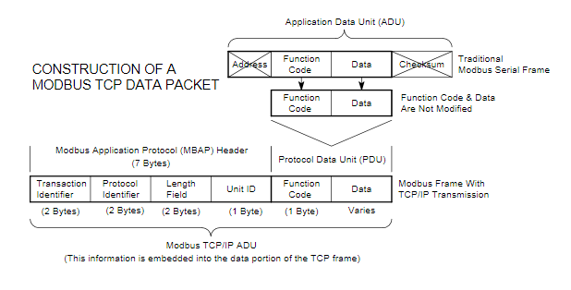
Memory Data Read
Memory index | Bit length
( 2 bytes ) | ( 2 bytes )
001e
0008
Memory Data Write
0f or 01
Memory index | Bit Index | Byte Index | Value
( 2 bytes ) | ( 2 bytes ) | ( 1 bytes ) | ( 1bytes )
01
0000
0000
0008 or 0006
001e
0001
01
01

Slide 13
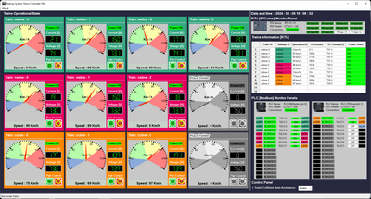
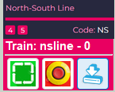




Track power control PLC
Third Railway Power Input Switch
Modbus-TCP
Third Rail 750V DC
2D Train in real-world emulator
HQ Trains Operation & Monitor HMI
On Train Emergency Power Control
Train input power switch
Front radar detection area
Real-world train module function mapping
Train DC moto
Train front collision detection radar
Input voltage sensor
Current sensor
Train speed sensor
S7comm
DC power
Train Driver Console [ on Train ]
Electrical Signal to PLC
latching relay or switch
On train antenna
Train driving control PLC
Wireless connection
Train sensors RTU
Sensors
Modbus-TCP
Electrical Signal to RTU
Railway antenna
S7comm
Modbus
S7comm-Bus

Slide 14
Real-world train module function mapping
Train DC moto
Train front collision detection radar
Train DC moto
Input voltage sensor
Current sensor
Train speed sensor
On train antenna
Wireless connection
Train sensors RTU
Train driving control PLC
Railway antenna

Slide 15



HMI Set Val to PT4
HMI Set Val to PT3
Physical Sensor signal link to PT1
Condition value generator :
True -> 1.01
False-> 1.02
Val to PT5
Physical Sensor signal link to PT2
%M = 000002
%M = 000001
%M = 000003
%M = 000005
IF IN_STATA:
OUT = 1.01
ELSE
OUT = 1.02
END IF
Address
%M = 000004

