Slide 1
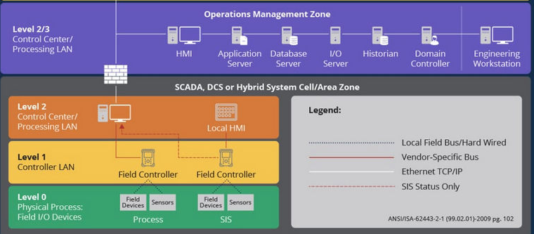
Different OT levels OPC-UA data follow with related OPC-UA-TCP server and client configuration
Provide the OPC-UA-TCP client Communication interface for user to build their own HMI and Operation management Zone service
OPC-UA Client
OPC-UA Client
Provide the PLC, IED and RTU simulation program with OPC-UA-TCP server for user to build different Level1 field controller
OPC-UA Server
OPC-UA Client
OPC-UA Client
Electrical Signal Simulation Link Clients
PLC
OPC-UA Server
RTU
OPC-UA Server
Provide connection interface lib for user to connect to the virtual or physical level0 OT device
Electrical Signal Simulation Link Server

