Slide 1
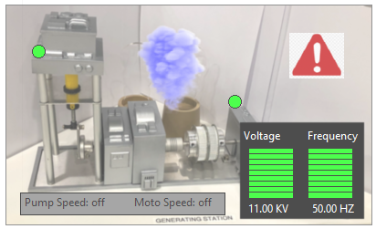
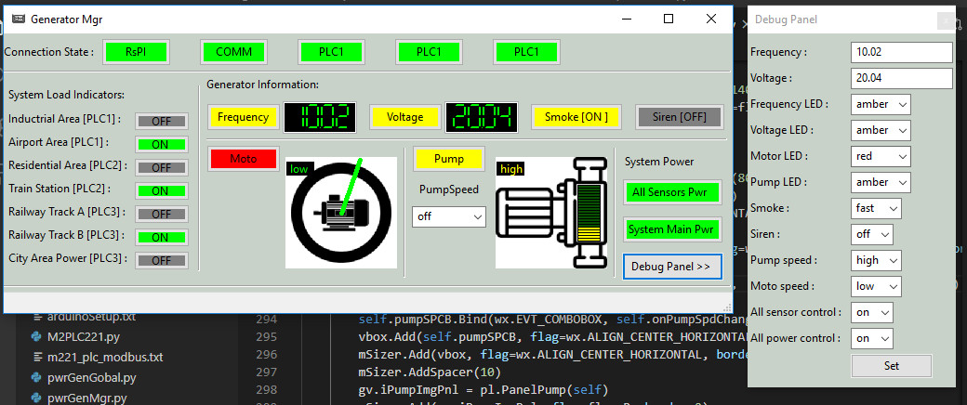

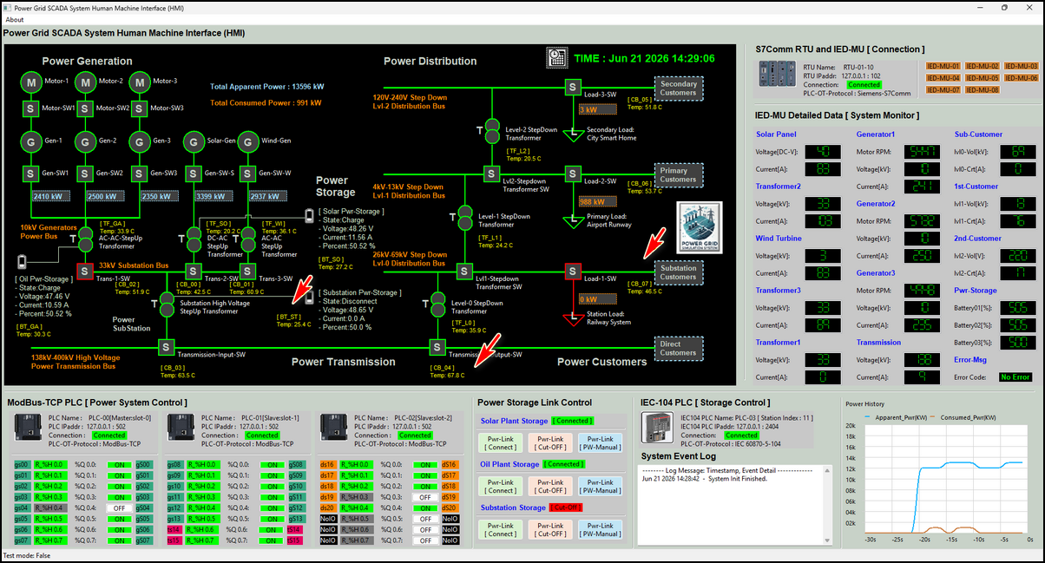
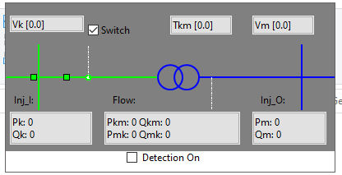
Python Virtual RTU Simulator With IEEE 1815-2021 DNP3.0 Communication Protocol and Integrate with PowerGrid Generator Cyber Twin System
Level0 OT Physical Field I/O Devices
Level1 OT Controller Devices
Level2 OT Control Console or HMI
Gas Power Generator Simulator Program
Power Transmission Control RTU Simulation Framework
Generator Control And Monitor
UDP Simulated Electrical Signal RTU Input
Input Parameter Dict
NDP3 Client
Auto
Control
Logic
DNP3 Server
NDP3 Client
Power Grid Monitor HMI
Transformer Simulator Program
UDP Simulated Electrical Signal RTU Output
Output Parameter Dict
Metering Unit Simulation
UDP Simulated Electrical Signal RTU Input
DNP3 Server
NDP3 Client

Slide 2
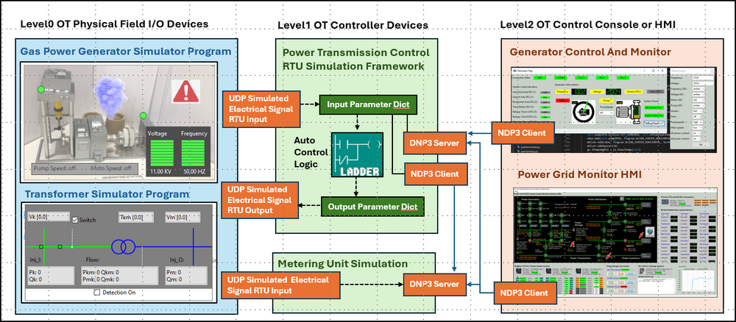
Python Virtual RTU Simulator With IEEE 1815-2021 DNP3.0 Comm Protocol

