Slide 1
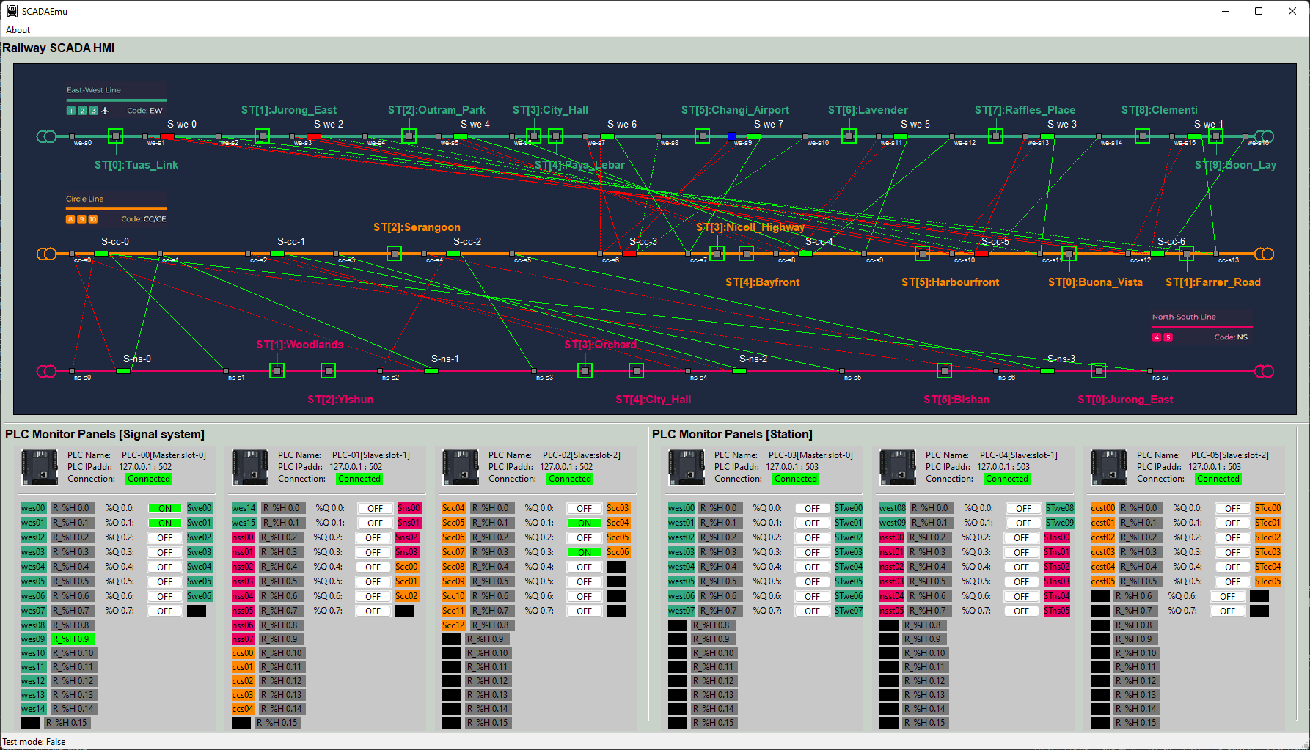
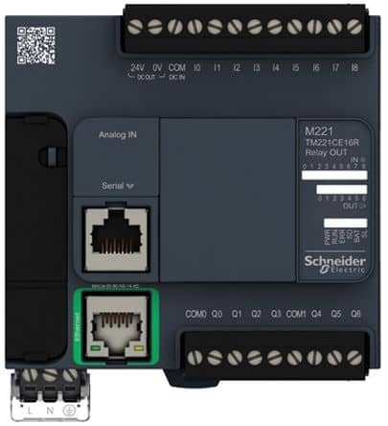
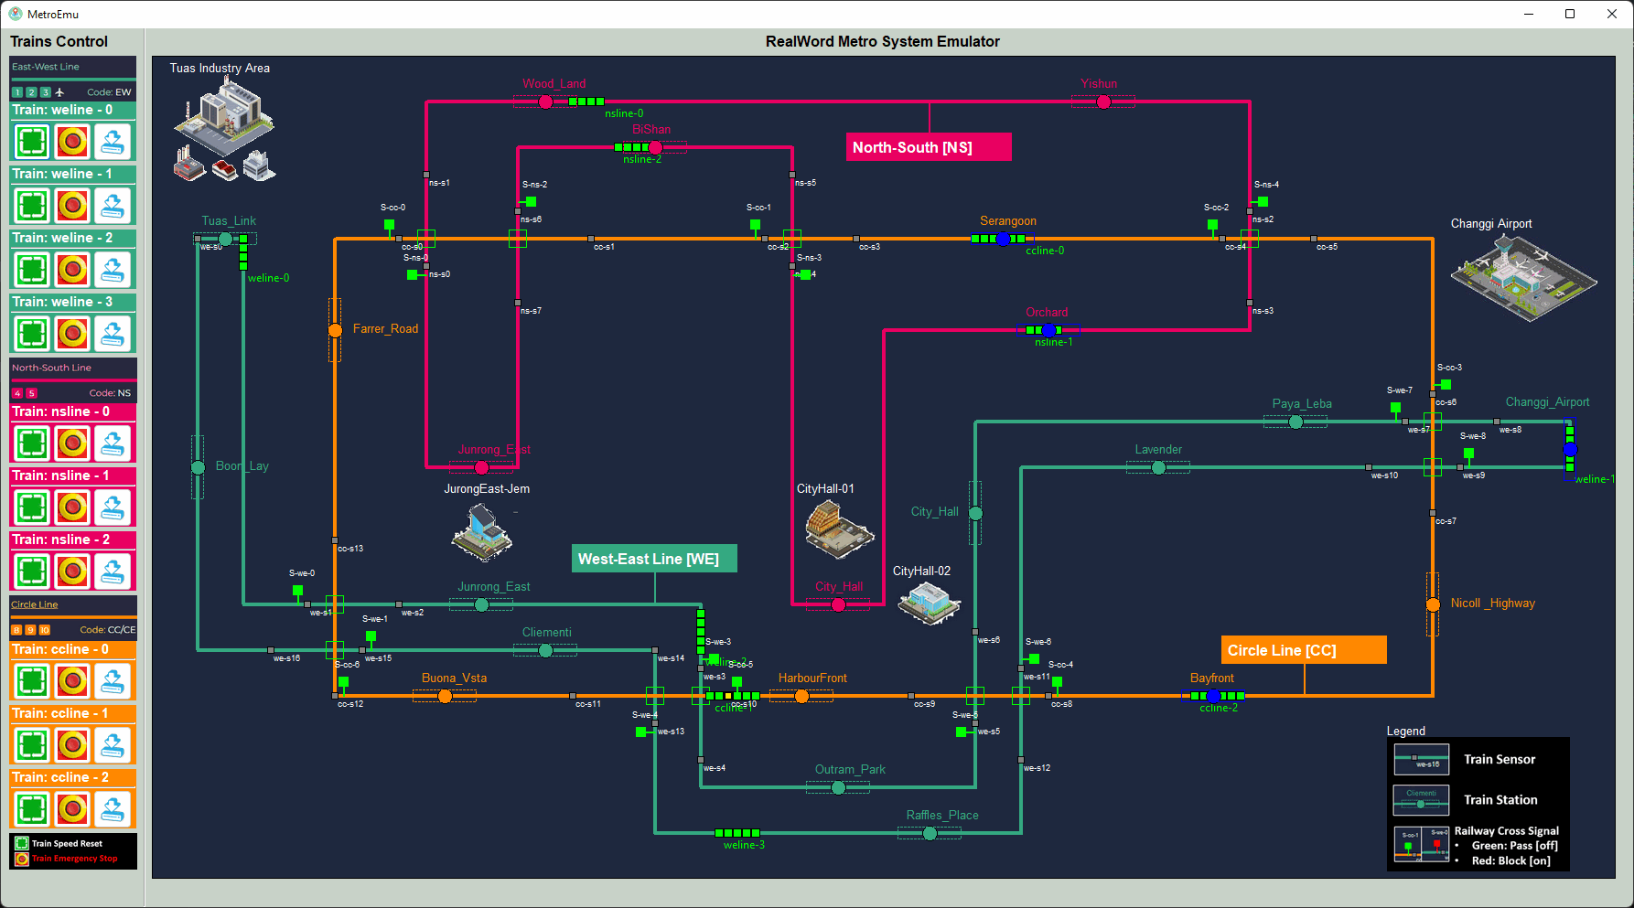
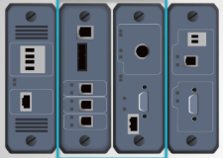
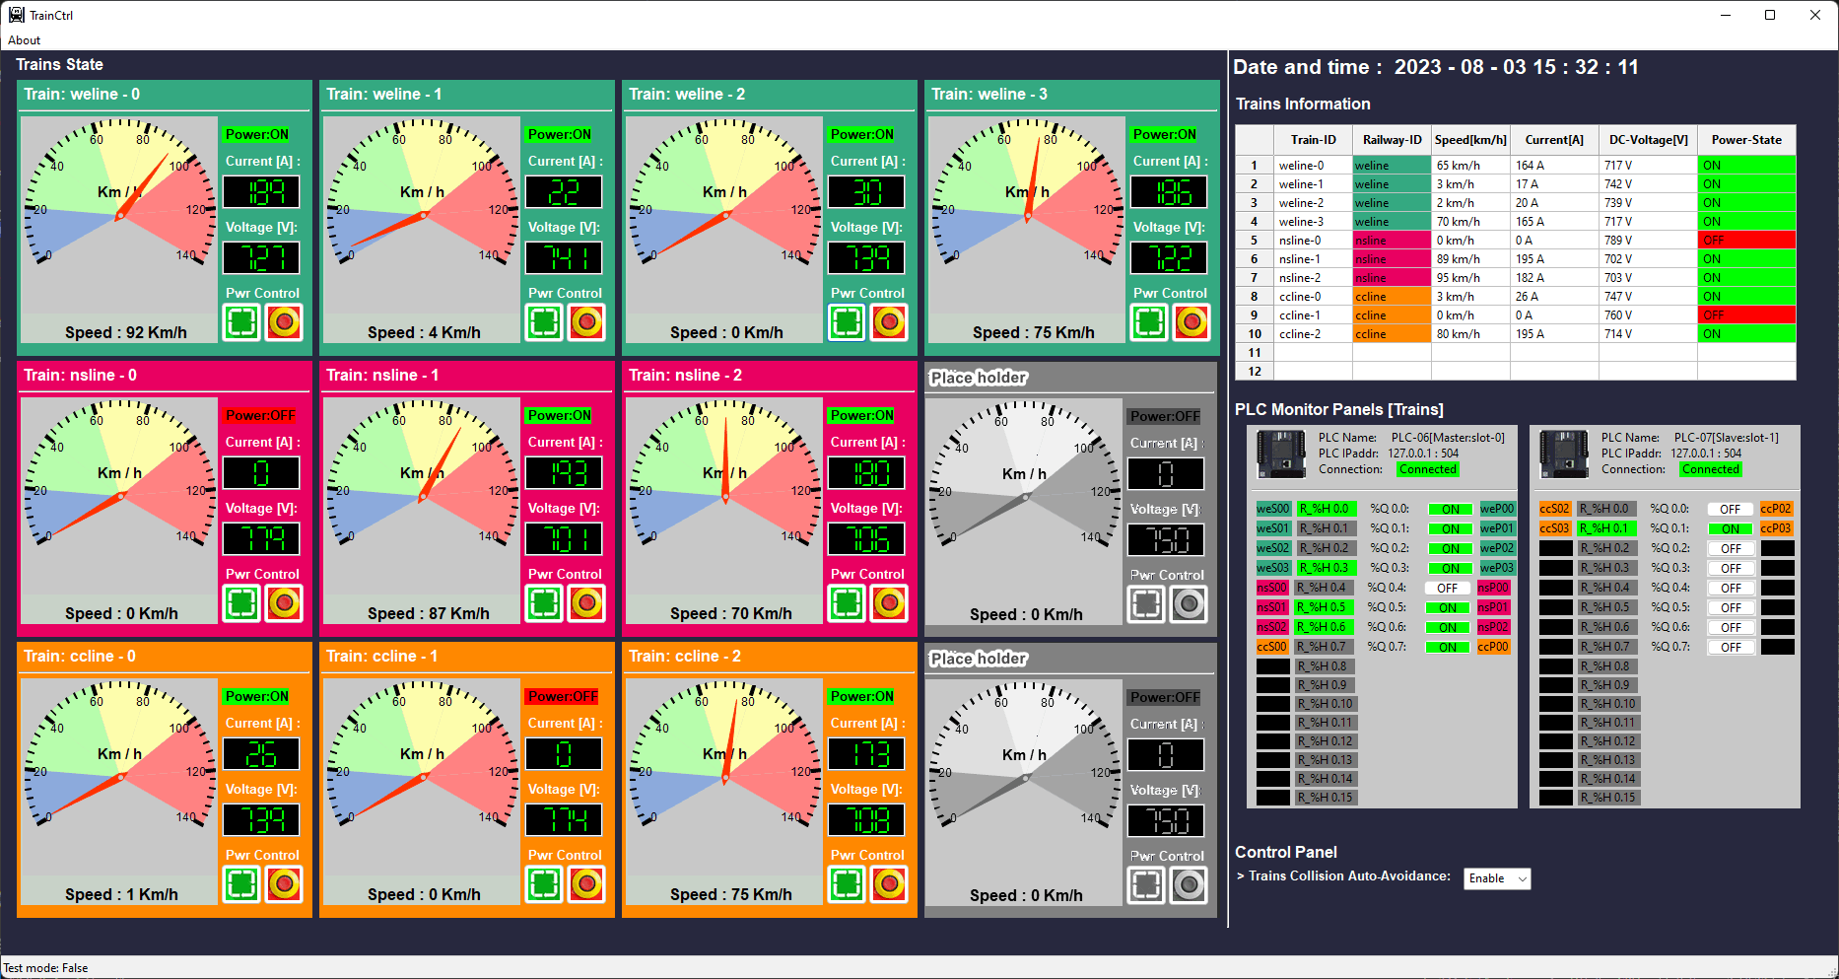
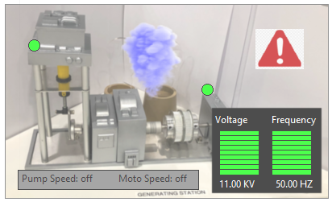
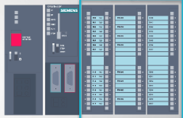
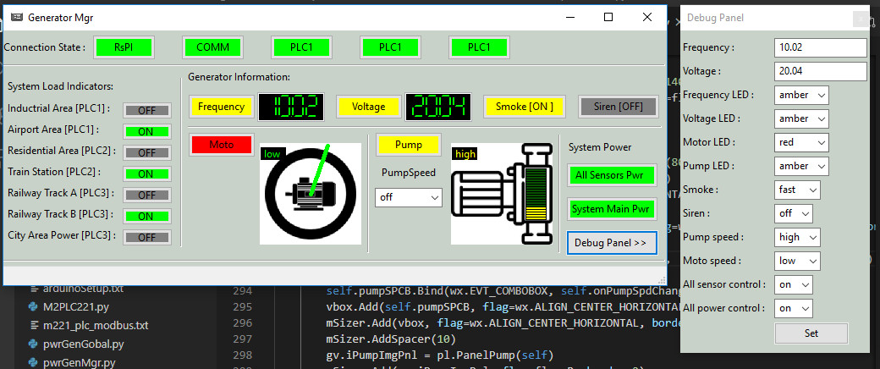
PLC simulator [Modbus-TCP]
Modbus
Railway Signal System HMI
2D Railway[Metro] System Real-world Emulator
Electrical signal simulation
Electrical signal simulation
RTU simulator [S7Comm]
Railway Train System HMI
2D Power Grid System Real-world Emulator
Power supply simulation
PLC simulator [S7Comm]
Power Grid and Substation System HMI
Electrical signal simulation
RTU simulator [S7Comm]
S7Comm bus

