Slide 1
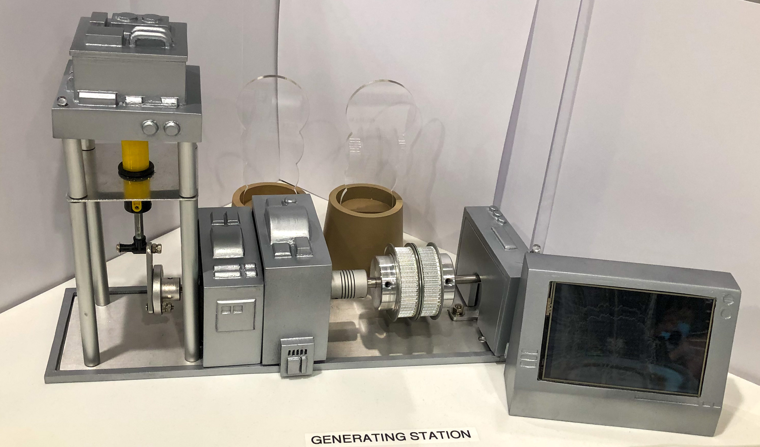
Substation LED Indicator
Generator output frequency and Voltage Display LCD Screen
Generator Fuel Pump
Generator Moto

Slide 2
