Slide 1
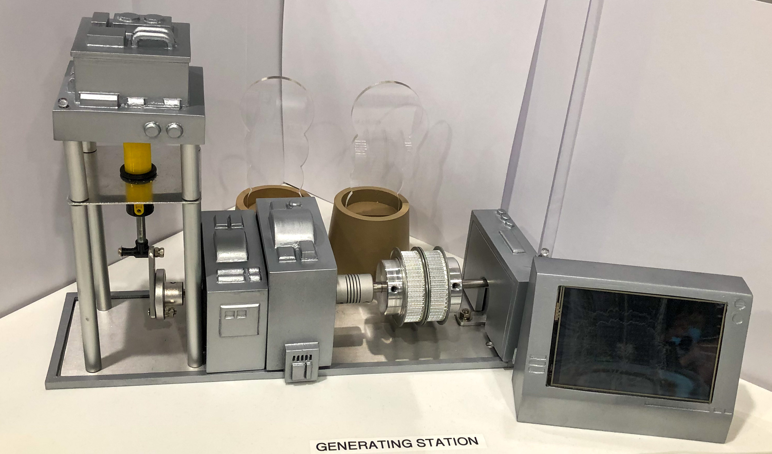
Substation LED Indicator
Generator output frequency and Voltage Display LCD Screen
Generator Fuel Pump
Generator Moto

Slide 2
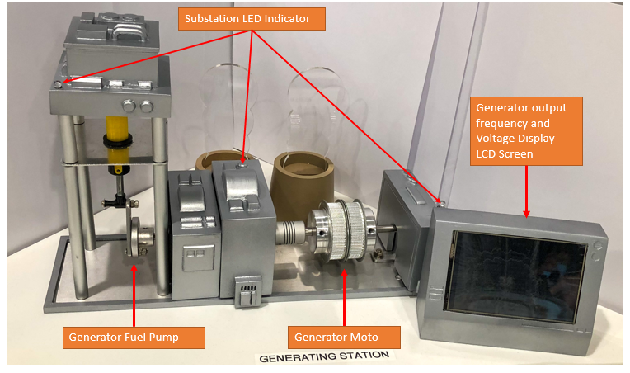
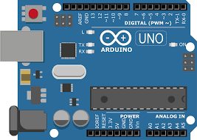


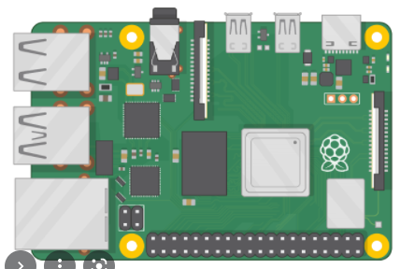

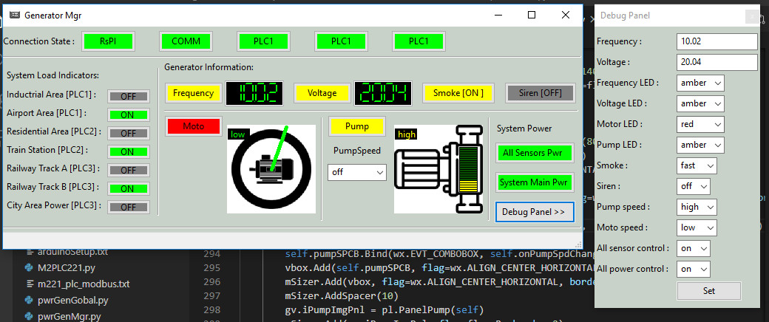
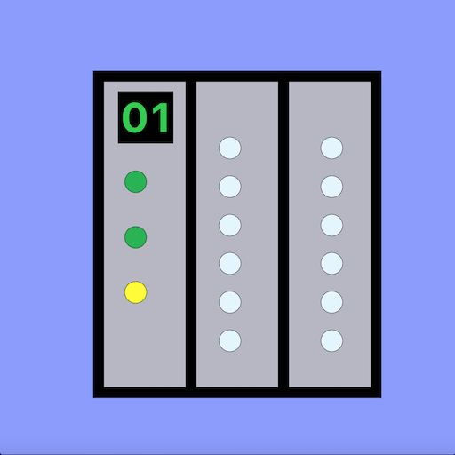
Arduino
Generator hardware
Arduino I/O output
Monitor PC
user
Raspberry PI USB output
Raspberry PI
Network switch
PLC to motor control switch
M221 PLC
PLC to fuel pump switch
Generator control HMI

