Slide 1



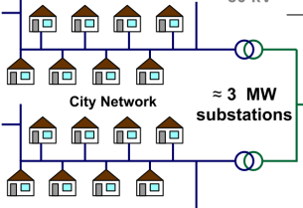


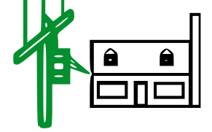
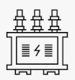
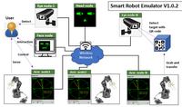
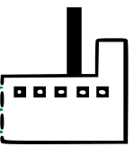

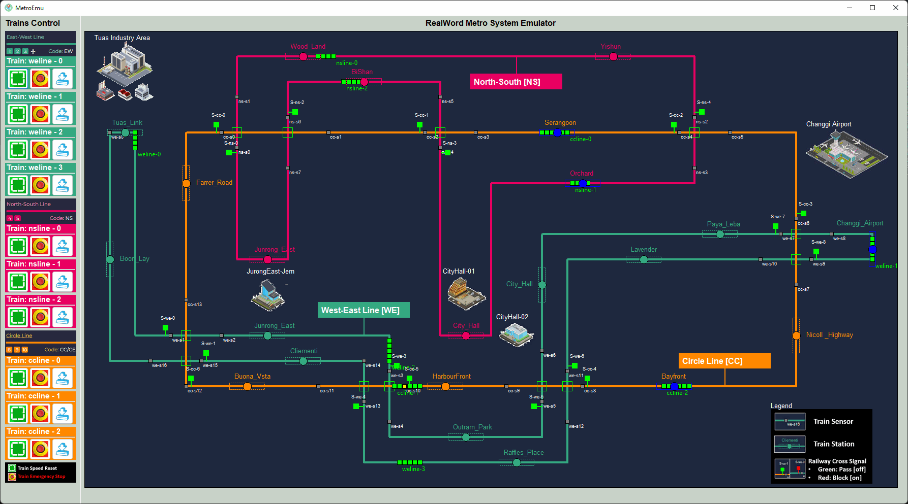

Solar panel power plant
Wind turbine
Power plant
Power plant
Color Key:
Blue: Generation
Red: Transmission
Green: distribution
Black: Customer
Fuel pump and moto
Smart Home Simulation System
Power generator
lvl2
Secondary Customer
40V
3.3 KV
120-240V
10KV
DC-AC generating substation
AC-AC generating substation
AC generating substation
Secondary step-down transformer
Smart Factory Simulation System
33kV
33kV
33kV
Primary Customer
Generating step up transformer
lvl1
4-13kV
138k-400k V
Primary step-down transformer
Substation Customer
Railway Simulation System
lvl0
26-69kV
Substation step down transformer
138k-230k
direct customer
138k-230k transmission customer

Slide 2

Solar panel power farm
Wind turbine power farm
Natural gas power plant
P
PLC Connection and Control Point ( remote circuit breaker + closer sensors)
Fuel pump and moto
R
RTU Monitoring Point (metering unit)
P
P
P
Smart Home Simulation System
R
R
lvl2
Secondary Customer
40V
3.3 KV
Power generator
120-240V
P
P
R
R
R
10KV
P
P
P
R
DC-AC generating substation
P
R
AC-AC generating substation
Secondary step-down transformer
R
R
AC-AC generating substation
Color Key:
Blue: Generation
Red: Transmission
Green: distribution
Black: Customer
Smart Factory Simulation System
33kV
R
P
Primary Customer
33kV
P
33kV
lvl1
P
Generating step-up transformer
P
P
4-13kV
R
P
138k-400k V High voltage transmission
R
R
P
P
Primary step-down transformer
P
Substation Customer
Railway Simulation System
R
R
lvl0
P
26-69kV
Online real time city weather data
138k-230k
direct customer (optional )
138k-230k transmission customer (optional)
P
R
R
Substation step down transformer

Slide 3
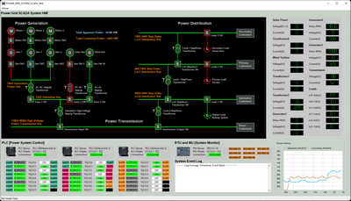




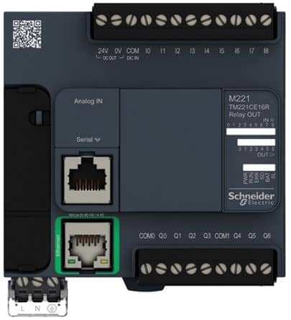
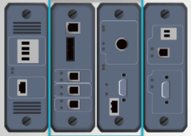
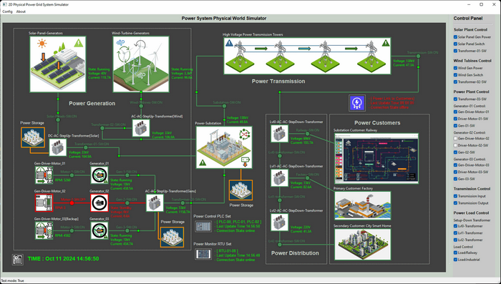
Power Grid Simulation System
Mini Energy-OT-System Cyber Security Digital Twin
Power System Scada HMI
Level 2
Power Grid
Control Center Processing LAN
Power System control HMI
Power System Monitor HMI
Maintenance workstations
Modbus
S7Comm
PLC Simulator
Power Link Interface
Level 1
OT System Controller LAN
Generation Control PLC
Generation Monitor RTU
Transmission Control PLC
Transmission Monitor RTU
Distribution Monitor RTU
Distribution Control PLC
RTU Simulator
Electrical MU
Simulator
Power System Physical World Simulator
Simulated Electrical signal
Level 0
Physical Process
Field I/O
device
Circuit breakers
Step up transformer
Electrical MUs
Power generator
Step down transformer
Station Loads
Solar Panels
High voltage power bus
Primary Loads
Wind Turbines
Low voltage power bus
Secondary Loads

Slide 4
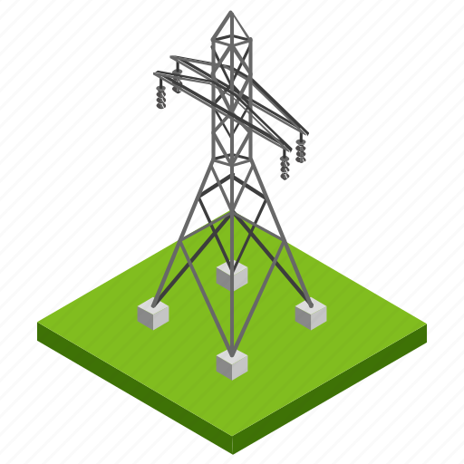

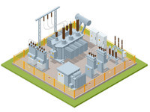




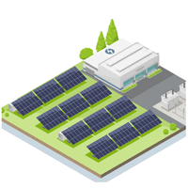





Slide 5










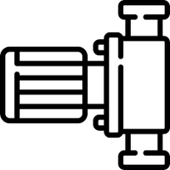

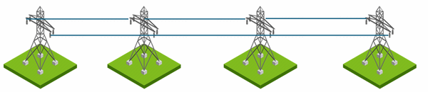


Slide 6




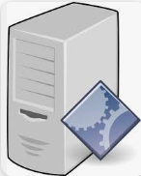


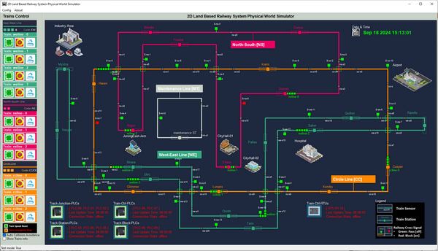

Power Grid OT Simulation System Network Diagram and Components View
ICS [OT network ]
Online real time city weather data
Power Grid Physical Real World Simulation Network
Supervision network SCADA
Production network
Physical world simulator
Maintenance laptops
Local HW-Engineering admin laptop
OT-Field device admin
ICS engineer
Ethernet TCP/IP, Modbus TCP, S7Comm, MMS
internet
Circuit Control PLC set
Power Grid operator
Electrical signal I/O
Power Grid monitor & control HMI
Real time monitor PLC set
Remote controllable circuits breakers
Modbus TCP
and
S7Comm
Other power customer physical world simulator/network
Components with MU integrated
Monitor RTUs
SV value

Slide 7
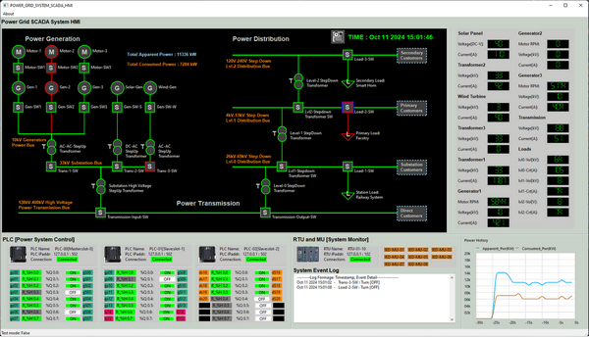

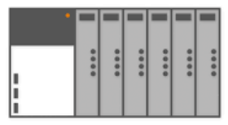
2D Power Grid Physical-world Simulation Program
Power Grid Supervisory Human Machine Interface
Circuit breaker logistic signal interface
SV sensors analog / linear signal interface
Modbus-TCP client interface
S7Comm to Manufacturing Message Specification (MMS) IEC61850 Converter Interface
Measurement Unit simulation
PLC0
PLC1
PLC2
…
MU00
MU01
RTU simulation
MU08
S7Comm client Interface
PLC
simulation
S7Comm Bus
Simulated MMS Bus
IEC 61850 Modbus-TCP Bus

Slide 8
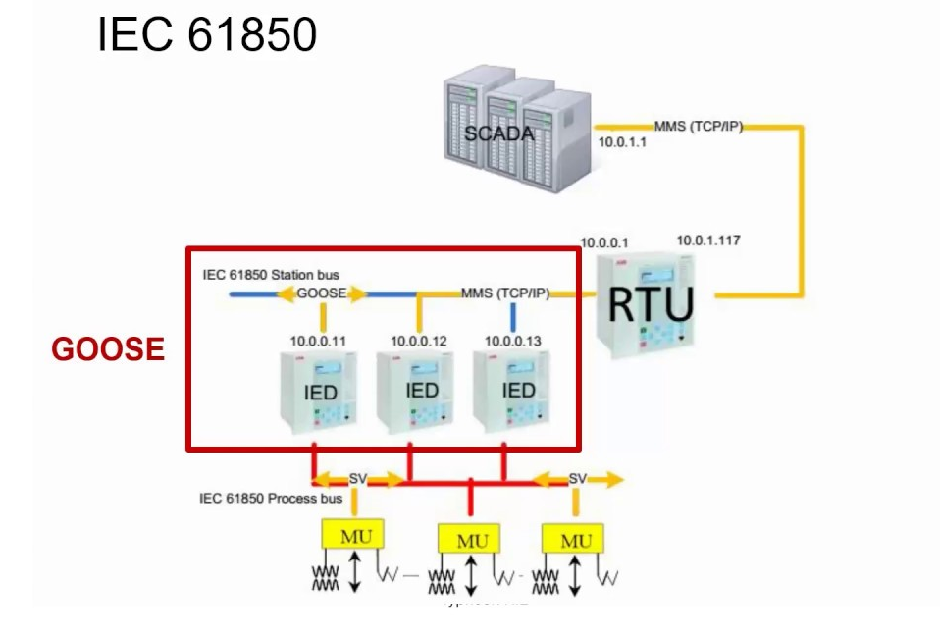
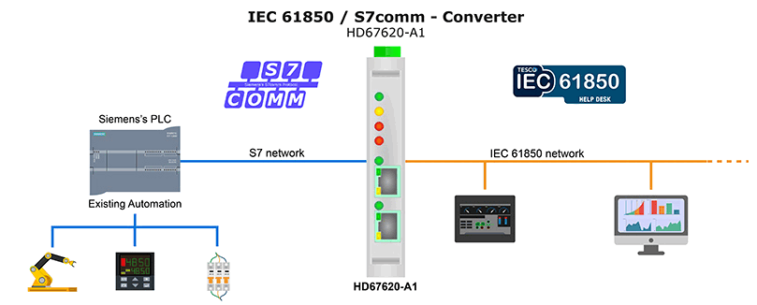
Simulate the
MU ⬄ IED <= MMS => RTU <= MMS => SCADA
With
MU ⬄ PLC <= S7Comm => HD676220-AD Converter ⬄ SCADA

Slide 9
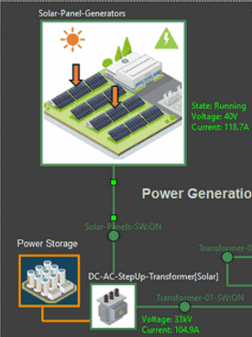
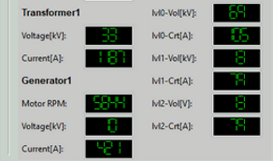
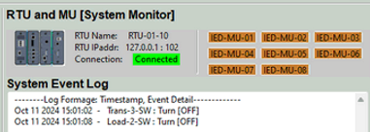
Physical world data generation
IEC61850 data visualization
Work state: running, Idle , error
Power output state: Voltage, current
Special State: such as motor RPM, battery percentage
Solar farm MU
Solar storage MU
RTU
S7Comm
Transformer-01-MU
S7Comm to Manufacturing Message Specification (MMS) IEC61850 Converter Interface simulator

Slide 10
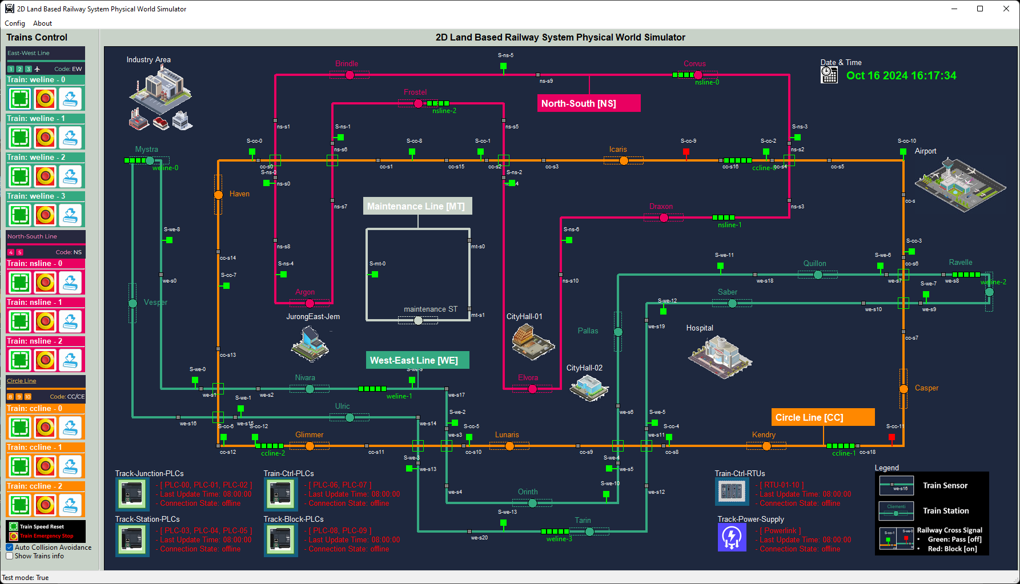
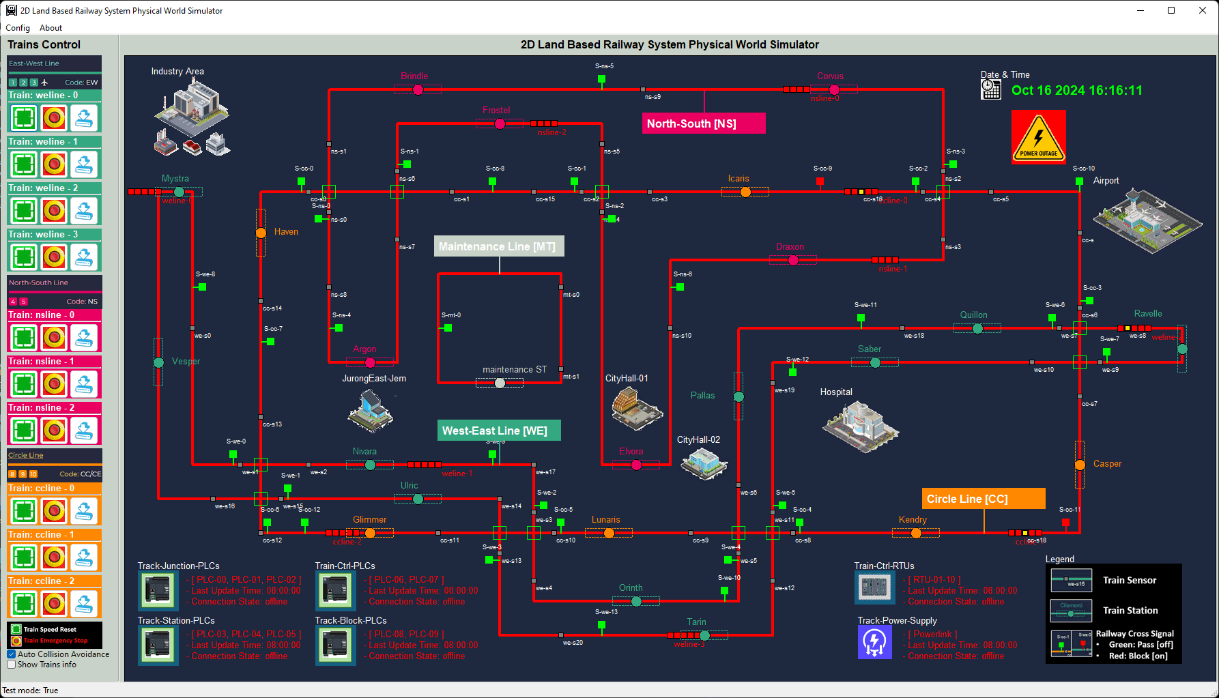


Before FDI attack
After FDI attack
7
All trains emergency stop because lose power.
All tracker change to power fail state (red color)
Railway shows power outage alert.
Power link energy transfer drop to 0v 0A
After get 3 times high voltage alert, HMI confirm railway system power error, HMI auto safety control active to cut off the railway transformer’s output to protect the system.
6
Power Link
Physical world simulation shows power input of railway system cut off.
HMI send PLC coil set control command to cut off the railway system’s transformer output circuit breaker.
5
4
PLC
4
Modbus-TCP
RTU
S7Comm
2
3
MU00
False data read by HMI
HMI read the railway operating voltage is out of safety range 0~72kV, Show alert.
1
FDI Power Outage Attack Workflow Diagram
Attacker keeps injecting the high voltage value (100KV) regularly to one of the RTU address to overwrite the reading from the railway’s transformer’s metering unit.

