Slide 1
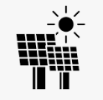
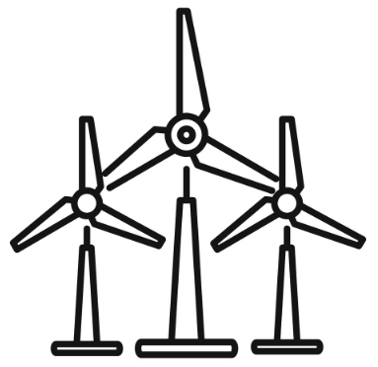

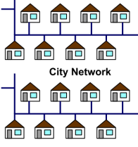


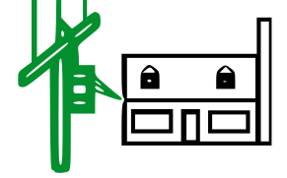
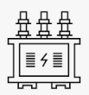
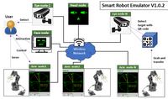
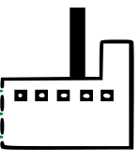

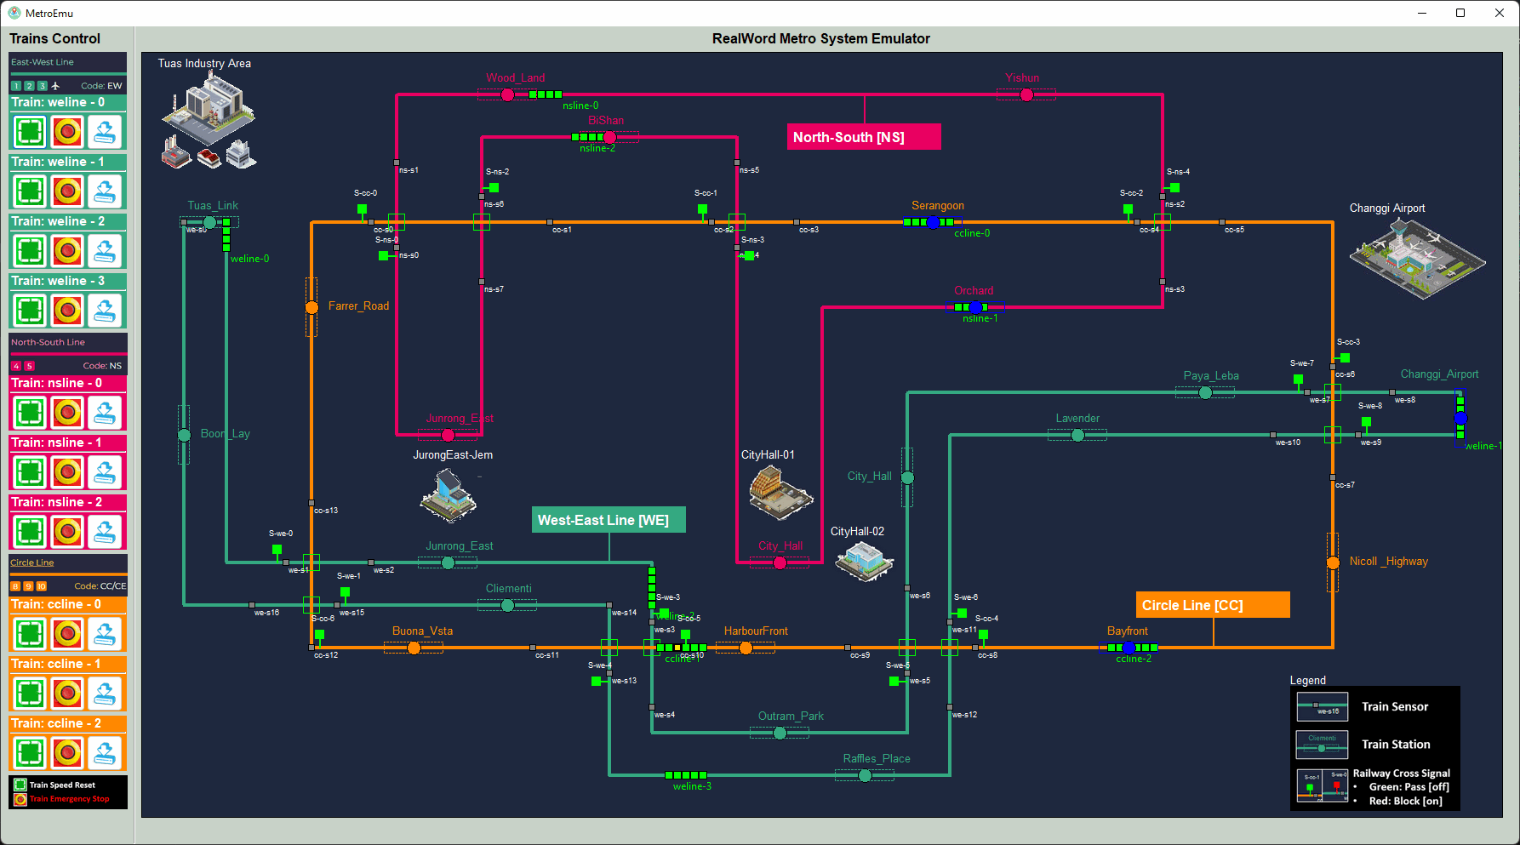

Solar panel power plant
Wind turbine
Power plant
Power plant
Color Key:
Blue: Generation
Red: Transmission
Green: distribution
Black: Customer
Fuel pump and moto
Smart Home Simulation System
Power generator
lvl2
Secondary Customer
40V
3.3 KV
120-240V
10KV
DC-AC generating substation
AC-AC generating substation
AC generating substation
Secondary step-down transformer
Smart Factory Simulation System
33kV
33kV
33kV
Primary Customer
Generating step up transformer
lvl1
4-13kV
138k-400k V
Primary step-down transformer
Substation Customer
Railway Simulation System
lvl0
26-69kV
Substation step down transformer
138k-230k
direct customer
138k-230k transmission customer

Slide 2

Solar panel power plant
Wind turbine
Power plant
Power plant
Color Key:
Blue: Generation
Red: Transmission
Green: distribution
Black: Customer
P
PLC Connection and Control Point
Fuel pump and moto
R
RTU Monitoring Point
Smart Home Simulation System
P
P
P
Google weather API
R
R
Secondary Customer
40V
3.3 KV
Power generator
lvl2
120-240V
P
P
R
R
R
10KV
P
P
P
DC-AC generating substation
P
R
R
AC-AC generating substation
AC generating substation
Secondary step-down transformer
R
R
R
P
Smart Factory Simulation System
33kV
33kV
33kV
Primary Customer
P
lvl1
P
Generating step up transformer
P
P
4-13kV
R
P
138k-400k V
R
R
P
P
Primary step-down transformer
P
Substation Customer
Railway Simulation System
R
R
lvl0
P
26-69kV
P
R
R
Substation step down transformer
138k-230k
direct customer
138k-230k transmission customer

Slide 3
