Slide 1
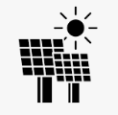
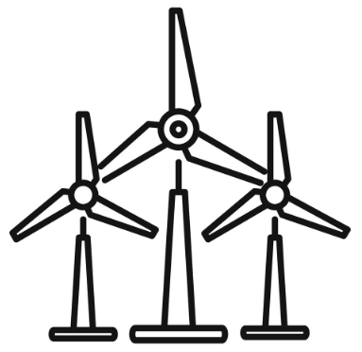


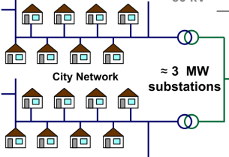

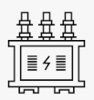
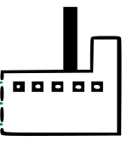

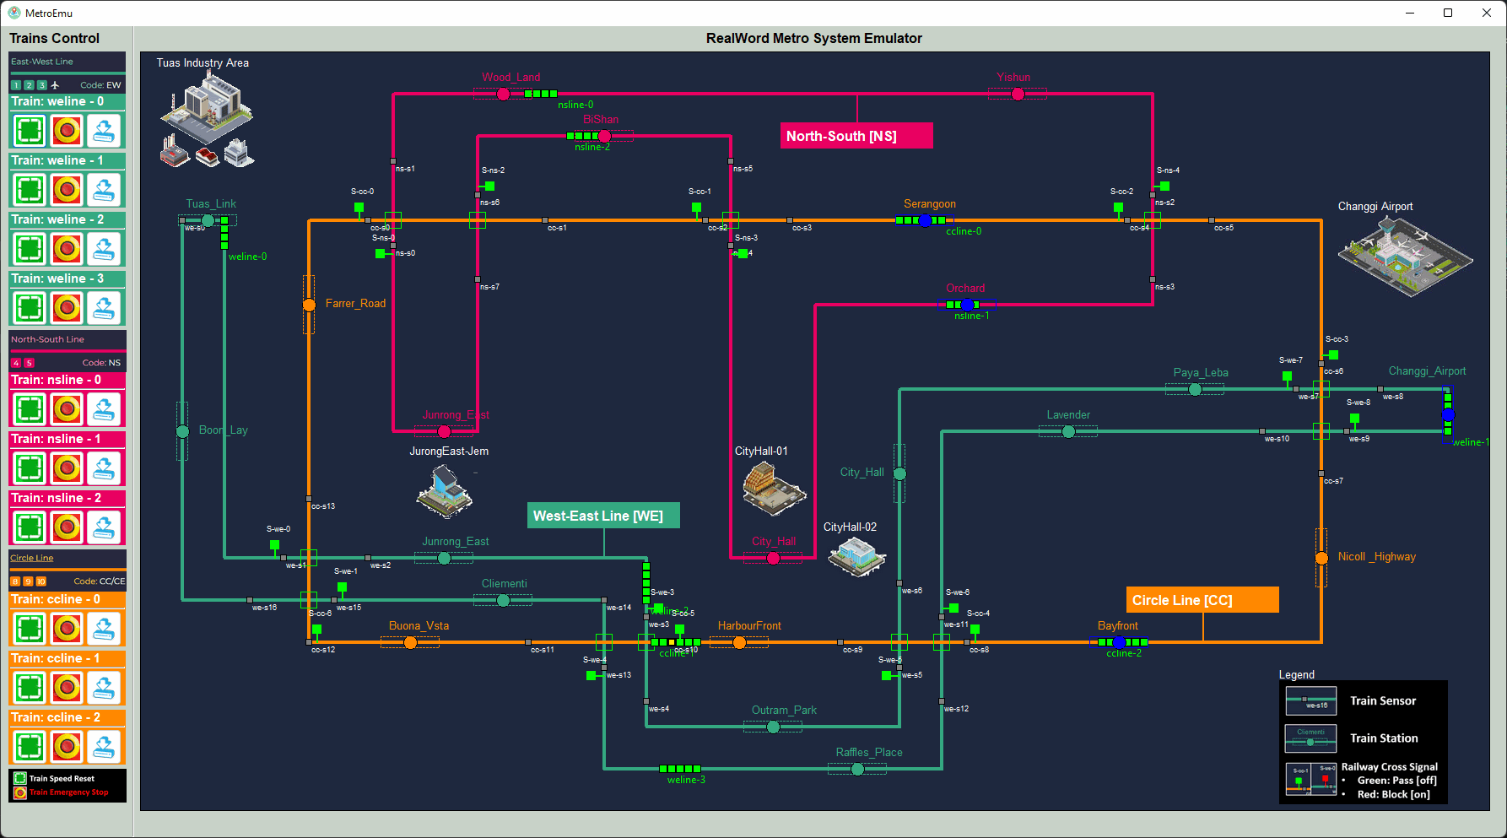

Solar panel power plant
Wind turbine
Power plant
Power plant
Fuel pump and moto
40V
3.3 KV
Power generator
lvl2
120-240V
10KV
DC-AC generating substation
AC-AC generating substation
AC generating substation
Secondary step down transformer
33kV
33kV
33kV
Primary Customer
Generating step up transformer
lvl1
4-13kV
138k-400k V
Primary step down transformer
lvl0
26-69kV
Substation step down transformer
138k-230k direct transmission customer
138k-230k transmission customer
Substation Customer

