Slide 1
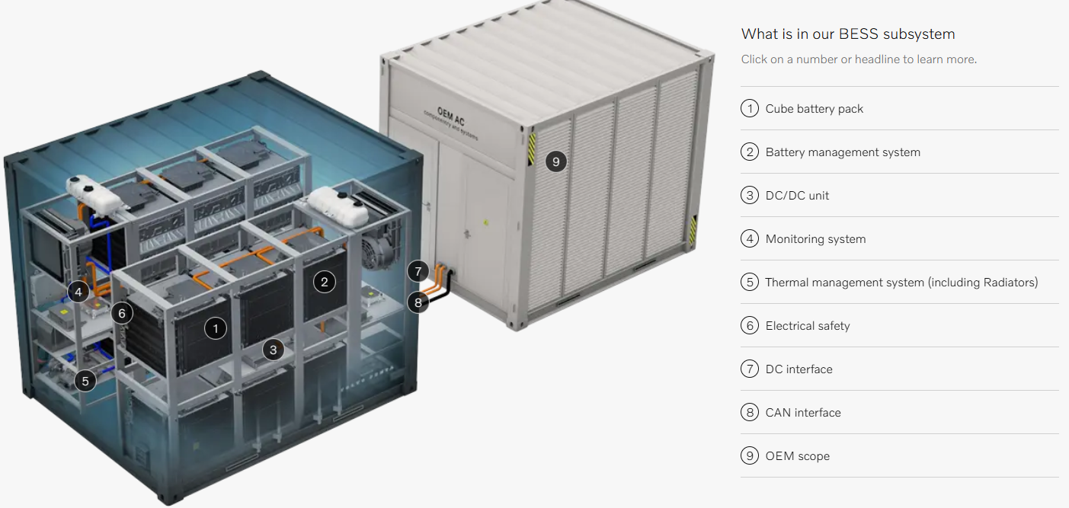

Simulated battery pack capacity value
Simulated basic Battery Charge/Discharge management system
Simulated ABB-AC500 IEC60875-104 PLC to monitor all the data in the BESS
Basic charge/discharge voltage and current safety mechanism
Simulated basic DC-AC converter to integrate in the power grid’s AC-AT step up transformers

Slide 2
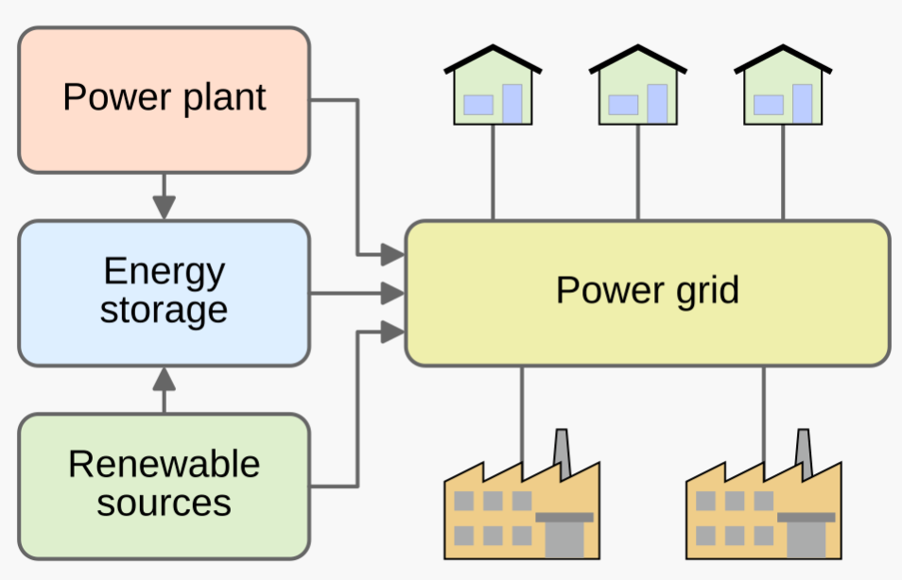
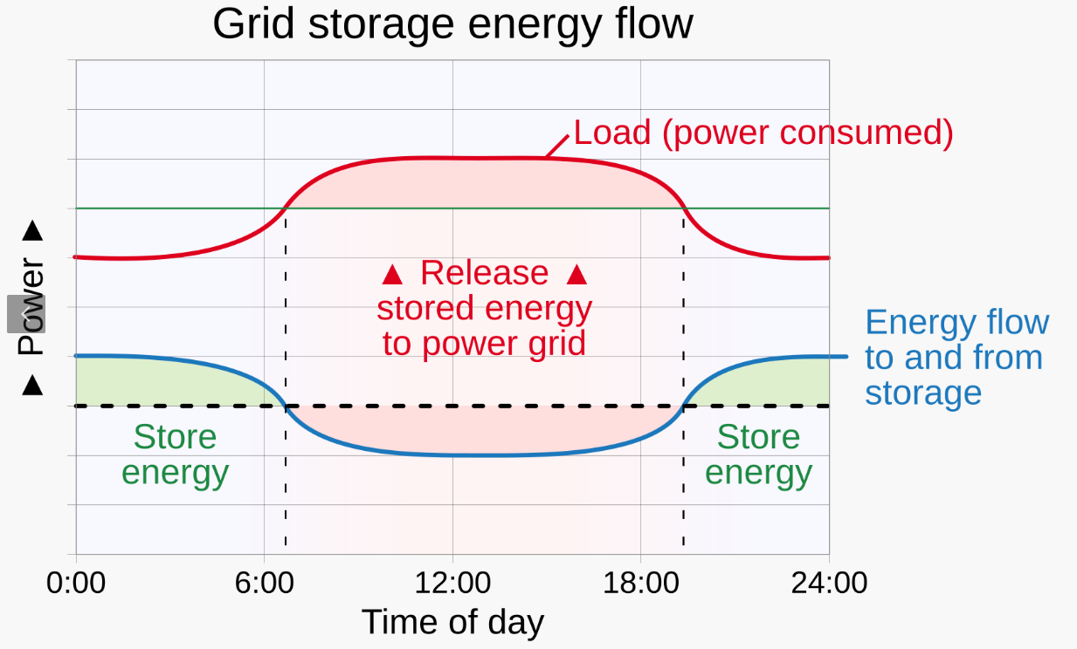

Slide 3
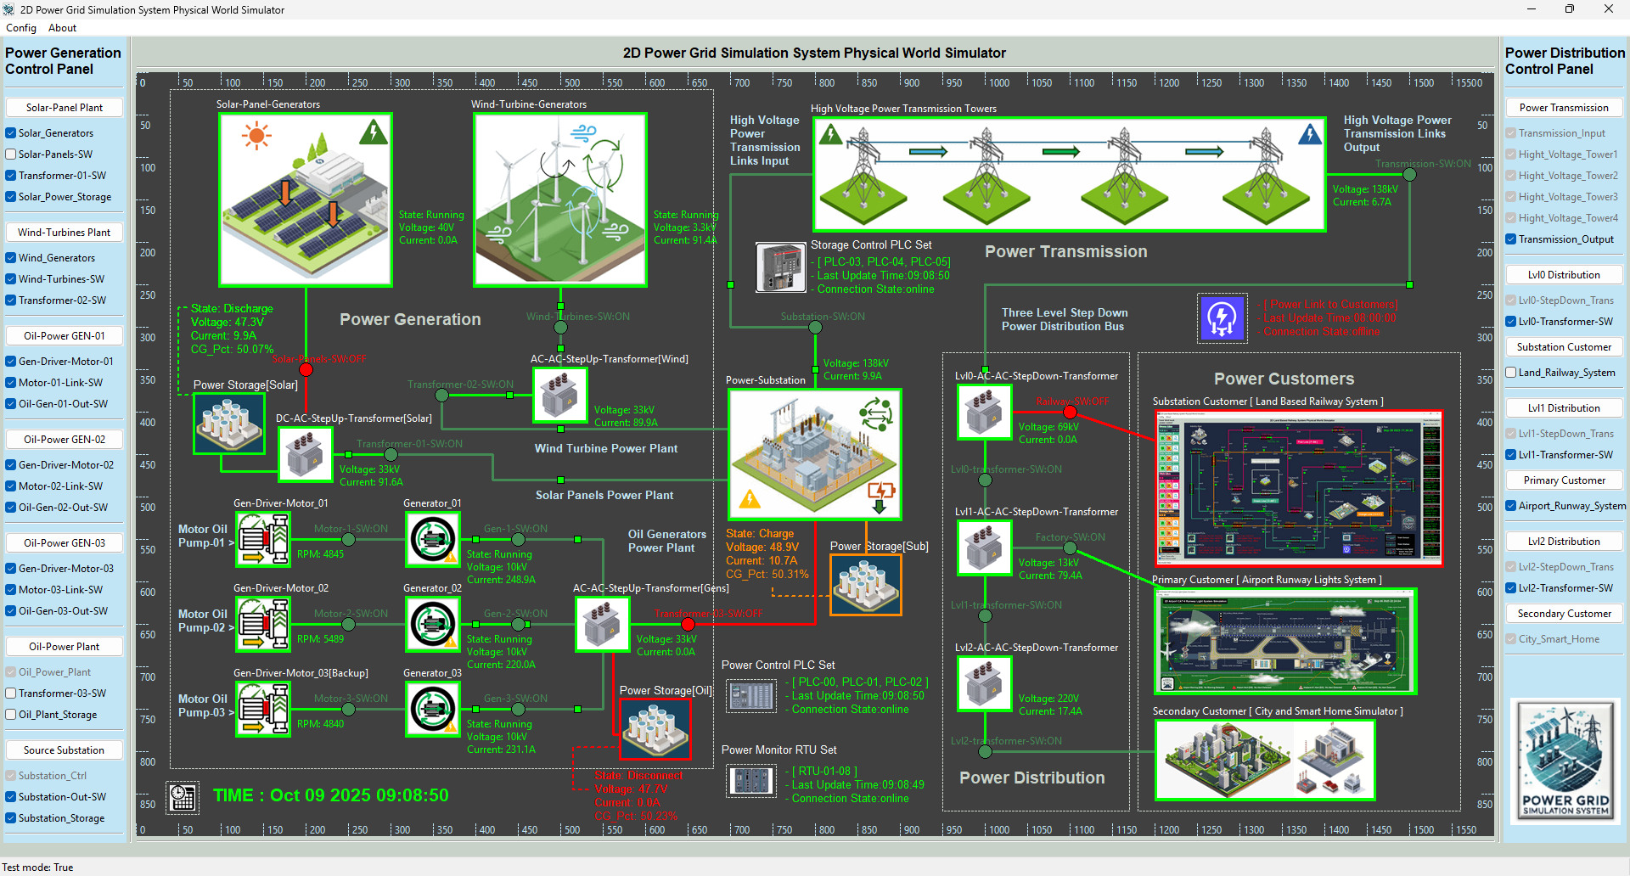
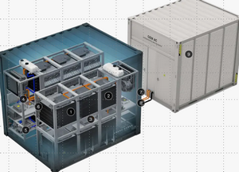
BESS
OEM Scope
Energy Battery Scope
BESS for power station
BESS for renewable power source
BESS for traditional power plant

Slide 4

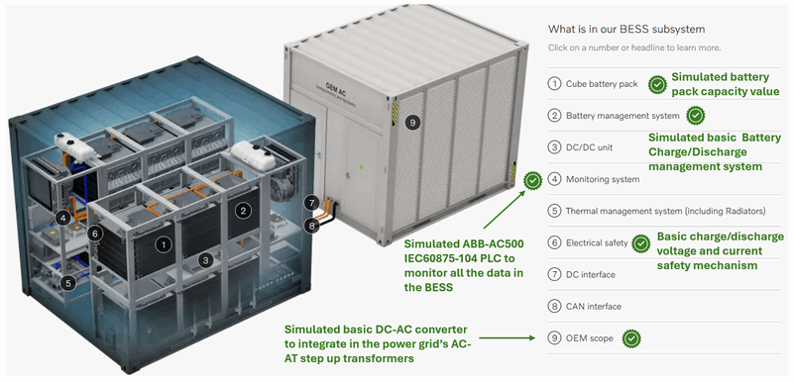
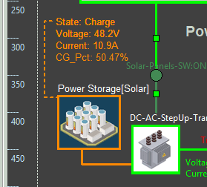
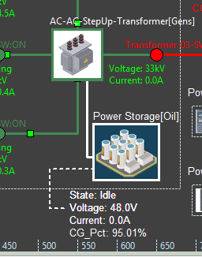
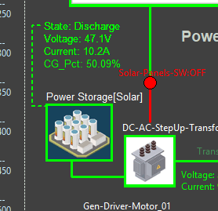
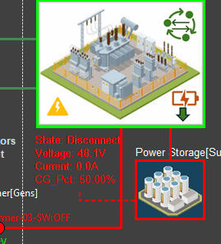
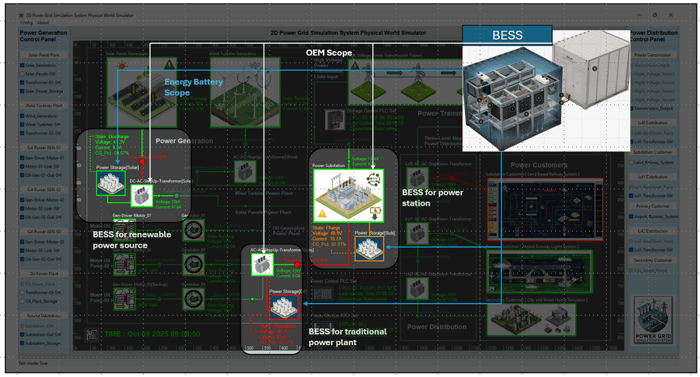
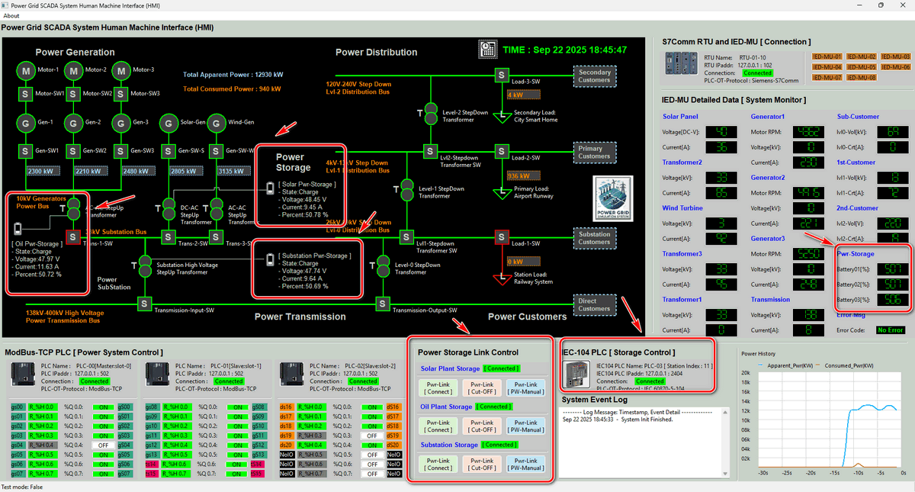

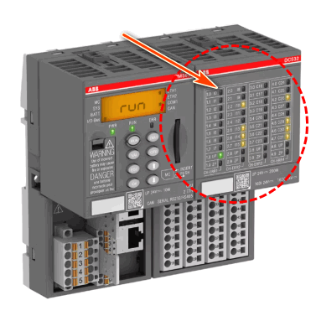
Implement Battery Based Energy Storage System (BESS) In Power Grid OT Cyber Range
Power Grid Cyber Range Physical World OT Components Simulator
Battery Based Energy Storage System (BESS)
Discharging
Charging
Idle
Disconnect
Power Grid Cyber Range Operator Human Machine Interface
MU00
MU01
MU02
AC500 PLC Simulator
IEC61850 Bus
IEC60870-5-104 Bus
GOOSE (Generic Object-Oriented Substation Event) Network
SCADA (Supervisory Control and Data Acquisition) Network
Level 0 OT Physical Process Field I/O Device Layer
Level 1 OT System Controller LAN Layer
Level 2 Power Grid Control Center Processing LAN Layer

